Slide 1
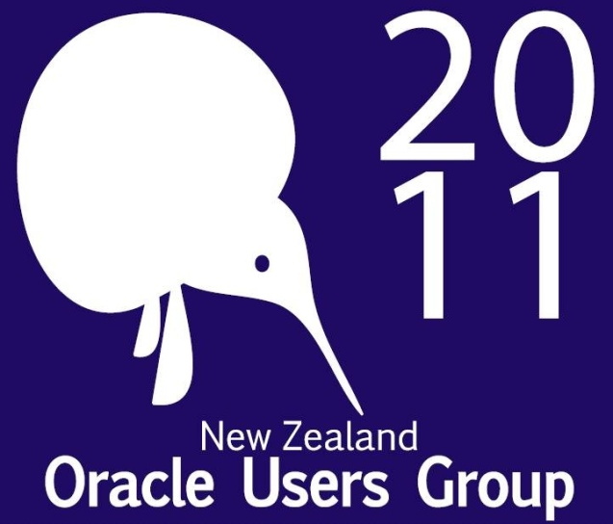
Should I Upgrade or go to Oracle Fusion Applications?

Slide 2

It Depends
Any Questions?

Slide 3
Objectives
This session's speaker had the privilege of working with the Oracle Fusion Applications development team throughout the development of Oracle Fusion Applications, on behalf of all Oracle user groups. One thing they did was collect questions for a Q&A every quarter, and by far the most common was, "Do I upgrade, or do I go straight to Oracle Fusion Applications?" This presentation looks at the different factors you need to consider so you can make the right choice for yourself. You need to know all the facts, all the considerations, all the risks, all the options, and all the costs. Only then can you start to plan your strategy. The answer is simple: it depends—let's understand on what.

Slide 4
Debra Lilley
  Oracle Alliance Director and Fusion Champion for Fujitsu UK & Ireland
  President of UKOUG
  Oracle ACE Director, OCP & Oracle Masters
  Oracle Apps since 9.4.1 (15 years)
  End User Advisor for Constellation Research
  2008 Oracle Magazine Award ‘User Group Evangelist of the Year’

Slide 5

My Audience?
Technical?
Business User?
Apps User?
Oracle?
Attended my session yesterday?

Slide 6

It Depends…..
On Your Organisation
Know Your Organization
  Your Business Strategy
  Your IT Strategy
DO NOT BE DRIVEN SIMPLY BY ORACLE

Slide 7

It Depends….
Where You Are Today
Assumption Old Version – Why?
  No Budget?
  No additional value?
  Too many customizations?
HOW DO FUSION APPS CHANGE THIS?

Slide 8
It Depends….
On You Understanding the Myths
Your existing application is NOT going away
You Do NOT have to go to Fusion Applications
You DO however have to think about Support

Slide 9

It Depends….
If Fusion Caters For Your Needs
Is what you need in first Release?
Do You Like It?

Slide 10
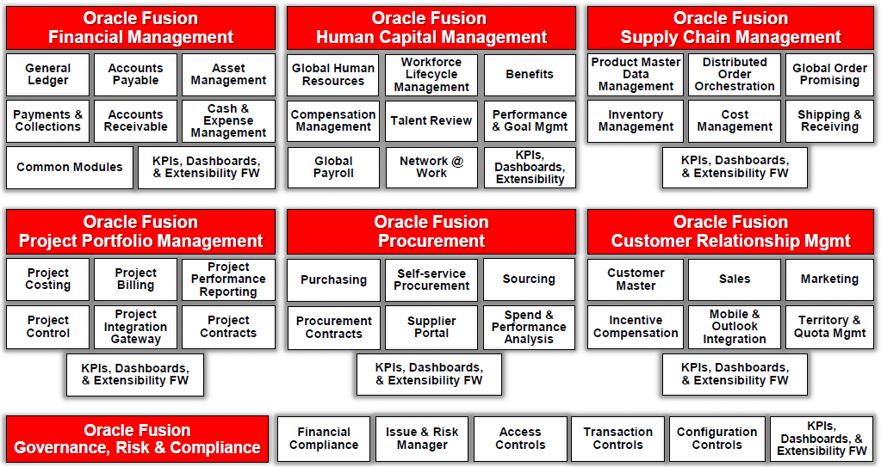
What’s In It

Slide 11
It Depends ………
If You Want New Functionality
Co-Exisitence
Don’t think just because you can’t replace your current system with Fusion Applications there is no value in it for you
Notes:
Talk about PFG

Slide 12
Understanding Co-Existance
Co-Existence Strategy Protects Your Investment
Financial Management
E-Business Suite
PeopleSoft
JD Edwards
Fusion Applications
Hyperion
Fusion GRC
Fusion Accounting Hub
Procurement
Fusion Shared-Service Procurement
Project Portfolio Management
Primavera
Fusion Project Portfolio Management
Human Capital Management
Fusion Talent Management
Fusion Incentive Compensation
Supply Chain Management
Agile PLM
Transportation Management
Warehouse Management
VCP
Fusion Distributed Order Orchestration
Fusion Product Hub
CRM
Siebel CRM
CRM On Demand
Fusion Sales Planning
Fusion Incentive Compensation
Fusion Customer Hub

Slide 13
It Depends….
On Your Technology Adoption
Fusion Applications are a window on Fusion Middleware Development

Slide 14
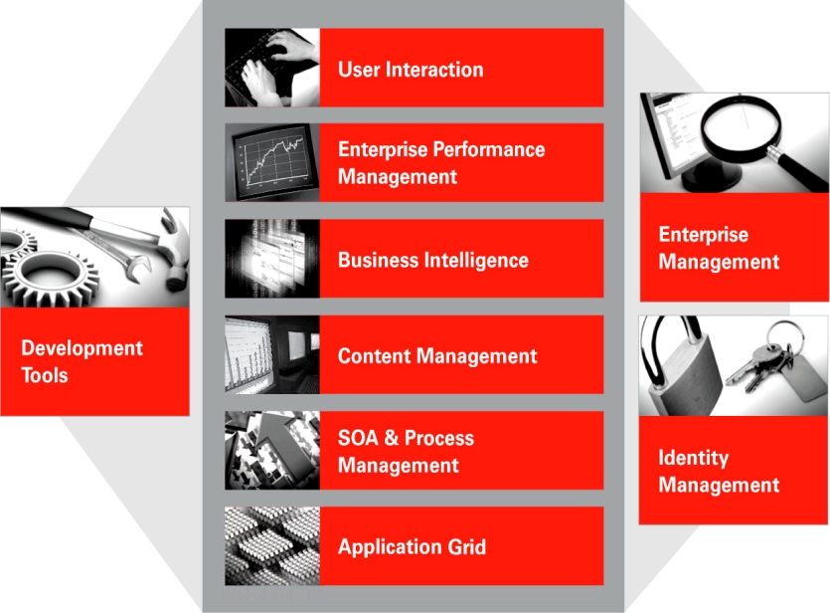
FMW– The Technology
Notes:
But first explain what is FMW so everyone on same page

Slide 15
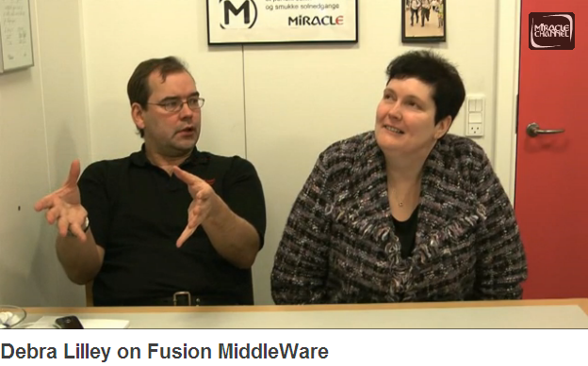
Miracle Video on FMW
http://www.miraclechannel.dk/video/550193/debra-lilley-on-fusion

Slide 16
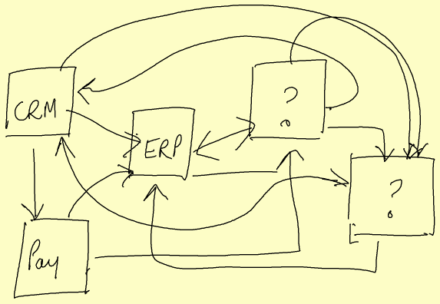
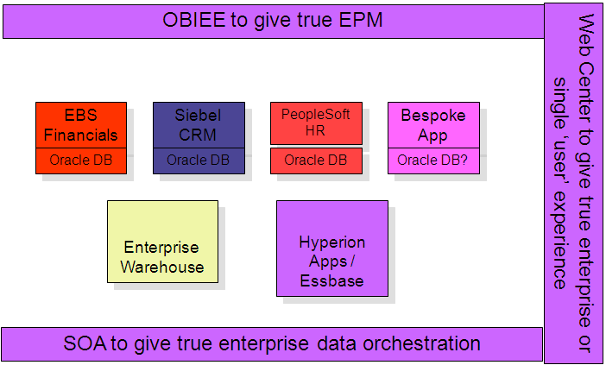
Fusion Technology for the IT Estate
.
.
From This ………….To This
Notes:
Adopting FMW

Slide 17
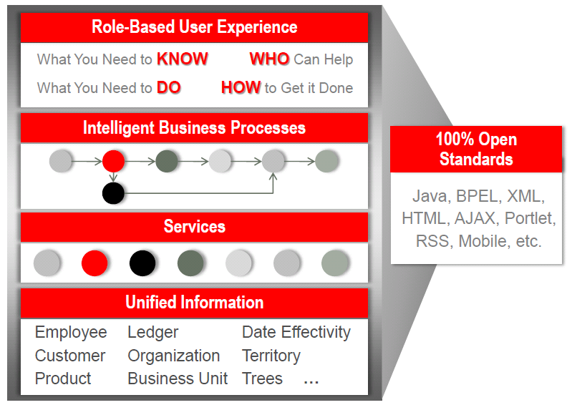
Design Principles

Slide 18

It Depends….
As ever on cost
Licence
  Applications
  Technology
Skills
Platform
Migration

Slide 19

It Depends….
On your IT Drivers
Appetite for Change
  Last upgrade – just technical?
Leading edge? Unlikely if still on old version

Slide 20


10 Things You Can Do Today to Prepare for the
Next Generation Applications
A
Keep Current with the Oracle Applications Releases
Inventory your Enterprise Business Assets
Prepare your Roadmap for the Future
Applications Best Practices
B
C
Leverage Future-Proof Solutions and Technology Today
Extend the Value of Oracle Applications Unlimited
1
Rethink your “Customization” Strategy
Consolidate your Master Data
Embrace SOA-Based Integration
Extend your Business Intelligence Applications Portfolio
Adopt Enterprise Reporting & Publishing
Secure your Global Enterprise
Increase Information Worker’s Productivity
Centralize your Document Management
Consider Grid Infrastructure
Centralize your Applications Lifecycle Management
2
3
4
5
6
7
8
9
White Paper from Dr. Nadia Bendjedou Oracle
10
Notes:
20

Slide 21

BIG PLUG
Monday 1530
MW3002/4 #11700
Preparing for Fusion Applications?
Nadia Bendjedou

Slide 22

It Depends….
On your business case
The business case has to stack up, make sure it answers all the questions

Slide 23

It also depends….
On You
Why are you at OOW?

Slide 24
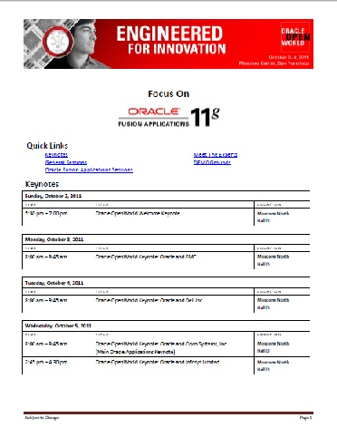
Where to Learn at OOW
http://www.oracle.com/openworld/oow11-focuson-fusionapps-486937.pdf
Keynote: Wed 8am - Oracle and Cisco Systems, Inc. Moscone North

Slide 25
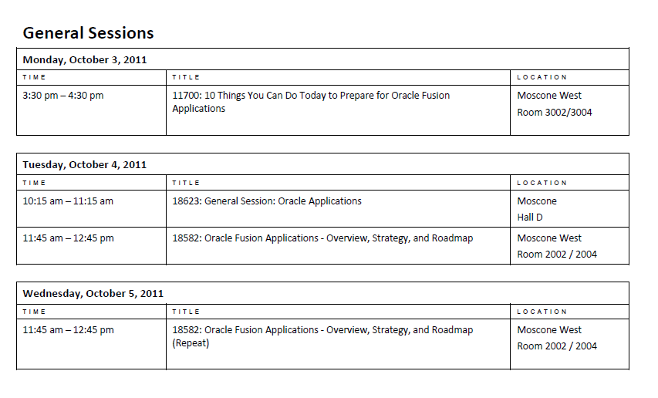
Top Sessions

Slide 26

Oracle’s Fusion Nation
Over 500 Fusion Applications spokespeople -- Handpicked from our early adopter customers, Fusion Apps Ramp-Up partners, strategic user group members, and Oracle employees who are Fusion App experts.
Visible throughout Oracle OpenWorld as part of the Fusion Nation

Slide 27
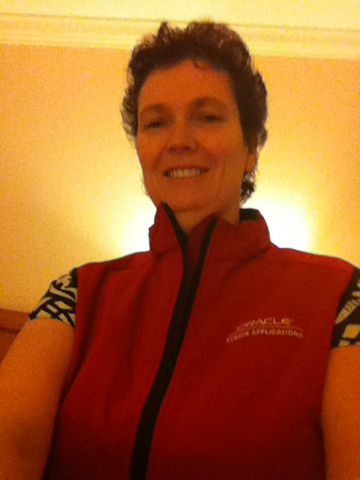
Love The Vest
Stop Us and Ask about Fusion Applications

Slide 28
And Afterwards?
Your partner
Your Account Manager
Your User Group
Your Path to Understanding Fusion Applications

Slide 29
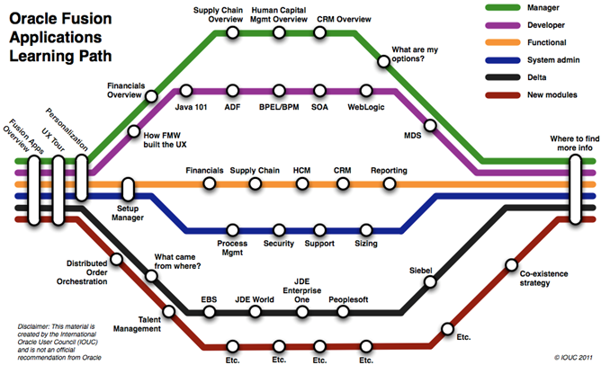
Our Map

Slide 30
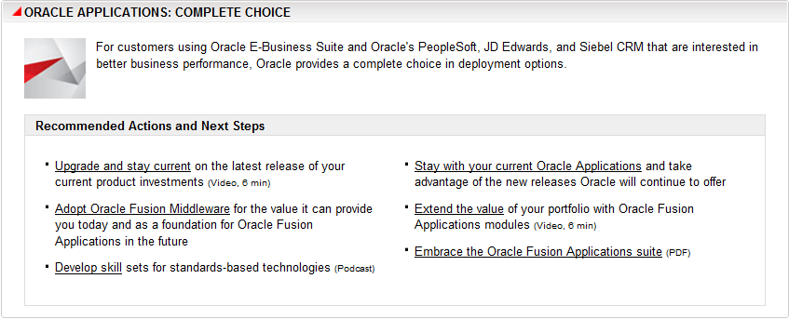
http://www.oracle.com/us/products/applications/fusion/index.html

Slide 31
Don’t Do Nothing
Look at Fusion Apps
Look at latest release
Understand your organization
Which makes more sense when all the dependencies are known
Make a plan
Execute it

Slide 32
Questions

Slide 33

And Finally….
Consolidation to The Cloud
Thursday
1.30pm
Moscone South 300
#08633

