Slide 1
How Hot Is My Data? Leveraging Automatic Data Optimization (ADO) Features in Oracle 12c Database For Dramatic Performance Improvements
Jim Czuprynski
Zero Defect Computing, Inc.
November 21, 2014

Slide 2
My Credentials
30+ years of database-centric IT experience
Oracle DBA since 2001
Oracle 9i, 10g, 11g OCP and Oracle ACE Director
> 100 articles on databasejournal.com and ioug.org
Teach core Oracle DBA courses (Grid + RAC, Exadata, Performance Tuning, Data Guard)
Regular speaker at Oracle OpenWorld, IOUG COLLABORATE, OUG Norway, and Hotsos
Oracle-centric blog (Generally, It Depends)

Slide 3
Our Agenda
Automatic Data Optimization: Why Bother?
ADO: Space-Based vs. Time-Based
Compression: Saving Space and I/O
How Hot is My Data? Using Heat Maps
ADO: How It All Works
ADO Policies: Results
Now, A Warning
Q+A

Slide 4
Automatic Data Optimization: Why Bother?
Flash storage is everywhere and getting cheaper
Disk storage has never been cheaper
Abundant CPU resources yields cheaper compression
Compressed data accessed in fewer physical IOs
Proper compression usage takes planning …
For now, flash-based storage is still somewhat precious
Improper compression negatively affects application performance
Just because we can compress doesn’t mean we should
… but the right compression can mean extreme performance!

Slide 5
Automatic Data Optimization (ADO)
Moves or compresses data based on observed usage patterns
Leverages heat maps to determine how often data has been accessed
Tracks exactly how data has been utilized
DML versus query
Random access versus table scan
Usage patterns can be tracked at tablespace, segment, and even row level

Slide 6
Covering the Space-Time Continuum
An ADO policy can be based on either space or time
Space-based:
Moves segment between tablespaces in different storage tiers
Movement is based on “fullness” of initial tablespace
Time-based:
Compresses data more tightly within same object
Data compressible at three levels:
ROW STORAGE (row level within a segment)
SEGMENT (one database object at segment level)
GROUP (multiple database objects)

Slide 7
Space-Based Migration: An Example
Segment resides initially in tablespace on Tier 0 storage:
Server-based flash (e.g. FusionIO card in PCIe slot)
Exadata flash-based grid disk
SSD
+FLASH
Tier 0 storage space monitoring detects that tablespace space in use exceeds 90%
+COLD
ADO automatically moves entire segment to another tablespace on Tier 1 / 2 storage

Slide 8
Time-Based Compression: An Example
Initially, heavy DML and query activity:
Leave data uncompressed
After 3 days of more limited access: Enable ADVANCED compression
After 30 days of no modifications:
Enable HCC QUERY LOW* compression
After 90 days of no access:
Enable HCC ARCHIVE HIGH* compression
* Requires Exadata, ZFS Appliance, or Pillar Axiom storage

Slide 9
ADO: A Simple Example
Data source: 5M row table, 10 years of history
Data will be loaded into two tables:
AP.ROLLON_PARTED contains most recent three months’ data
AP.RANDOMIZED_PARTED partitioned for historical data storage:
P1_HOT: 12/2013 and later P3_COOL: 2009 - 2011
P2_WARM: 01/2012 – 11/2013 P4_COLD: Before 2009
ADO Goals:
Limit usage of tablespace ADO_HOT_DATA on flash storage
Apply appropriate compression as data grows “colder” over time

Slide 10
Leveraging Storage Tiers
+COOL
+COLD
+WARM
+FLASH
ADO_HOT_DATA ADO_HOT_IDX
ADO_WARM_DATA ADO_WARM_IDX
ADO_COOL_DATA ADO_COOL_IDX
ADO_COLD_DATA ADO_COLD_IDX
Tier 0: SSD or Flash
Tier 1: Fast HDD (SAS, Outer Cylinders)
Tier 1: Slower HDD (SAS, Inner Cylinders)
Tier 2: Slow HDD (SATA)

Slide 11
Activating Heat Mapping
SQL> ALTER SYSTEM SET heat_map = ON;
Must be activated before any ADO policies are created!
Hottest Tablespaces (from DBA_HEATMAP_TOP_TABLESPACES)
Alloc
Tablespace Segment Space Earliest Earliest Earliest
Name Count (MB) Write Time FTS Time Lookup Time
--------------- ------- ------- ------------------- ------------------- -------------------
ADO_COLD_DATA 1 57 2014-02-07.12:14:13 2014-02-07.00:07:55
ADO_COLD_IDX 0 1
ADO_COOL_DATA 1 41 2014-02-07.12:14:13 2014-02-07.00:07:55
ADO_COOL_IDX 0 1
ADO_HOT_DATA 1 9 2014-02-07.00:07:55 2014-02-07.12:14:13 2014-02-07.00:07:55
ADO_HOT_IDX 0 1 2014-02-07.18:03:35 2014-02-07.18:03:35
ADO_WARM_DATA 3 50 2014-02-07.12:14:13 2014-02-07.00:07:55
ADO_WARM_IDX 0 1
AP_DATA 4 131 2014-02-07.12:14:13
AP_IDX 7 130 2014-02-07.00:07:55 2014-02-07.12:14:13
Recently-Touched Segments (from DBA_HEAT_MAP_SEG_HISTOGRAM)
Object Segment Segment Segment
Owner Object Name Subobject Name Last Touched Wrtn To? FTS? LKP?
------ -------------------- -------------------- ------------------- -------- -------- --------
AP RANDOMIZED_PARTED P1_HOT 2014-02-07 11:27:05 NO YES NO
AP RANDOMIZED_PARTED P2_WARM 2014-02-07 11:27:05 NO YES NO
AP RANDOMIZED_PARTED P2_WARM 2014-02-07 11:27:05 NO YES NO
AP RANDOMIZED_PARTED P3_COOL 2014-02-07 11:27:05 NO YES NO
AP RANDOMIZED_PARTED P3_COOL 2014-02-07 11:27:05 NO YES NO
AP RANDOMIZED_PARTED P4_COLD 2014-02-07 11:27:05 NO YES NO
AP RANDOMIZED_PARTED P4_COLD 2014-02-07 11:27:05 NO YES NO
AP ROLLON_PARTED 2014-02-07 11:27:05 NO YES NO
AP ROLLON_PARTED_PK 2014-02-07 11:27:05 NO NO YES

Slide 12
Sample Objects
Non-Partitioned:
Partitioned:
CREATE TABLE ap.rollon_parted (
key_id NUMBER(8)
,key_date DATE
,key_desc VARCHAR2(32)
,key_sts NUMBER(2) NOT NULL
)
TABLESPACE ado_hot_data
NOLOGGING
PARALLEL 4
ILM ADD POLICY
TIER TO ado_warm_data;
CREATE TABLE ap.randomized_parted (
key_id NUMBER(8)
,key_date DATE
,key_desc VARCHAR2(32)
,key_sts NUMBER(2) NOT NULL
)
PARTITION BY RANGE(key_date) (
PARTITION P4_COLD
VALUES LESS THAN (TO_DATE('2009-01-01','yyyy-mm-dd'))
TABLESPACE ado_cold_data
,PARTITION P3_COOL
VALUES LESS THAN (TO_DATE('2012-01-01','yyyy-mm-dd'))
TABLESPACE ado_cool_data
,PARTITION P2_WARM
VALUES LESS THAN (TO_DATE('2013-12-01','yyyy-mm-dd'))
TABLESPACE ado_warm_data
,PARTITION P1_HOT
VALUES LESS THAN (MAXVALUE)
TABLESPACE ado_hot_data NOCOMPRESS)
NOLOGGING PARALLEL 4;

Slide 13
Implementing ADO Time-Based Policies
ALTER TABLE ap.randomized_parted
MODIFY PARTITION p1_hot
ILM ADD POLICY
ROW STORE
COMPRESS ADVANCED
ROW
AFTER 180 DAYS OF NO MODIFICATION;
ALTER TABLE ap.randomized_parted
MODIFY PARTITION p2_warm
ILM ADD POLICY
COMPRESS FOR QUERY LOW
SEGMENT
AFTER 300 DAYS OF NO ACCESS;
Row-level compression policy
ALTER TABLE ap.randomized_parted
MODIFY PARTITION p3_cool
ILM ADD POLICY
COMPRESS FOR QUERY HIGH
SEGMENT
AFTER 600 DAYS OF NO ACCESS;
ALTER TABLE ap.randomized_parted
MODIFY PARTITION p4_cold
ILM ADD POLICY
COMPRESS FOR ARCHIVE HIGH
SEGMENT
AFTER 900 DAYS OF NO ACCESS;
Segment-level compression policies, but leveraging HCC compression

Slide 14
Testing ADO Policies: Global Policy Attributes
Adjusting ADO Policy Attributes for Faster Test Cycles
BEGIN
DBMS_ILM_ADMIN.CUSTOMIZE_ILM(
parameter => DBMS_ILM_ADMIN.POLICY_TIME
,value => DBMS_ILM_ADMIN.ILM_POLICY_IN_SECONDS);
DBMS_ILM_ADMIN.CUSTOMIZE_ILM(
parameter => DBMS_ILM_ADMIN.EXECUTION_INTERVAL
,value => 3);
DBMS_ILM_ADMIN.CUSTOMIZE_ILM(
parameter => DBMS_ILM_ADMIN.TBS_PERCENT_USED
,value => 90);
DBMS_ILM_ADMIN.CUSTOMIZE_ILM(
parameter => DBMS_ILM_ADMIN.TBS_PERCENT_FREE
,value => 25);
END;
/
Treats days like seconds
Sets ILM execution interval
Overrides tablespace fullness defaults

Slide 15
Testing ADO Policies: Executing Workloads
SET SERVEROUTPUT ON
DECLARE
cur_max NUMBER := 0;
new_max NUMBER := 0;
ctr NUMBER := 0;
BEGIN
SELECT MAX(key_id)
INTO cur_max
FROM AP.rollon_parted;
cur_max := cur_max + 1;
new_max := cur_max + 50000;
FOR ctr IN cur_max..new_max
LOOP
INSERT INTO ap.rollon_parted
VALUES(ctr
,(TO_DATE('12/31/2013','mm/dd/yyyy')
+ DBMS_RANDOM.VALUE(1,90))
,'NEWHOTROW'
,20
);
IF MOD(ctr, 5000) = 0 THEN
COMMIT;
END IF;
END LOOP;
COMMIT;
EXCEPTION
WHEN OTHERS THEN
DBMS_OUTPUT.PUT_LINE('Fatal Error: ' || SQLERRM);
END;
/
Inserts 50,000 new rows into AP.ROLLON_PARTED to test space-based ADO policy

Slide 16
Testing ADO Policies: Executing Workloads
UPDATE ap.randomized_parted
SET key_desc = 'Modified *** MODIFIED!!!'
WHERE key_desc <> 'Modified *** MODIFIED!!!'
AND key_date BETWEEN TO_DATE('2013-12-01','YYYY-MM-DD')
AND TO_DATE('2013-12-31','YYYY-MM-DD')
AND ROWNUM < 50001;
COMMIT;
Updates 50,000 rows in “hottest” table partition
SELECT MAX(LENGTH(key_desc)), COUNT(key_sts)
FROM ap.randomized_parted
WHERE key_date BETWEEN TO_DATE('2012-03-15','YYYY-MM-DD')
AND TO_DATE('2013-11-30','YYYY-MM-DD')
AND ROWNUM < 10001;
Touches 10,000 rows in “warmer” table partition
SELECT MAX(LENGTH(key_desc)), COUNT(key_sts)
FROM ap.randomized_parted
WHERE key_date BETWEEN TO_DATE('2011-03-15','YYYY-MM-DD')
AND TO_DATE('2011-04-14','YYYY-MM-DD')
AND ROWNUM < 10001;
Touches 10,000 rows in “colder” table partition

Slide 17
Testing ADO Policies: Forcing ILM Evaluation
DECLARE
tid NUMBER;
BEGIN
DBMS_ILM.EXECUTE_ILM(owner => 'AP', object_name => 'ROLLON_PARTED', task_id => tid);
DBMS_ILM.EXECUTE_ILM(owner => 'AP‘, object_name => 'RANDOMIZED_PARTED',task_id => tid);
END;
/
Now, all we have to do to is wait for the database’s nightly maintenance task cycle to complete …
`
ILM Objects Most Recently Evaluated
(from DBA_ILMEVALUATIONDETAILS)
Task ILM Object Subobject
ID Policy Owner Object Name Name Object Type Reason Chosen Job Name
----- ------ ------ -------------------- ---------- --------------- ------------------------------ ----------
2905 P150 AP RANDOMIZED_PARTED P4_COLD TABLE PARTITION SELECTED FOR EXECUTION ILMJOB582
2905 P149 AP RANDOMIZED_PARTED P3_COOL TABLE PARTITION SELECTED FOR EXECUTION ILMJOB580
2905 P147 AP RANDOMIZED_PARTED P1_HOT TABLE PARTITION SELECTED FOR EXECUTION ILMJOB576
2905 P148 AP RANDOMIZED_PARTED P2_WARM TABLE PARTITION SELECTED FOR EXECUTION ILMJOB578
2895 P146 AP ROLLON_PARTED TABLE POLICY DISABLED
. . . . .
2889 P150 AP RANDOMIZED_PARTED P4_COLD TABLE PARTITION PRECONDITION NOT SATISFIED
2889 P148 AP RANDOMIZED_PARTED P2_WARM TABLE PARTITION PRECONDITION NOT SATISFIED
2889 P149 AP RANDOMIZED_PARTED P3_COOL TABLE PARTITION PRECONDITION NOT SATISFIED
2889 P147 AP RANDOMIZED_PARTED P1_HOT TABLE PARTITION SELECTED FOR EXECUTION ILMJOB564
2888 P146 AP ROLLON_PARTED TABLE SELECTED FOR EXECUTION ILMJOB562

Slide 18
ADO Space-Based Policies: Results
Free
Tablespace Space
Name (MB)
--------------- -------
ADO_COLD_DATA 87
ADO_COOL_DATA 135
ADO_HOT_DATA 14
ADO_WARM_DATA 151
Free
Tablespace Space
Name (MB)
--------------- -------
ADO_COLD_DATA 87
ADO_COOL_DATA 135
ADO_HOT_DATA 2
ADO_WARM_DATA 151
Free
Tablespace Space
Name (MB)
--------------- -------
ADO_COLD_DATA 87
ADO_COOL_DATA 135
ADO_HOT_DATA 16
ADO_WARM_DATA 127
Initially, tablespace ADO_HOT_DATA (sized at just 25MB) is almost 50% empty.
Data grows in table AP.ROLLON_PARTED, so ADO_HOT_DATA is now 90% full).
Next ILM evaluation detects change, so AP.ROLLON_PARTED moves automatically to ADO_WARM_DATA.

Slide 19
ADO Time-Based Policies: Results
Results of Partitioned Table Loading (from DBA_TAB_PARTITIONS)
Avg
Partition Compression Compress # of Row
Name Level For Row Count Blocks Len
---------- ------------ -------- ------------ -------- -----
P1_HOT DISABLED 39,801 232 34
P2_WARM DISABLED 958,717 5,255 34
P3_COOL DISABLED 1,500,592 8,185 34
P4_COLD DISABLED 2,500,890 13,587 34
Table partition sizes and compression before ADO policies went into effect …
… and a few moments after test workloads were applied and ILM refresh requested.
Results of Partitioned Table Loading (from DBA_TAB_PARTITIONS)
Avg
Partition Compression Compress # of Row
Name Level For Row Count Blocks Len
---------- ------------ ---------- ------------ -------- -----
P1_HOT DISABLED 39,801 232 34
P2_WARM ENABLED 958,717 4,837 34
P3_COOL ENABLED QUERY HIGH 1,500,592 1,603 34
P4_COLD ENABLED ARCHIVE HIGH 2,500,890 1,879 34
Between 5X and 7X compression!

Slide 20
ADO Compression: Performance Impacts
Statistic | Before Compression | After Compression
Execution Time | 3.61s | 3.29s
Physical Reads | 5,185 | 4,783
Optimizer Cost | 398 | 366
“Warm” Partition:
SELECT MAX(LENGTH(key_desc)), COUNT(key_sts)
FROM ap.randomized_parted
WHERE key_date BETWEEN TO_DATE('2012-01-15','YYYY-MM-DD')
AND TO_DATE('2013-10-15','YYYY-MM-DD');
“Cool” Partition:
Execution Time | 4.46s | 1.88s
Physical Reads | 8,074 | 1,605
Optimizer Cost | 619 | 124
SELECT MAX(LENGTH(key_desc)), COUNT(key_sts)
FROM ap.randomized_parted
WHERE key_date BETWEEN TO_DATE('2010-01-15','YYYY-MM-DD')
AND TO_DATE('2011-10-15','YYYY-MM-DD');
“Cold” Partition:
Execution Time | 5.77s | 4.23s
Physical Reads | 13,451 | 2,116
Optimizer Cost | 1,027 | 147
SELECT MAX(LENGTH(key_desc)), COUNT(key_sts)
FROM ap.randomized_parted
WHERE key_date BETWEEN TO_DATE('2005-03-15','YYYY-MM-DD')
AND TO_DATE('2008-04-14','YYYY-MM-DD');

Slide 21
ADO: Wrinkles and Caveats
Finally, some warnings:
ILM features are not yet supported for multi-tenant databases
Querying Heat Map views vs. DBMS_HEAT_MAP objects seems to return slightly different results
HCC ratios vary with datatypes, NDVs, and NULLs … so your mileage may vary

Slide 22
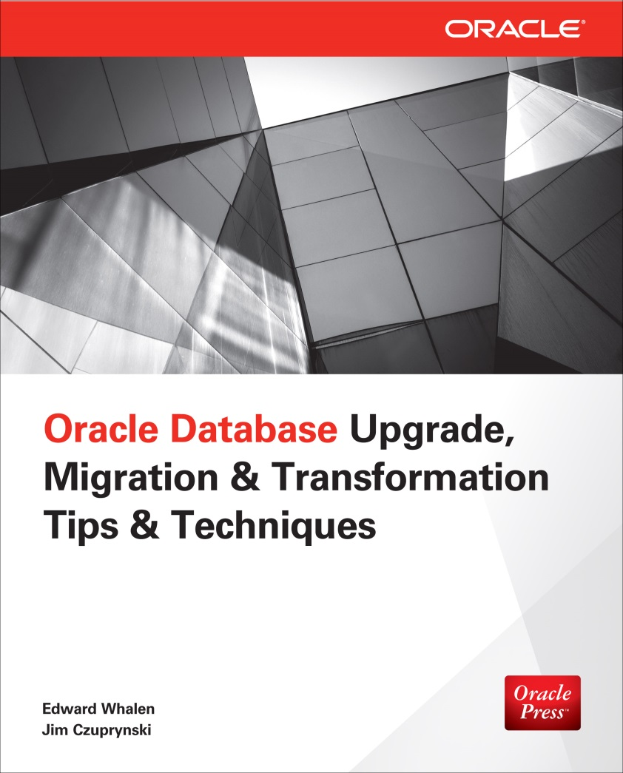
Coming Soon …
Coming in Spring 2015 from Oracle Press:
Oracle Database Upgrade, Migration & Transformation Tips & Techniques
Covers everything you need to know to upgrade, migrate, and transform any Oracle 10g or 11g database to Oracle 12c
Discusses strategy and tactics of planning Oracle migration, transformation, and upgrade projects
Explores latest transformation features:
Recovery Manager (RMAN)
Oracle GoldenGate
Cross-Platform Transportable Tablespaces
Cross-Platform Transport (CPT)
Full Transportable Export (FTE)
Includes detailed sample code

Slide 23
Over To You …

Slide 24
Thank You For Your Kind Attention
How Hot Is My Data? Leveraging Automatic Data Optimization (ADO) Features in Oracle 12c Database For Dramatic Performance Improvements
If you have any questions or comments, feel free to:
E-mail me at jczuprynski@zerodefectcomputingcom
Follow my blog: http://jimczuprynski.wordpress.com
Follow me on Twitter (@jczuprynski)
Connect with me on LinkedIn (Jim Czuprynski)

