Slide 1


Oracle Fusion Applications
A Case Study
John McDonald
Senior Manager, Deloitte, New Zealand
John Hansen
Senior Director, Applications Development & Product Management, Oracle Corporation, Japan and Asia-Pacific

Slide 2
Agenda
Oracle Fusion Applications – John Hansen
        Update on Global Customer Momentum, Adoption and Deployment
2. Elizabeth Arden Case Study – John McDonald
        The Context
        The Project
        The Product: Performance Management
        The Product: Compensation Management
        The Benefits / The Challenges / Service Improvement and Extensions
    3. Call to Action

Slide 3
Oracle Fusion Applications Update – John Hansen
Notes:
Sarah – 5 mins

Slide 4


Oracle Delivers The Most Complete
Cloud-Based Talent Management Suite
Oracle Fusion
Human Capital Management
Oracle Fusion and Taleo
Talent Management
Global HR
Global Payroll
+
Recruitment and On-boarding
Learning and
Development
Performance Management
Workforce Management
Engagement and Retention
Compensation and Rewards
Talent Review
Social
Mobile
Integration
Analytics
Reliable
Secure
Notes:
4
Key Message: Oracle HCM is in the Cloud
We provide world-class technology capabilities, and provide best-in-class human capital management processes. Oracle provides a complete and integrated human capital management solution, focusing on Workforce Optimization, Workforce Rewards, Worker Interaction, and Talent Management.

Slide 5



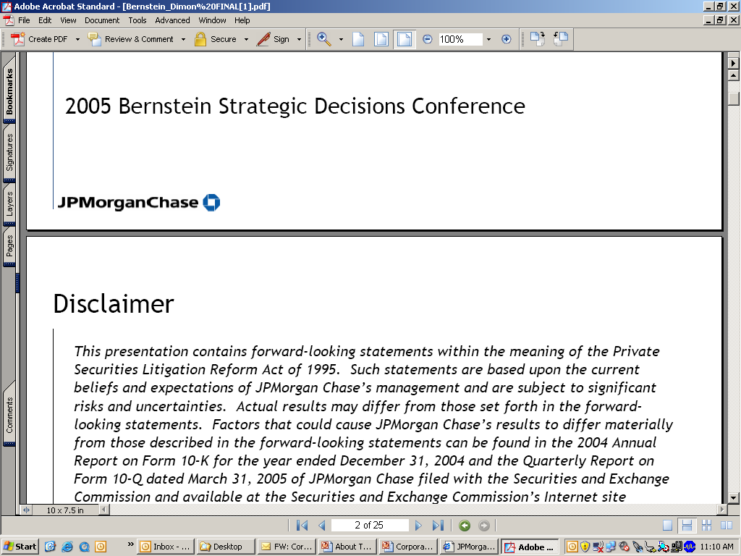

































































































Some Oracle Cloud Customers
ERP, Human Capital, Talent Management

Slide 6

Adopt

Slide 7



Complete Choice
The message remains the same
Continue on Your Current Path
  Upgrade to the latest release of your current Oracle Applications
Incrementally Adopt Fusion Apps
  Add new Fusion Applications modules and coexist with
  your current Oracle Applications
Embrace the Complete Suite
  Deploy the comprehensive suite of Fusion Applications products

Slide 8
Fusion Application Customer Adoption
Customers by Product Family
Customers by Geography

Slide 9
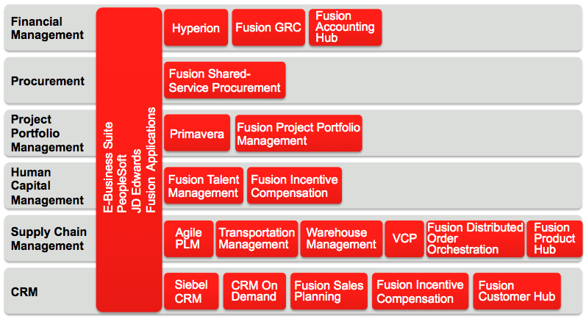
Fusion Application Customer Adoption
Full Suite
Coexistence

Slide 10
Deploy

Slide 11
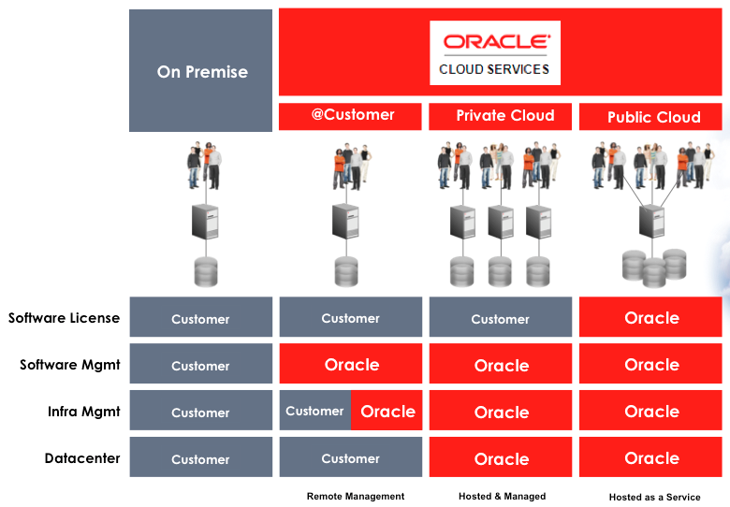
Fusion Application Customer Deployment
Customers by Deployment Type

Slide 12

Global Tier 4 Data Centers
Linglithlow
Chicago
Toronto
London
Amsterdam
Santa Clara
Japan*
Austin
Oklahoma City
Singapore*
Sydney
Gen 4 Data Centers
Global footprint for security & performance
Multi-data center regional coverage for DR
Compliance certifications
24X7 follow the sun active monitoring and support
* In future

Slide 13
Elizabeth Arden Case Study – John McDonald
Notes:
Sarah – 5 mins

Slide 14



MyHRDoor
Implementation of Oracle Fusion at Elizabeth Arden
Implementing Oracle Fusion within Elizabeth Arden
https://www.youtube.com/watch?v=WtLqpWn2xBo
Notes:
Tim

Slide 15
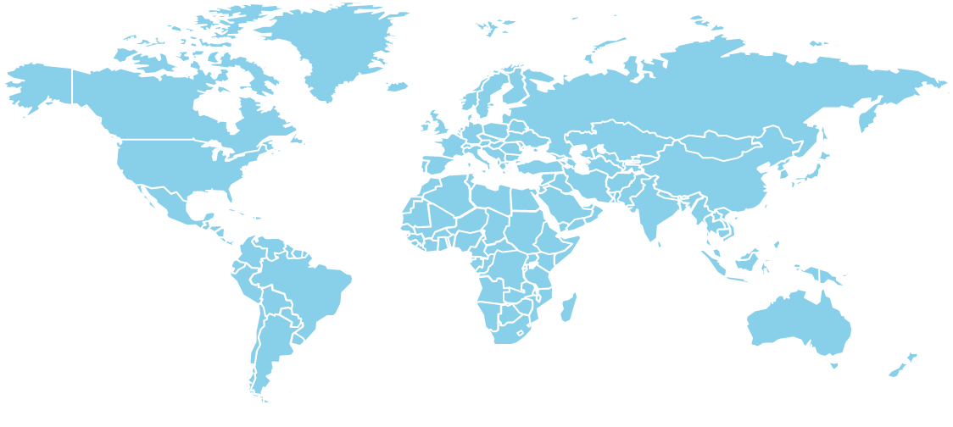




















Elizabeth Arden global presence.
3000 employees across 16 countries around the world, consisting of Head Office and Beauty Consultants
Notes:
We have 3,000 employees worldwide, which consists of Head Office, Field Sales & Beauty Consultants. We have offices in 16 countries around the world and are distributed in another 65 countries through a network of distributors.
International: Europe, APO and DMTR = 1700

Slide 16




MyHRDoor project - Objectives
As Elizabeth Arden continues to grow and expand its global business, there is an increasing need for an integrated HR system to provide global business visibility
Objective: Implement a global and integrated HR system enabling us:
One version of the truth
The performance review and compensation management
An integrated reporting
Standardized HR processes globally
Notes:
Objective: Implement a global and integrated HR system which allows:
the central repository of the employees data, giving “one version of the truth” and transparency of data
To satisfy existing practices in terms of the annual performance review and compensation management. Fusion was able to cope with customizations that were required for Elizabeth Arden
Enable better control of budgets linked to workforce and compensation by intergraded reporting
Standardize HR processes globally and share/adopt best practices; ultimately, reduce and eliminate manual paper processes and reducing risks of data inaccuracy
Initially, not a key objective (will change along the project): Create a system about and for employees, giving them ownership of their data by the Employee Self Service component especially for BA

Slide 17

Why Fusion
Elizabeth Arden requirements in the choice of its system…
  Initially:…
    Worldwide coverage
    Support our current and future needs
    Recognized successful HR solution
    Vanilla Implementation
    SaaS (Software as a Service) Solution
  Specific Focus on…
  Integrated functionality across Core HR, Performance /Compensation
  Oracle’s long-term partner
Notes:
The basic requirements of the project can be defined as follow. These requirements will then be used to identify the potential suitable HR System providers:
a) Capability of a worldwide coverage. Elizabeth Arden is a truly international company, having affiliates and entities all over the world. It is then critical to design a global HR system environment. The system should also be globally accessible.
Elizabeth Arden Inc. in the US is not included in the first phases of the project. However, the system should offer the possibility to:
Create an interface with this entity, if relevant; and
Integrate this entity in the future.
b) Capability to support our current and future HR functional needs. Our first need is focused on the implementation of a strong Personnel Data Management solution. However, the final qualified software supplier should also be capable to offer more strategic HR functionalities that can be easily added in the future. Included in the future needs will be the ability to interface with the international local payroll systems These possible extensions should be possible with minimum customization..
c) Recognized successful HR solution. The supplier should be well recognized in the Human Resource Management Information landscape and its software should have been successfully implemented in companies with the same characteristics as Elizabeth Arden International (number of employees, number of affiliates, worldwide presence, etc.).
d) Capability for a vanilla implementation limiting the required customization and the implementation timeline to minimum. Elizabeth Arden has limited internal (HR and IT) resources to dedicate to this project. As a consequence, the design, configuration and deployment of the software should be relatively easy. In addition, the Human Resources organization, activities and processes are quite straightforward, standard and do not require strong customization.
e) Capability to offer a SaaS (Software as a Service) Solution. Elizabeth Arden took the strategic decision to implement a SaaS solution for this software. The software supplier should then provide (or recommend a partner doing so) all hardware, network equipment, operating systems, Windows anti-virus and other hardware and software necessary to host the software applications and databases in its data centers.
The software supplier or its partner will manage the data center facilities necessary to support the operation of the applications by Elizabeth Arden.
Selection of Oracle Fusion as well as Deloitte
Fusion answered most of these requirements, except : Recognized successful hr solution and vanilla implementation. However, selected because the great module in performance and compensation and the long-term relationship between EA/Oracle.

Slide 18
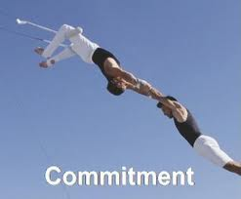
Why Deloitte
Elizabeth Arden requirements in the choice of its system integrator…
  Breadth of experience in global HR transformations
  Depth of knowledge of Oracle functionality
  Experience with international coverage
  Cultural fit with Elizabeth Arden
Notes:
During the RFP process, deloitte emerged as the strongest partner for this project. Yes, they came up positively on all our requirements such as :
Breadth of experience in global HR transformations
Depth of knowledge of Oracle functionality
Experience with international coverage
Cultural fit with Elizabeth Arden
But more importantly, their level of commitment for this porject came up and made the difference with the other system integrators.

Slide 19
The Project
Notes:
Tim – 5 mins

Slide 20


The project team
The ‘MyHRDoor’ project team was formed of representatives from all three parties to enable the most collaborative approach
Benefits
A collaborative approach from all three parties
Joint accountability for the success of the project
A joined-up project management office and steering committee to provide clear project governance
A friendly working environment which promotes knowledge sharing and teamwork
©2012 Deloitte MCS Limited

Slide 21
Challenges
The MyHRDoor project presented a series of challenges which were overcome by the project team
Solutions
The collaborative team effort promoted easy knowledge transfer and helped to mitigate challenges
The team were able to learn about the application ‘on the job’, and quickly amass a deep knowledge
Consistent support was provided by the Oracle team throughout the project duration to resolve bugs
The choice of a first-rate system integration partner in Deloitte provided the project experience and depth of knowledge to ensure that the project continued
Continual support and guidance from the steering committee
Challenges
Fusion HCM is a brand new application, and as such it came with lots of problems and limitations
Given the nature of the ‘first-time’ implementation, there was no prior knowledge within the project team of the application
No frame of reference was available from previous projects; the MyHRDoor team had no previous mistakes to learn from
©2012 Deloitte MCS Limited

Slide 22
The project continues…
In June 2012, MyHRDoor went live to users in the UK and Switzerland. The project team is now engaged in rolling the solution out to the rest of International
Phase 2a – EMEA:
Spain
South Africa
Denmark
France
Italy
Sweden
Norway
Brazil
Germany
Phase 2b – ASPAC:
China
Taiwan
South Korea
Australia
Singapore
New Zealand
Phase 1 (Complete)
Phase 2a
Phase 2b
Phase 3
 | 2011 |  |  |  |  |  | 2012 |  |  |  |  |  | 2013 |  |  |  |  |  | 2014
Timelines
Phase 1
Phase 2a
Phase 2b

Slide 23
The Product:
Fusion Performance Management
Notes:
Chris

Slide 24
Elizabeth Arden Performance/Compensation Process
Elizabeth Arden had a consistent global Performance and Compensation Review Process
Executive Mgt Team/ Country GM
Budget/KPI Finalization for each affiliate
April / May
Fiscal Year: 1st July to 30th of June
Country/Department /Job Level
Financial/Non Financial Goals Setting
August / September
Country/Department /Job Level
Mid-Year Performance Review
January
Country/Department /Job Level
Final Performance review
June
Executive Mgt Team
Target Achievement Review for each affiliate
July
Country/Department /Job Level
Salary Increase /Bonus Impact
September
Notes:
Sarah
Note: consistent global Performance and Compensation Review Process, embedded into business processes. Personal comment: right balance between structure and flexibility

Slide 25
Fusion Performance Management at Elizabeth Arden
The Fusion Performance Management functionality has enabled Elizabeth Arden’s existing process to be recorded on a global platform
The existing form
Transferring the paper process:
Setting KPIs
Utilising competencies
Reviewing and rating KPIs
Completing the performance lifecycle
Additional benefits

Slide 26
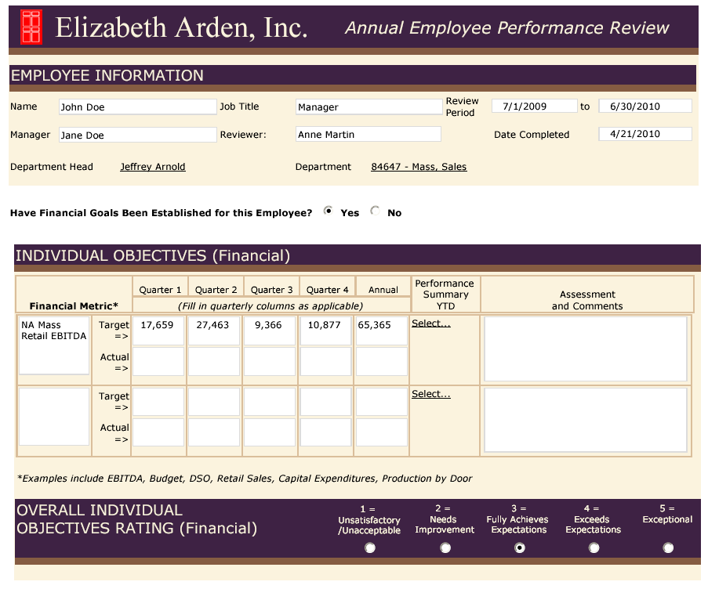
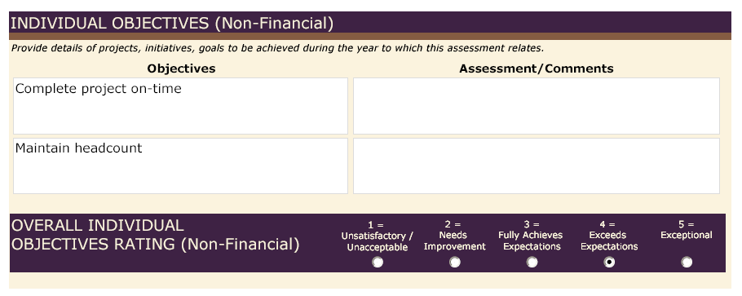
The existing form
Elizabeth Arden already has a well documented, easy to understand and measurable performance management process for its employees
Financial Objectives
Performance Ratings
Non Financial Objectives
The current performance document ensures that there is fair tracking of:
Financial and Non financial Objectives;
Business Competencies
However, it is not an integrated system approach
Notes:
Copyright © 2007, SAS Institute Inc. All rights reserved.
26

Slide 27
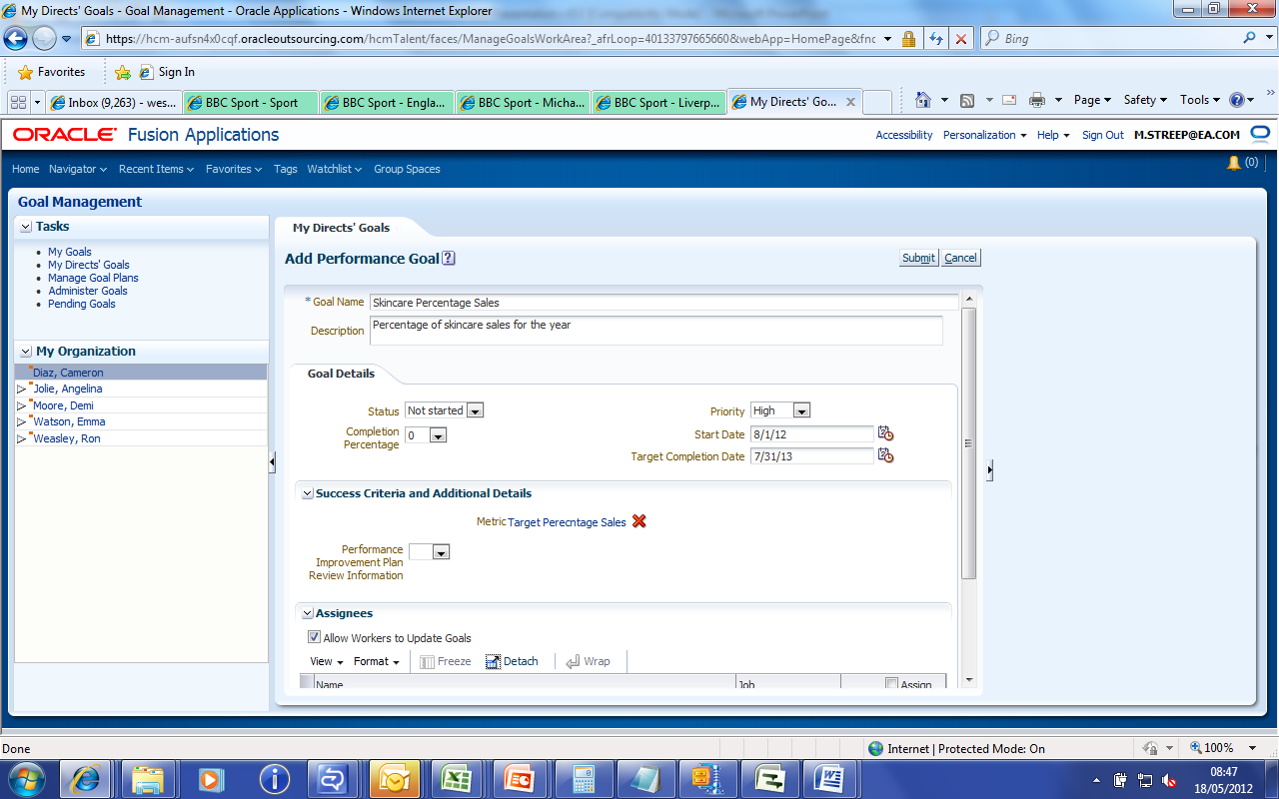
Translating the paper process: setting KPIs
A great benefit of the Fusion Performance Management functionality is the ability to record individual KPIs as goals against employees
Fusion Goal management allows individual employee KPIs to be transferred directly into quantifiable, meaningful goals at the start of each performance management lifecycle.
This is of particular use to Elizabeth Arden’s beauty consultant population, for measuring individual sales targets.
KPIs are translated to the name of a goal
Fusion User Interface allows for more detailed analysis to be captured

Slide 28
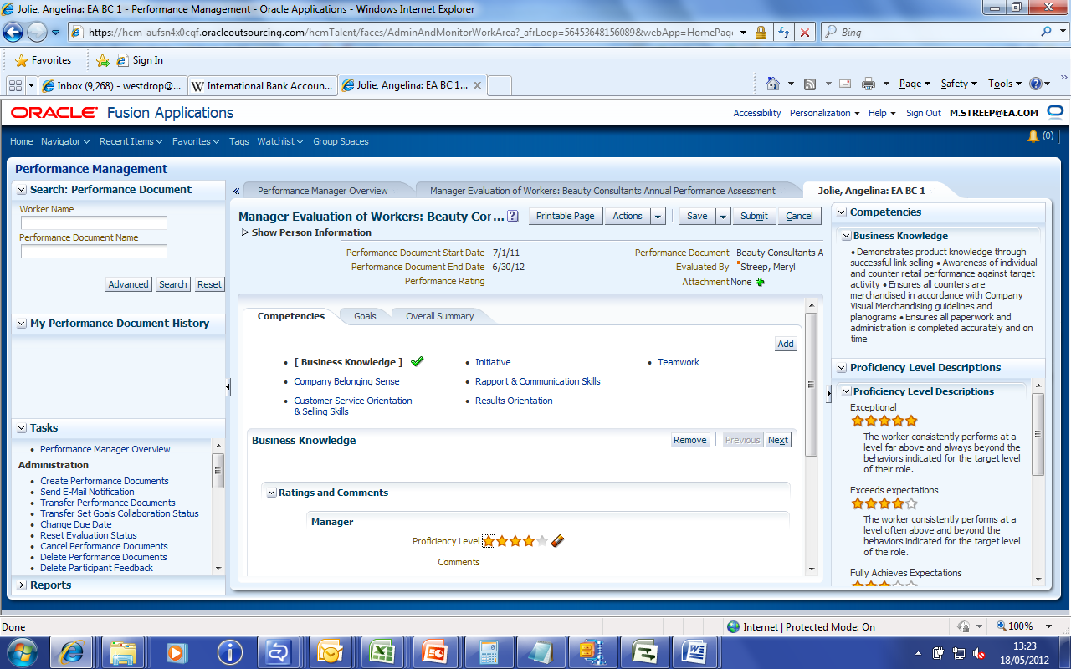
Translating the paper process: utilising competencies
Predefined competencies are linked to employees in Fusion via their job profiles.
Once the KPIs have been set and the performance document has been initiated, the employee’s individual qualitative job competencies are pulled through into the document. These competencies can each be given a rating, and comments can be provided against each one.
Competency details are captured in the performance document
Every behaviour required to be demonstrated by an employee is delivered as a competency
Ratings against individual competencies allows the manager to assess performance at a micro level on individual elements

Slide 29
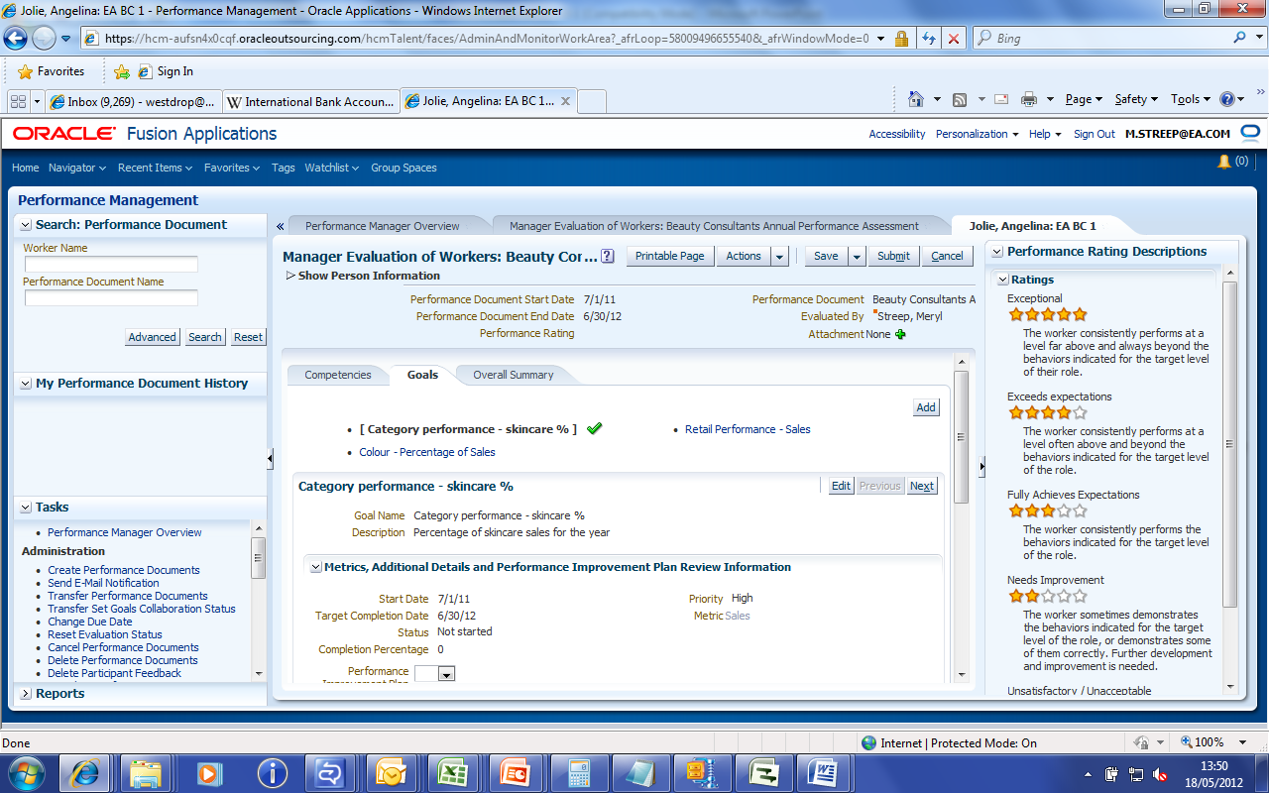
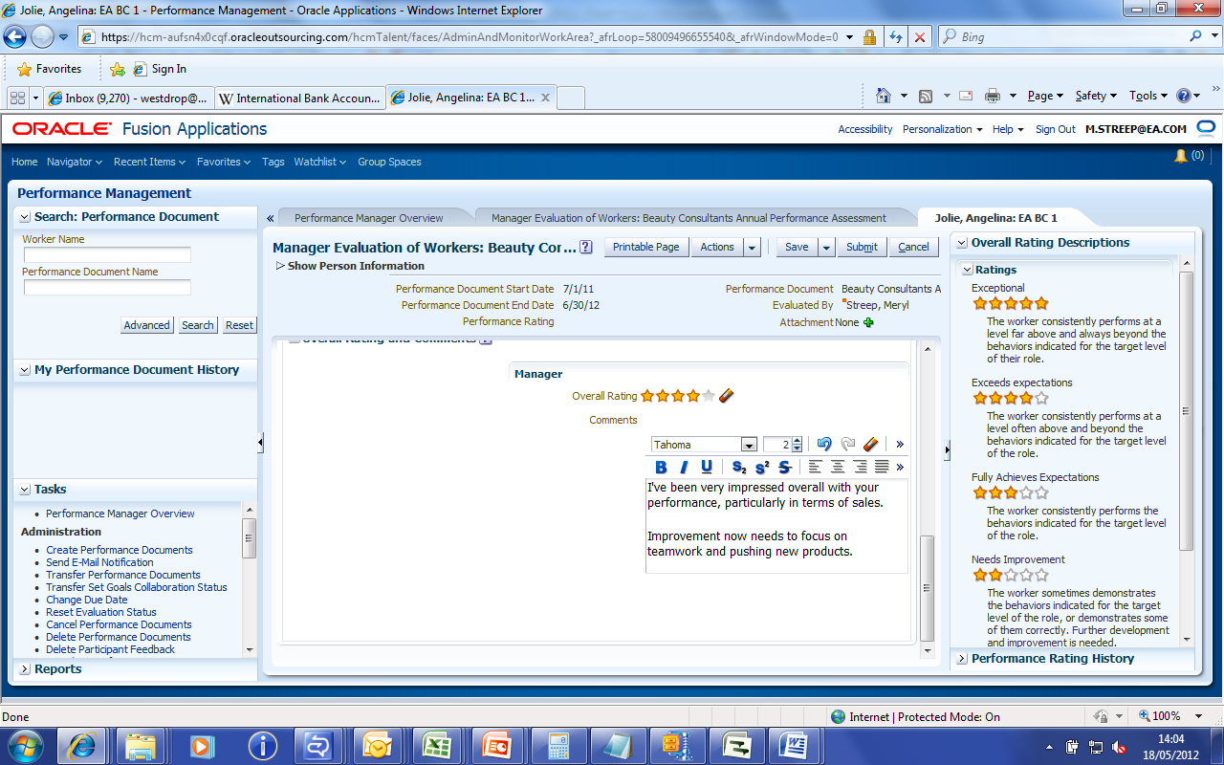
Translating the paper process: rating KPIs
Once the employee’s qualitative competencies have been reviewed and rated, Fusion then allows for a final quantitative rating against the KPIs
Applying the same principle to the goals as to the competencies means sales targets are measured throughout the year and employees are rated against them at year end, providing a transparent approach to evaluating sales performance
A manager’s overall rating at the end of the performance cycle is based on their analysis of each of the individual components, be their KPIs or behavioural targets.
Again, the focus is on transparency, measurability and simple analysis to ensure the right ratings are applied to the right employees.

Slide 30
Completing the performance lifecycle
After a manager has completed their final rating, the performance documents are distributed for approval, and link up with compensation management
Performance ratings are collated by HR through an approvals process;
HR ensures that a “standard distribution” is achieved across the organisation
Compensation management kicks in to distribute the right salary and bonus amounts, linking high performance to high reward
Performance ratings are finalised and distributed to the employees

Slide 31
Additional benefits
The Fusion Performance Management application allows further functionality to be incorporated into the process, which acts as a catalyst for cultural change
Ability to collect 360 degree feedback from colleagues
Introduction of employee self-assessment via self-service
Using the functionality to track Performance Improvement Plans
Notes:
Ability to collect 360 degree feedback from colleagues throughout the performance lifecycle and incorporate this into the final performance document
Introduction of employee self-assessment via self-service; increasing the visibility of the performance process and embedding cultural change
Using the functionality to track Performance Improvement Plans and ongoing performance documents outside of the final end of year submission

Slide 32
The Product:
Fusion Compensation Management
Notes:
Chris

Slide 33
Fusion Compensation Management at Elizabeth Arden
The Fusion Compensation Management functionality has provided Elizabeth Arden with enhanced budgeting functionality, and provides an integrated link with Performance Management
A global integrated approach to compensation and performance:
View performance ratings in worksheets
Performance linked eligibility profiles
Manage compensation budgets
Model compensation

Slide 34
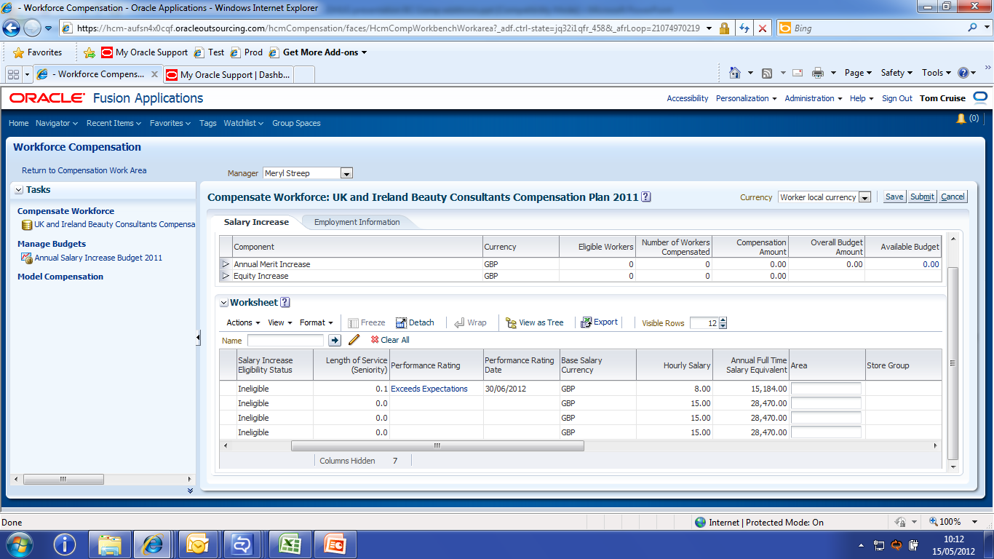
Performance ratings in the compensation worksheets
Once the initial performance ratings have been signed off by managers, they are pulled into the compensation worksheet to assist budget distribution
The compensation specialist can select which performance plan should be taken into consideration when they set up the worksheets
The performance rating is automatically populated from Fusion Performance Management
Manager can see each individual’s performance rating when they access the worksheet.

Slide 35
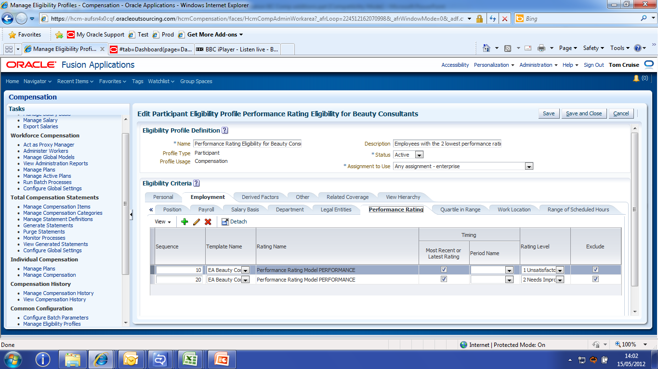
Performance linked eligibility profiles
The actions that can be taken on the compensation worksheet are defined by eligibility profiles, linked to the employee’s performance rating
Eligibility profiles can be set up and linked to compensation plans so that employees with performance ratings below a certain level are excluded from the plan
This enables a strictly enforced correlation between high performance and high reward
Managers are able to see whether their employees are meeting the correct eligibility criteria

Slide 36
Managing compensation budgets
Fusion Compensation Management has allowed Elizabeth Arden to replicate their paper-based budgeting process via a comprehensive system approach
Compensation specialist determines eligibility and budgeted amounts, for workers based on performance of the Company and Department
Compensation Specialist
Managers are assigned a budget which they then distribute amongst their team.
Area Sales UK Manager 1
Head Office Manager US
Head Office China Manager
Beauty Consultant
Beauty Consultant
Beauty Consultant
Head Office Employee
Head Office Employee
Managers choose how to allocate compensation within their team guided by:
The amount of budget they have been assigned
The suggested % increase based on performance provided by the compensation specialist
Head Office
Employee
Head Office Employee
Head Office
Employee

Slide 37
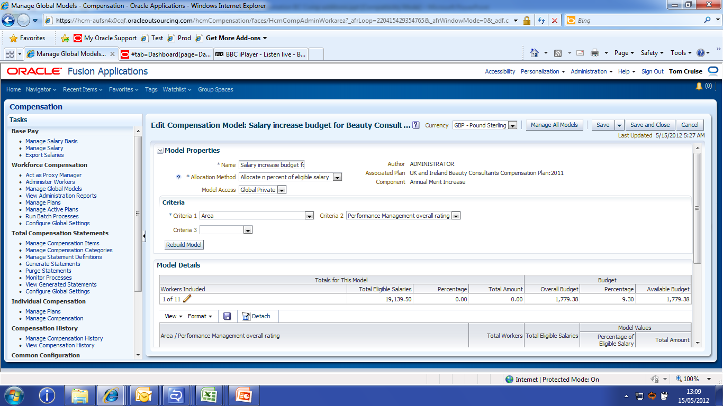
Model compensation
The Elizabeth Arden Compensation Specialist is able to create models based on various criteria to determine their budgets and recommendations for increases
The compensation specialist can assign budgets to managers based on the performance ratings of their employees.
They can also provide suggested increase amounts per employee, based on different criteria
This enables the consistent global approach to compensation which Elizabeth Arden requires; directly linking salary/ bonus increases to performance ratings
Performance can be selected as a criteria for salary increase/ bonus allocation in the model.

Slide 38
The Benefits and Challenges
Notes:
Sarah and Chris

Slide 39




Key benefits for Elizabeth Arden
In addition to the expected benefits, MyHRDoor was the right leverage for organizational change
Greater visibility of the organization through key HR indicators and global job classification
Empowerment of Line managers
Communication Improvement with our employees and more specifically our Beauty Consultants
Ultimately, HR function focused on strategic HR activities
Visibility
Empower
Communicate
Strategic HR
Notes:
Expected Benefits:
Seamless integration of performance and compensation
Tailored Elizabeth Arden-specific configuration across all modules
Homogenised criteria at a global level
Framework for satisfying the global job classification model
Visibility of all employee data
Best-practice global HR processes
Improved communication with the beauty consultant population, who are often based in remote locations away from the head office
But also
The implementation of ‘MyHRDoor’ at Elizabeth Arden will have an impact that reaches beyond technology and process improvement. The system will act as a catalyst for wider organisational and cultural change
Greater visibility of our organization and the way it structures per country and function, through key HR indicators + implementation fo a global job classification . It allows HR to support better the business strategy in terms of organization design and talent management.
The system enables a cultural change, giving more responsibility to managers
The system participates in the overall strategy of improving our communication with our employees and more specifically our Beauty consultants
Provided in the transactional HR activities, the absence of a global HR Information System prevents any more strategic HR activity such as Talent Management, Workforce Planning, Organizational Development as well as Headcount Reporting and Budgeting to be lead.

Slide 40
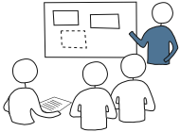
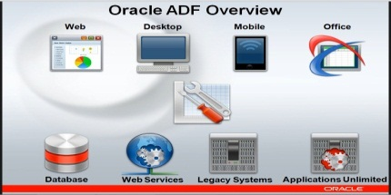


Extensions
Fusion is fully configurable and provides a lot of flexibility and ‘personalisation’ for customers (down to the user level).
We recommend driving adoption through focus on service delivery, not extensions
  How will the role of HR business partners change?
  Is there a role for an HR generalist?
  Will there be an HR service center?
Oracle is planning significant user interface enhancements
Consider Platform as a Service (PaaS) extensions to remain in a cloud environment:
  Oracle Java and Database Cloud Services
  Same technology used to develop Fusion HCM
  Note that identity management for Fusion Applications SaaS is currently separate from the PaaS common identity framework
ADF Development
Oracle Java
Cloud Service

Slide 41
Ongoing challenges with the application
There are still areas of improvement for the application, which Elizabeth Arden are helping to identify
Limited functionality for configuring custom approvals and notifications which fall outside of the normal manager hierarchy
No current functionality to download offline versions of the application which can be updated and then uploaded at a later date
No current functionality to establish position hierarchies which display vacancies via the organisation chart
Limitations in the configuration of custom security profiles
Notes:
In the current version of the application, there is limited functionality for configuring custom approvals and notifications which fall outside of the normal manager hierarchy
There is currently no functionality to download offline versions of the application which can be updated and then uploaded at a later date – this would be particularly useful for the remote beauty consultant population and their performance documents
The current version of the application does not have the functionality to establish position hierarchies which display vacancies via the organisation chart – Oracle are working on including this in a future release
There are limitations in the configuration of custom security profiles, which have meant that some design requirements have not been possible to meet

Slide 42
The Future of MyHRDoor
Notes:
Tim

Slide 43

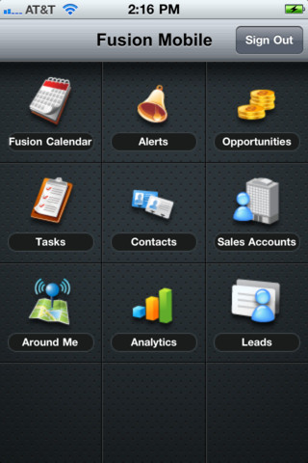
Future system improvements
Thanks to the ever-improving nature of the Fusion HCM application, Elizabeth Arden has been able to define a ‘future wish-list’ of functionality
“Mobile” or “tablet” access for Beauty Consultants, enabling employees to more effectively access their performance documents and increase process efficiency
Utilise the “Network at Work” functionality of Oracle Fusion HCM to ensure that Area Managers and Beauty Consultants stay in touch more effectively and improve business communication
Push for further enhancements of the Fusion HCM application, for example the ability to take the performance management documents “offline”
Continue the global rollout and ensure that this global solution is provided to all employees in the organisation worldwide.
There is the possibility of further extensions to MyHRDoor in the Talent Management and Recruitment modules
Notes:
Blog
Communication tool

Slide 44
A call to Action

Slide 45
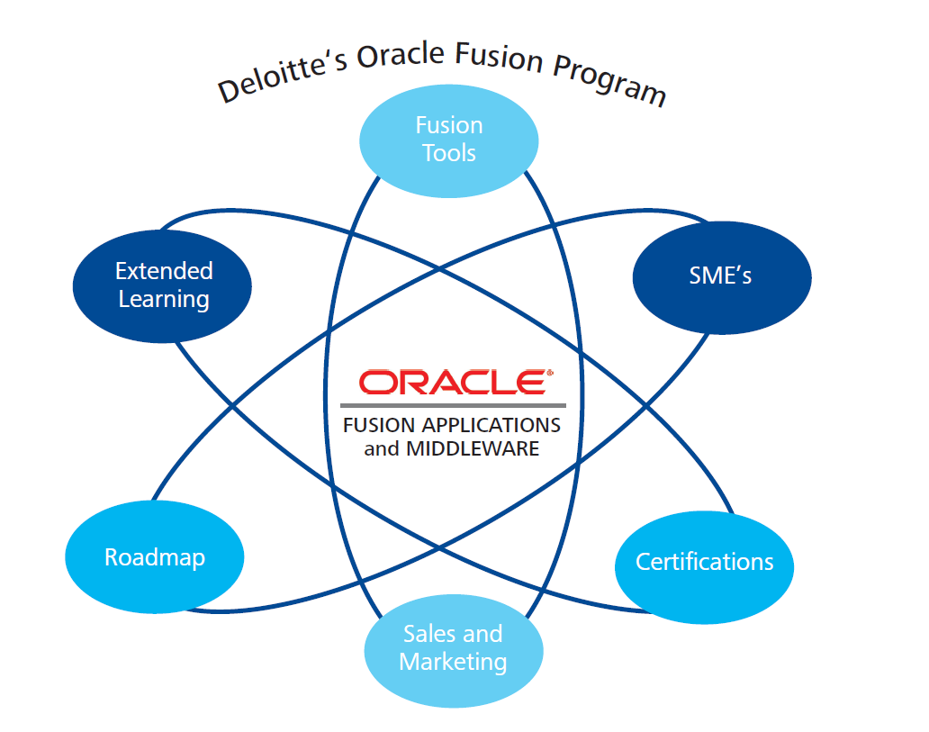

Slide 46
Roadmap Example
Implement Oracle HR Analytics & data warehouse and use your information to drive value
Transform your ability to deliver service to leaders and employees
Implement new Fusion technology for Compensation Mgt
Leverage New Fusion Functionality and Eliminate PeopleSoft Bolt-on’s
Avoid upgrade to PeopleSoft v9.1 with Fusion upgrade
Transparency of Performance, Talent Review, and Comp transactions
Extend the Fusion platform to include remaining HCM
(upgrade from PeopleSoft)
Investment
Provide for Global and Local Decision Making
Implement new Fusion technology for Performance Mgt, Talent Review
Remain on a PeopleSoft HCM supported release
Results
Notes:
Phased approach starting with Talent Mgt followed by Compensation.
Eliminating PSFT Bolts ons along the way..

Slide 47
Next Steps – Call to Action
Applications Review
  Review Application Landscape
  Review Application Versions
  Conduct an Applications Roadmap
  Enterprise Technology Review
  Review Middleware Layer
  Review Reporting Layer
  Co-Existence Opportunities

Slide 48

Questions and Answers

Slide 49
Deloitte refers to one or more of Deloitte Touche Tohmatsu Limited (“DTTL”), a UK private company limited by guarantee, and its network of member firms, each of which is a legally separate and independent entity. Please see www.deloitte.co.uk/about for a detailed description of the legal structure of DTTL and its member firms.
Deloitte MCS Limited is a subsidiary of Deloitte LLP, the United Kingdom member firm of DTTL.
This publication has been written in general terms and therefore cannot be relied on to cover specific situations; application of the principles set out will depend upon the particular circumstances involved and we recommend that you obtain professional advice before acting or refraining from acting on any of the contents of this publication. Deloitte MCS Limited would be pleased to advise readers on how to apply the principles set out in this publication to their specific circumstances. Deloitte MCS Limited accepts no duty of care or liability for any loss occasioned to any person acting or refraining from action as a result of any material in this publication.
© 2013 Deloitte MCS Limited. All rights reserved.
Registered office: Hill House, 1 Little New Street, London EC4A 3TR, United Kingdom. Registered in England No 3311052.
Member of Deloitte Touche Tohmatsu Limited

