Slide 1
Got a minute to spare?
http://jdevadf.oracle.com/amx

Slide 2
The preceding is intended to outline our general product direction. It is intended for information purposes only, and may not be incorporated into any contract. It is not a commitment to deliver any material, code, or functionality, and should not be relied upon in making purchasing decisions. The development, release, and timing of any features or functionality described for Oracle’s products remains at the sole discretion of Oracle.

Slide 3


Develop Mobile Apps for Smart Devices
Converging Web and Native Applications
ORACLE
PRODUCT
LOGO
Chris Muir
Oracle ADF Product Manager

Slide 4

Program Agenda
Mobile Enterprise Challenges
Oracle’s Mobile Strategy
Oracle ADF Mobile - Roadmap
Demonstration

Slide 5
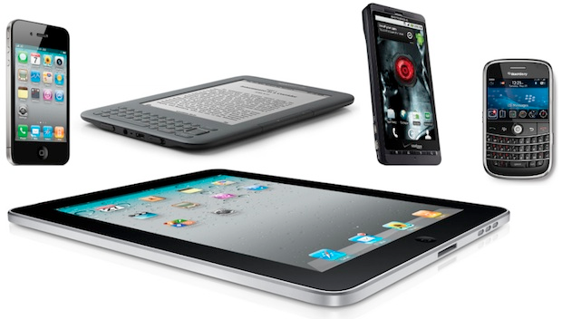
Mobile Enterprise Challenges
In pursuit of productivity and connectivity
Technology evolving at Consumer pace
  iOS, Android, RIM, Windows Mobile…
  Different tools, languages, platforms, etc.
User expectations are high
  Biased by Consumer experiences
But Enterprise IT is optimized for web
  Technology expertise, headcount, processes
  Now must meet demand for mobile
    Multiple platforms and form factors

Slide 6
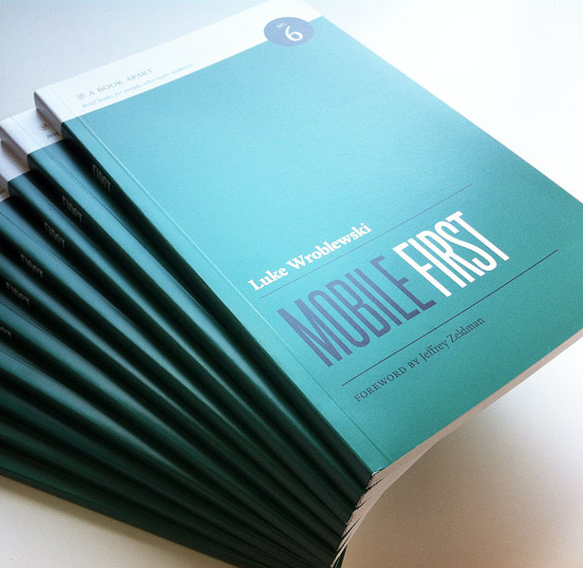
“But things have changed so dramatically over the past few years that starting with the desktop may be an increasingly backwards way of thinking about a Web product. Designing for mobile first not only prepares you for the explosive growth and opportunities in this space, it forces you to focus and enables you to innovate.”
Luke Wroblewski
Author: Mobile First

Slide 7
Program Agenda
Mobile Enterprise Challenges
Oracle’s Mobile Strategy
Oracle ADF Mobile - Roadmap
Demonstration

Slide 8
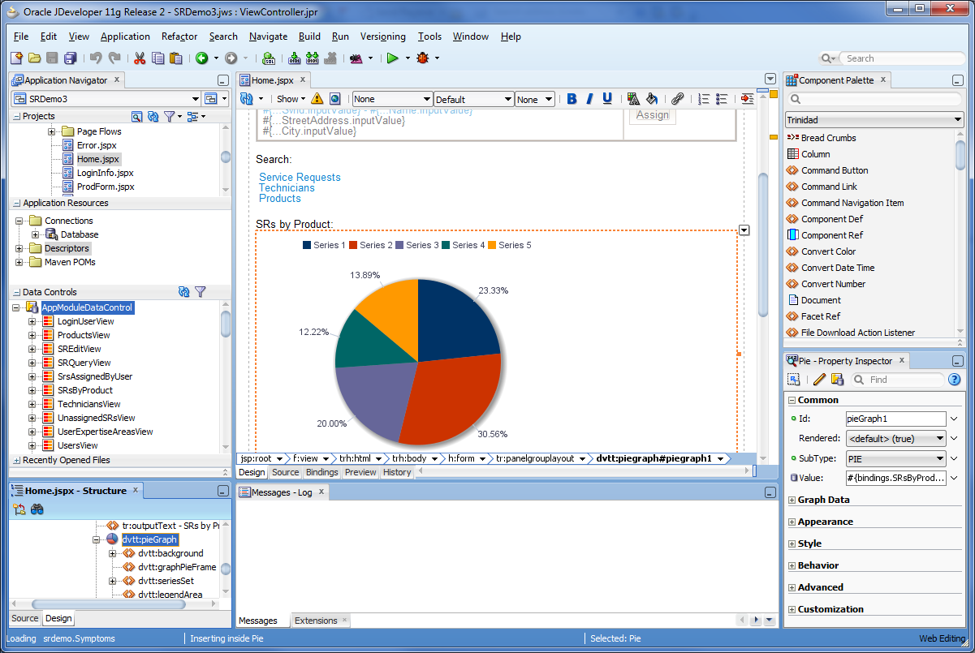
Mobile Development with JDeveloper 11g R2
Coupled with Oracle’s Application Development Framework (ADF)
  Oracle’s strategic Java EE framework, core to Oracle’s Fusion Applications
Complete enterprise application framework
  Declarative and visual development
  Reuse business services
  Reuse developer skills and tooling
    Consistent developer
    experiences for web, mobile,
    desktop, and MS Office
    applications

Slide 9
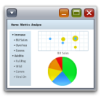




Multi-Channel Development – Single Programming Model
Web
Mobile
Desktop
Office
WAP 2.0
HTML (5.0)
AJAX
User Interface
ADF Mobile
ADF Faces / WebCenter
Portlets
Business Logic
Java

Slide 10
Oracle’s Mobile Development Strategy
Extend enterprise applications and data to mobile clients
Support multiple channels and platforms
  Provide one common platform for both desktop-based and mobile enterprise applications (ADF)
  Minimize development cycle and cost
  Minimize customer TCO

Slide 11
Mobile Development with Oracle ADF
Use Case | Solution | Description | Function & Benefits
Tablet Laptop/Desktop Replacement | ADF Faces RC Components | For desktop browser apps that are fully functional in iPad and Android tablet browsers | Desktop browser based applications must perform flawlessly in Tablet browser Single codebase Simplest rollout, maintenance, portability
Mobile Phone Mobile Approval and Search | ADF Mobile Browser | For web pages that adapt to the mobile browser where they are viewed | Allows users to perform quick actions while on the go Benefits from application optimizations to smartphone form factor Some benefit from Device Service enhancements Supports broad range of mobile browsers (smartphones and feature phones)
Smartphone/tablet Advanced Mobile Workers and Mobile Approval and Search | ADF Mobile | For mobile apps that install and run on iOS devices | Applications must be optimized for device form factors Requires both devices services access as well as offline support Access to local storage and device services (camera, bar scanner, etc.) Reuse existing ADF development skills Minimizes development cycle for supporting new mobile platforms

Slide 12
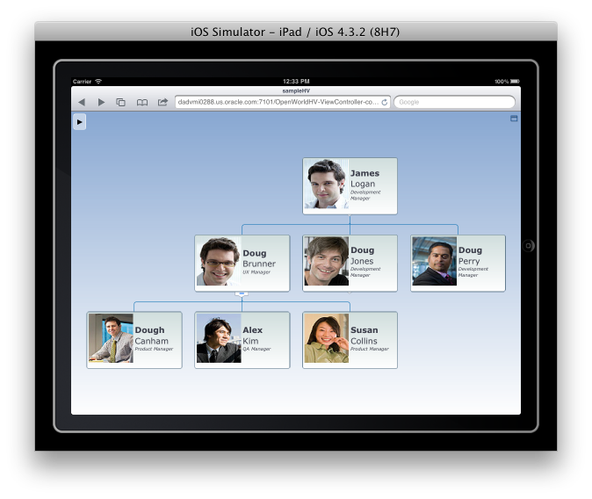
ADF Faces RC Enhancements for Tablets
Introduced ADF 11.1.1.6.0
OS Gesture Support
  Drag n drop, multi-select, hover, context menu, touch etc.
Optimized
  Table component
  DVT HTML5 implementation
  CSS3 support
  Flowing downward layout support
  Performance & JavaScript optimizations
You wont have to re-develop
But you still need to test

Slide 13
Mobile Development with Oracle ADF
Use Case | Solution | Description | Function & Benefits
Tablet Laptop/Desktop Replacement | ADF Faces RC Components | For desktop browser apps that are fully functional in iPad and Android tablet browsers | Desktop browser based applications must perform flawlessly in Tablet browser Single codebase Simplest rollout, maintenance, portability
Mobile Phone Mobile Approval and Search | ADF Mobile Browser | For web pages that adapt to the mobile browser where they are viewed | Allows users to perform quick actions while on the go Benefits from application optimizations to smartphone form factor Some benefit from Device Service enhancements Supports broad range of mobile browsers (smartphones and feature phones)
Smartphone/tablet Advanced Mobile Workers and Mobile Approval and Search | ADF Mobile | For mobile apps that install and run on iOS devices | Applications must be optimized for device form factors Requires both devices services access as well as offline support Access to local storage and device services (camera, bar scanner, etc.) Reuse existing ADF development skills Minimizes development cycle for supporting new mobile platforms

Slide 14
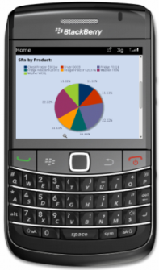
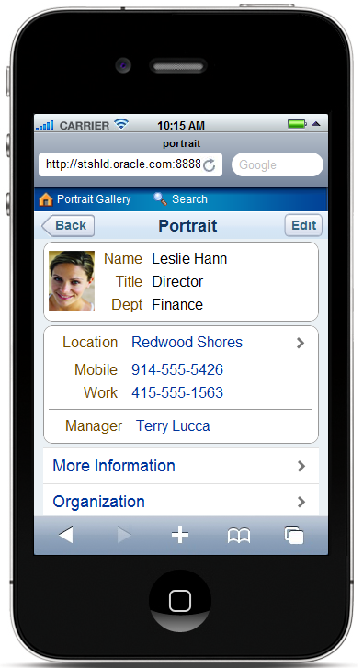
ADF Mobile Browser content
Compatibility with virtually any mobile browser
Delivers mobile optimized user experience
  Touch screen and touch pad support
  Special iOS native UI optimization
From your smartphone:
  http://stshld.oracle.com:8888/demo

Slide 15
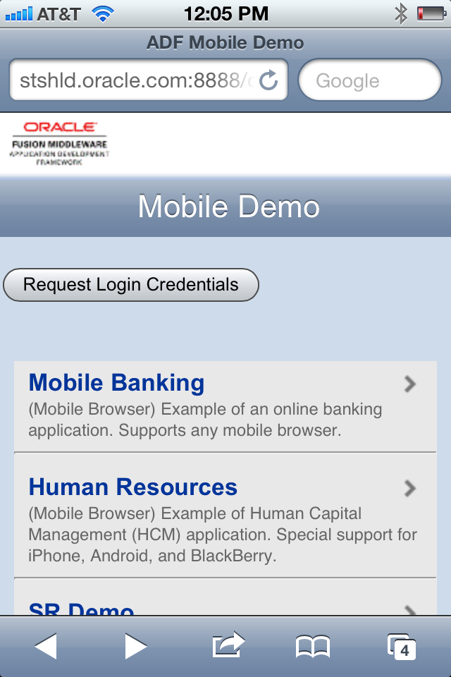
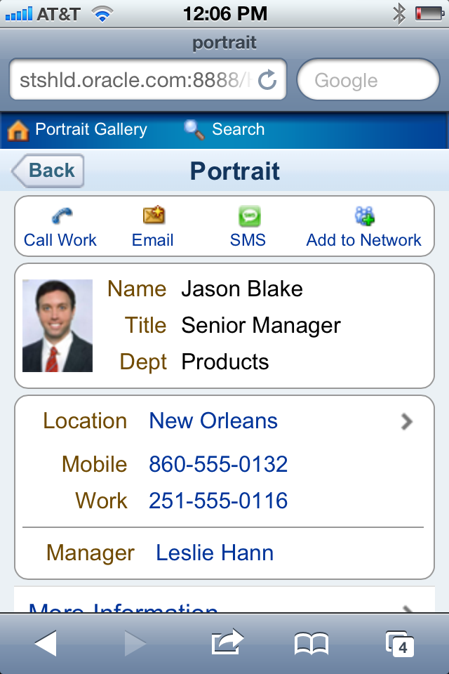
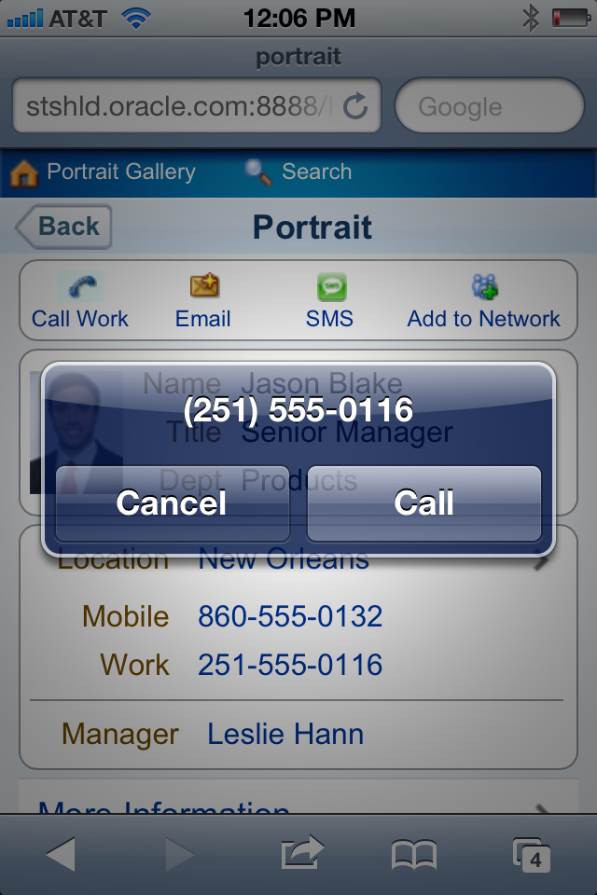
ADF Mobile Browser Demo Site
  http://stshld.oracle.com:8888/demo

Slide 16
Mobile Development with Oracle ADF
Use Case | Solution | Description | Function & Benefits
Tablet Laptop/Desktop Replacement | ADF Faces RC Components | For desktop browser apps that are fully functional in iPad and Android tablet browsers | Desktop browser based applications must perform flawlessly in Tablet browser Single codebase Simplest rollout, maintenance, portability
Mobile Phone Mobile Approval and Search | ADF Mobile Browser | For web pages that adapt to the mobile browser where they are viewed | Allows users to perform quick actions while on the go Benefits from application optimizations to smartphone form factor Some benefit from Device Service enhancements Supports broad range of mobile browsers (smartphones and feature phones)
Smartphone/tablet Advanced Mobile Workers and Mobile Approval and Search | ADF Mobile | For mobile apps that install and run on iOS devices | Applications must be optimized for device form factors Requires both devices services access as well as offline support Access to local storage and device services (camera, bar scanner, etc.) Reuse existing ADF development skills Minimizes development cycle for supporting new mobile platforms

Slide 17
Program Agenda
Mobile Enterprise Challenges
Oracle’s Mobile Strategy
Oracle ADF Mobile - Roadmap
Demonstration

Slide 18
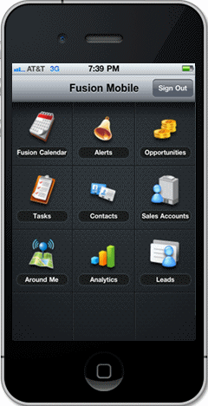
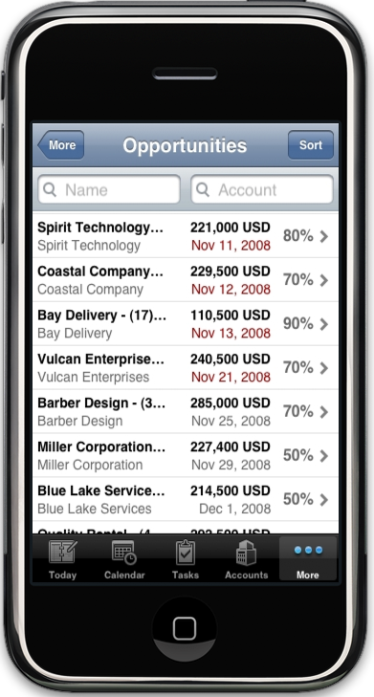
ADF Mobile - Roadmap
Declaratively develop hybrid on-device apps with HTML5 UI
Access local storage and device services (camera, bar scanner, etc.) via PhoneGap
Reuse existing ADF development skills
Minimize development cycle for supporting new mobile platforms

Slide 19
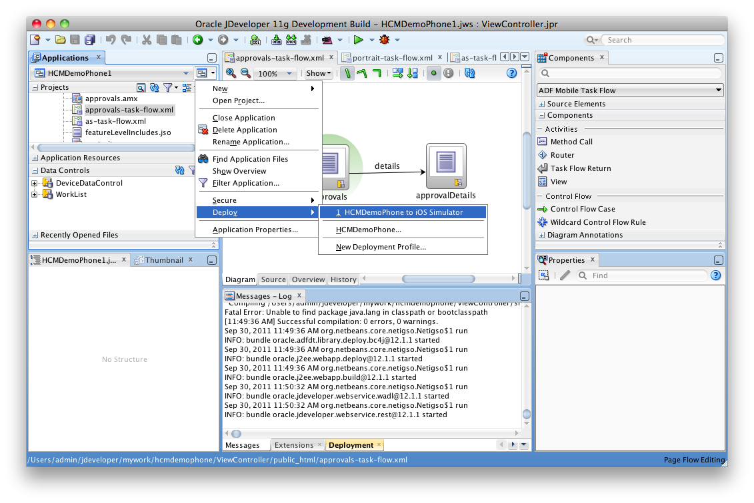
Build Once, Deploy to Multiple Mobile Platforms
Common and meta-data based application definition
Device specific deployment options and packages
Support app store based and third party app provisioning
solutions
Support for market leading
mobile platforms such as
iOS
Supporting mix of local
and remote content

Slide 20
Access and Security
Authentication:
  SSO Integration across Features
  OAM/OID support (i.e. integration with Fusion Middleware)
  Can support offline authentication
Access Control:
  Role based access (show/hide UI)
Encryption:
  Credential store
  Local data
  Communication channels

Slide 21

ADF Mobile Architecture
Device Native Container
ADF Mobile Browser (Trinidad)
HTML5 & JavaScript
Web View
Credential Management,
SSO, & Access Control
ADF Mobile
XML View
Local HTML
Server HTML
ADF Faces RC
ADF Controller
Application
Configuration
Third Party Web Sites
Device Native
View
Managed Beans
Java
Configuration Server
Phone Gap
ADF Model
Web Services (SOAP & REST)
Device
Services
Local Data
Mobile
Device
Server

Slide 22
Availability & Licensing
v1.0 went gold last week (22nd October 2012)
Simply an extension of normal ADF
No additional licenses required
License comes with a purchase of WebLogic Server
If you own WLS, you already have ADF Mobile
Is not covered under the ADF Essentials license

Slide 23
Demo

Slide 24
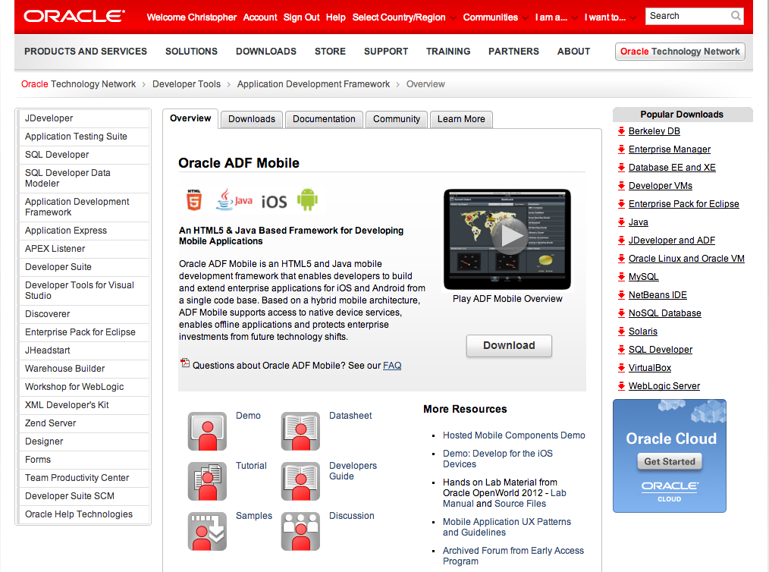
Further Information http://bit.ly/adfmobile

Slide 25
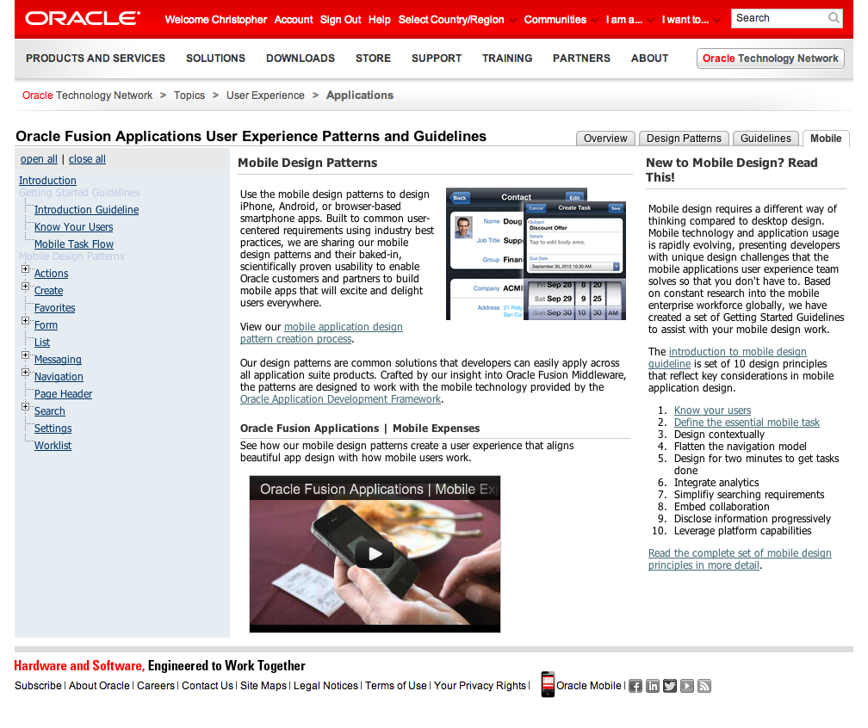
Further Information http://bit.ly/adfmobileuxguidelines

Slide 26



Join the JDeveloper/ADF Community
Twitter
twitter.com/JDeveloper
Facebook
facebook.com/JDeveloper
Oracle’s JDeveloper PM blog
blogs.oracle.com/JDeveloperpm
oracle.com/technetwork/jdev

Slide 27

For More Information
www.oracle.com/jdev
  Tutorials
  Demos
  Software
  Discussions
  Blogs
  And more…

Slide 28
Q&A

