Slide 1
Email AR Invoices To Customers
Presented by Chitra Kanakaraj

Slide 8
Agenda
Introduction
AR Invoicing process in Oracle EBS
Need for AR Invoicing process improvement
Email AR Invoices/Credit Memos
Creating Directory Object in Oracle EBS Server
Code to initiate the BPA Invoice Creation Process
Scheduling concurrent Request in Oracle EBS
Creating Monitor Application using APEX

Slide 9
Abstract
The Oracle EBS Receivables module does not contain standard functionality to email AR Invoices to Customers at present. From the customer’s point of view, this is a vital feature that speeds up Invoice processing time and reduces cost, time and resources - in other words, adds tangible business value to any Oracle EBS customer. But, there is no out-of-the-box solution from Oracle. Our Kiwi slogan “DO IT YOURSELF” has inspired me a lot to come up with a solution for this issue using basic skills like PL/SQL coding and APEX application development. Let’s explore the solution with tips and tricks from a real, live implementation.

Slide 10
AR Invoicing Process In Oracle EBS
Enter and complete the invoice/credit memos
Print the invoices
Put all the invoices into envelopes
Run all the envelopes to the post

Slide 11
Need for AR Invoicing Process Improvement
Invoice Print should have an option to EMAIL the document to the customer if they have an email address defined in the customer master record, communications tab
Not being able to communicate electronically with the customers has an impact on the ability to bill in time and thus has an impact on collecting revenue.
This is one of the top 20 Receivables Enhancements Requests refer:
Bug 6635894
Global Companies awaiting this Enhancement Request

Slide 12
Email AR Invoices/Credit Memos
Customisation = dollars!
This is not a Customisation
This is a PLUGIN

Slide 13
UOW AR Invoices/Credit Memo Statistics per Year
Manual Invoices 4300
System Created Invoices 3000
Not all Invoices are dispatched by post
At least about 2/3rd by post and the rest as an email attachment
4867 out of which approximately 50 posted to Foreign Countries.
Local postage paid per year 4817x0.64 = $3082.88

Slide 14
Email AR Invoices/Credit Memos
Three Main Operations
Create Directory to Access Concurrent Request output files
-DBA JOB-
Scheduled Concurrent Request Running Overnight
-PL/SQL Code-
APEX Monitor
-An Application-

Slide 15
Two Tier Server Architecture
FinDB Server
Oracle Database tier
Oracle Framework Apps tier
O
Oracle User
Applmgr User
Oracle middleware software
Forms/Reports for
Oracle Financials
11g11g Or11acle database
11g Oracle database
Concurrent Manager Running batch job
output
Logs
Read files using PL/SQL File Object

Slide 16
Syntax to Create Directory Object
CREATE OR REPLACE DIRECTORY
CONC_OUT AS
'/u012/orauat12/inst/apps/orauat12_findbapp-ut12/logs/appl/conc/out';
GRANT EXECUTE, READ, WRITE ON DIRECTORY CONC_OUT TO APPS WITH GRANT OPTION;
GRANT EXECUTE, READ, WRITE ON DIRECTORY CONC_OUT TO SYSMON WITH GRANT OPTION;
GRANT READ ON DIRECTORY CONC_OUT TO UOWAPPS;

Slide 17
Code to Initiate the Invoice Creation Process
Identify the current concurrent request that creates AR Invoices/Credit Memos in Oracle EBS
For R12.1.3 the concurrent request short name is ARBPIPMP
One of the inputs for this request is a transaction number.
Collect all completed transaction details made for the day.
Initiate the concurrent request by calling fnd_request.submit_request API
and using the collected invoice number as the input value for each
request call.
Store the request id numbers and the transaction (Invoice) number in a local table. The request id number is the reference for reading out the PDF file later from the concurrent output directory.

Slide 18
Code to Initiate Invoice Dispatch Process
Collect all request id’s stored in the local table
Read all PDF Invoices created for these request id’s and make a copy in a local table for future reference and also to display on the APEX Monitor
Using the Transaction number stored in the local table extract the email address of the customer.
Dispatch the Invoice PDF file stored locally to the extracted email address by using APEX_MAIL.SEND APEX utility

Slide 19
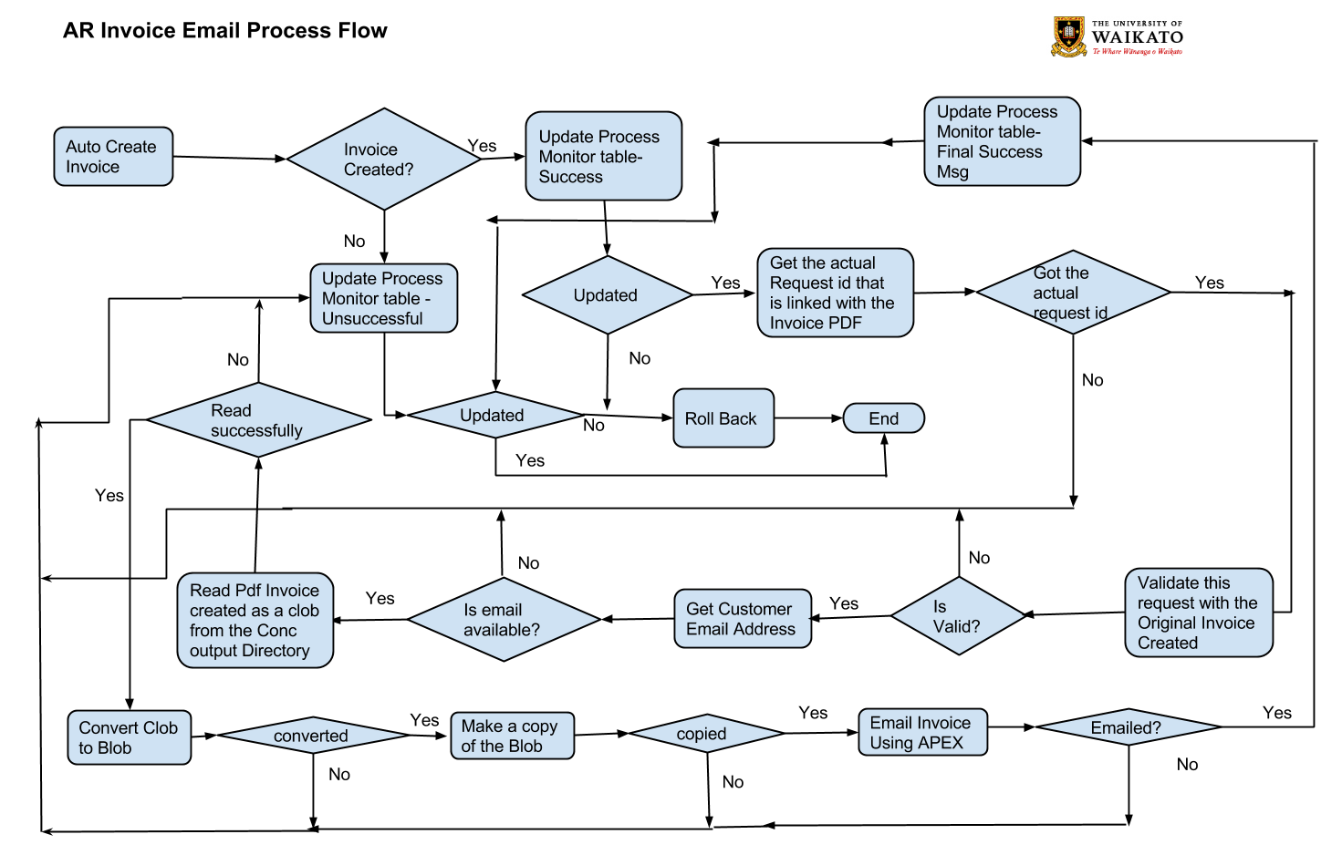
Process Flow

Slide 20
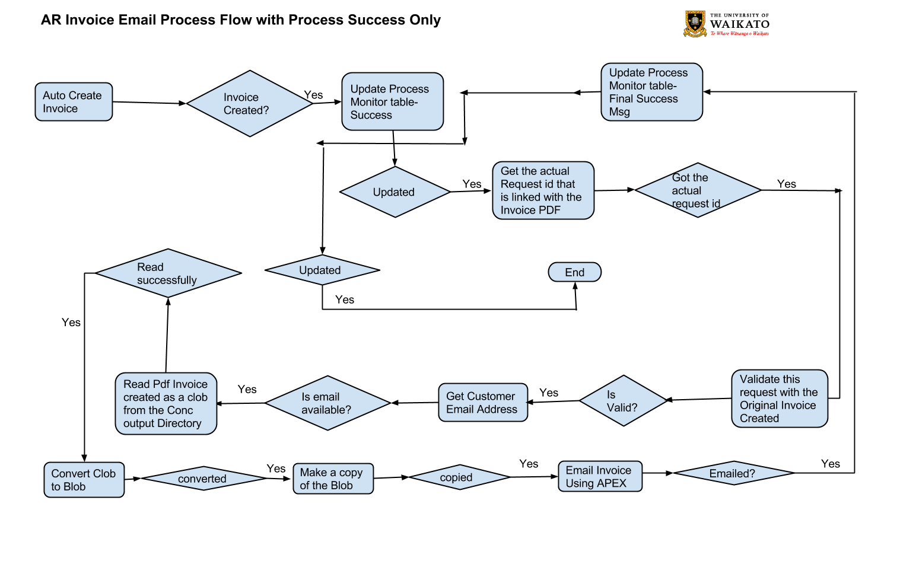
Process Flow

Slide 21
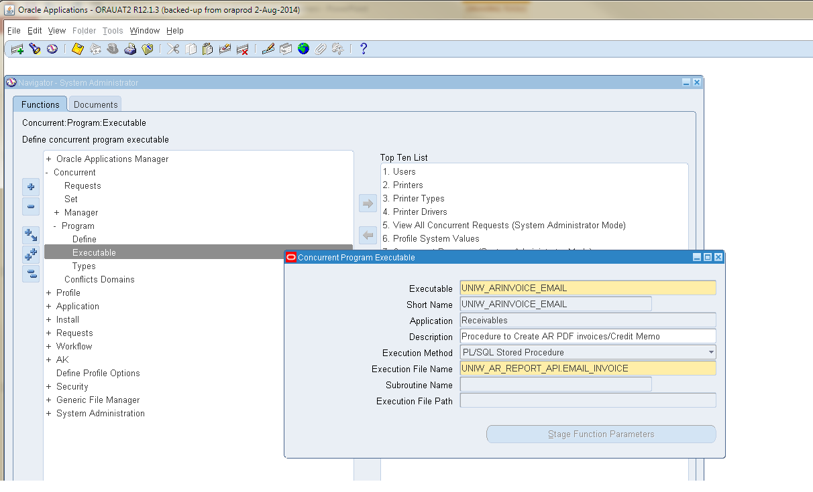
Oracle EBS Concurrent Request Setup

Slide 22
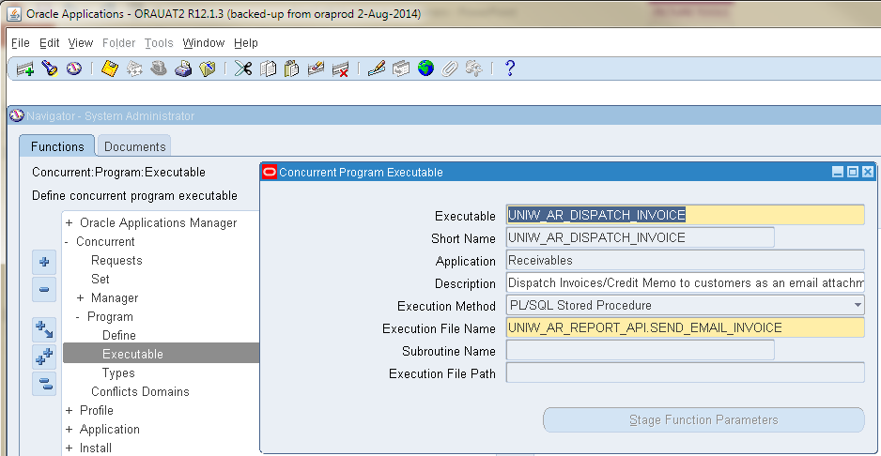
Oracle EBS Concurrent Request Setup

Slide 23
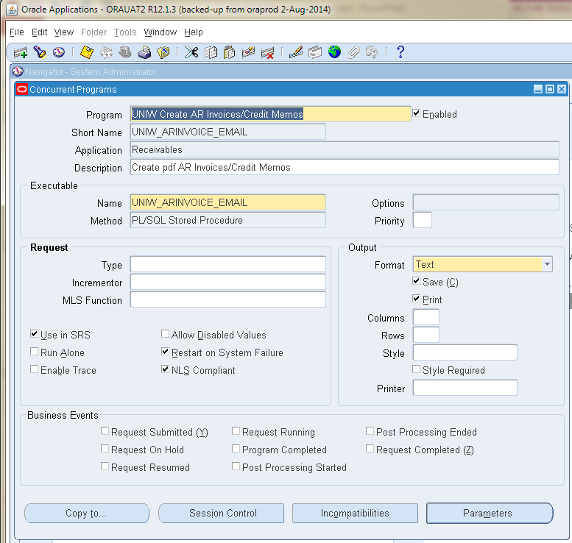
Oracle EBS Concurrent Request Setup

Slide 24
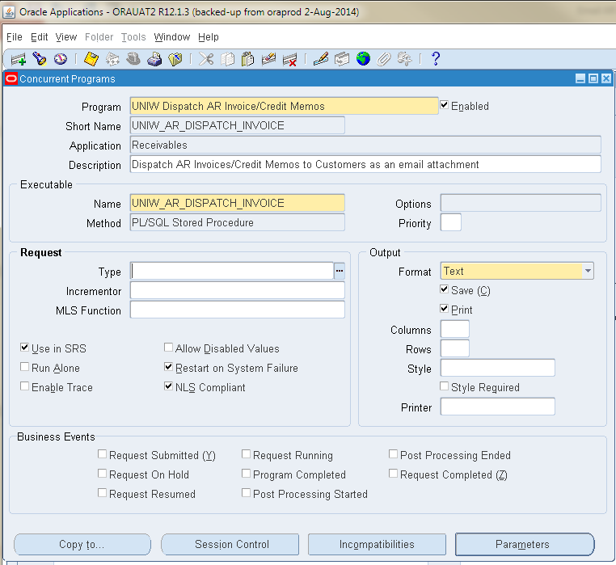
Oracle EBS Concurrent Request Setup

Slide 25
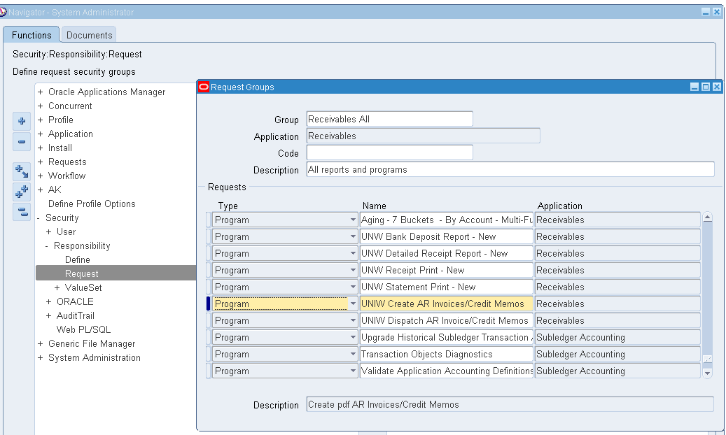
Oracle EBS Concurrent Request Setup

Slide 26
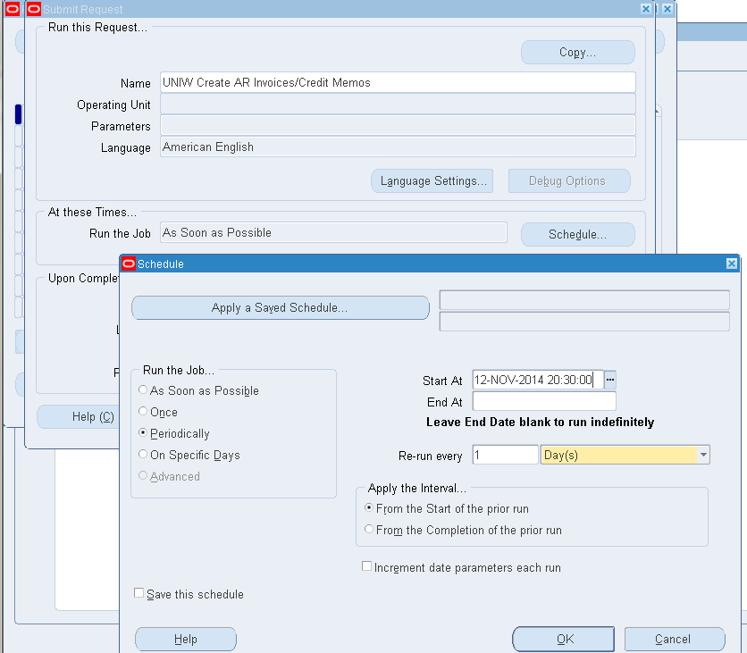
Scheduling Concurrent Request in Oracle EBS

Slide 27
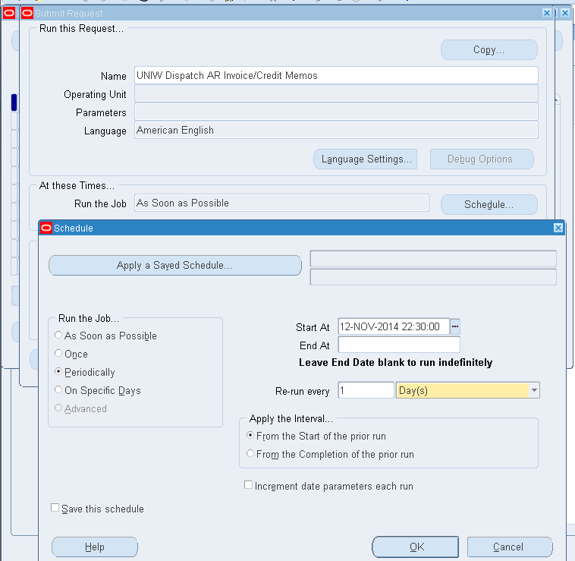
Scheduling Concurrent Request in Oracle EBS

Slide 28
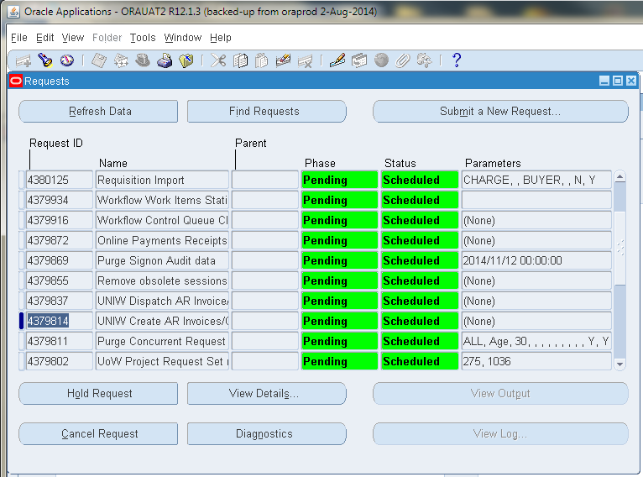
Scheduling Concurrent Request in Oracle EBS

Slide 29
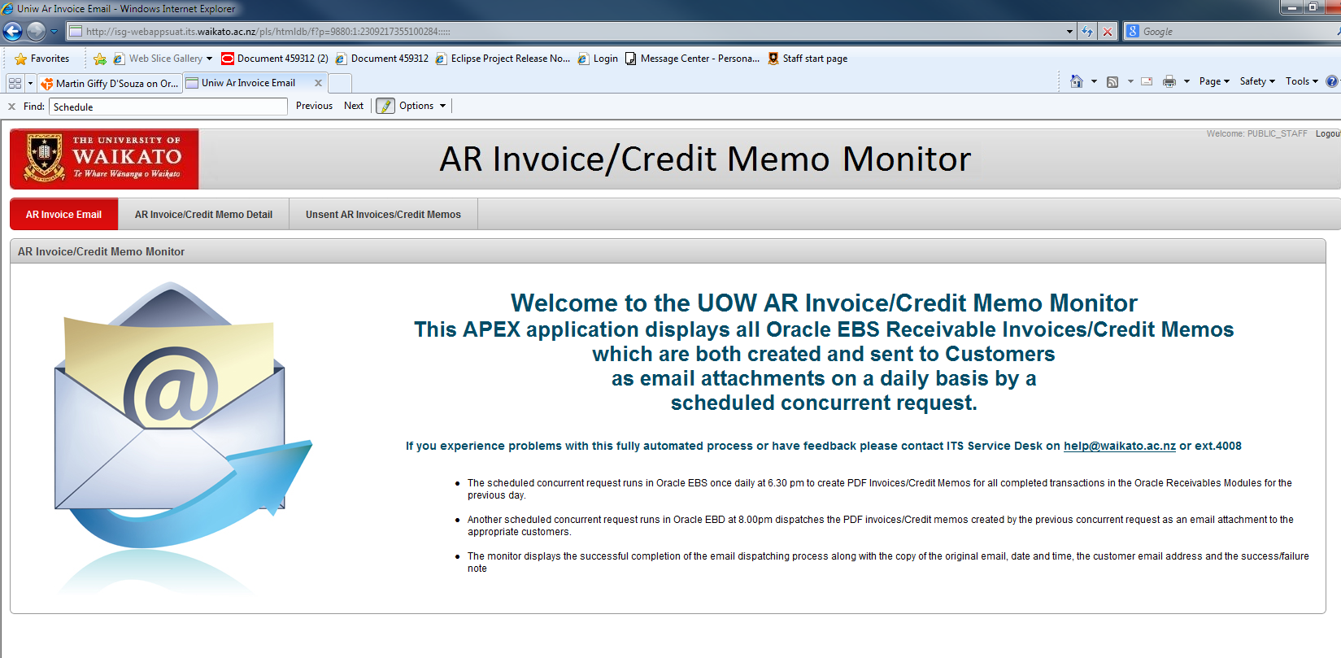
APEX Monitor

Slide 30
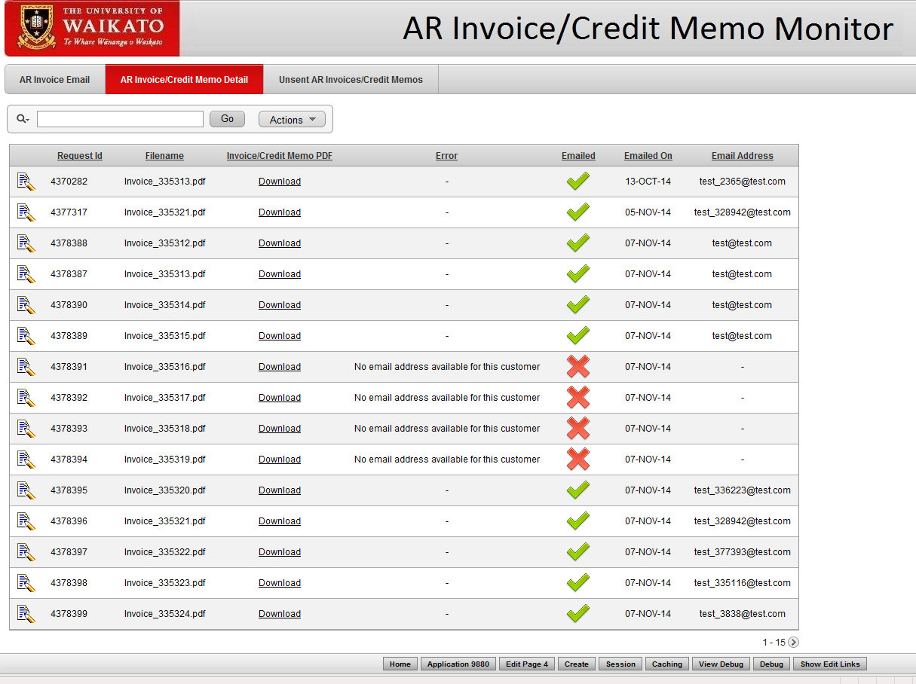
APEX Monitor

Slide 31
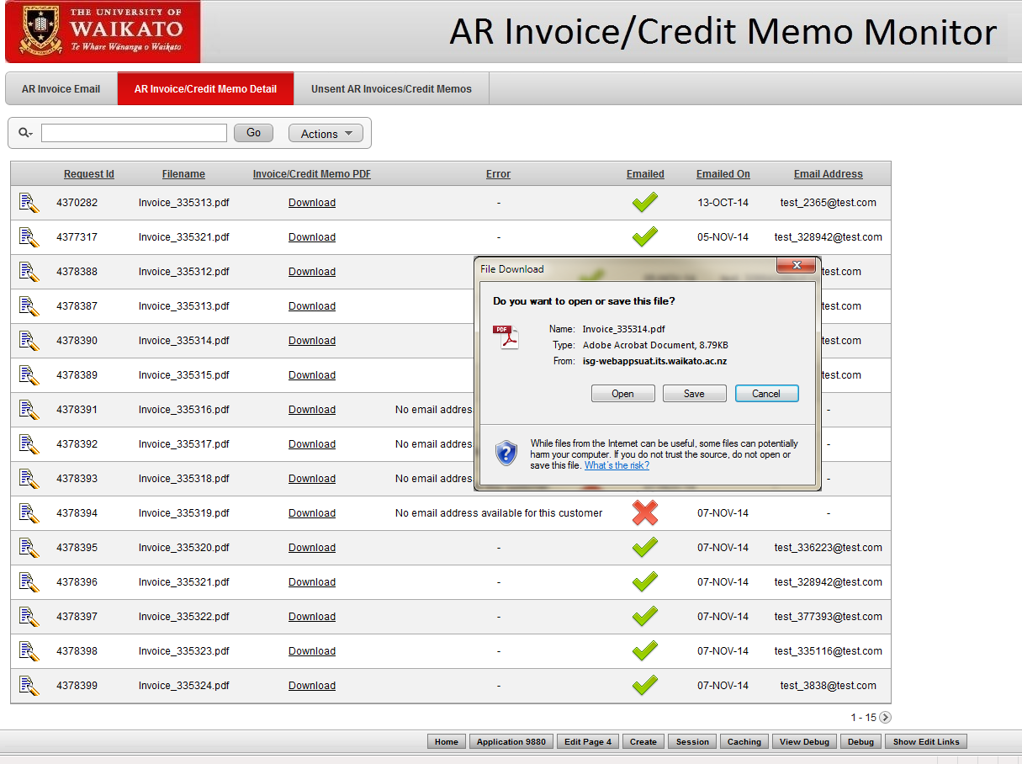
APEX Monitor

Slide 32
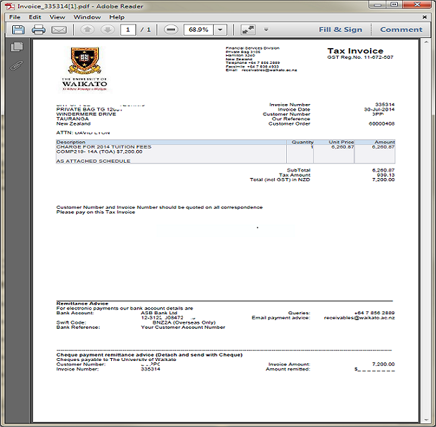
APEX Monitor

Slide 33
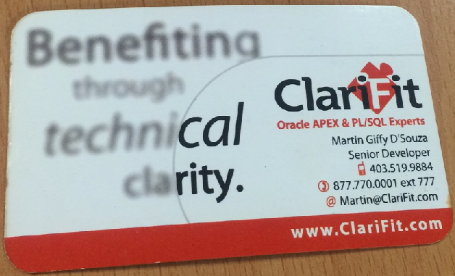
APEX Monitor
What if the Email Address is Incorrect
Martin Giffy D’Souza’s Code
APEX Mail Log

Slide 34
APEX Monitor

Slide 35
APEX Monitor
What if there isn’t any email address available for the selected customer in Oracle EBS
Bulk Upload Customer Email Address in Oracle EBS

Slide 36
Demo
Oracle Financial EBS
APEX Monitor
My Mail Inbox
Enquiries and Code request to Chitra

Slide 37
Questions

Slide 38
End

