Slide 2
The Future of Oracle Forms: Upgrade, Modernize, or Migrate?
Chris Muir
Principal ADF Product Management, Application Development Tools
Notes:
Most Oracle Forms applications contain hundreds of man-years of investment. So what do you do with that investment? Squeeze an extra few years out of your investment by getting on the latest version? Modernize your technologies? Or dump it and migrate to Java, Oracle Application Development Framework (Oracle ADF), Oracle Application Express, or even .NET? Come to this session to meet with some of the leading Oracle Forms experts for an open discussion on the options; costs; risks; and fear, uncertainty, and doubt about Oracle Forms.

Slide 3
Please raise your hand if you work with Oracle Forms.

Slide 5
"Oracle has no plan to discontinue support of Oracle Forms"
Oracle Application Development Tools Statement of Direction: Oracle Forms, Oracle Reports and Oracle Designer
March 2012 - http://bit.ly/oracleFormsSod201203

Slide 7
Conclusion
“Oracle has no plan to discontinue support of Oracle Forms”

Slide 9
Program Agenda
Oracle’s vision, strategy and roadmap
Modernize, upgrade or migrate?
New strategic technologies
More information

Slide 10
Program Agenda
Oracle’s vision, strategy and roadmap
Modernize, upgrade or migrate?
New strategic technologies
More information

Slide 11
Oracle’s Vision for Forms
Clear statement of direction
“Oracle has no plans to discontinue support of Oracle Forms”
http://bit.ly/oracleFormsSod201203
Focus
We will continue to upgrade it with new features
Provide integration points to integrate your other technologies
Open up JEE/standards development to “traditional” Oracle implementers

Slide 12
Our Recommendations for Forms Customers
Protect

Slide 13
Our Recommendations for Forms Customers
Protect
Extend

Slide 14
Our Recommendations for Forms Customers
Protect
Extend
Evolve

Slide 15
Program Agenda
Oracle’s vision, strategy and roadmap
Modernize, upgrade or migrate?
New strategic technologies
More information

Slide 16
You've just told us you're not desupporting Forms.
So why should we change at all?

Slide 17
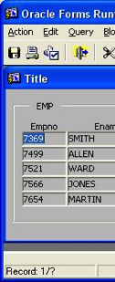
The Changing Nature of Business
1985
1980s
1940s
2000
2007
2013+
Notes:
Oracle Forms started as Interactive Application Facility (IAF), which had two main components: the compiler (Interactive Application Generator - IAG) and the runtime interpreter (Interactive Application Processor - IAP). Released with Oracle Database version 2, IAF provided a character mode interface to allow users to enter and query data from an Oracle database. It was renamed to FastForms with Oracle Database version 4 and added an additional tool to help generate a default form to edit with IAG, the standard tool. The product saw one more name change before gaining its current moniker, called SQL*Forms version 2 with the Oracle 5 database.

Slide 18
BILLION
GLOBAL MOBILE 3G SUBSCRIBERS
18
Copyright © 2012, Oracle and/or its affiliates. All rights reserved.
Notes:
There are now 1.1B Global 3G Mobile Subscribers, ramping quickly at 37% per year. This compares with the approximately 6.1 billion global mobile phone subscribers, so you can see there is tremendous upside growth potential with smartphones as well.
3G includes CDMA 1x EV-DO and Rev. A/B, WCDMA, HSPA; One user may have multiple mobile subscriptions and may be counted as multiple subscriber (per Source: Informa WCIS+.)

Slide 19
Mobility Is a Priority and Challenge for I.T.
Bring Your Own Device (BYOD) Practices in 2011
Top Mobility Challenges for CIOs
By 2015, Mobile usage will surpass pc’s and other wired devices.
74% Allow some sort of BYOD usage.
Securing corporate information
41%
74%
Integrating with other systems
31%
Less than 10% “FULLY AWARE” of the devices accessing their network
10%
Supporting multiple devices
28%
Forbes: Mobile Business Statistics For 2012
CIO Insight: Top Challenges of Enterprise Mobility, 2012
Notes:
Forbes:http://www.forbes.com/sites/markfidelman/2012/05/02/the-latest-infographics-mobile-business-statistics-for-2012/
Forbes: The Latest Infographics: Mobile Business Statistics For 2012
89% have mobile devices such as smartphones or tablets connecting to corporate networks
Apple iOS is the most common mobile platform used to connect in corporate environments
Enterprise tablet adoption will grow by almost 50% per year.
• By 2015 mobile app development projects will outnumber native PC projects by a ratio of 4-to-1.
• The iOS and Android platforms will be adapted to meet enterprise requirements and Windows 8 Tablets will hit the market.
• The introduction of Quadcore to tablets, 4G, Cloud Computing and the continuous adoption of HTML5 will make the tablet even more integrated into the work environment.
How Secure Is BYOD?
Bring your own device (BYOD) versus company purchased device – is a burning debate within the CIO ranks. Some say it’s over, that it’s too late to stop BYOD. I’m not so sure, but the statistics so far point to a less secure BYOD world.
74% of companies allow some sort of BYOD usage*
Less than 10% of organizations are “fully aware” of the devices accessing their network
81% of Employees use at least one device for business use
Main Point: BUSINESS IMPERATIVE: ANYTIME, ANYWHERE ENGAGEMENT
Script:
These trends are undeniable: Mobile Computing continues to grow. Today’s customers are constantly connected and want to engage with your brand when and where they choose, whether on the web or via mobile or social channels.
Users accessing the web through mobile devices has almost doubled every year since 2009. Today’s customers are constantly connected whether on the laptop at the office, the iPad at home or on a mobile phone when on the go. 48% of consumers use their mobile devices to research and browse products and services and they expect their experience to be optimized for the form factor and consistent with the brand experience on your traditional web.
From Ted Schadler – Forrester – “Empower “
“Empower people by focusing on their tasks and context in the moment of a decision.
Customers interact directly with the organization in their moments of decision. Mobile apps and
sites (we call them all “apps” here) let people act — and offer feedback — in those moments. It’s why
25 of the top 30 online US retailers have built native iPhone apps — to capture mobile retail revenue as
it balloons from $6 billion this year to $31 billion by 2016.”
Out of the 6 billion people on the planet 4.8 billion have a mobile and only 4.2 billion own a toothbrush
This equals 87% of the world’s population
China and India account for 30% of this growth
Over 300,000 apps have been developed in the past 3 years alone
If we look at it from a business perspective – just looking at one of the major players: Google earns 2.5 Billion in mobile ad revenue annually.
There are more iPhones sold per day (402k) than people born in the World per day (300k)
http://www.digitalbuzzblog.com/infographic-2012-mobile-growth-statistics/ The purpose of this slide is to describe that Mobility is both a priority and a challenge for most enterprises.
It is a priority since the growth and use of mobile devices is growing at a increasing rate and already estimates predict that over 85% of the worlds’ population already are mobile device subscribers. For the enterprise this means that people are bringing these devices to work – in fact over 74% of companies allow personal mobile devices. Yet in that same study estimates reveal that less than 25 % of those enterprises are actively managing the apps and therefore the data that is being accessed from these mobile devices.
Just consider the challenges this introduces to the enterprise – so it is no surprise that in a recent CIO Insight study reveals that Security remains a top concern, followed by worrying about integrating the mobile apps/devices to the enterprise systems and support of multiple types of devices, platforms, operating systems, etc.
Source of studies are below:
The statistics have been taken from various sources to give us an ideas of the growth and impact that Mobile technologies are having in our lives. :
Source: MobiThinking - http://mobithinking.com/mobile-marketing-tools/latest-mobile-stats LATEST UPDATE (February, 2012):
According to MobiThinking analysts, there are $5. 9 billion mobile subscribers today (that's 87 percent of the world population). Growth is led by China and India, which now account for over 30 percent of world subscribers. Compared to only about 1 billion number of computer users.
45 percent of the world’s population is now covered by a 3G mobile - with faster access to internet and mobile apps.
Source: http://blog.maas360.com/archives/mobilitymanagement/bring-your-own-device/
BYOD practices in 2011
3% of employers do not have a policy
71% of employers ALLOW PERSONAL DEVICES
54% of employees use tablets for both business and personal use
71 +3 = 74% either allow and or don’t have a policy on allowing personal mobile devices
What’s more when looking at how enterprises are managing their applications – less than 25 % have clear plan around how they are managing their apps, their data across all these mobile devices.
And we looked that what are CIO’s main concerns around the growth of mobile technologies – there are top three challenges cited ( according to a recent CIO Insight study)
Source: CIO Insight (Ziff Davis) http://www.cioinsight.com/c/a/Technology/Top-Challenges-of-Enterprise-Mobility/
Top three challenges faced by CIOs are:
Securing corporate information – 41%
Integrating mobile apps with other apps and systems – 31%
Supporting mutliple devices – 28%
So how is Oracle addressing these challenges? Let’s take a look
Main Point: BUSINESS IMPERATIVE: ANYTIME, ANYWHERE ENGAGEMENT
Script:
These trends are undeniable: Mobile Computing continues to grow. Today’s customers are constantly connected and want to engage with your brand when and where they choose, whether on the web or via mobile or social channels.
Users accessing the web through mobile devices has almost doubled every year since 2009. Today’s customers are constantly connected whether on the laptop at the office, the iPad at home or on a mobile phone when on the go. 48% of consumers use their mobile devices to research and browse products and services and they expect their experience to be optimized for the form factor and consistent with the brand experience on your traditional web.
From Ted Schadler – Forrester – “Empower “
“Empower people by focusing on their tasks and context in the moment of a decision.
Customers interact directly with the organization in their moments of decision. Mobile apps and
sites (we call them all “apps” here) let people act — and offer feedback — in those moments. It’s why
25 of the top 30 online US retailers have built native iPhone apps — to capture mobile retail revenue as
it balloons from $6 billion this year to $31 billion by 2016.”
Out of the 6 billion people on the planet 4.8 billion have a mobile and only 4.2 billion own a toothbrush
This equals 87% of the world’s population
China and India account for 30% of this growth
Over 300,000 apps have been developed in the past 3 years alone
If we look at it from a business perspective – just looking at one of the major players: Google earns 2.5 Billion in mobile ad revenue annually.
There are more iPhones sold per day (402k) than people born in the World per day (300k)
http://www.digitalbuzzblog.com/infographic-2012-mobile-growth-statistics/ The purpose of this slide is to describe that Mobility is both a priority and a challenge for most enterprises.
It is a priority since the growth and use of mobile devices is growing at a increasing rate and already estimates predict that over 85% of the worlds’ population already are mobile device subscribers. For the enterprise this means that people are bringing these devices to work – in fact over 74% of companies allow personal mobile devices. Yet in that same study estimates reveal that less than 25 % of those enterprises are actively managing the apps and therefore the data that is being accessed from these mobile devices.
Just consider the challenges this introduces to the enterprise – so it is no surprise that in a recent CIO Insight study reveals that Security remains a top concern, followed by worrying about integrating the mobile apps/devices to the enterprise systems and support of multiple types of devices, platforms, operating systems, etc.
Source of studies are below:
The statistics have been taken from various sources to give us an ideas of the growth and impact that Mobile technologies are having in our lives. :
Source: MobiThinking - http://mobithinking.com/mobile-marketing-tools/latest-mobile-stats LATEST UPDATE (February, 2012):
According to MobiThinking analysts, there are $5. 9 billion mobile subscribers today (that's 87 percent of the world population). Growth is led by China and India, which now account for over 30 percent of world subscribers. Compared to only about 1 billion number of computer users.
45 percent of the world’s population is now covered by a 3G mobile - with faster access to internet and mobile apps.
Source: http://blog.maas360.com/archives/mobilitymanagement/bring-your-own-device/
BYOD practices in 2011
3% of employers do not have a policy
71% of employers ALLOW PERSONAL DEVICES
54% of employees use tablets for both business and personal use
71 +3 = 74% either allow and or don’t have a policy on allowing personal mobile devices
What’s more when looking at how enterprises are managing their applications – less than 25 % have clear plan around how they are managing their apps, their data across all these mobile devices.
And we looked that what are CIO’s main concerns around the growth of mobile technologies – there are top three challenges cited ( according to a recent CIO Insight study)
Source: CIO Insight (Ziff Davis) http://www.cioinsight.com/c/a/Technology/Top-Challenges-of-Enterprise-Mobility/
Top three challenges faced by CIOs are:
Securing corporate information – 41%
Integrating mobile apps with other apps and systems – 31%
Supporting mutliple devices – 28%
So how is Oracle addressing these challenges? Let’s take a look

Slide 20
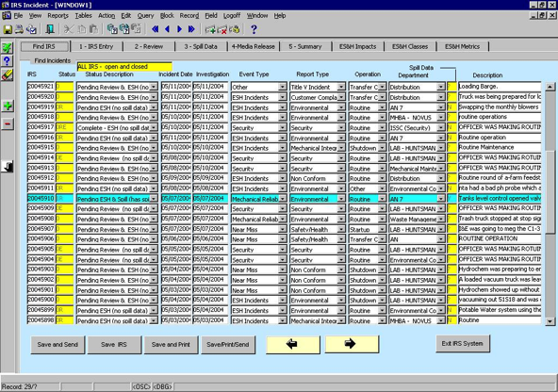
"But how do we modernize this?"
Notes:
Oracle Forms started as Interactive Application Facility (IAF), which had two main components: the compiler (Interactive Application Generator - IAG) and the runtime interpreter (Interactive Application Processor - IAP)

Slide 21
Paths to Modernization
Upgrade
Exploit new features
Integrate technologies
UI modernization
Complete rewrite

Slide 22
Paths to Modernization
Upgrade
Exploit new features
Integrate technologies
UI modernization
Complete rewrite
Oracle Forms 11gR1 and 11gR2 are the current releases (12c coming soon)
10g to 11g is a smooth upgrade
Well trodden path from C/S to web
Most code upgrades without change
Other changes are well understood
Exploit new features of centrally managed application

Slide 23
Paths to Modernization
Upgrade
Exploit new features
Integrate technologies
UI modernization
Complete rewrite
Primary reason to upgrade:
Stay supported, certified and secure

Slide 24
Paths to Modernization
Upgrade
Exploit new features
Integrate technologies
UI modernization
Complete rewrite
11gR1 - External events (AQ), JavaScript integration, database proxy user support, new EM integration, runtime and diagnostic features
11gR2 - Integration with OAM, RUEI, reduced footprint, additional certifications
OVAB 11.1.1.6 + patch #15492477
WLS features - EM, logging, diagnostics, web services, mobile, ADF, OAM, Web Center

Slide 25
Paths to Modernization
Upgrade
Exploit new features
Integrate technologies
UI modernization
Complete rewrite
Forms 11g runs on WLS
Integrate with external web services
SMS, email, credit check, file system
Integration with other applications
CRM, HR, Siebel, Peoplesoft
A way of adopting new technologies
Web services, SOA, BPM, Java, ADF

Slide 26
Paths to Modernization
Upgrade
Exploit new features
Integrate technologies
UI modernization
Complete rewrite
Call out to web services from Forms
Java importer wraps web service client proxy
React to 3rd party events
When-Event-Raised trigger
Listens for events from a queue
Oracle Forms
Web service
External event

Slide 27
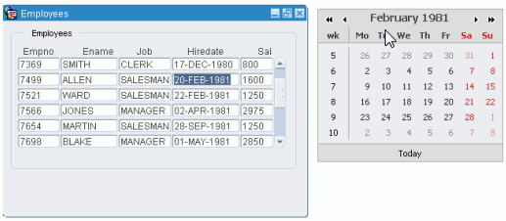
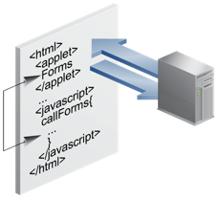
Paths to Modernization
Upgrade
Exploit new features
Integrate technologies
UI modernization
Complete rewrite
JavaScript can call into Forms
When-Customer-Javascript-Event
Call JavaScript from Forms
Web.JavaScript_Eval()

Slide 28
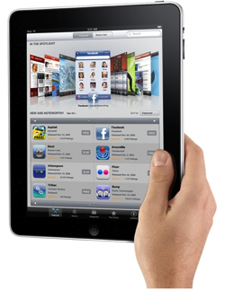
Paths to Modernization
Upgrade
Exploit new features
Integrate technologies
UI modernization
Complete rewrite
Users are now driven by their experiences with the web and mobile
They just expect more!

Slide 29
Paths to Modernization
Upgrade
Exploit new features
Integrate technologies
UI modernization
Complete rewrite
60min Forms Makeover
Java Beans - Introduce non-native UI elements into Forms
PJC - Extend existing Forms UI components
JavaScript - Integrate with JavaScript features

Slide 30
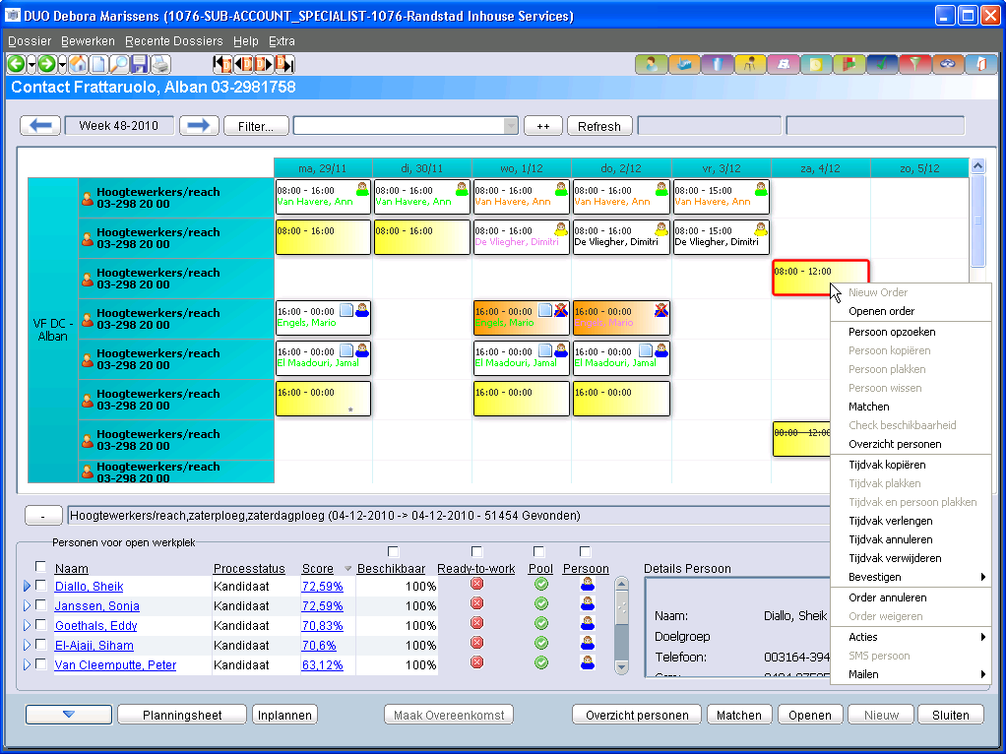

Slide 31
Paths to Modernization
Upgrade
Exploit new features
Integrate technologies
UI modernization
Complete rewrite

Slide 32
Migration or Rewrite
Leaving Forms behind
Questions you must be asking
What are the business drivers?
What is this REALLY going to cost?
Am I fully aware of my options?
Are my staff skilled up for change?
Am I aware of architecture changes?
Will the change suit my end users?
Am I building for the future or to past?
A hundred other questions!

Slide 33
Migration or Rewrite
Different approaches to change
Big bang
Throw away everything and start again
“Automagic/one button” migration
Reached end of life anyway
Phased
Hybrid co-existence
Exploit common code (where it make sense!)
New technologies to become a common touch point
Manual redevelopment

Slide 34
Program Agenda
Oracle’s vision, strategy and roadmap
Modernize, upgrade or migrate?
New strategic technologies
More information

Slide 35
New Strategic Technologies
IDM / BI
ExaLogic
Opening up JEE technologies
Java developers, Forms developers, database developers, mobile application developers, SOA developers, Web 2.0 developers...
Our history with Oracle business applications
Oracle ADF underpins Fusion Applications and Middleware
ADF Mobile allows cross platform iOS & Android development
BPEL, BPMN,
BAM
ERP
HCM, CRM
ADF
Content
Data Integration
Business
Intelligence
Collaboration
Blog - Tag
Social Activity

Slide 36
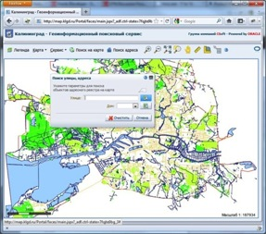
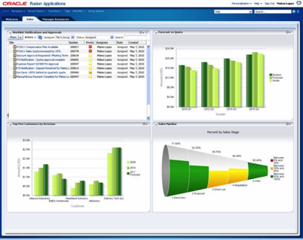
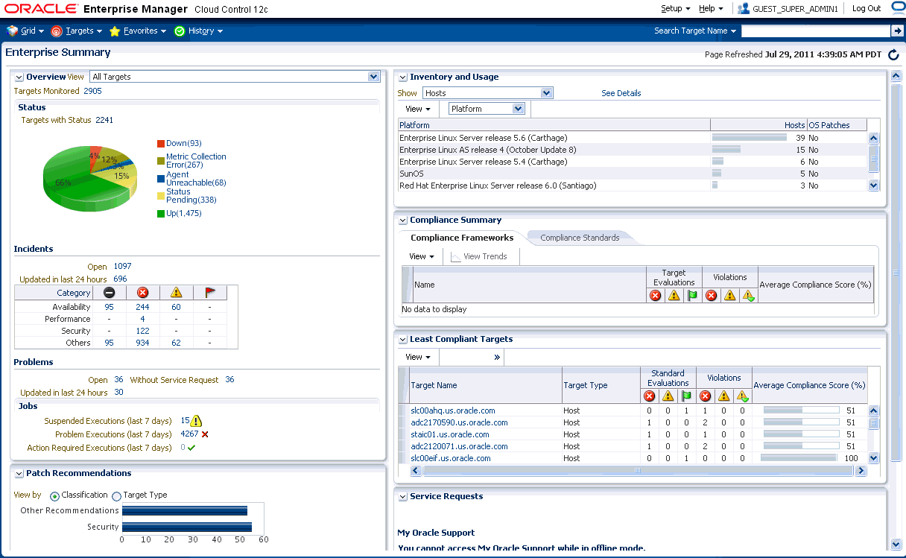
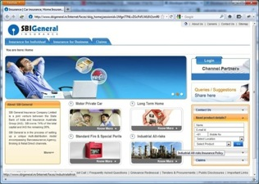
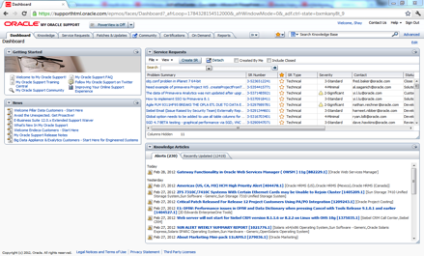
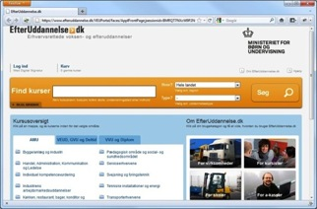
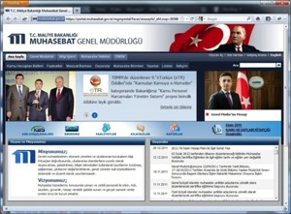
New Strategic Technologies
IDM / BI
ExaLogic
BPEL, BPMN,
BAM
ERP
HCM, CRM
ADF
Content
Data Integration
Business
Intelligence
Collaboration
Blog - Tag
Social Activity

Slide 37
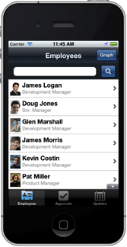
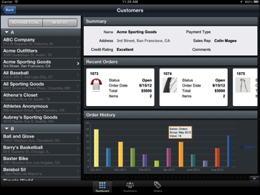
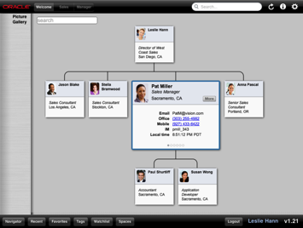
ADF Mobile
Cross iOS & Android development
Native-hybrid mobile applications
Thin localized JVM
Notes:
Well, after looking at the different features of the framework, let’s look at the ADF Mobile client side architecture.
ADF Mobile-based applications would have a thin native layer targeted for each platform. This basically allows the application to install as a native application, as well as host device-native modules such as PhoneGap and Java Virtual Machine.
For device services integration, PhoneGap is added to the framework to provide a common interface to a variety of device services.
User interface is based on HTML5 and JavaScript. These are running inside a webview in the native container.
ADF Mobile also embed a lightweight and headless JVM. This JVM is embedded into each instance of the application, and provides Java support.
Lastly, application contents are packaged as features. A feature is a group of functionality within an ADF Mobile application. An example of the artifacts within a feature maybe a taskflow and a few AMX based screens, or may simply point to a local HTML or Remote HTML page. It contains icons, images, and names that are used when application renders the features. Whether a particular content within a feature shows up is governed by constraint. For example, you may have one feature that has two content types or taskflows – one content for the smartphone, and one for the tablet. You can set up constraint so the appropriate content is delivered for the intended target.
The features are packaged into feature archive, or FAR files. An application may be composed of one or more of these application archives.
This is a great feature to support modularity. For example, you may implement a feature and feature archive for account management for a sales app, and then an employee gallery for a HR app. If you need to create a mobile app that contains both account management and employee gallery, you can simply import the two feature archives from these apps, and create a new application that delivers both functionality.

Slide 38
Program Agenda
Oracle’s vision, strategy and roadmap
Modernize, upgrade or migrate?
New strategic technologies
More information

Slide 39
More Information
Online content on Forms OTN Page (Google Oracle Forms)
Statement of direction
Oracle Forms 10 Years Younger (Oracle Forms Makeover)
Oracle Forms webcasts
Migration from Forms to Java or Apex

Slide 40
Key Points to Take Away
Oracle has no plans to desupport Oracle Forms
You have many options to modernize your investment
Allow the business and customers drive the change, not IT
Protect, extend, evolve
ADF underpins our Fusion Applications and Middleware strategy

Slide 41
Join the JDeveloper/ADF Community
Twitter twitter.com/JDeveloper
Facebook facebook.com/JDeveloper
Oracle’s JDeveloper PM blog blogs.oracle.com/JDeveloperpm
oracle.com/jdev

Slide 42
For More Information
www.oracle.com/jdev
Tutorials
Demos
Software
Discussions
Blogs
And more…
Notes:
You can also use www.oracle.com/adf for ADF specifically

Slide 43
Q&A

