Slide 1
Inside the Exalytics
Osama Mustafa
Gurus Solutions

Slide 2
About Me
Oracle ACE.
Oracle OCP,OCE,OCS …
Certified Ethical Hacker.
Fusion Middleware Specialist.
RAC-ATTACK Organizer around the world.
Speaker in Oracle User Group.
Author for the book : Oracle Penetration Testing.
Technical Reviewer for Oracle books.
Published Articles in different Magazine.
Blogger.

Slide 3
Gurus Solutions
Guru Solution was founded in 2004 and it’s market leader in IT Consulting.
Focusing on Oracle and Operating system.
Oracle BI
Fusion
Middleware
Database
Operating
System
Training
Gurus Solutions Gives you a better idea about your solutions
https://www.gurussolutions.com/

Slide 4
Agenda
Oracle Exalytics Overview.
What components come with Exalytics ?
Installation and Delivery Process.
OBIEE On Exalytics
Timesten On Exalytics.
Oracle Exa Famliy.

Slide 5
"Everything runs faster if you keep it in DRAM, when you keep it in main memory," Ellison said. "So we decided to put together a piece of hardware and a piece of software where the database is parallel and in–memory and the machine itself is all fully parallel."

Slide 6
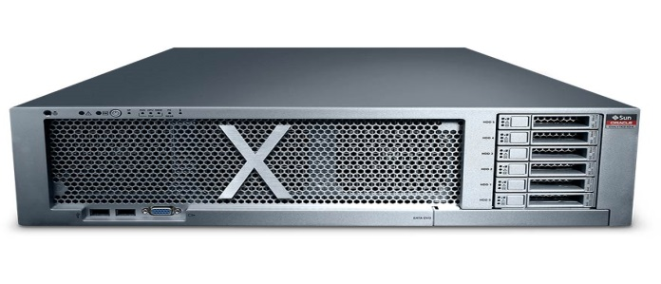
Oracle Exalytics overview.
Oracle Exalytics In-Memory Machine is the industry’s first engineered in-memory analytics machine that delivers no-limit, extreme performance for Business Intelligence and Enterprise Performance Management applications.
Oracle Exalytics In-Memory Machine hardware is an optimally configured server architected to enable in-memory analytics for business intelligence workloads and includes powerful compute capacity, abundant memory, fast storage and fast networking options, and also supports direct attached storage options.

Slide 7
The memory and storage is matched with the right amount of compute capacity. Oracle Exalytics high-speed processors provide excellent single-thread performance as well as support high-thread concurrency. These processors are matched with operating systems (Oracle Enterprise Linux ).
More than one instance means → OVM.
The reason why performance is to extreme is that the Exalytics architecture is designed to store your business intelligence data in main memory, this means response time is dramatically faster with no network latency or disk I/O.

Slide 8
Even if you data store in database, you still can use exalytics Because the TimesTen in-memory database is populated through the Oracle BI 11g Server, the underlying data can be stored in just about any type of database.
Caching data into in-memory database can be done while application is running, if a new BI Dashboard is published during the week then you can dynamically start caching the underlying data into the TimesTen in-memory database without any downtime.
BI Server caching is optimized for lots of small results sets whereas TimesTen in-memory database can handle upto 5TB of cached data

Slide 9
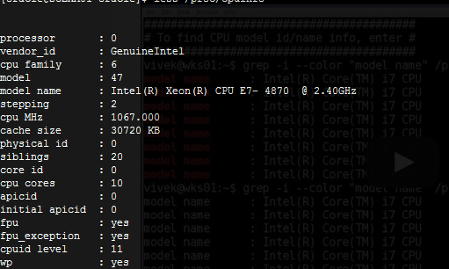
CPU
Memory

Slide 10
Storage
Operating system

Slide 11
What components come with Exalytics ?
The following software runs on Exalytics:
Oracle Business Intelligence Foundation Suite.
Oracle TimesTen In-Memory Database for Exalytics.
Oracle Endeca Information Discovery.
Exalytics-Powered App Demo
http://www.youtube.com/watch?v=oLLic4ytFsw

Slide 12
Installation and Delivery Process
First it’s configured and installed by Oracle ACS over 2 days.
Day #1 :- Unpacking, Racking, networking, RAID ……
Day #2 :- Software
Operating system usually Oracle Linux.
Oracle Weblogic.
Oracle OBIEE 11g for exalytics..
Oracle Timesten for exalytics.
Post installation Process ACS:-
Creating Initial Timesten DB.
Configure OBIEE 11g → include patching.
My Work :-
Configure RPD.
Configure Timesten Caching, Schema, Security , Datasource … etc.
Connecting RPD to Timesten.

Slide 14
Oracle Business Intelligence Foundation Suite
Oracle’s Business Intelligence platform, part of Oracle Fusion Middleware 11g.
Built on Oracle WebLogic Server.
BI Presentation Server delivers dashboards, reports, alerts, web service integration.
Oracle Business Intelligence Foundation Suite also includes Oracle Essbase - the industry leading multi-dimensional OLAP Server for analytic applications.
If you already have OBIEE 11g and need to use Exalytics migrated is your option.

Slide 15
Exalytics Usage Advantage :-
Ease of Installation & Maintenance.
Enhanced Presentation Features.
Perfect Performance.
Ease of Installation & Maintenance
As any Fusion middleware Exalytics contains Weblogic, OBIEE and Timesten
Enhanced Presentation Features
All the data will be cached in-memory
Perfect Performance.
Server Specification is high, perfect combination of two softwares.

Slide 16
Performance Comparisons
OBIEE On Exalytics | Oracle DB | Exdata
Response Time | 18X | 23X
Essbase on Exalytics | Performance
Essbase Response Time | 16 X
Essbase Read | 80 X
Essbase Write | 20 X
Planning Response Time | 20 X
Forecasting | 16 X

Slide 17
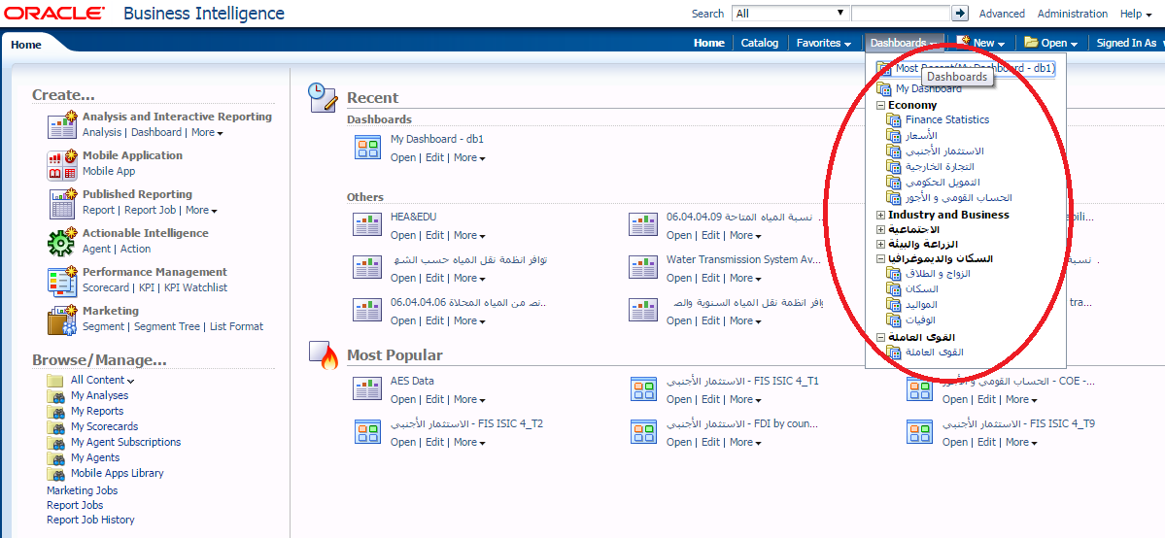
OBIEE Presentation Page ( User Page ).

Slide 18
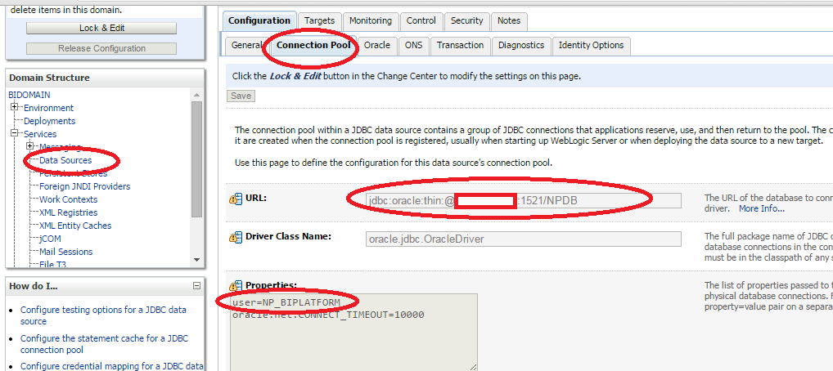
Console Page for OBIEE

Slide 19
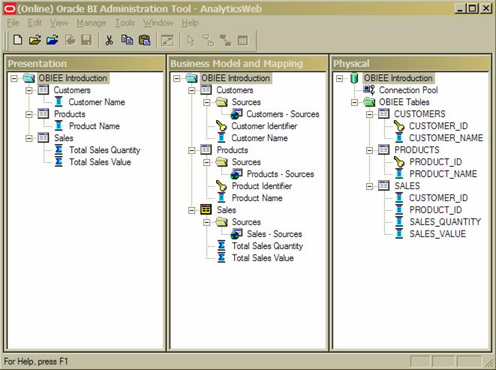

Slide 20
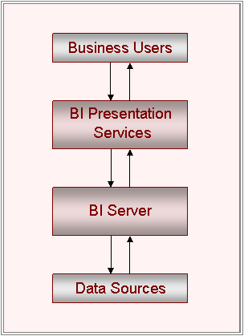
How OBIEE Works

Slide 21
Users request data through analyses, which translate into logical SQL requests
The BI Presentation Services receive the selection of presentation items made by a business user very simple SQL query, and forwards it to the BI Server.
The Oracle BI Server converts these logical SQL requests into one or more physical SQL, MDX or other queries.
These are then processed by the underlying data sources, using their optimizations.
Data is then combined and returned to users in the form of dashboards

Slide 22
OBIEE caching vs TimeSten caching
Both are different Concept.
BI Server caching is for caching the end results of "Logical SQL" queries.
TimesTen in-memory database caches data in structures that resemble the Business Model in your RPD.
BI Server caching is optimized for lots of small results sets whereas TimesTen in-memory database can handle upto 5TB of cached data.
BI Server caching is also a file-based cache, whereas TimesTen data will reside totally in RAM.
You can Use OBIEE caching on exalytics which will be another benefits beside In-memory database.

Slide 23
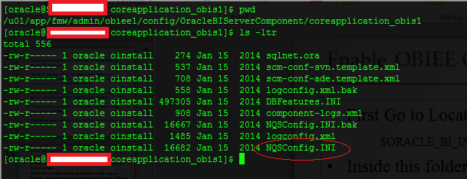
Enable OBIEE Caching
First Go to Location :-
$ORACLE_BI_INSTNACE/config/OracleBIServerComponent/coreapplication_obis1
Inside this folder, File Called NQSConfig.INI this file contain parameters for OBIEE.

Slide 24
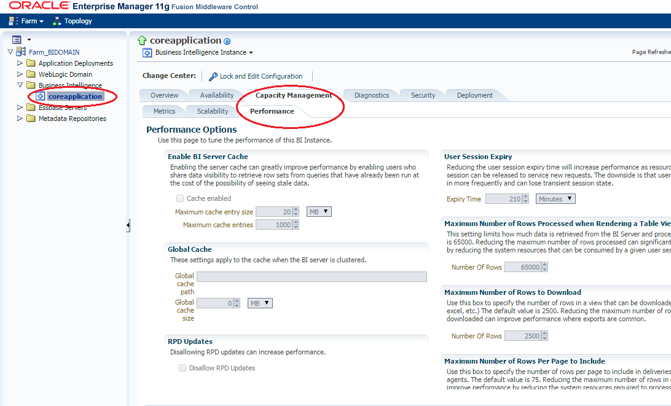
With Any Editor Search for “Query Result Cache Section”
Enable=Yes
Restart the services.

Slide 25
Oracle OBIEE Essbase
Oracle Essbase is an OLAP (Online Analytical Processing) Server that provides an environment for deploying pre-packaged applications or developing custom analytic and enterprise performance management applications. Oracle Essbase, along with Oracle BI Suite Enterprise Edition Plus, is part of the Oracle BI Foundation.
Essbase gets its name from Extended Spreadsheet Database and is commonly accessed via a spreadsheet add-in that provides users the capability to analyze information within a familiar environment such as Microsoft Excel

Slide 26
OBIEE Summary Advisor
The Summary Advisor is a tool that :-
evaluate the collected statistics (Cache hits are ignored)
recommend aggregates
and creates an aggregate persistence script

Slide 27
OBIEE nqcmd
nqcmd is an ODBC client tools for BI Server that is named
nqcmd.exe / Linux
nQCmd.exe / Windows.
Queries with many thousands of rows will not work with nqcmd.
You can use nqcmd to run queries against other ODBC data sources than the Oracle BI Server
You can run nqcmd.exe from :-
the Command Line prompt
Job Manager utility

Slide 28
How to use nqcmd Linux Version
If bash profile does not include variables needed then you will have to run this script first :-
Location :-
$ORACLE_INSTANCE/bifoundation/OracleBIApplication/coreapplication/setup/
Then
source bi-init.sh Or ./bi-init.sh
Back to OBIEE home:-
$ORACLE_MW/ORACLE_BI1/bifoundation/server/bin
Inside the folder Run nqcmd.

Slide 29
nqcmd –d dsn –u username –p password –s sql_input_file –o result_file
Example :-
nqcmd -d DsnExample -u weblogic -p mypassword
Sql Commands
To clear Cache : Call SAPurgeAllCache()
s sql_input_file_name
The name and path of a text file that includes your test SQL queries.
o result_file
The name and path of a file to which the utility will write the query results. This option is only used with -s.

Slide 30
Oracle In-memory Timesten database
Oracle Timesten Stores all its data in memory so there is no disk overhead.
TimesTen has been used for applications which require lightning fast real-time data management. For example: Banks would use TimesTen to do fraud checks in a fraction of a second.
With Exalytics TimesTen has been enhanced to support analytical processing for business intelligence queries.
Oracle BI 11g queries will be directed against the TimesTen in-memory database cache rather than your underlying data sources.

Slide 31
Oracle Timesten Architecture on Exalytics
Oracle BI Sever Communicate with Timesten Through Timesten Client.
Summary Advisor & nqcmd used by Oracle BI server to access Timesten.
ODBC configured on Timesten level.
Summary Advisor
Oracle BI
nqcmd
ODBC
Timesten

Slide 32
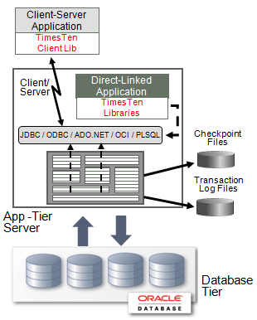

Slide 33
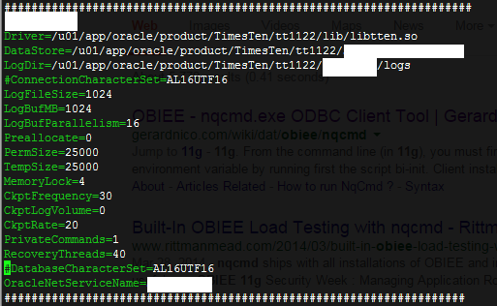
/u01/app/oracle/product/TimesTen/tt1122/info
vi sys.odbc.ini

Slide 34
Oracle Timesten
What happens if I load data more than Timesten memory capacity ?
Simply you cannot, TimesTen is designed to work with all data in memory, for example if timesten 500GB allocated to your data then you will not be able to load in more than this. If you try then you'll get an error!

Slide 35
Oracle Timesten
What happens if I reboot the machine/Exalytics is data will be lost ?
Ok it’s in-memory database, but the data also stored on disk. So if you reboot the Exalytics machine then you won't lose your data! When you start up the TimesTen services after the reboot it will load all the data from disk into main memory.

Slide 36
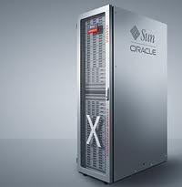
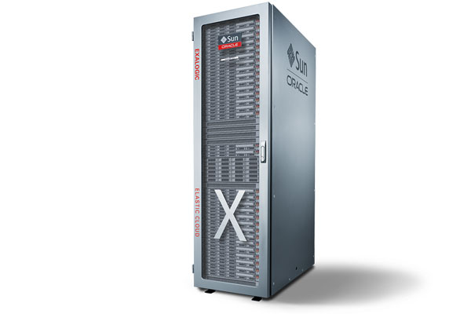
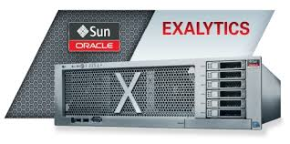
Oracle Exa Family
Oracle Exadata best for :-
Data warehousing
Database consolidation
Oracle Exalogic best for :-
Cloud computing
Application consolidation
Oracle Exalytics best for :-
Business intelligence
Financial system
operational planning

Slide 37
osama.mustafa@gurussolutions.com
@OsamaOracle
http://osamamustafa.blogspot.com
Osama Mustafa

