Slide 1
Oracle Enterprise Manager – Cloud Control 12c
Simon Keys, The Small Ronnie
Martin Lambert, The Large Ronnie

Slide 2
4,000,000
development hours
200 major features
500
enchancement
requests
100,000 regression tests
every night

Slide 3
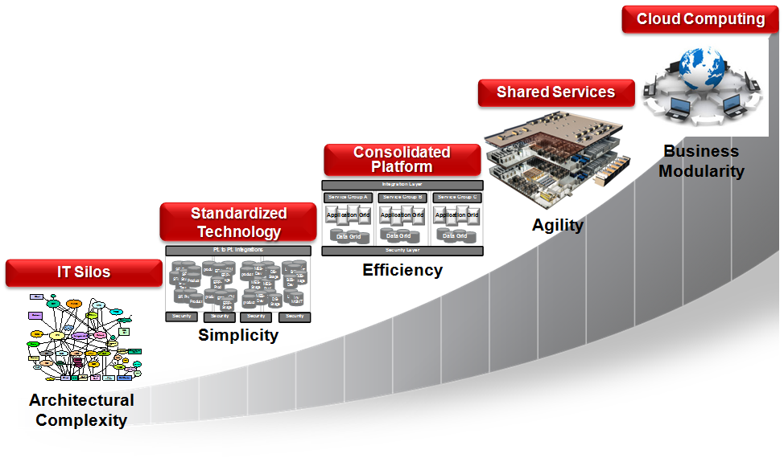
Roadmap to Database Cloud
Cloud
Customers
DBaaS
Customers
Consolidation
Customers
Oracle DB-as-a-Service
Oracle DB Service Catalog
Consolidate on optimized platforms e.g. Exadata
Standardize on Oracle
Heterogeneous DB Environments

Slide 4
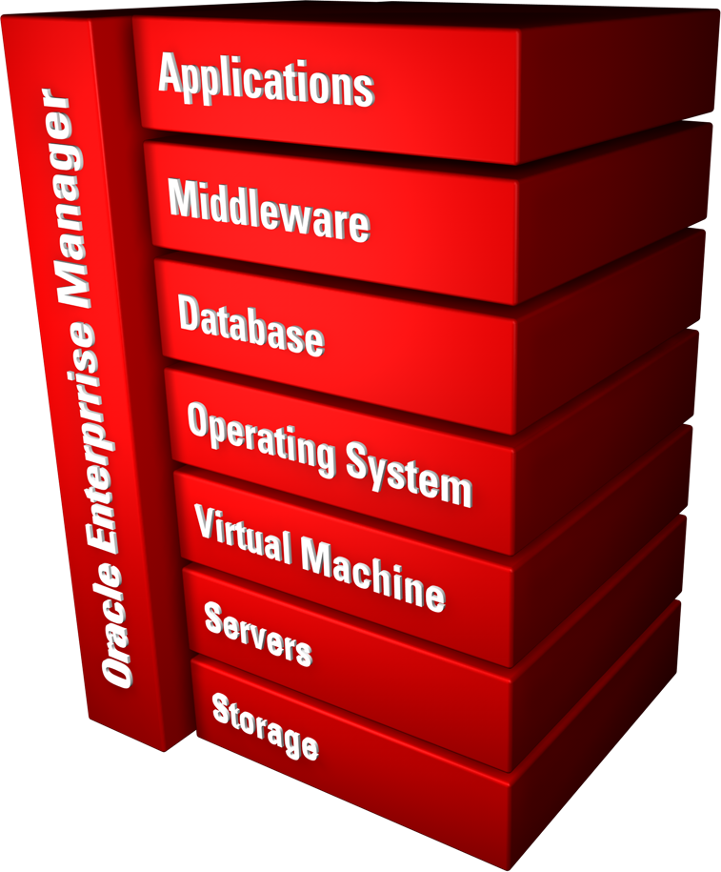
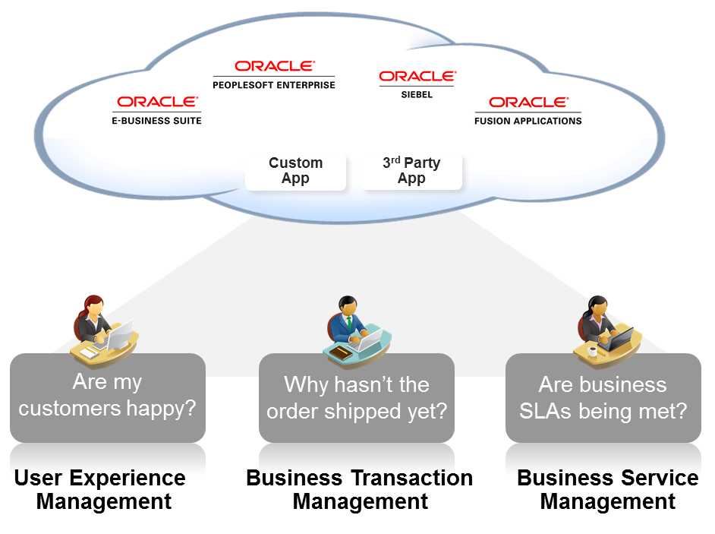
Total Cloud Control
Complete Lifecycle Management
Integrated Cloud Stack Management
Business-Driven Application Management
Self-Service IT
|
Simple and Automated
|
Business Driven

Slide 5
MANAGING DATABASES IN PRIVATE CLOUDS
ENGINEERED SYSTEMS
DATABASE CLOUD SERVICES
PERFORMANCE
CHANGE MANAGEMENT
Deliver Highest Service Quality with Lowest Risk & Effort

Slide 6
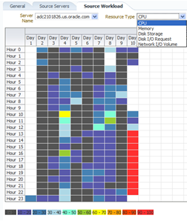
Consolidation Planner
Leverages resource utilization and configuration data from Enterprise Manager repository
CPU, memory, storage, network
Over a representative period
Administrator specifies servers and constraints for workload migration
Physical/virtual servers
Existing/planned servers
Business/technical constraints
Detailed analysis on different scenarios of consolidated workloads

Slide 7
Consolidation Planner
Notes:
E9604126690&userreg=n

Slide 8
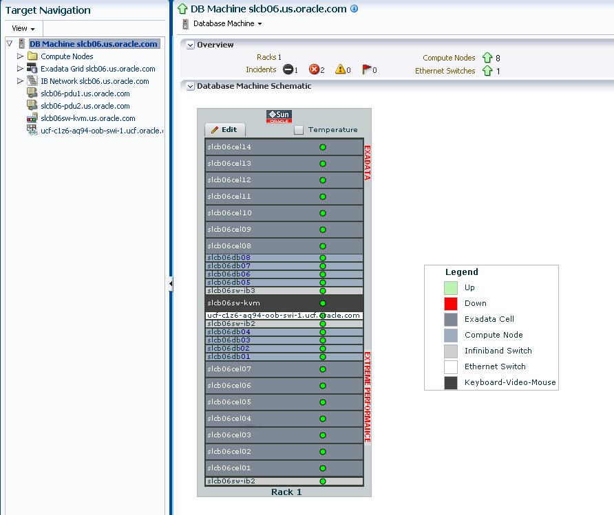
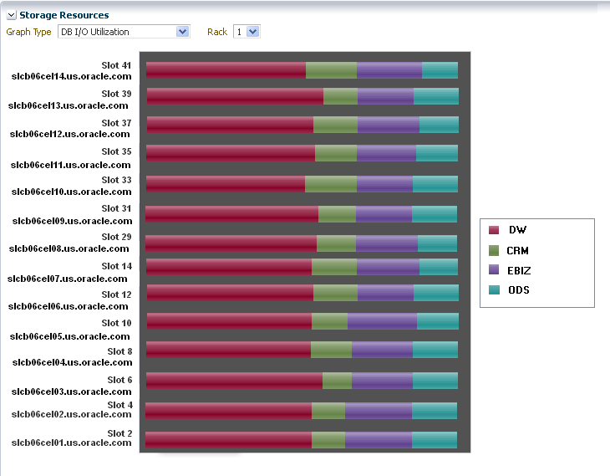
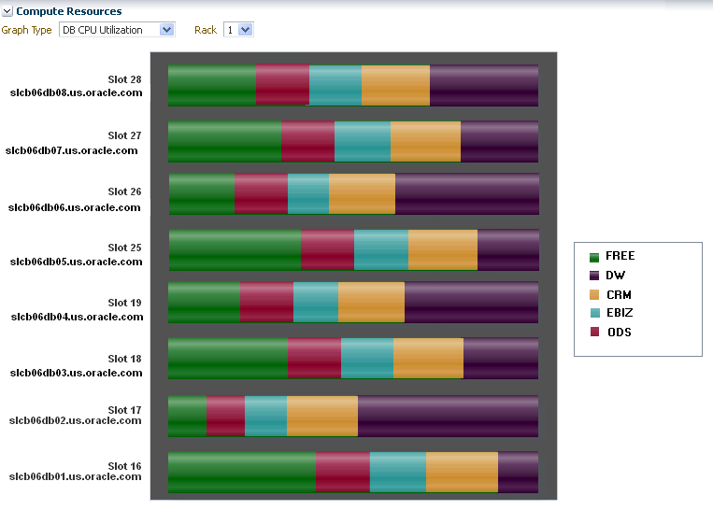
Exadata Management Integrated Management of Hardware and Software
Hardware view
Schematic of Storage cells, Database Servers (compute nodes) & switches
Hardware components alerts
Software/system view
Performance, availability, usage by databases, services, clusters
Software alerts from db, cluster, ASM
Topology view of DB systems/clusters
Configuration view
Version summary of all components along with patch recommendations

Slide 9
Exadata Plug In

Slide 10
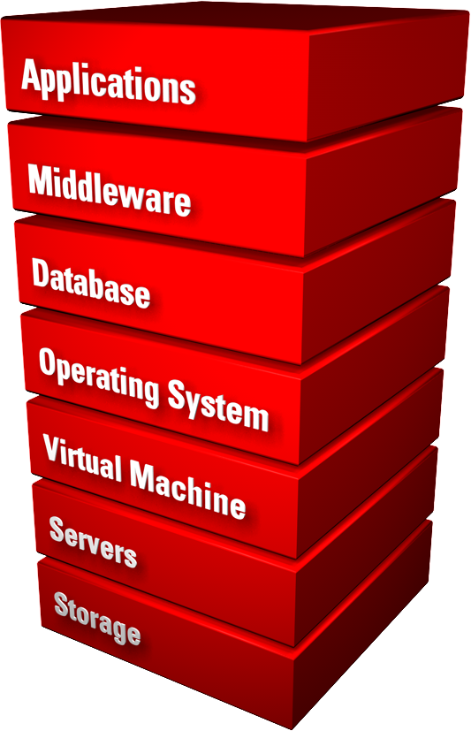
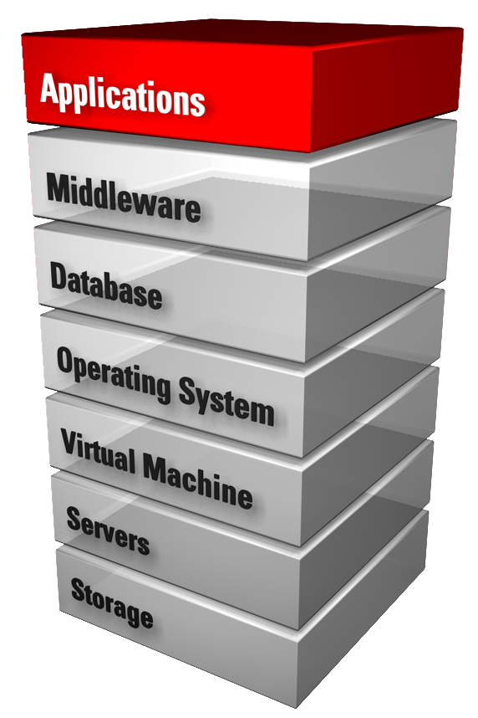
New Massively Scalable Framework Robust, Extensible and Secure
Better performance and scalability
Self-update
Enhanced security
New web 2.0 user interface
Powerful configuration management
My Oracle Support
Host 1
Plug-Ins (Database, FMW, Fusion Apps, . .)
Agent
DB Plug-In
FMW Plug-In
Monitoring
Database
Web Logic
Configuration Management
Auto-Push
Management Services
Host 2
Task Automation
Agent
Security
FMW Plug-In
FA Plug-In
Web Logic
Fusion Apps
Oracle Enterprise Manager

Slide 11
Plug in Architecture

Slide 12
Oracle Enterprise Manager 12c
Cloud Lifecycle Management
Plan
Optimize
Meter, Charge and Optimize Services
Meter resource utilization and cloud usage
Optionally chargeback to application owners, end-users, and/or business departments
Optimize cloud performance, capacity, QOS, agility, geography, people, costs…
Meter & Charge
Setup
Applications and
Business Services
Platform as a Service
DBaaS
MWaaS
Build
DBaaS
MWaaS
Manage
Infrastructure as a Service
Test
Monitor
Deploy
Notes:
- j

Slide 13
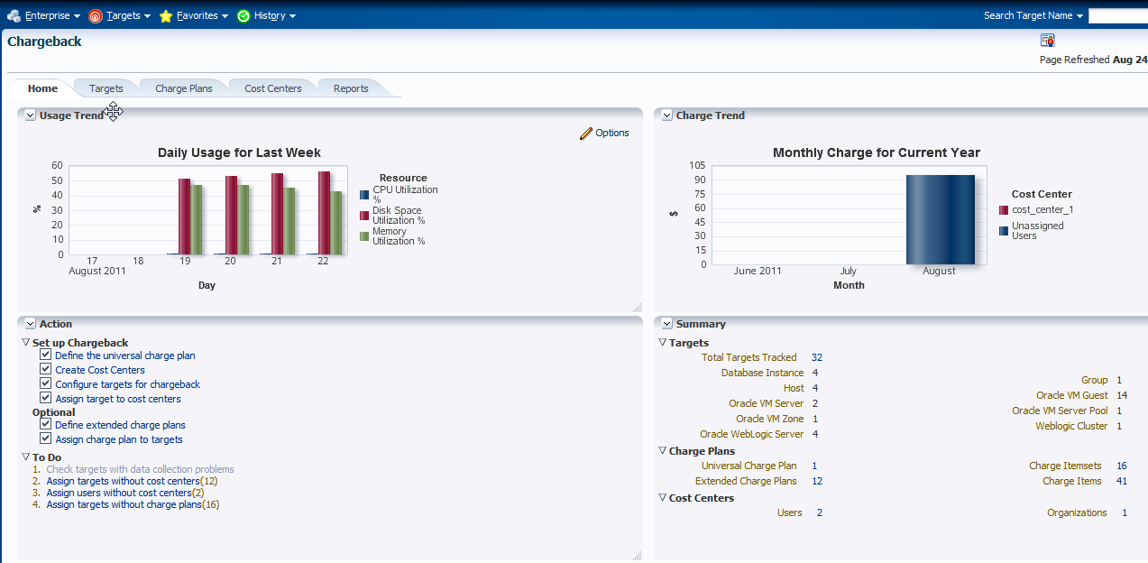
Metering and Chargeback
App-to-Disk Resource Metering
VM Guests, Database, Web Logic Server, Host
Composite Target: aggregation over supported target types
CPU, Memory, Storage, Network Bandwidth
Database transactions, SQL Executions, etc.
Mid Tier resource usage
Application/Activity metering (planned)
User Defined Chargeback Plan
Usage-based items (Resource and Activity)
Configuration-based items
Fixed-cost items

Slide 14
Chargeback Metrics
Target | Type | Configuration or Metrics
Database | Fixed | –
 | Configuration | Version, edition, RAC nodes, licensed sessions, options, features
 | Usage | DB time, CPU time, SQL executes, user transactions, disk reads/writes
Application Server | Fixed | –
 | Configuration | Clustered, version, options
 | Usage | Active sessions, active requests,
Host or VM | Fixed | –
 | Configuration | CPU, allocated memory, disk size
 | Usage | CPU utilization, memory usage, disk utilization,

Slide 15
Metering and Chargeback

Slide 16
Real-Time ADDM
Real-time analysis of hung or slow database systems
Holistically identify global resource contentions and deadlocks
Quantified performance impact
Precise, actionable recommendations
Provide cluster-wide analysis for RAC
Notes:
{MUGHEES}
New in EM12c Real-time ADDM

Slide 17
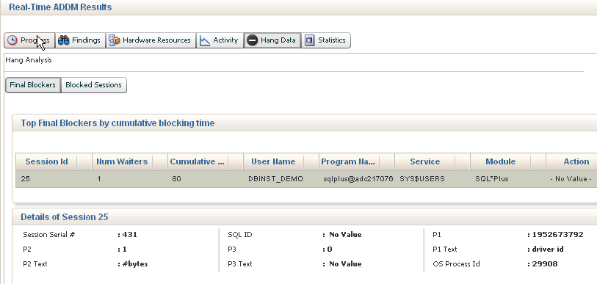
Real-Time ADDM
Real-time analysis of hung or slow database systems
Holistically identify global resource contentions and deadlocks
Quantified performance impact
Precise, actionable recommendations
Provide cluster-wide analysis for RAC
Notes:
{MUGHEES}

Slide 18
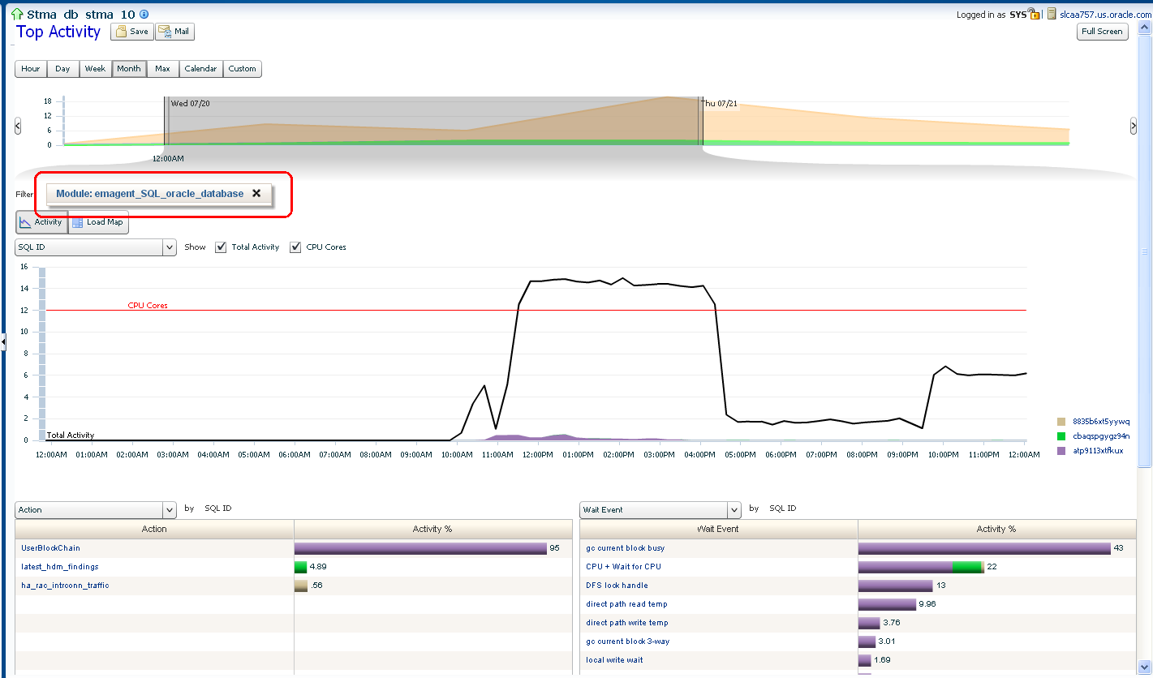
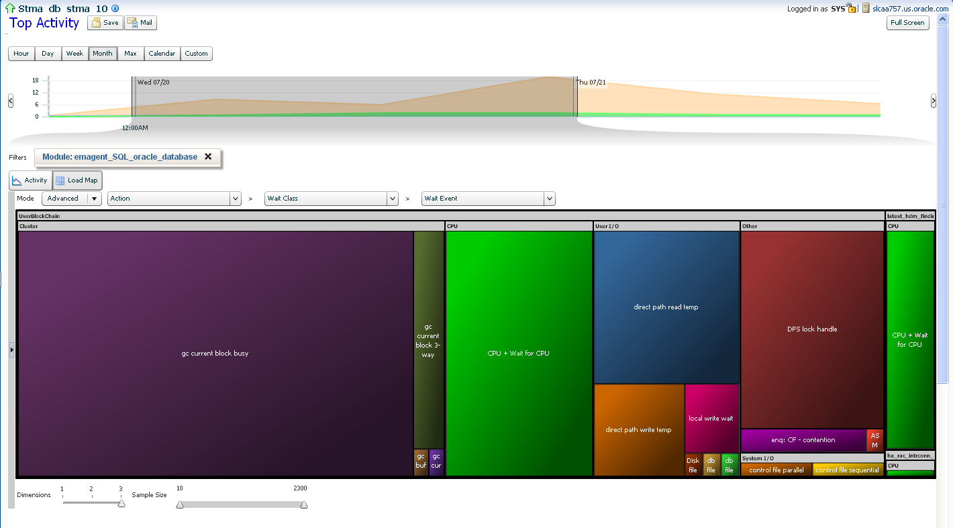
Active Session History (ASH) Analytics
Advanced analysis with graphical ASH report
Select any time period for analysis
Analyze performance across many dimensions
Provides visual filtering for recursive drill-downs
Different visualizations: Stacked chart or Tree Map
Collaborate with others using Active Reports
Notes:
{MUGHEES}

Slide 19
Realtime ADDM / ASH Analytics

Slide 20
Q&A
Notes:
20

Slide 21
Corbett: So it's "Goodnight" from me.
Barker: And it's "Goodnight" from him.
Both: Goodnight!
Corbett: So it's "Goodnight" from me.
Barker: And it's "Goodnight" from him.
Both: Goodnight!

