Slide 1

Database as a (Cloud) Service
Tim Sillay
Rob Reakes
Oracle Enterprise Architecture

Slide 2
The following is intended to outline our general product direction. It is intended for information purposes only, and may not be incorporated into any contract. It is not a commitment to deliver any material, code, or functionality, and should not be relied upon in making purchasing decisions. The development, release, and timing of any features or functionality described for Oracle’s products remains at the sole discretion of Oracle.
This document in any form, software or printed matter, contains proprietary information that is the exclusive property of Oracle. Your access to and use of this confidential material is subject to the terms and conditions of your Oracle Software License and Service Agreement, which has been executed and with which you agree to comply. This document and information contained herein may not be disclosed, copied, reproduced or distributed to anyone outside Oracle without prior written consent of Oracle. This document is not part of your license agreement nor can it be incorporated into any contractual agreement with Oracle or its subsidiaries or affiliates.

Slide 3
Agenda
Introductions
How did we get here?
The Stack
A strategy for Cloud Computing
Delivering Database as a Cloud Service
Engineered Systems as a Cloud Platform
A New Zealand Perspective

Slide 4
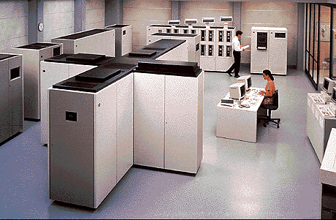
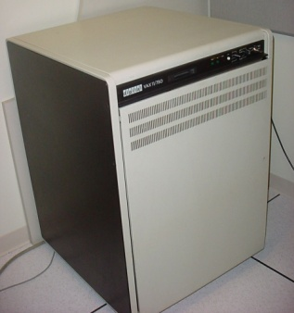
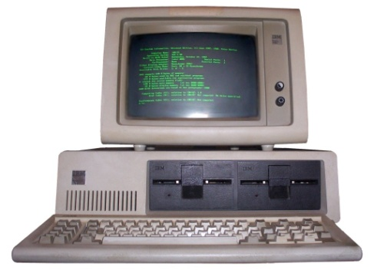
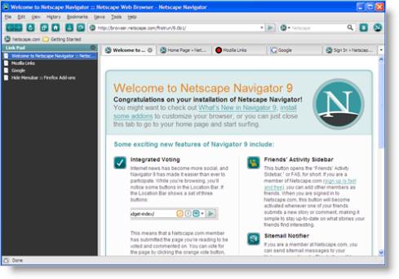
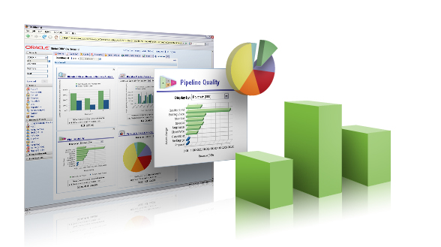

Trends, Drivers and Influences Change...
Mainframe 1965
Midrange 1975
Client/Server 1985
Web 1.0 1995
Web 2.0 2005
Cloud, Mobile 2015
Notes:
Five major generations of IT solutions, each characterised by greater openness, greater agility, increased accessibility and reduced costs.
Demands a greater investment in integration, a greater level of complexity, typically done at home.
2015 isnt far away, when we look back we will be using words like ‘cloud’, ‘mobile’
But what is a cloud anyway?

Slide 5
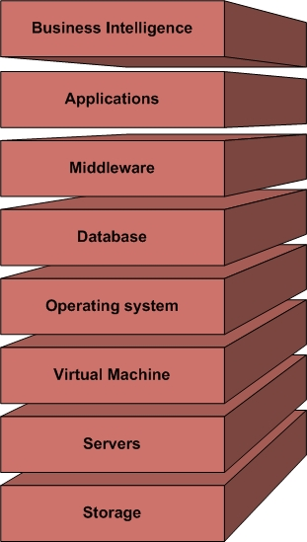



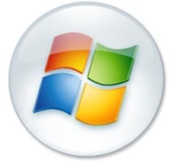



The Modern IT Stack
Notes:
Lets take a look at the current best practice around delivering IT to the business.
A simplified view of the stack of technologies which make up a typical commercial I.T. system.
It is complex, customer owns the problem, turns to SI’s, expensive, multi vendor,
Big SI industry
The reason we got from mainframes to was because we needed greater agility, which means greater openness, standards.

Slide 6
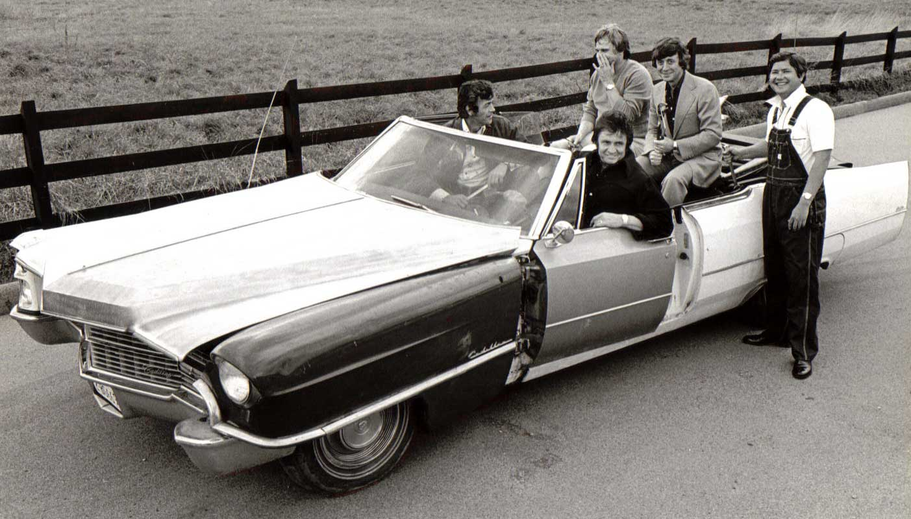
One Piece at a Time

Slide 7
“CIO stands for Chief Information Officer… Currently CIOs spend most of their time evaluating, buying, and assembling cool little technology components into expensive computer systems that don’t work very well and provide precious little useful information to the people running the business.”
Larry Ellison
Notes:
One of the things we have heard consistently is that CIOs spend more time making IT work, given the complexity of the IT industry, than they do helping the business.
Why has it got this complex? What happened to the ‘Information’ bit of CIO?

Slide 8
Two Key Points that shape Oracle
Complexity
  The Customer owns the cost of integrating the stack
  The Customer must invest in ‘Vendor Management’
  An entire ecosystem has built business models around this problem space.
Information
  ICT is rich in applications that automate process
  These applications generate a lot of Data
  It is difficult to make sense of this data
  Competitive differentiation will come from effectively managing and making this data available for decision making

Slide 9
How do customers fix this?
On Premise Deployments
Consolidate
Standardise
Optimise
Off Premise Deployments
Outsource
On Demand
Cloud

Slide 10



How big is this ‘Cloud’ thing?
“Cloud Computing”
51.8 Million Results
“The Beatles”
118 Million Results
“Jesus”
716 Million Results
Notes:
You may not be doing it just yet, but it will pay to have a strategy.

Slide 11

NIST Definition of Cloud Computing
Cloud computing is a model for enabling convenient, on-demand network access to a shared pool of configurable computing resources (e.g., networks, servers, storage, applications, and services) that can be rapidly provisioned and released with minimal management effort or service provider interaction.
This cloud model promotes availability and is composed of:
5 Essential Characteristics
On-demand self-service
Resource pooling
Rapid elasticity
Measured service
Broad network access
3 Service Models
SaaS
PaaS
IaaS
4 Deployment Models
Public Cloud
Private Cloud
Community Cloud
Hybrid Cloud
Source: NIST Definition of Cloud Computing v15

Slide 12
Sorry, What?
Operational Efficiency
Simplified Self-Service Access
Programmatic Configuration
Deployment Efficiency
Standardized Building Blocks
Automated Provisioning
Runtime Efficiency
Improved Performance
Lower Cost
Notes:
Better service from IT to the Business (QOS)
Agility
Standard Service Contracts

Slide 13

Why isn’t everyone using ‘Cloud’ then?
120 years ago, most buildings had a generator in their basement.
A.C. Power made it economical to transmit power over distance.
Everyone gets the same type of power.
Data has been growing at an exponential rate.
Available Bandwidth in New Zealand has not.
It’s an Architecture and Operating model conversation, not a pure technology play.
Notes:
What was the tipping point? AC.
What does this require? Standardization
We have recently seen a resurgence in ‘Home Generation’. This may be a new tipping point, where the cost/benefit of self generation balances the convenience.

Slide 14
How is this Different ?
Service Orientation
  Agreed Contracts for the service
  Ruthless Standardisation
  Self Service from a predefined catalog
Funding Model
  Moving to an OPEX model
  Strategic CAPEX Investment Required
Operating Model
  ICT as a service from both internal and external providers

Slide 15
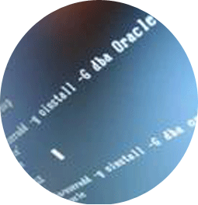


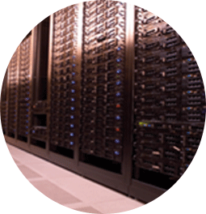
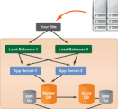

Cloud Drivers
Reduce Complexity
Reduce time to Market
$
Green
Change IT Cost Structure
Strategic
Tactical
Scale on Demand
Optimizing dev / test environments
Virtualization
Metering and Chargeback
Notes:
15
So way up at 10’ level - you can approach this in a number of ways between the two extremes of strategic and tactical.
Cloud can really be a vehicle to implement strategic improvements to enterprise IT. This includes things like changing the cost structure of IT for lower TCO, it could a method to reduce complexity and enable rapid time to market, or even used to support other strategic initiatives, such as implementing a corporate green strategy.
There are a lot of tactical motivators for cloud as well. A lot of these are also cost and ROI related, and can include things as simple as deploying virtualization technologies or things like enabling a more sophisticated way to pay for IT with new metering and chargeback capabilities.
-----

Slide 16
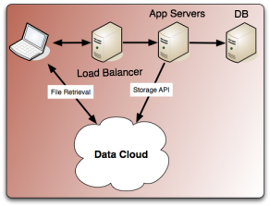

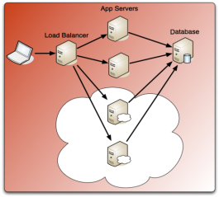
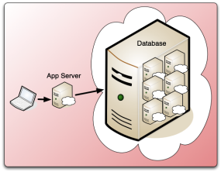
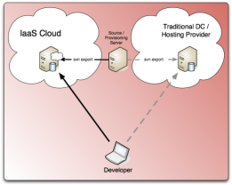
What Do You Want the Cloud to Do?
Common Use Cases
Augmentation
(Elastic scaling)
Shared Services
Resource sharing
(consolidation)
Development
and Test
Most enterprises are trying
  Shared development and test environments
  Hardware & Services consolidation
Notes:
You do need to have some general idea about the basic direction you want to go first because not everything is going into a cloud, but clouds are particularly attractive for a few different things:
You can use them for Augmentation which is great if you’ve got workloads that are really spikey like web services or HR self-service platforms is another good example. Instead of paying for peak load capacity for all these individual silos, you can share or off-load resources to a cloud.
This is great option, but it’s generally used in SaaS or PaaS deployments because it’s really dependent on how stateful your specific applications are, and the interdependence between the datasets that need to be load balanced.
Shared Services is like a logical extension of SOA with shared databases, middleware, security services – which is starting to become a more popular target of cloud computing projects –like Database as a Service is a great example.
Cloud Computing can also be an expansion of traditional IT consolidation projects, i.e., consolidating multiple applications or departments onto shared servers, network and storage - but with the Cloud’s capabilities for provisioning and managing the resources.
Development and Test is probably one of the best private cloud use-cases because very dynamic
Using a shared resource is great alternative to buying and provision big test farms dedicated to individual apps that might or might not ever see the light of day.
In all the cloud engagements that we’re seeing at Oracle, the first two are gaining traction, but this session will go into more detail on some of the capabilities required to support these last two types of use cases

Slide 17

Oracle’s Cloud Strategy
Complete
  Applications
  Platform
  Infrastructure
Enterprise Grade
  High Performance
  Scalable
  Available
  Secure
Fit for Purpose
  Public, Private, Hybrid
  Manageable
Notes:
So, what is Oracle’s overall cloud computing strategy? Our objectives are first to ensure that cloud computing is fully enterprise grade, that is, that is high performance, scalability, reliability, availability, security and standards-based for portability and interoperability. All the “ilities”… Secondly, we will support both public and private cloud computing in order to give customers choice.

Slide 18
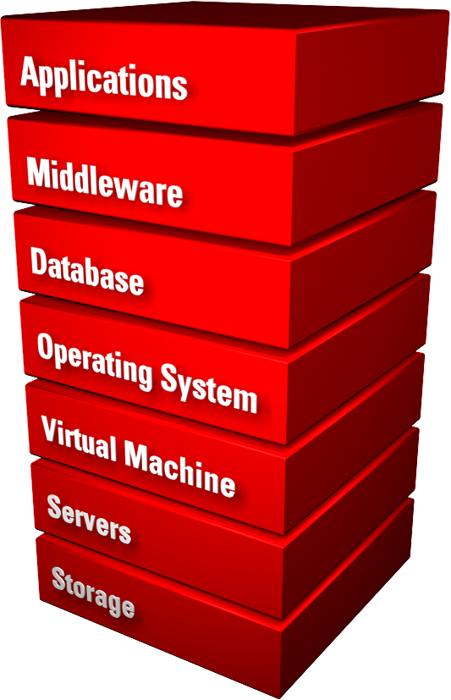
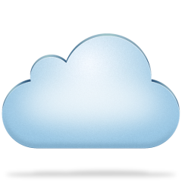


Oracle’s Cloud Strategy
Complete Cloud Stack
Software
As a Service
Applications
From
Platform
As a Service
Cloud Computing
Infrastructure
As a Service
To
Disk Image
Notes:
I want to dispel the myth that cloud requires virtualisation

Slide 19
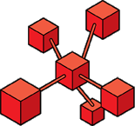

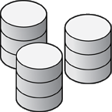
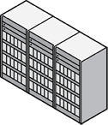
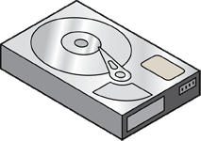


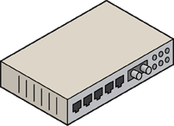


Oracle Private Cloud Platform
Platform as a Service
Cloud Management
Shared middleware and database services
Elastically scalable, highly available
Extreme performance
Comprehensive functionality
Robust development environment
Rapid deployment
Complete cloud lifecycle management
Complete apps to disk management
Self-service
Policy-based resource management
Metering & chargeback
Infrastructure as a Service
Shared compute and storage services
Elastically scalable, highly available
Physical and virtual
x86 and SPARC
Flash, disk and tape storage

Slide 20
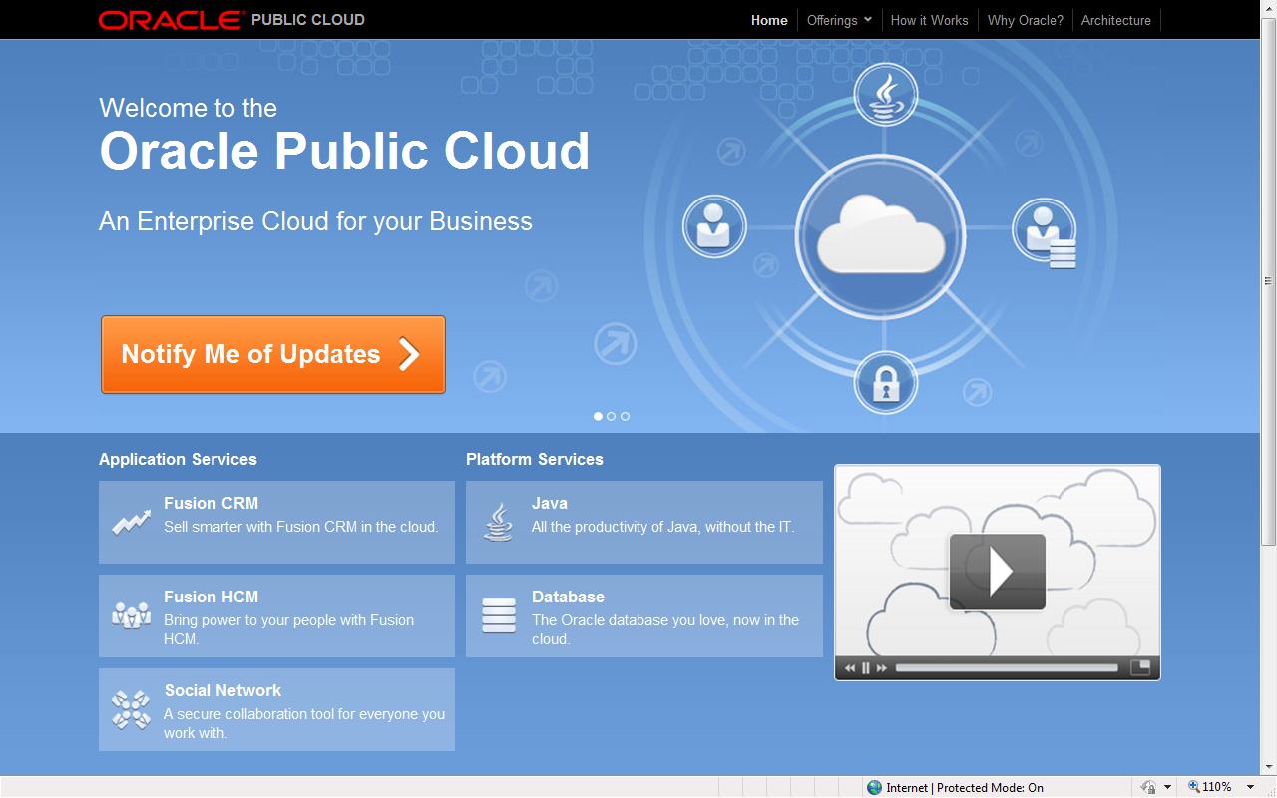
Oracle Public Cloud Platform

Slide 21

Oracle’s Cloud Strategy
Evolution of Private and Public Clouds
Public Clouds
Hybrid
IaaS
PaaS
IaaS
Public Cloud Evolution
SaaS
PaaS
SaaS
Private Cloud Evolution
Virtual Private Cloud
App1
App2
App3
App1
App2
App3
App1
App2
App3
App1
App2
App3
Consolidate
Standardize
Private PaaS
Private PaaS
Private PaaS
Private IaaS
Private IaaS
Private IaaS
Silo’d
Grid
Private Cloud
Hybrid
Physical
Dedicated
Static
Heterogeneous
Virtual
Shared services
Dynamic
Standardized appliances
Self-service
Policy-based resource mgmt
Chargeback
Capacity planning
Federation with public clouds
Interoperability
Cloud bursting

Slide 22
Considering DBaaS?
Business Considerations
  Business User Benefits ?
    Reporting / Analytics
  Business Process Benefits ?
    Scale up for peak
  Strategic Benefits
    M&A ?
IT Considerations
  Strategy
    Diversified or Unified?
  People and Process
    How do we operationalise?
  Technology Architecture ?

Slide 23







Understanding Database as a Service
Setting Up and Running Database Servers on Demand
Traditional Database Deployment
(Admin driven)
Specify and procure hardware
As-a-Service
Deployment
(End-user driven)
Configure hardware
DEPLOYMENT PORTAL
Set up software through Web interface
Database
Deploy hardware
OS
Service
Machines
Configure and deploy supporting software
Capacity adjusts as demand changes
Configure and deploy Database
Retire software when not needed
Self-Service Provisioning
Add hardware and reconfigure stack as demand grows
Notes:
Main point: working, simple definition of cloud computing
So what is this “cloud computing”? In contrast to traditional computing, where deploying an app entails procuring/configuring/etc….[6 clicks to build traditional stack—build emphasizes how tedious this is]
…cloud computing [click] is about deploying software via a very simple interaction with a user interface such as a portal, and [click] having the capacity for that app automatically adjust based on demand without the deployer having to do anything additional. And, by the way [click] this whole approach is enabled by the very technologies we mentioned earlier. In other words, the cloud computing approach is a natural evolution that builds on the capabilities enabled by those other technologies—it’s not something revolutionary that entails ripping and replacing technology investments you’ve already made. It’s about further leveraging those technologies in an architecture and approach that is even more effective at addressing the challenges we mentioned.

Slide 24

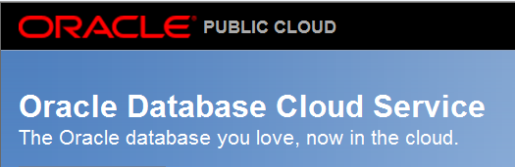

Oracle DBaaS in the Public Cloud Model
NIST Cloud Model Definition:
Cloud Provider:
Installs, manages & maintains DBaaS
Cloud Consumer:
Accesses and directly uses DBaaS
Cloud Characteristics | Service Models | Deployment models
On-demand self-service | IaaS | Public cloud
Resource pooling | PaaS | Private cloud
Rapid elasticity | SaaS | Community cloud
Measured service (metered) |  | Hybrid cloud
Broadband network access
(Oracle Public Cloud)
Legend:
(Oracle Partnered Cloud Provider)
(Multiple Customers)
Oracle DBaaS

Slide 25


Oracle DBaaS in the Private Cloud Model
NIST Cloud Model Definition:
Cloud Provider:
Installs, manages & maintains DBaaS
Cloud Consumer:
Accesses and directly uses DBaaS
Cloud Characteristics | Service Models | Deployment models
On-demand self-service | IaaS | Public cloud
Resource pooling | PaaS | Private cloud
Rapid elasticity | SaaS | Community cloud
Measured service (metered) |  | Hybrid cloud
Broadband network access
Oracle DBaaS
for Internal
Private Cloud
Legend:
Oracle DBaaS
(Customer Engineered Oracle DBaaS)
(Customer)

Slide 26


Oracle DBaaS in the Community Cloud Model
NIST Cloud Model Definition:
Cloud Provider:
Installs, manages & maintains DBaaS
Cloud Consumer:
Accesses and directly uses DBaaS
Cloud Characteristics | Service Models | Deployment models
On-demand self-service | IaaS | Public cloud
Resource pooling | PaaS | Private cloud
Rapid elasticity | SaaS | Community cloud
Measured service (metered) |  | Hybrid cloud
Broadband network access
(Oracle Public Cloud)
(Oracle Partnered Cloud Provider)
Oracle DBaaS
for Internal
Private Cloud
Legend:
Oracle DBaaS
(Multiple Customers with shared interests and compliance policies)
(Customer engineered Oracle DBaaS)

Slide 27
Oracle DBaaS in the Hybrid Cloud Model
NIST Cloud Model Definition:
Cloud Provider:
Installs, manages & maintains DBaaS
Cloud Consumer:
Accesses and directly uses DBaaS
Cloud Characteristics | Service Models | Deployment models
On-demand self-service | IaaS | Public cloud
Resource pooling | PaaS | Private cloud
Rapid elasticity | SaaS | Community cloud
Measured service (metered) |  | Hybrid cloud
Broadband network access
(Oracle Public Cloud)
(Customer)
And / Or
(Oracle Partnered Cloud Provider)
Oracle DBaaS
for Internal
Private Cloud
Legend:
Oracle DBaaS
(Customer engineered Oracle DBaaS)
(Multiple Customers)

Slide 28

DBaaS Deployment Architectures

Slide 29


Infrastructure Cloud
Server - Provision Database in a VM
Reasons for adoption
  • Simple to implement
  • Excellent isolation
  • Mixed workloads
  • As-is consolidation
  • Legacy support
Customer concerns
  • Lower consolidation density
  • Lower ROI
  • Performance (latency)
  • Managing sprawl
  • Not suitable for all deployments
ERP
CRM
EDW
OS
OS
OS
DB
DB
DB
Hypervisor
Hypervisor

Slide 30
Database Cloud
Platform - Provision Database
Reasons for adoption
  • Consolidation density
  • Good ROI
  • Performance
  • Supports any app
Customer concerns
  • Requires OS standardization
  • Database only
ERP
EDW
CRM
DB
DB
DB
OS
OS

Slide 31
Database Cloud
Database - Provision Schema
Reasons for adoption
  • Most efficient
  • Extremely fast provisioning
  • Best ROI
  • Performance
  • Efficient memory use
Customer concerns
  • App qualification required
  • Requires OS and DB standardization
  • Isolation
ERP
CRM
EDW
DB
OS
OS

Slide 32


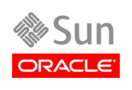

Mapping DBaaS in Oracle’s Cloud Technology
Applications
Enterprise Manager
3rd Party Apps
Oracle Apps
ISV Apps
Cloud
Management
Cloud Management Roadmap
Platform as a Service
Application
Performance Mgmt
Self-Service
Integration:
SOA Suite
Process Mgmt:
BPM Suite
Security:
Identity Mgmt
User Interaction:
WebCenter
Chargeback
Lifecycle Management
Application Grid: WebLogic Server, Coherence, Tuxedo, JRockit
Service Level Management
Database Grid: Oracle Database, RAC, ASM, Partitioning,
IMDB Cache, Active Data Guard, Database Security
Configuration Management
Resource Scheduling
Infrastructure as a Service
Application Quality Mgmt
Capacity Planning
Oracle Solaris
Operating Systems: Oracle Enterprise Linux
Oracle Enterprise Linux
Oracle VM for SPARC (LDom)
Solaris Containers
Oracle VM for x86
Ops Center
Servers
Physical & Virtual
Systems Mgmt
Storage
Notes:
32

Slide 33
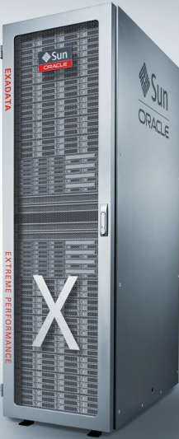
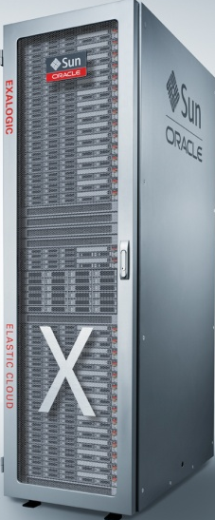
Mapping DBaaS in Oracle’s Cloud Technology
Applications
Enterprise Manager
3rd Party Apps
Oracle Apps
ISV Apps
Cloud
Management
Cloud Management Roadmap
Platform as a Service
Application
Performance Mgmt
Self-Service
Integration:
SOA Suite
Process Mgmt:
BPM Suite
Security:
Identity Mgmt
User Interaction:
WebCenter
Chargeback
Lifecycle Management
Application Grid: WebLogic Server, Coherence, Tuxedo, JRockit
Service Level Management
Database Grid: Oracle Database, RAC, ASM, Partitioning,
IMDB Cache, Active Data Guard, Database Security
Sun Oracle Exadata V2
and
Database Machine
Configuration Management
Resource Scheduling
Infrastructure as a Service
Application Quality Mgmt
Capacity Planning
Oracle Solaris
Operating Systems: Oracle Enterprise Linux
Oracle Enterprise Linux
Oracle VM for SPARC (LDom)
Solaris Containers
Oracle VM for x86
Ops Center
Servers
Physical & Virtual
Systems Mgmt
Storage
Notes:
33

Slide 34
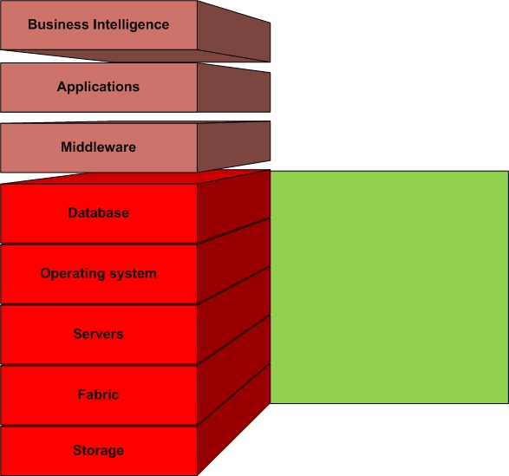
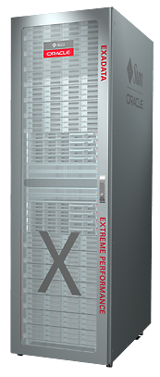
Engineered Systems - Database
Pre-Configured
Low touch
Manageable
More Agile
Data Tier Consolidation
Extreme Performance
_x86
Notes:
Talk SAP on EXA
Works as advertised. At least 10x performance gain
Elaborate in detail later

Slide 35
Cloud in a Box
Oracle Exadata
Best for Database Cloud
  Only database machine that runs and scales all workloads
  Predictable response times in multi-database, multi-application, multi-user environments
Add more racks to scale the cloud
  Standard building Blocks
Notes:
The best way to build a cloud is to let Oracle do it for you. Oracle Exadata is essentially a cloud in a box. It runs all the technology we’ve discussed in this seminar, including Oracle RAC, ASM, and Clusterware. It provides superior storage by utilizing the advanced Exadata storage servers. The net result is the perfect platform for consolidation into the database cloud. It combines servers, storage, networks into one integrated package where we have solved all the difficult integration problems, especially as it relates to providing the highest end-to-end performance. Database and Storage software is fully tuned and optimized for the above system to deliver orders of magnitude higher performance levels for both OLTP and DW. The system is modular and extensible, fully fault-tolerant and serviceable, and is made with low-cost high volume components that represents the industry’s most proven technology.

Slide 36
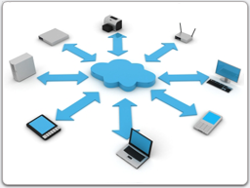
Cloud Management

Slide 37

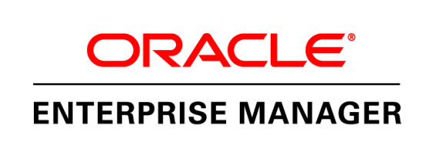
Enterprise Manager 12c Major Themes
Enterprise Ready Framework
Applications Management
Cloud Management
Middleware Management
Chargeback and Capacity Planning
Database Management
Exadata and Exalogic Management
Application Quality Management
Configuration Management
Provisioning and Patching

Slide 38
Cloud Management
Objectives
Complete, pre-integrated, off the shelf private cloud solution
Quickly transform an enterprise data center into private cloud
Complete cloud life cycle management
Self service provisioning, chargeback, policy based scale up/scale down
Support for virtual and physical environments
  Sparc and X-86
Support for Engineered Systems

Slide 39
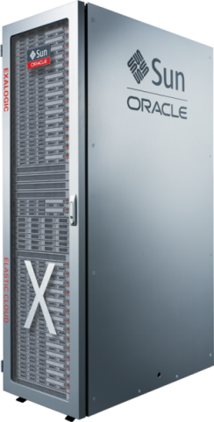
Oracle Cloud Management
Applications
Oracle Enterprise Manager
3rd Party Apps
Oracle Apps
ISV Apps
Cloud
Management
Cloud Management Roadmap
Platform as a Service
Application
Performance Mgmt
Self-Service
Integration:
SOA Suite
Process Mgmt:
BPM Suite
Security:
Identity Mgmt
User Interaction:
WebCenter
Lifecycle Management
Chargeback
Oracle Fusion Middleware
Oracle Database
Configuration Management
Resource Scheduling
Infrastructure as a Service
Application
Quality Mgmt
Capacity Planning
Oracle Solaris
Oracle Linux
Operating Systems: Oracle Enterprise Linux
Oracle VM for SPARC (LDom)
Solaris Containers
Oracle VM for x86
Ops Center
Servers
Physical & Virtual
Systems Mgmt
Storage
Notes:
Has self service across all deployment models.
39

Slide 40
Chargeback / Accountability
Helps align IT with business goals by revealing who consumes which resources
Drives better decision making and planning for IT budget requirements
Key features
  Resource usage tracking
  Chargeback reporting
  Cost allocation and charge plan evaluation
  Interface for private cloud self-service application
  Charge plan templates

Slide 41
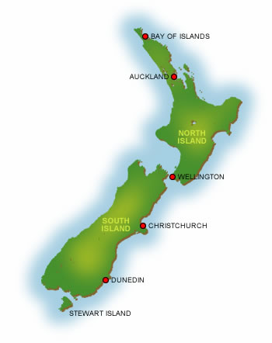
What’s happening in NZ ?

Slide 42


All of Government Computing Services
Infrastructure as a service
  10 Year contract Announced
  New Datacenters in Hamilton
Roadmap includes
  Platform as a Service
  Collaboration Platform
  Common Desktop

Slide 43
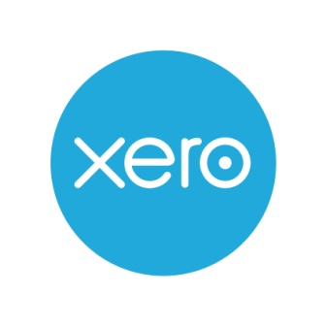


Local Service Providers
Interest from Cloud service providers is increasing
Infrastructure as a Service (IaaS) has rapidly become a commodity
Platform (Database / Java / Middleware) offerings will move to the mainstream
Application as a Service requires all customers to receive the same offering (no customisation).

Slide 44
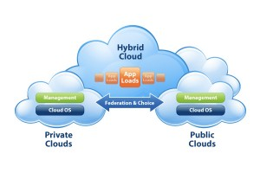
Those inconvenient laws of Physics
The hybrid cloud describes a model where a public cloud can provide excess ‘Burst’ capacity as required
NZ Broadband infrastructure limits our ability to rapidly move large volumes of data
We are always limited by the speed of light !

Slide 45
Summary
Oracle technology supports deployment in all Cloud models.
  Public
  Private
  Community
  Hybrid
We are predicting growth in Platform as a Service
We provide comprehensive Cloud Management capability
Engineered systems are the ultimate standard building block for Cloud computing

Slide 46
