Slide 1

Oracle In-memory Timesten Database
Osama Mustafa
Principal consultant/ DBA

Slide 2


About me
Oracle ACE.
Oracle OCP,OCE,OCS …
Certified Ethical Hacker.
Fusion Middleware Specialist.
RAC-ATTACK Organizer around the world.
Speaker in Oracle User Group.
Author for the book : Oracle Penetration Testing.
Technical Reviewer for Oracle books.
Published Articles in different Magazine.
Board member in Oracle RAC SIG.
Volunteer in IOUG, ODTUG & UKOUG.
Blogger.

Slide 3
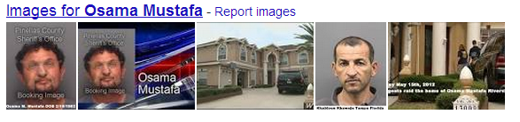
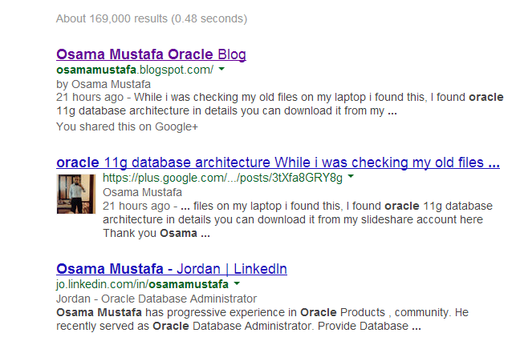
GoogIe Search
Without Oracle
With Oracle

Slide 4
Gurus Solutions
Guru Solution was founded in 2004 and it’s market leader in IT Consulting.
Focusing on Oracle and Operating system.
Oracle BI
Fusion
Middleware
Database
Operating
System
Training
Gurus Solutions Gives you a better idea about your solutions
https://www.gurussolutions.com/

Slide 5

Agenda
Timesten Overview.
Timesten vs Oracle Database.
Timesten Caching Overview.
Timesten Connectivity.
Timesten Installation / Linux Version.
Timesten Caching
  Oracle Side.
  Timesten side.
Tune Tips

Slide 6
What is Timesten ?
Any company looking for faster, reliable and access data quickly thru application, which mean they planned to develop new generation of application, especially if this application expected high number of transactions.
  For Example :- telecom applications, billing and fraud detections
Oracle TimesTen In-memory database (TimesTen) the solution for any faster application.
TimesTen store data in the memory which mean no network latency or no disk I/O, in that case transaction will take just microsecond

Slide 7
What is Timesten ?
Reliability in TimesTen occurs in logging data and transactions to disks to provide full recovery.
TimesTen can be configured for high availability and instant failover.
New generation of full system engineered hardware oracle embedded TimesTen in Oracle Exalytics to enable oracle business intelligence with two editions standard and enterprise to preform high speed query

Slide 8
What is Timesten ?
TimesTen is relational database support full SQL transaction and PL/SQL.
TimesTen designed to manage data in physical memory, therefore there is no special hardware/software requirement one consideration while working with TimesTen which is have sufficient RAM available in the application tier.
The size for TimesTen will be limited by amount of physical RAM in the server
  Example :-
32bit platforms considered by 32bit address space otherwise 64bit platforms has no limit size depend on physical memory you have in this server

Slide 9
What is Timesten ?
another benefits As Any application having appropriate number of CPU is important to run application faster.
TimesTen can run multiple application per time
Oracle database instant client installed with TimeSten to enable SQL*NET to communicate with oracle database.
TimesTen Supported Different Platforms and can installed to work as Standalone database the supported Operating system.

Slide 10
Cont’d
  Linux x86
  Linux x86-64
  Solaris SPARC (64-bit) o Microsoft Windows x86
  Microsoft Windows x64 (64-bit)
  IBM AIX
  Solaris x86-64 (64-bit)
The Oracle TimesTen Database support different version of Oracle Database
  Oracle Database 12c
  Oracle Database 11g Release 2
  Oracle Database 11g Release 1

Slide 11

Oracle Timesten vs Oracle Database
Comparison | TimesTen | Oracle Database
Checkpoint | Checkpoint process | DBWR
Connections | ttserver process | Listener
Logical files | N/A | Tablespace
Parameter file | Sys.odbc.ini | initSID.ora
Database information | N/A | Controlfile
instance | One/more can be running on same daemon | No Daemon, each instance has its own processes

Slide 12
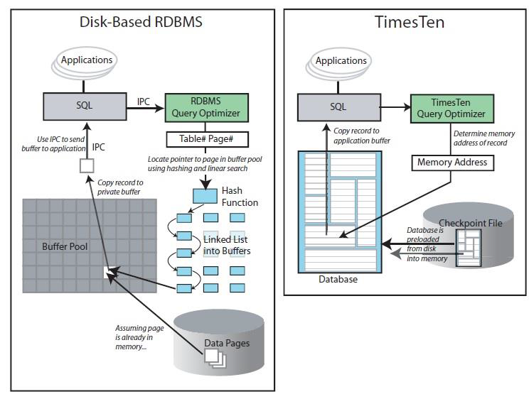

Slide 13
Timesten caching
Another concept for TimesTen Called TimesTen Application Tier Database Cache is Oracle database product option that provide real time, read/write caching for oracle database with this option transaction response time will be improved by caching performance-critical subset of tables and table fragment from oracle database to application tier.
TimesTen Cache is deployed in application-tier for multi-user in application.
application connect to cache database and access cached tables using JDBC, ODBC, ADO.NET Or OCI.

Slide 14
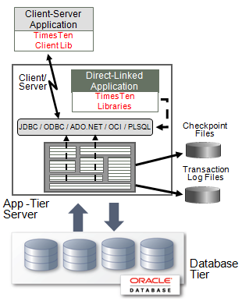
Timesten caching
cached tables operates like regular relational tables in RDBMS.

Slide 15
Timesten caching
Applications using TimesTen Cache may choose to configure a combination of caching options:-
    Read-only caches
      Transactions are performed in the Oracle Database and the changes are refreshed to the TimesTen cache database.
    Read-write
      Transactions are performed in the TimesTen cache database and then propagated to the Oracle Database.
    On-demand and preloaded cached
      Data may be loaded on-demand or preloaded

Slide 16

Timesten Connectivity
TimesTen and TimesTen Cache support different kind of connectivity each one of them has its own advantage and disadvantage.
Applications can connect to a TimesTen database in different way :-
  Direct driver connection
  Client/server connection
  Driver manager connection

Slide 17
Cont’d
Direct driver connection
Traditional database system.
  TCP/IP or another IPC mechanism is used by client applications to communicate with a database server process.
  TimesTen and application on the same host.
  Java/OCI applications access direct ODBC driver through JDBC/OCI.
  Fastest One.
Driver manager connection
  Can provide support for ODBC applications written for a different ODBC version.
  Support multiple RDBMS products with ODBC interfaces.
  Database independent interface for example: - MS ODBC driver.

Slide 18
Cont’d
Client/server connection
  TimesTen and application on a different or the same host.
  The server daemon spawns a separate server child process for each client connection to the database (called child Process).
  Client communicates with a server daemon process.
  Depend on the network, therefore it will be slower.
  Provide more flexibility

Slide 19
Timesten Installation Steps/ Linux
To install TimesTen on Linux System you have to perform these steps:-
  Shared memory, Semaphores (Kernel Parameters).
    Depend on server memory.
    Oracle provide equation to calculate size of segments
    PermSize + TempSize + LogBufMB + 64 MB
  Large pages/Huge pages (Optional).
    It’s advisable to configure large pages.
    Use of HugePages is required if the size of the TimesTen main shared memory segment is greater than 256 GB.
    If there is support for Huge Pages you can check value from “cat /proc/meminfo”
  IPC Client/Server (Daemon Ports).

Slide 20
Cont’d
On Linux/Unix Operating system No GUI provided to install Oracle TimesTen.
Download TimeSten Software From OTN:
  http://www.oracle.com/technetwork/database/database-technologies/timesten/downloads/index.html
To start installation Run the following Command ./setup.sh
The Installation document provided on my blog :-
  http://osamamustafa.blogspot.ae/2014/01/installing-oracle-timesten-in-memory.html
Video Link:-
  http://osamamustafa.blogspot.com/2014/07/install-oracle-timesten-on-linux-video.html

Slide 21
Installation Time
Please choose an instance name for this installation? [ tt1122 ]
  Instance name will be 'tt1122'.
  Is this correct? [ yes ]
Of the three components:
[1] Client/Server and Data Manager
[2] Data Manager Only
[3] Client Only
Which would you like to install? [ 1 ] 1
Where would you like to install the tt1122 instance of TimesTen? [ 1 ] /u01/app/TimesTen
The daemon logs will be located in /u01/app/TimesTen/tt1122/info
Would you like to specify a different location for the daemon logs? [ no ]
Installing into /u01/app/TimesTen/tt1122 ...
Uncompressing ...

Slide 22
Installation Time
Do you want to use the default port number for the TimesTen daemon? [ yes ]
The daemon will run on the default port number (53396).
Restrict access to the the TimesTen installation to the group 'oinstall'? [ yes ]
Please enter a value for TNS_ADMIN (s=skip)? [ ] /u01/app/fmw/Oracle_BI1/network/admin
What is the TCP/IP port number that you want the TimesTen Server to listen on? [ 53397 ]
Do you want to install QuickStart and the TimesTen Documentation? [ no ] yes
Where would you like to install the quickstart and doc directories (s=skip)? [
/u01/app/TimesTen/tt1122 ]
Where would you like to create the DemoDataStore directory? [ [u01/app/TimesTen/tt1122/info ]
Creating /u01/app/TimesTen/tt1122/info/DemoDataStore ...
Would you like to use TimesTen Replication with Oracle Clusterware? [ no ]

Slide 23
Installation Hints
After the installation the Daemon will be started without any DataStore.
Creating sys.odbc.ini file needed for DataStore and connections (Direct, Client/Server, or IPC
#located at $TT_HOME/info/sys.odbc.ini
[TEST_DSN]
Driver=/u01/app/oracle/TimesTen/tt11.2/lib/libtten.so
DataStore=/u01/app/oracle/info/TEST_DSN
LogDir=/opt/oracle/info/TEST_DSN/log
PermSize=32
TempSize=32
PLSQL=1
DatabaseCharacterSet=AL32UTF8
OracleNetServiceName=orcl
[ODBC Data Sources]
MYDS=TimesTen 11.2.1 Driver

Slide 24
Installation Hints
After creating the above DataStore Daemon should be restart to load DataStore.
  ttDaemonAdmin –restart
To test TimesTen Using this DataStore
  ttisql TEST_DSN
Till this step we only configure Timesten Without caching.

Slide 25
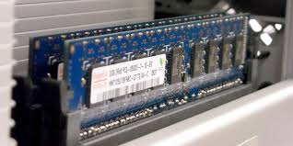
Timesten Caching
To start TimesTen caching the both databases should be configured Oracle database and Oracle in-memory database TimesTen.
The following steps discuss the configuration to cache tables in TimeSten as quick concept:-
  Configure connection between oracle database and TimesTen (SQL*NET).
  Which tables will be cached?
  Create cache admin.

Slide 26
Timesten Caching / Oracle Side
Steps | Description
Create TBS | Login to Oracle using sys user to create TBS.
Create TimesTen Schema | Create user and run initCacheGlobalSchema.sql to $TT_HOME/oraclescripts to create the TimesTen schema in the Oracle database
Create a Cache Administration User | Create an Oracle account for the cache administration user.
Grant System Privileges to the Cache Administration | Run $TT_HOME/oraclescripts/grantCacheAdminPrivileges.sql to grant the necessary privileges
Grant Data Access Privileges to the Cache Admin | cache administration user is responsible for monitoring

Slide 27
Timesten Caching / Oracle Side
sqlplus sys@orcl as sysdba
create tablespace ttcache datafile ttchache.dbf' SIZE 100M;
@TimesTen/tt1121/oraclescripts/initCacheGlobalSchema.sql
- Enter the name for created tablespace, in our case ttcache.
create user cacheadm identified by cacheadm
default tablespace ttchache
quota unlimited on ttchache
temporary tablespace temp;
@TimesTen/tt1121/oraclescripts/grantCacheAdminPrivileges.sql
  - Enter the name for created user, in our case cacheadm

Slide 28
Timesten Caching / Timesten Side
Steps | Description
Create DataStore | Sys.odbc.ini add DSN to connect Oracle database
Configure TNS_ADMIN Location | Configure this step while setup or change location by run <install_dir>/bin/ttmodinstall
Create Cache user on TimesTen | Same user should be create on oracle database and TimesTen example:- cacheadm
Grant privileges to cache user | Owner for cached table should be created
Create the table owner in TimesTen | cache administration user is responsible for monitoring
Assign grid to DataStore then create cache Group | This step in simple and can be run with TimesTen Command.

Slide 29
Timesten Caching / Timesten Side
Datasource should be configured ( sys.odbc.ini ).
TNS_ADMIN can be modified by running ttmodinstall command and point to the new location, inside tnsnames.ora connection to desired oracle database should be created since it will be used by DataStore.
Connect to DataStore:-
  ttIsql MYDS
Create the cacheadmin in TimesTen:-
    create user cacheadm identified by cacheadm;
    grant create session, cacheadm,
    create any table, drop any table to cacheadm;
  Or
  Grant all to cacheadm;

Slide 30
Timesten Caching / Timesten Side
DataStore is ready but cacheadm password is not.
Exit from the old databsource connection → connect using the below:-
ttIsql "DSN=MYDS;UID=cacheadm;PWD=cacheadm;OraclePWD=cacheadm"
set cacheadm password:-
call ttCacheUidPwdSet('cacheadm', 'cacheadm');
Create grid and assign it to DataStore
  call ttGridCreate('TEST');
  call ttGridNameSet('TEST');

Slide 31

Timesten Caching / Notes
ttGridCreate
  Creates a cache grid. This built-in procedure needs to be run only once. You can run it from any standalone data store or from the active or standby master data store in an active standby pair.
ttGridNameSet
  Associates a TimesTen data store with a grid.
This procedure requires the CACHE_MANAGER privilege.
Grid
1
3
2
Schema
RAM
Tables
Nameset

Slide 32
Timesten Caching / Timesten Side
Finally caching is ready, Create Cache Group to Start :-
  create readonly cache group Test_table
  autorefresh interval 5 seconds
  from
  scott.dept (
  deptno number(2) not null, dname varchar2(14),
  loc varchar2(13),
  primary key (deptno)),
  scott.emp (
  empno number(4) not null,
  ename varchar2(10), job varchar2(9), deptno number(2),
  primary key(empno),
  foreign key (deptno) references scott.dept(deptno));

Slide 33
Timesten Caching / Notes
The name for this cache group Test_table
It will refresh and cache data every 5 Sec.
It will be connected to oracle database, schema scott, table dept.
Not all the column included.
Primary key should be added on oracle database and TimesTen.

Slide 34

Tune Tips
First it’s really Hard to Tune timesten comparing to
Oracle database.
One of the most tools used in TimesTen for troubleshooting:-
  Using the ttCapture utility
  Using the ttStatus utility
  Using the ttTraceMon utility
  Using the ttXactAdmin utility
  Using ODBC tracing

Slide 35
Tune Tips
ttCapture utility:-
  This utility capture information about the TimesTen Configuration the information will be written to files that provides TimesTen technical support with a snapshot of system using the command is simple ttCapture –dest [file_location].
ttStatus utility
This utility check the status of the TimesTen daemon and the state of all TimesTen connections.
ttTraceMon utility
  Enable and disable the TimesTen internal tracing facilities, tracing options can be enabled and disabled separately for each database, this utility requires the ADMIN privilege.

Slide 36
Tune Tips
ttXactAdmin utility
  Displays ownership, status, log and lock information for each outstanding transaction. You can also use it to show all current connections to a database.

Slide 37


Slide 38




osama.mustafa@gurussolutions.com
@OsamaOracle
http://osamamustafa.blogspot.com
Osama Mustafa

