Slide 1

Making sense of the new WebCenter Content
Site Studio 11g 101
Chad Wappes
Whoopass Consulting, Ltd.

Slide 2
What is Site Studio?
A Multi-Site Management Tool
Enables Centralized Control Over Presentation and Security
Enables Decentralized Contribution of Content

Slide 3
Site Studio Features
A strong separation of design and content
A high level of reusable elements for site designers
In-context authoring, editing, and review of content
Dynamic, automatically generated navigation for websites
Runs on top of Oracle’s Content Server

Slide 4
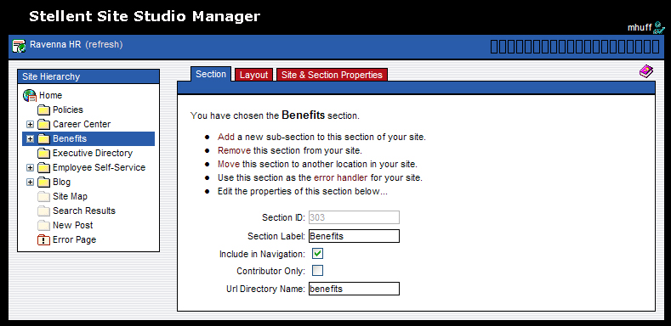
Site Studio Roles and Tools
Separation of roles
Site Studio tool
#
Users
Designer
Manager
Contributor
Browser
Developers / Brand Managers
Site Owner /
Manager
Contributors
Consumers

Slide 5
Site Studio and Content Server
Site Studio runs on top of Oracle Content Server
All assets and content are stored in the Content Server
Content Server security and workflow can be used
Revision history is available for all content items

Slide 6
Site Studio Assets
Project File
Template Pages
Sub Templates
Placeholder Definitions Files
Region Templates
Region Definition Files
Element Definition Files

Slide 7
Site Studio Content
XML Data Files
Native Documents, for example:
  Word Documents
  PDF Files
  Excel Spreadsheets
  PowerPoint Files
  Text Files
  Multimedia Files (Images, Videos, etc)

Slide 8
Page Assembly
There are no static web pages in Site Studio.
Pages are assembled by merging site assets with the associated content, when the consumer views the page.
This should make more sense during the demo.

Slide 9
Q & A

Slide 10
Thank You!
Email: chad@whoopassconsulting.com www.whoopassconsulting.com

