Slide 1
BI Publisher in EBS R12
Presenter: Sarah Sinclair

Slide 2
What we will cover
This presentation will outline how to build a simple XML Publisher report in R12 from scratch.
I will cover how to build the data definition, template file as an RTF with BI Publisher and how to link it into a concurrent program.

Slide 3
What we will cover
I will touch on more advanced concepts like conditional formatting and linking the report to a pl/sql package.
Show you how to modify existing XML Publisher reports.

Slide 4
What we will cover
At the end of the presentation the audience should have a good grasp of how to build a simple XML Publisher/Bi Publisher report and be ready to start on more advanced concepts.

Slide 5
Some Definitions
OBIEE – Oracle Business Intelligence Enterprise Edition
BI Publisher / XML Publisher

Slide 6
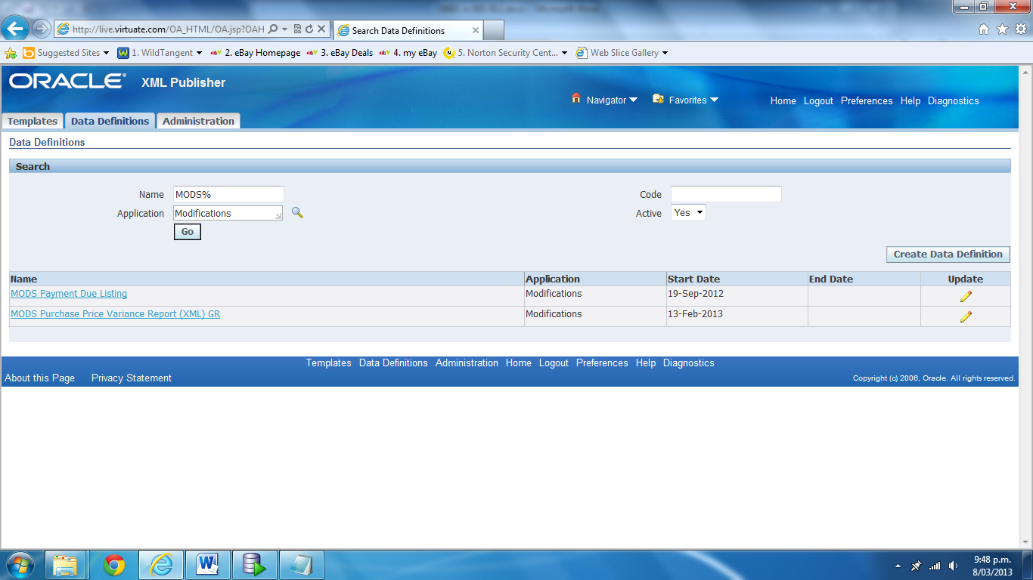
Getting Started
Responsibility: XML Publisher Administrator
Menu option: Data Definitions:

Slide 7
Data Definition File
Data Definition File: MODS_AP_INVOICES_V1.xml
<?xml version="1.0" encoding="UTF-8"?>
<!-- $Header MODS_AP_INVOICES.xml 115.1 2012/09/17 09:36:48 ssinclair ship $ -->
<dataTemplate name="MODS_AP_INVOICES" description="MODS Invoice Demo Report" version="1.0">
<properties>
<property name="include_parameters" value="true" />
<property name="include_null_Element" value="true" />
<property name="debug_mode" value="off" />
</properties>
<dataQuery>
<sqlStatement name="Q1">
<![CDATA[select invoice_num, invoice_amount, invoice_date
from ap_invoices_all
where rownum <10]]>
</sqlStatement>
</dataQuery>
</dataTemplate>

Slide 8
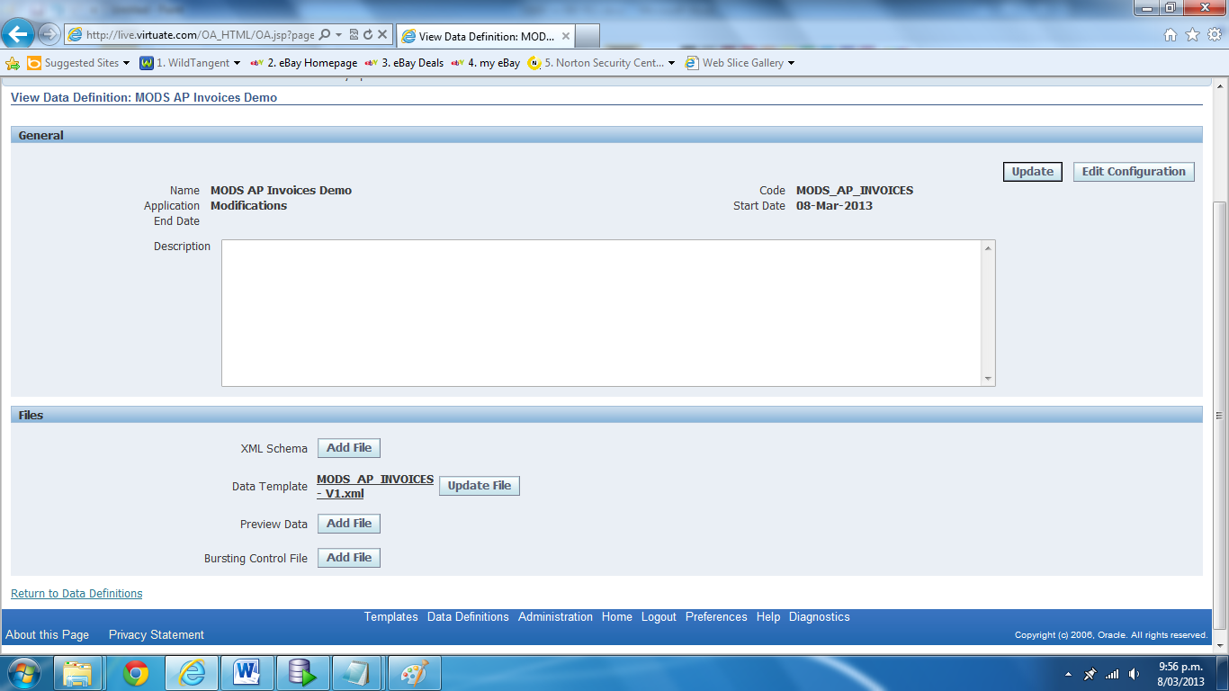
Data Definition File

Slide 9
Concurrent Program
XDODTEXE (Seeded java program: Java Concurrent Program)
Same Shortname as data definition.
Same Application as data definition.

Slide 10
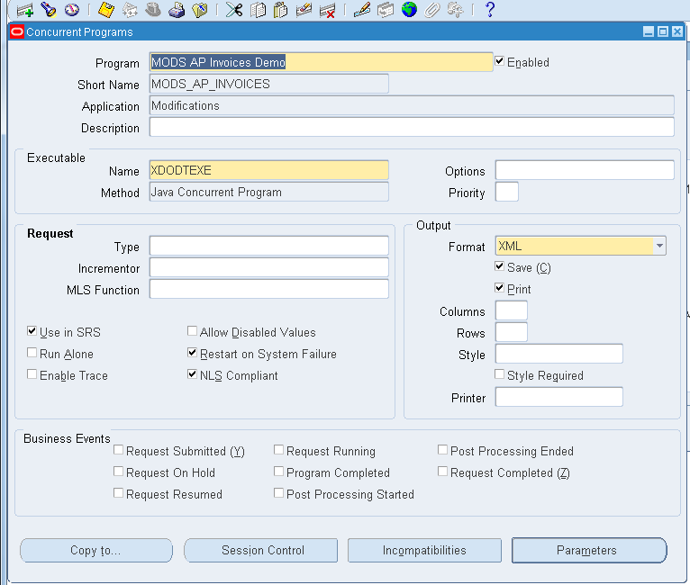
Concurrent Program

Slide 11
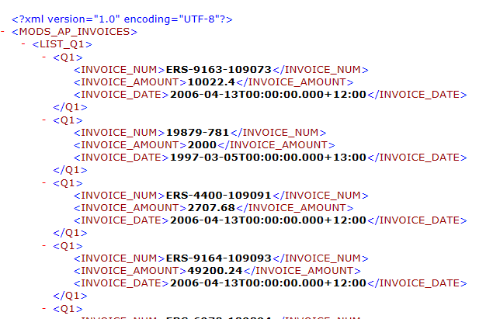
Concurrent Program
Run the program and capture the output

Slide 12
Template File
This is your layout
Required: OBIEE BI Publisher Desktop
Download from:
http://www.oracle.com/technetwork/middleware/bi-publisher/downloads/index.html
Open Word (example is Word 2010) :
Add-Ins should appear

Slide 13
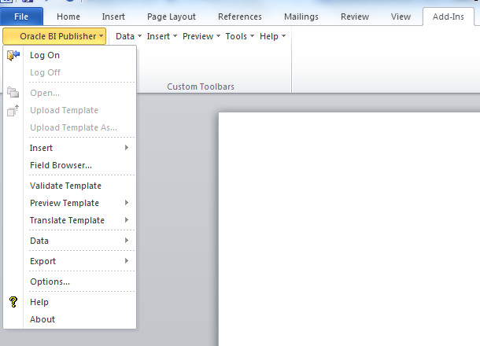
Template File

Slide 14
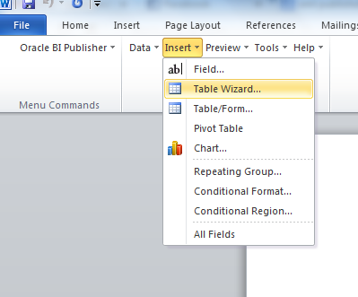
Template aFile
Choose Data->Load XML Data and load in your sample file.
Use the wizard to build a sample template:

Slide 15
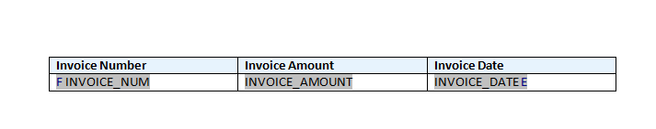
Template File
Result from wizard:

Slide 16
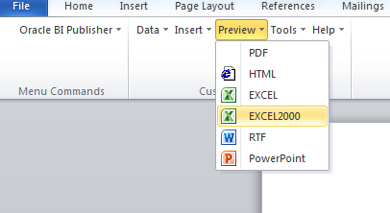
Template File
Preview it in Word:

Slide 17
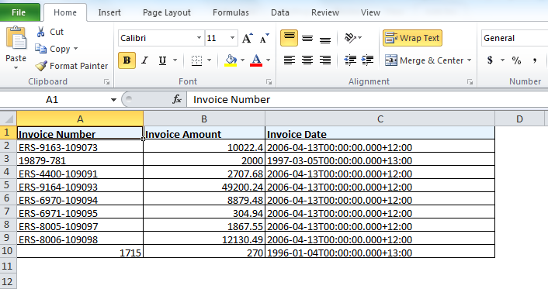
Template File
Resulting Spreadsheet

Slide 18
Template File - alterations
Alignment
Align in word as per usual (trick to put a space in before any text to force it to left align in XL.

Slide 19
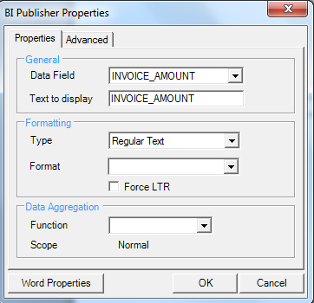
Template File - alterations
Format the amount
BEFORE

Slide 20
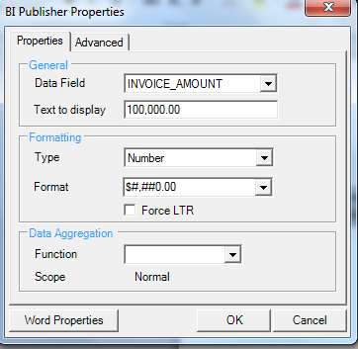
Template File - alterations
Format the amount
AFTER

Slide 21
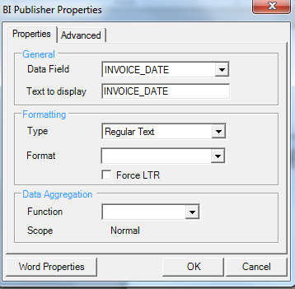
Template File - alterations
Format the DATE
BEFORE

Slide 22
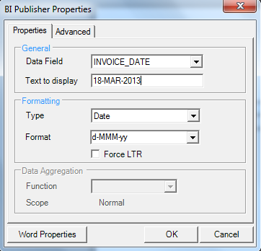
Template File - alterations
Format the DATE
AFTER

Slide 23
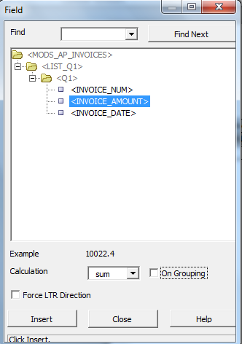
Template File - alterations
Sum of Amount
Insert->Field

Slide 24
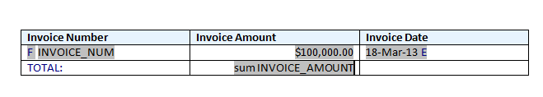
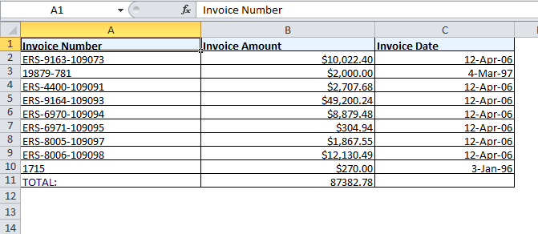
Template File – alterations
Resulting template file
Resulting preview

Slide 25
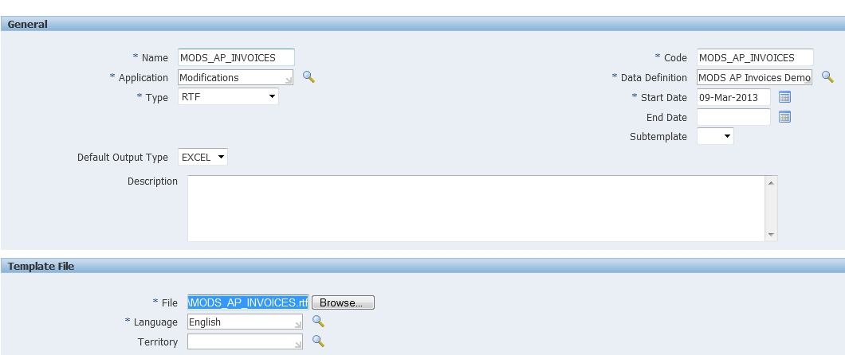
Template File – in EBS
Responsibility: XML Publisher
Menu: Templates
Create a new temple
Same Shortname and Application

Slide 26
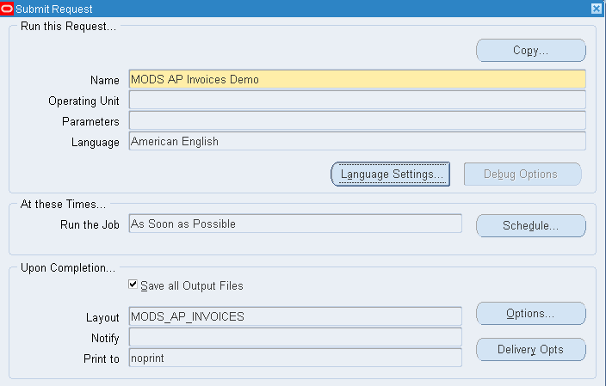
Template File – in EBS
Run on concurrent manager
Layout will appear automatically

Slide 27
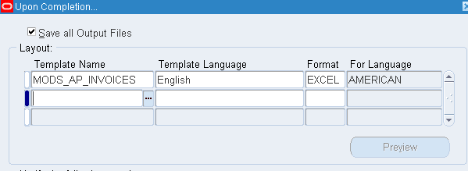
Template File – in EBS
You can choose other templates or extra templates

Slide 28
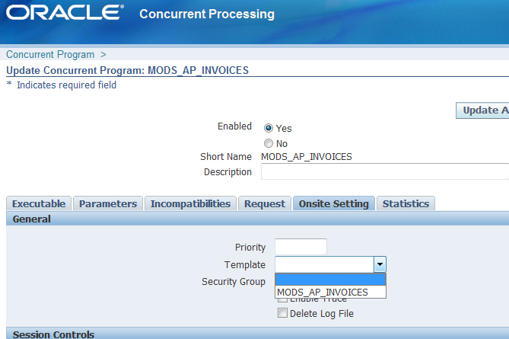
More concurrent options
Responsibility: System Administration
Menu: Concurrent->Programs

Slide 29
Adding Parameters
Change your data definition file:
<parameters>
<parameter name="P_ROWNUM" dataType="number" />
</parameters>
<dataQuery>
<sqlStatement name="Q1">
<![CDATA[select invoice_num, invoice_amount, invoice_date
from ap_invoices_all
where rownum <= :P_ROWNUM]]>
</sqlStatement>
</dataQuery>

Slide 30
Adding Parameters
Add the parameter to your concurrent program with the same name as in your data definition file:
Load the new data definition file in and run the concurrent request with no template to get a new sample xml file.
Completing with warning is expected:

Slide 31
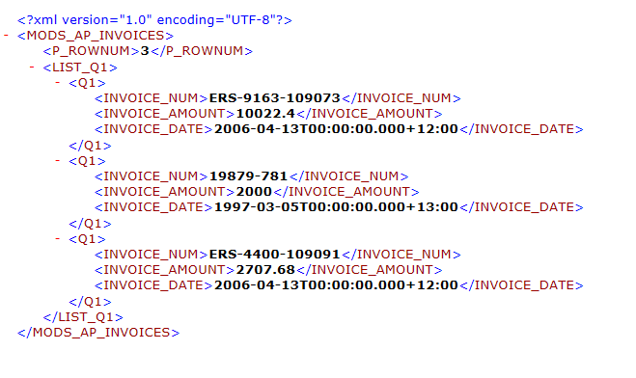
Adding Parameters
Output is now restricted to the number of rows in the parameter – the parameter is in the file

Slide 32
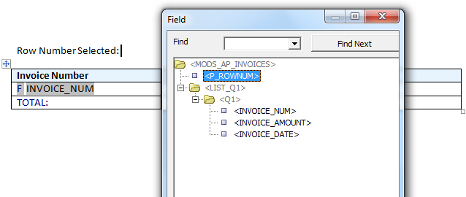
Adding Parameters
Include the parameter on the template file if desired.

Slide 33
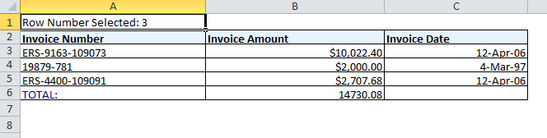
Adding Parameters
Upload template file into XML Publisher and run on concurrent manager
Result file

Slide 34
Other advanced concepts
Calling a package
Alter the data definition file.
<dataTrigger name=”beforeReport” source=”PACKAGE.proc()”/>
<sqlStatement name=”Q1”>
<![CDATA[&g_resultset]]>
</sqlStatement>

Slide 35
Other advanced concepts
Create the package referenced in the database
Register the parameters from the data definition in the file specification
Register the g_resultset variable in the file specification
Now you can use the parameters in your query.
Query is returned in the format
g_resultset := ‘select invoice_num from ap_invoices_all’;’’

Slide 36
Other advanced concepts
Programmatic changes within BI Publisher
Display sysdate <?xdofx:sysdate()?>
Simple calculations <?xdofx:2+3?>
Oracle functions <?xdofx:lpad('aaa',10,'.')?>

Slide 37
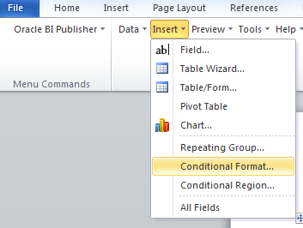
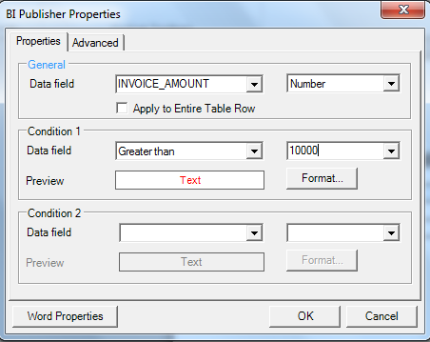
Other advanced concepts
Conditional formatting

Slide 38
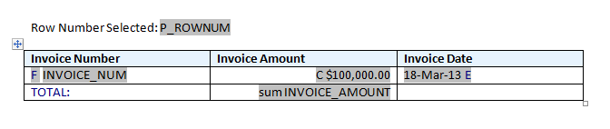
Other advanced concepts
Resulting template
Denoted by the C – double click here to edit.

Slide 39
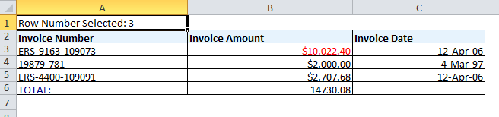
Other advanced concepts
Conditional formatting
Result

Slide 40
Other advanced concepts
Excel templates
Patch 12415414 to enable them

Slide 41
Other advanced concepts
Why Excel template instead of RTF?
Multiple tab
Calculations/Functions
Binary/Excel output (smaller file output sizes)

Slide 42
Modify Existing Reports
Step 1:
Download the data definition file.
Create your own copy.
Alter the SQL or PL/SQL

Slide 43
Modify Existing Reports
Step 2:
Upload Data Defintion against a MOD version.

Slide 44
Modify Existing Reports
Step 3:
Create your modified concurrent report as a copy where appropriate
Test the new data definition and retrieve the XML output

Slide 45
Modify Existing Reports
Step 5:
Upload the Template file as a MODS version.
Retest your concurrent program

Slide 46
Modify Existing Reports
Step 4:
Download the standard RTF Template – modify with your retrieved XML.
TEST standalone.

Slide 47
Any questions ?

