Slide 2
Cloud Integration Reference Architecture Fire Alarm Demo
James Taylor
Oracle Fusion Middleware
james.x.taylor@oracle.com

Slide 3
Agenda
Introduction
Proposed Architecture
Benefits
Summary
Introduction
Proposed Architecture
Benefits
Summary
.

Slide 4
Introduction
Fire Alarm Scenario – An alerting system for people in bush fire threatened areas
Time-sensitive
Reliable
Utilising Cloud Services to provide enhanced functionality
Leverage Out of the Box Functionality in Oracle Middleware to Integrate between Public and Private Clouds.
Hybrid Cloud Integration
High Availability
Performance
Reliability
Scalability

Slide 5
Agenda
Introduction
Proposed Architecture
Benefits
Summary
.

Slide 6
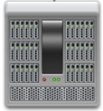
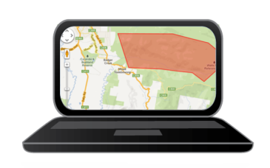
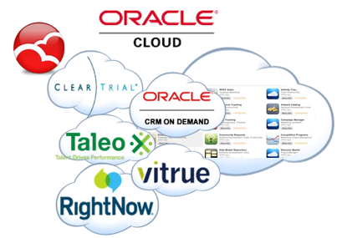
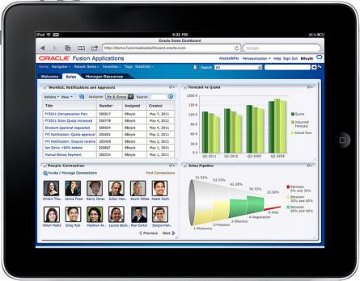
Proposed Architecture High Level
API
BPEL
UMS
SERVICE BUS
.

Slide 7
Proposed Architecture
Hybrid Cloud Integration
OSB to facilitates service virtualisation across Public & Private Clouds
BPEL - Quick Service Orchestration/Generation by using available Virtual OSB services
Coherence provides a Cloud-based Cluster for Parallel Processing
BPM promotes Business Innovation and Change Management connecting traditional Silos across Public/Private Clouds
Hybrid Cloud Integration
Oracle Service Bus
Oracle Coherence
BPEL
BPM

Slide 8
Proposed Architecture (Cont)
1) Mobile Application:
Captures User’s Geo-location, Mobile and Language preferences
Integrates seamlessly with OSB via a RESTful invocation
OSB receives invocation with a “Person” details and stores this information in Coherence by using the out-of-the box “Result Caching” Capabilities
Hybrid Cloud Integration
Oracle Service Bus
Oracle Coherence
BPEL
BPM

Slide 9
Proposed Architecture (Cont)
2) Fire Alarm Web Site:
Mapping application defines “at risk areas” by using Google Maps.
Integrates seamlessly with OSB via a RESTful invocation
OSB receives invocation with a “Fire Alarm Zone” details and stores this information in Coherence by using the out-of-the box “Result Caching” Capabilities
Hybrid Cloud Integration
Oracle Service Bus
Oracle Coherence
BPEL
BPM
Notes:
All kinds of data
Large volumes
Valuable insight, but difficult to extract (structured and unstructured data)
Often extremely time sensitive
Most of the vast data types portrayed here is consumer data and while the business will want to leverage Oracle Event Processing for business and application data, they are also impacted by this consumer data and information from the vast array or sensors where stream events showing temperatures in a container mid-pacific may destroy high cost food goods unless immediate action is taken or …
.. For Starbucks immediately analyzing tweats after launching a new coffee, seeing spikes of negative comments, and very quickly figuring out that the negative reactions came from stores that were serving a particular warmed cheese sandwich, whose aroma did not go with the new coffee smell….. Huge ROI due to quick analysis and specific targeted response.
And as you can see from A bank solution, a customers Tweets are also being analzed by Oracle Event Processing and stored in Big Data to augment his preferences and influence his/her real time targetted campaigns

Slide 10
Proposed Architecture (Cont)
3) Fire Alarm Engine:
Coherence Cluster will react based on the Fire Alarm Event and it will initiate an “in-parallel task” to correlate all “Person” entries within the “Fire Alarm Zone”.
NOTE: This task is executed across all servers in the cluster in parallel.
Coherence will invoke the “Notification Engine” for each Person found in the “Fire Alarm Zone”
Hybrid Cloud Integration
Oracle Service Bus
Oracle Coherence
BPEL
BPM

Slide 11
Proposed Architecture (Cont)
4) Notification Engine:
Notification Engine will integrate with the Notification Engine via a Custom Coherence JCA Adapter, which was implemented by the JCA SDK Framework.
A BPEL Subscriber will receive the message via the Coherence JCA Adapter and it will enrich it by using virtual Services via OSB:
SalesForce Cloud CRM
Google Cloud (Translation Services)
Hybrid Cloud Integration
Oracle Service Bus
Oracle Coherence
BPEL
BPM

Slide 12
Proposed Architecture (Cont)
4) Notification Engine (cont):
BPEL Service will send the “enriched message” to an OSB “virtual messaging provider” service, that happens to interact with a final SMS Cloud Provider via UMS engine.
Note: Since the Notification Engine uses “reliable messaging”, in case of any error, the transaction will rollback and the message will be sent back to the Coherence Cache. i.e. No messages will be lost in case of failure!
Hybrid Cloud Integration
Oracle Service Bus
Oracle Coherence
BPEL
BPM

Slide 13
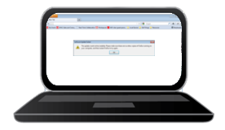
Proposed Architecture Fire Alert System (Emergency Services) - Technical Level
3
6
Continuous and Parallel Queries
7
JCA
<People in
threatened Area>
BPEL
2
5
<SOA-Direct>
<OSB In-built Caching>
<OSB In-built Caching>
8
<SOA-Direct>
<SOA-Direct>
10
12
Oracle Service Bus
(OWSM)
1
4
9
11
13
<RESTful>
<RESTful>
<RESTful/SOAP>
<RESTful>
<RESTful>
14
SMS
Provider
Registration Website
Alerting Website
Notes:
Steps:
1. User registers their mobile number and language preferences through a simple website. The website notes their location using the navigation implementation in HTML5. This data is then transmitted through a RESTful interface to OSB.
2. OSB stores the language preferences in a database table and using the built in Result Caching in OSB, the location data is loaded into a Coherance cluster.
3. Utilising the Java API for Coherance, specifically the Continuous Query Cache listener, this data is transformed into a Java object, which is more easily manipulated later.
4. A fire authority user is able to define at-risk areas using a simple mapping interface.
5. This area data is then loaded into the Coherance cache in the same way as the mobile user’s location data.
6. Upon detecting the creation of an at-risk area, the Coherance cluster raises an event and kicks off a Parallel query. This query determines which, if any, users are in danger.
7. The relevant information about at-risk people is placed into a JMS message.
8. Which, using a publish/subscribe model, is used to kick off a BPEL process.
9/10. The BPEL process checks the stored language preferences of the registered user, using their phone number as an identifier.
11. If the language preference is not English, then a request is made to translate the alert message.
12. OSB transforms the SOAP-based SOA-Direct request into a RESTful invocation of the Google Translate API to facilitate the translation.
13. Once the final message is determined, a request is made to send the SMS notification.
14. Likewise, OSB transforms the SOAP-based SOA-Direct request into a RESTful invocation of a public SMS service in order to notify those people in danger.
15. Those people who registered within the at-risk area receive a message, in their natural language, notifying them of the danger posed and further actions to be taken.

Slide 14
Proposed Architecture Good Guys/Coles System (Retail) - Technical Level
6
JMS Topic
OEP
7
<JCA>
Continuous and Parallel Queries
5
<People in
threatened Area>
BPEL
2
4
<SOA-Direct>
<OSB In-built Caching>
<OSB In-built Caching>
8
<SOA-Direct>
10
Oracle Service Bus
OEG
DMZ
3
11
<RESTful>
<RESTful>
1
9
<RESTful/SOAP>
<RESTful>
SMS
Provider
Mobility / Tracking
Area Definition Website
Notes:
Steps:
1. User registers their mobile number and language preferences through a simple website. The website notes their location using the navigation implementation in HTML5. This data is then transmitted through a RESTful interface to OSB.
2. OSB stores the language preferences in a database table and using the built in Result Caching in OSB, the location data is loaded into a Coherance cluster.
3. Utilising the Java API for Coherance, specifically the Continuous Query Cache listener, this data is transformed into a Java object, which is more easily manipulated later.
4. A fire authority user is able to define at-risk areas using a simple mapping interface.
5. This area data is then loaded into the Coherance cache in the same way as the mobile user’s location data.
6. Upon detecting the creation of an at-risk area, the Coherance cluster raises an event and kicks off a Parallel query. This query determines which, if any, users are in danger.
7. The relevant information about at-risk people is placed into a JMS message.
8. Which, using a publish/subscribe model, is used to kick off a BPEL process.
9/10. The BPEL process checks the stored language preferences of the registered user, using their phone number as an identifier.
11. If the language preference is not English, then a request is made to translate the alert message.
12. OSB transforms the SOAP-based SOA-Direct request into a RESTful invocation of the Google Translate API to facilitate the translation.
13. Once the final message is determined, a request is made to send the SMS notification.
14. Likewise, OSB transforms the SOAP-based SOA-Direct request into a RESTful invocation of a public SMS service in order to notify those people in danger.
15. Those people who registered within the at-risk area receive a message, in their natural language, notifying them of the danger posed and further actions to be taken.

Slide 15
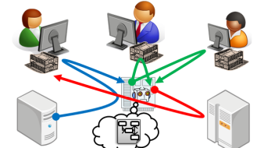
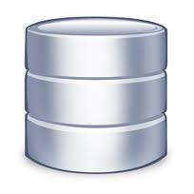
Proposed Architecture Deakin University System (Education) - Technical Level
6
JMS Topic
OEP
7
<JCA>
Continuous and Parallel Queries
5
<People in
threatened Area>
BPM
2
4
<SOA-Direct>
<OSB In-built Caching>
<OSB In-built Caching>
8
<SOA-Direct>
10
Oracle Service Bus
OEG
DMZ
3
11
<JCA>
<JCA>
1
9
<RESTful/SOAP>
<RESTful>
SMS
Provider
Student Systems
Databases/Repositories
Notes:
Steps:
1. User registers their mobile number and language preferences through a simple website. The website notes their location using the navigation implementation in HTML5. This data is then transmitted through a RESTful interface to OSB.
2. OSB stores the language preferences in a database table and using the built in Result Caching in OSB, the location data is loaded into a Coherance cluster.
3. Utilising the Java API for Coherance, specifically the Continuous Query Cache listener, this data is transformed into a Java object, which is more easily manipulated later.
4. A fire authority user is able to define at-risk areas using a simple mapping interface.
5. This area data is then loaded into the Coherance cache in the same way as the mobile user’s location data.
6. Upon detecting the creation of an at-risk area, the Coherance cluster raises an event and kicks off a Parallel query. This query determines which, if any, users are in danger.
7. The relevant information about at-risk people is placed into a JMS message.
8. Which, using a publish/subscribe model, is used to kick off a BPEL process.
9/10. The BPEL process checks the stored language preferences of the registered user, using their phone number as an identifier.
11. If the language preference is not English, then a request is made to translate the alert message.
12. OSB transforms the SOAP-based SOA-Direct request into a RESTful invocation of the Google Translate API to facilitate the translation.
13. Once the final message is determined, a request is made to send the SMS notification.
14. Likewise, OSB transforms the SOAP-based SOA-Direct request into a RESTful invocation of a public SMS service in order to notify those people in danger.
15. Those people who registered within the at-risk area receive a message, in their natural language, notifying them of the danger posed and further actions to be taken.

Slide 16
Proposed Architecture
(Cont.)
Hybrid Cloud Integration
Public Cloud
Private Cloud
Reasons behind using OSB
Reasons behind using Coherence

Slide 17
Technical Considerations
OSB Coherence entries expire after 2 minutes:
Prevents from sending duplicated alarms
Throttles “Person” locations
Fire Alarm Coherence entries do not expire, they are simply updated e.g. Person’s location or preference language.
Coherence CQC enriches OSB Coherence Entries and move them to an “easier to manage” Fire Alarm Coherence Entries

Slide 18
Technical Considerations (Cont.)
Custom Coherence JCA Adapater (extending JCA SDK)
Technical Components of this System:
WebLogic: Proxy, Coherence Cluster, DS, JMS, and SSL.
SOA project (Notification Engine)
Coherence API (Fire Alarm Engine)
OSB Projects (Service Virtualisation)
HTML 5-based Web sites (Fire Alarm Web Sites)

Slide 19
Challenges / Solutions
Challenges | Solutions
Creating a geo-fencing application | Google Maps API
Establishing a user’s GPS Location | Utilise HTML5 standards for navigation to retrieve location.
Seamlessly Integration between Oracle Products and External Applications | OSB and BPEL
Large Volumes of Data/Time Sensitive | Coherence - Caching and cluster in-parallel processing

Slide 20
Agenda
Introduction
Proposed Architecture
Benefits
Summary
.

Slide 21
Benefits
Integration in-house Applications and systems with External Services e.g. Google Cloud, SMS Cloud Providers
Real-time response time
Caters for Multi-lingual responses
Result Caching through Oracle Coherence:
Reduces response times
Saves costs
JCA facilitates reliable event-driven behaviour

Slide 22
Agenda
Introduction
Proposed Architecture
Benefits
Summary
.

Slide 23
Summary
OSB virtualises every interaction with Local and External Services, making a Hybrid Cloud Integration very easy to achieve.
Using Coherence for in-parallel real-time Cluster Based Processing and Integration
BPM promotes Business Innovation by allowing “Change Management” across Public and Private Clouds.

Slide 24
What next?
BPM Integration – Incident Report
Fusion CRM Integration
RightNow Integration
Extend Template for other Business Cases.
ADF Mobile
Integration with OEP for more complex event correlation

