Slide 1
Database Consolidation with Oracle

Slide 2
Agenda
Introduction
Database Consolidation Approach
Problems seen – no consolidation
Business need for Consolidation
Consolidation Case Study
  Oracle solution architecture
  Useful Information
Stake Holder Value proposition
Benefits achieved
Oracle migration tools
Cloud Future Proofing

Slide 3

Introduction
Myself - Sumanth Kaushik
Work for Hewlett Packard as a Senior Database Consultant
13 Years of Oracle specialist experience as a DBA, Database Architect & Database Consultant
Specialize in Oracle RAC, Oracle Streams and Oracle Golden Gate
OCP 11g DBA and Oracle Certified 10g RAC
Eager Crossfitter

Slide 4
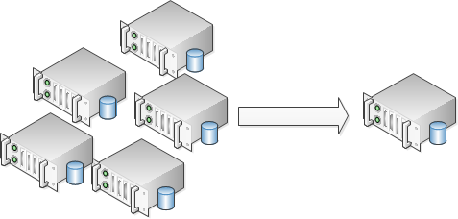
Database Consolidation Approach
Hardware Consolidation
  Multiple database consolidated into one or more servers (clusters)
Software Consolidation
  Multiple schemas consolidated into a single database

Slide 5
Database Consolidation Approach
Hardware Consolidation
  Benefits
    Risk reduction, Ease of manageability
  Risks
    Resource Crunch
Software Consolidation
  Benefits
    Fine Granularity, Database redesign
  Risks
    High risk & Change control

Slide 6

Problems Seen / Business Needs
Separate Infrastructure acquisition
High maintenance costs
High Deployment costs
High Database deployment timelines
Oracle versions diversity
Non Standard database support tools
Hard to Capacity Plan
High Licensing Costs
No Security controls

Slide 7
Oracle Solution Architecture
DB ORTO/DRTO’S
Service Class | ORTO | DRTO
Tier 1 | <30 min | <1 hour
Tier 2 | <4 hours | <48 hours
Tier 3 | <8 hours | <1 month
Non Production | <72 hours | <3 months

Slide 8
Oracle Solution Architecture
Overview
Solution | Operating System | Oracle Tools Used
Oracle Shared Platform Infrastructure | Red Hat Enterprise Linux 5.7 | Oracle 11.2.0.3 RAC Oracle 11.2.0.3 ASM Oracle 11.2.0.3 64-bit Enterprise Edition RAC Oracle 11g OEM Grid Control Oracle DataGuard
Notes:
Key factors
Cluster size
How many databases
Versions
Migration
Products
Fits into client architecture
Hardware consolidation

Slide 9
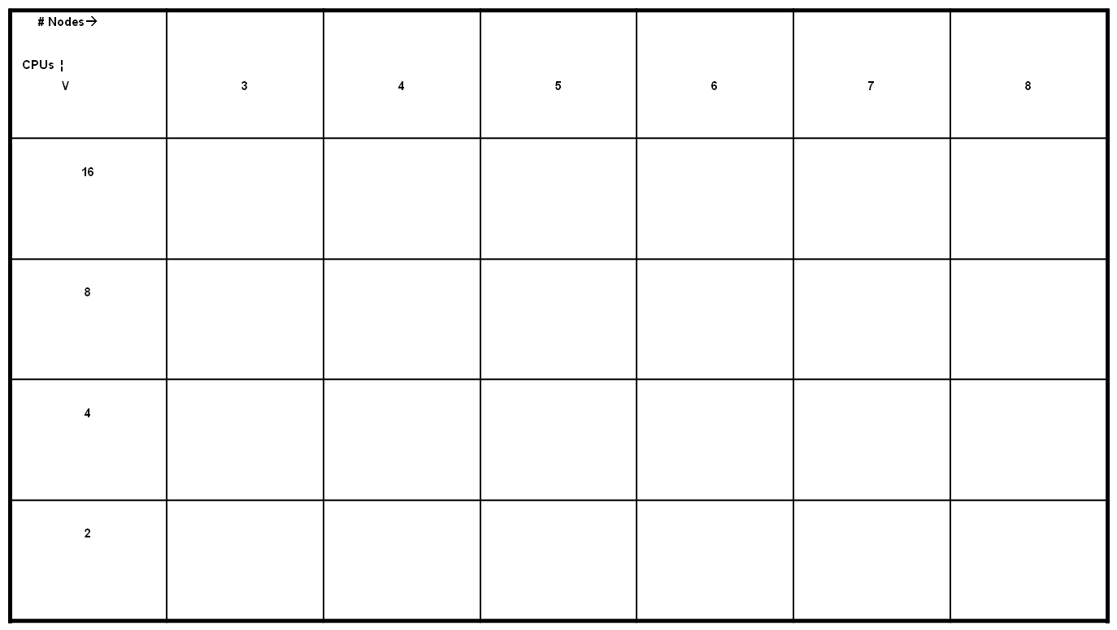
Oracle Solution Architecture
Cluster sizing
Large % capability increments not used (immediately)
“Expensive” increments
Bad N+1 price / performance
Optimised server purchase value, N+1
system availability, and consolidation
Higher patching and maintenance overhead*, but better N+1 price/ performance
SWEET SPOT
Good N+2 price / performance, but leads to more clusters
Notes:
Notes :

Slide 10

Oracle Solution Architecture
Key decisions
Cluster Size
  3-6 nodes per cluster
Server Size
  HP DL585 G7 – 24 cores /256 GB RAM
  HP DL380 G7 – 16 cores/ 16 GB RAM
Oracle instances
  15-20 instances per server
NICs
  1GbE Network Interface Cards

Slide 11
Oracle Solution Architecture
Disaster Recovery decisions
Stretch/ Extended Cluster
  Relatively Rare
  Heavily reliant on Infrastructure
  Third Site required for vote disk
SAN replication
  Relatively Simple
  Reliance on Storage Team
Oracle DataGuard
  Complies with Oracle MAA
  Offers snapshot/active configuration
  Standby can offer backups/reporting

Slide 12
Oracle Solution Architecture
Oracle services
Workload partitioned between cluster
Available/ Preferred mechanism
Prod / Test services
Backup services
Ad-hoc services for month-end/batch processing
Service | Preferred Instance | Available Instance | Comment
<db_name>_prod | <inst_name> | <inst_name> | Application Service
<db_name>_backup | <inst_name> | <inst_name> | Backup Service

Slide 13
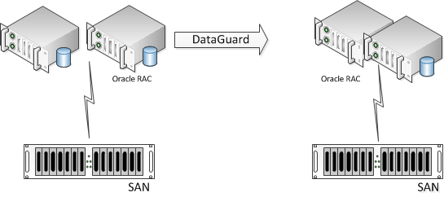
Oracle Solution Architecture
Oracle infrastructure Tiers
Tier 1

Slide 14
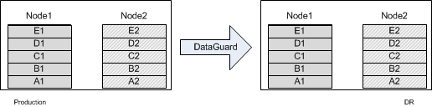
Oracle Solution Architecture
Oracle infrastructure Tiers
Tier 1
“2N” Solution for Tier 1
Atleast 2 instances running on the cluster.
Instances in Preferred/Available configuration.
Available/Preferred in Node-Pair Configuration.
Available/Available Configuration for Oracle RAC supported applications

Slide 15
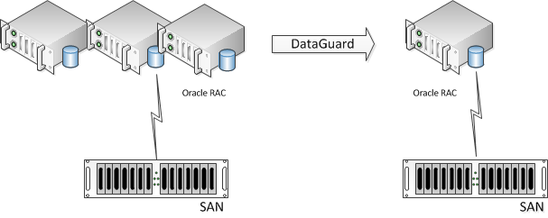
Oracle Solution Architecture
Oracle infrastructure Tiers
Tier 2

Slide 16
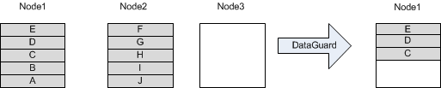
Oracle Solution Architecture
Oracle infrastructure Tiers
Tier 2
“N+1” Solution for Tier 2
Assign databases to use maximum resources
Instances in Available Configuration
Node failure can accommodate capacity on surviving nodes
Available configuration - RAC supported app/Adhoc processing
Notes:
Orca adopts the simplest method of managing redundancy in an Oracle cluster:
Use nodes with uniform resource capacity
Use one node as the unit of cluster resource allocation / redundancy ("N+1")
Assign databases to nodes so they utilise the resources as much as possible without service levels becoming unacceptable during peak loads. Capacity monitoring and planning is still required to handle growth and to accommodate new databases, but this can be managed; whereas failure situations require simple and sure resolutions.
Interconnect traffic is minimised.
Only 80% of the nodes are active nodes, so the effort required for some monitoring and management tasks is reduced.
Adding a node doesn't require rebalancing the allocations of resources across the cluster. ^{[H410]}
Applications that don't support RAC may still be accommodated into this environment because under normal conditions, only a single instance is active at any one time. The database is still vulnerable to RAC bugs and some of the overhead, but there is less reliance on RAC compatible application design.

Slide 17
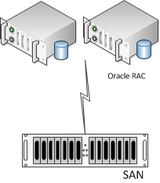
Oracle Solution Architecture
Oracle infrastructure Tiers
Tier 3

Slide 18
Oracle Solution Architecture
Oracle infrastructure Tiers
Non Production

Slide 19
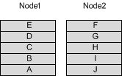
Oracle Solution Architecture
Oracle infrastructure Tiers
Tier 3/Non-Production
No dedicated redundancy.
Spare capacity for new databases.
Instance always in Available configuration

Slide 20
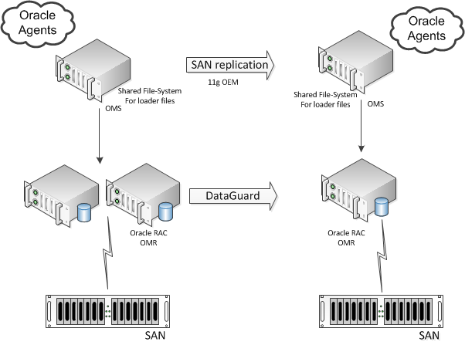
Oracle Solution Architecture
Oracle infrastructure Tiers
Management Tier

Slide 21
Oracle Solution Architecture
Oracle ASM
Tier | Disk Group | Disk Type
Tier 1 | DATA/FRA/ OCR/VOTE | Fast
 | WORK | SATA
Tier 2 | DATA/OCR/VOTE | Fast
 | FRA | SATA
 | WORK | SATA
Tier3 | DATA/FRA OCR/VOTE | SATA
 | WORK | SATA

Slide 22
Oracle Solution Architecture
Oracle Product Platform
Security
Oracle Audit Vault
Oracle Advanced Security
Oracle Label Security
Change Management
Oracle Change Management Pack
Oracle Configuration Management Pack
Provisioning &
Operational Management
Oracle Active Data Guard
Oracle RAC
Oracle RMAN
Oracle OEM 12c Grid Control
Oracle DBCA
Life Cycle Management &
Work Load Forecasting
Oracle Partitioning
Oracle Advanced Compression
Oracle Real Application Testing

Slide 23
Oracle Solution Architecture
Some more useful stuff
RMAN backups
Oracle Advanced Compression
Oracle DataGuard
Instance caging
ACFS
SCAN Names & Listener

Slide 24
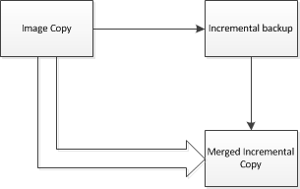
Useful Information ..
RMAN backups
Backup stored in FRA – Tier1/Tier2
LAN Free backup
Compression using RMAN backup
Usage of block change tracking
Incremental backup with updated image copy

Slide 25

Useful Information ..
Oracle Advanced Compression
Usage of compression with OLTP databases
    2x compression seen in most cases
    Performance improvement in queries
    Reduction in Disk IOPS
    No noticeable impact with writes
One of our migrated databases went from 1.5 TB to 800G

Slide 26
Useful Information ..
SCAN Names & Listener
SCAN name per cluster
Dedicated Listener per database on RAC nodes
Non default ports for Oracle listeners

Slide 27
Useful Information ..
ACFS & Oracle DataGuard
Oracle DataGuard
  Usage of active-dataguard for offload reporting
  Snapshot standby for update version of standby
ACFS
  Used for storing DBA files/RMAN backup scripts
  Migration file-store

Slide 28
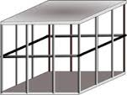
Useful Information ..
Instance Caging
Multiple databases on a server share CPU/ Memory and I/O
Instance caging – limit CPU of an Instance
Two Approaches
    Over-provisioned Approach - Development/ UAT
    Partitioning Approach – Production

Slide 29
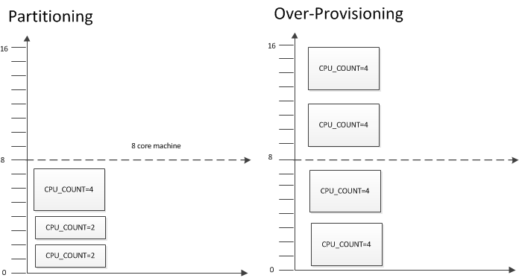
Useful Information ..
Instance Caging

Slide 30
Benefits Achieved
No need for Separate Infrastructure acquisition
Reduced hardware requirements
Cost Effective Infrastructure
Improved Asset Allocation
Lower cost to Provision
Lower cost to Extend capacity
Reduced manageability
Reduced Licensing Costs
Network Capacity Utilization
Agility/ Efficiency & Standardization
Future scoping for Private Clouds/DBaaS

Slide 31
Stake Holder - Value Proposition
Stake Holders | Concerns | Value Proposition | Products
Financial Controller | Cost of the project | Initial project costs provide saving in the next 3 years | Oracle RAC Oracle ASM Oracle Golden Gate Oracle Active Data Guard Oracle OEM Grid Control Oracle Advanced Compression
Enterprise Architect | Future Proofing Application compatibility Licensing New Technology RPO/ RTO/ DRTO Migration mechanism | New and fully supported technology Lower Licensing costs Platform meets RPO/RTO and DRTO requirements Roadmap secure for the next 3 years Zero downtime migrations | Oracle RAC Oracle ASM Oracle Golden Gate Oracle Active Data Guard Oracle OEM Grid Control
Business Unit | Performance Support High Availability Deployment time Migration time | Better performance Better Support High availability with zero downtime Quick deployment on new platforms Zero downtime migration | Oracle RAC Services Oracle Golden Gate Oracle Active Data Guard Oracle Management Packs

Slide 32
Stake Holder - Value Proposition
Stake Holders | Concerns | Value Proposition | Products
Infrastructure Manager | Storage Costs Network consumption Power consumption Asset space Maintenance costs | Reduction in Storage costs Cost savings in Network/Power and Assets | Oracle Advanced Compression Oracle Active Data Guard
Risk Manager | Infrastructure Security Compliance Application Security Compliance | New Infrastructure for security tools to meet audit requirements | Oracle Label Security Oracle Audit Vault Oracle Advance Security

Slide 33
Data Migration
Common tools used
Oracle Datapump
Oracle GoldenGate
Oracle Conventional Export/Import
Oracle Streams
Oracle DataGuard

Slide 34
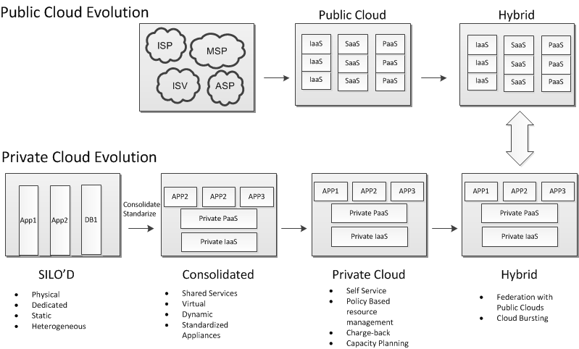
Cloud Evolution – Future Proofing

Slide 35
In the end ..
“An idea that is developed and put into action is more important than an idea that exists only as an idea.”
-Buddha

Slide 36
Thank You
Questions please ..
Sumanth Kaushik

