Slide 1

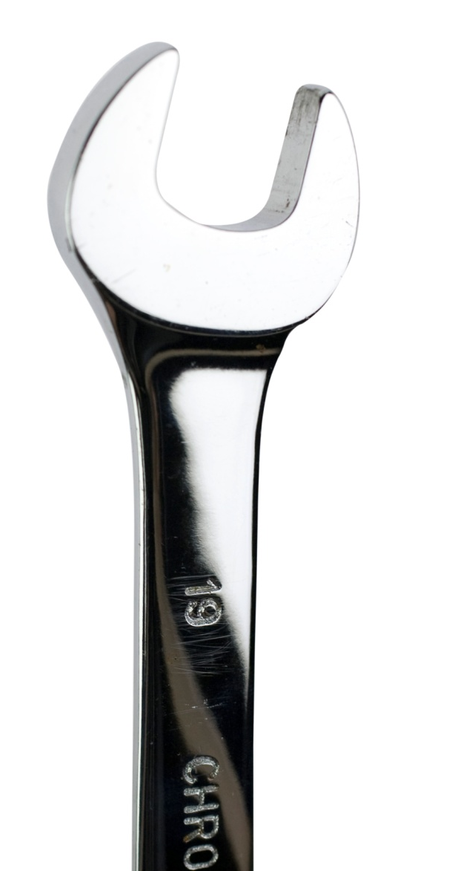
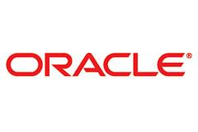
Oracle Fusion Applications
“The end of the beginning”:
Why Fusion Applications?
Who is deploying?
What are the steps to be taking?
Diamond Partner

Slide 2
Presenting Today
John McDonald | Senior Manager, Deloitte, New Zealand
John Hansen | Senior Director, Applications Development & Product Management, Oracle Corporation, Japan and Asia-Pacific

Slide 3
Agenda
1. Why Fusion Applications?
What is Fusion Applications?
What is the Fusion Applications Design Philosophy and Partner Model?
4. What is Oracle’s Fusion Applications “Early Adopter Program”?
5. How do Fusion Applications look and feel?
6. Where are the Deloitte Fusion Applications Implementations?
7. What are the next steps to be taking now?
8. Questions and Answers

Slide 4
Why Fusion Applications?

Slide 5
Why is Oracle focussing on Fusion Applications?
Oracle’s acquisitions have created significant opportunities:
Positioned Oracle to be the #1 ERP vendor and the #1 CRM vendor in the world

Slide 6
Why is Oracle focusing on Fusion Applications?
Oracle’s acquisitions have created significant opportunities:
Positioned Oracle to be the #1 ERP vendor and the #1 CRM vendor in the world
While also creating some challenges:
Necessitated a change in product development strategy

Slide 7
Why is Oracle focusing on Fusion Applications?
Oracle’s acquisitions have created significant opportunities:
Positioned Oracle to be the #1 ERP vendor and the #1 CRM vendor in the world
While also creating some challenges:
Necessitated a change in product development strategy
There is an increasing customer demand for solutions that can:
Leverage their existing technology investments
Provide modular approach to implementation that provides a lower TCO
Provide an architecture that can scale and adapt to business acquisitions and changes
Optimal operational decisions
Empowered information workers. BI is embedded as part of transaction flow

Slide 8

Oracle is consolidating their acquisitions and will roll out the newly developed Fusion Applications program on to the Global Market
Sigma
Dynamics
Telephony@Work
360Commerce
AutoVue
Sunopsis
Crystal Ball
OctetString
ProfitLogic
SleepyCat
MetaSolv
AppForge
Context Media
Bharosa
Tangosol
Innobase
Portal
Software
Triple Hop
HotSip
Thor
Technologies
Stellent
TempoSoft
TimesTen
JD Edwards
Oblix
LODESTAR
Agile
Bridgestream
BEA
I-flex
Retek
G-Log/OTM
Demantra
PeopleSoft
Siebel
Hyperion
Oracle EBS
SUN
MicroSystems
FUSION
“You assemble the components in the order that you want to use them.”
“It is a big project and we have been working on it for a long time…Fusion applications are brand new. They are completely architected around a service oriented architecture. Fusion is the only suite of applications built on standards-based middleware. Siebel wasn’t, eBusiness Suite wasn’t, SAP isn’t…”
- Larry Ellison, Oracle CEO

Slide 9
Path to Fusion
Continue on your current path Consider upgrade to the latest Applications Unlimited releases that will provide direct upgrade path to Fusion Move toward SOA and build skillsets around Fusion Middleware For customer development, ensure all integration are through supported interface points in Integration Repository, use BI Publisher and Oracle Application Framework
Move to Fusion step-by-step (coexistence) Add Fusion Application modules when available to existing Apps Unlimited or non-Oracle applications environment Adoption approach can be stand alone (not integrated), loosely integrated (custom), or tightly integrated with existing applications (pre-packaged coexistence integrations)
Upgrade to Fusion Applications Upgrade by pillar or single global instance when applications are available, and when you’re ready Oracle plans to provide direct upgrade path for select Apps Unlimited solutions to Fusion
Notes:
For organizations that choose to upgrade to a new Application Unlimited releases, consider
Upgrade to AU releases that will provide direct upgrade path to Fusion
Move toward SOA as integration platform and build skillsets around Fusion Middleware, JDeveloper, ADF and OBIEE
For custom developments or updates, ensure all integration are through supported interface points published in Integration Repository, use BI Publisher and Oracle Application Framework

Slide 10
What is Fusion Applications?

Slide 11
What is Oracle Fusion Applications?
The next generation Application Suite. It is the future of Oracle!
1. Adaptable
Built on standard, commercially-available middleware and supports SOA for simplified integration
Simple Integration, Lower Cost
Lower Cost Pool of IT Talent – Java based
Notes:
Code is built from scratch on Fusion Middleware
Consists of the best functionality from Apps Unlimited solutions, newly developed, all to guarantee: Adaptability, Productivity and Manageability
Lower integration costs and complexity
Reuse business services that you’re building today
Create services with single source of master data
Protect Ability to upgrade
Eliminate Costly Customisations
Lower cost localistions
Define and modify attributes of “best-of” data model …
Evolve business processes alongside your business model …
Implement and maintain business policies and procedures …
Select KPIs to display and save searches …
Personalize pages and dynamically show/hide views …

Slide 12
What is Oracle Fusion Applications?
The next generation Application Suite. It is the future of Oracle!
1. Adaptable
Built on standard, commercially-available middleware and supports SOA for simplified integration
Simple Integration, Lower Cost
2. Productive
Embedded business intelligence for better business management
Rich, productive, consistent user experience; Customer-Driven Design
Resulting in Large Productivity Gains
Lower Cost Pool of IT Talent – Java based
Notes:
Code is built from scratch on Fusion Middleware
Consists of the best functionality from Apps Unlimited solutions, newly developed, all to guarantee: Adaptability, Productivity and Manageability
Lower integration costs and complexity
Reuse business services that you’re building today
Create services with single source of master data

Slide 13
What is Oracle Fusion Applications?
The next generation Application Suite. It is the future of Oracle!
1. Adaptable
Built on standard, commercially-available middleware and supports SOA for simplified integration
Simple Integration, Lower Cost
2. Productive
Embedded business intelligence for better business management
Rich, productive, consistent user experience; Customer-Driven Design
Resulting in Large Productivity Gains
3. Manageable
Products can be implemented individually (modularized approach)
Flexible deployment options; on premise, hosted & managed, on demand or an hybrid
Lower Cost Pool of IT Talent – Java based
Rapid setup, with Setup Manager
Notes:
Code is built from scratch on Fusion Middleware
Consists of the best functionality from Apps Unlimited solutions, newly developed, all to guarantee: Adaptability, Productivity and Manageability
Lower integration costs and complexity
Reuse business services that you’re building today
Create services with single source of master data

Slide 14
What is the Fusion Applications Design Philosophy and Partnership Model?

Slide 15

The Making of Fusion Applications
All in Collaboration with Oracle’s Customers and Partners
Started with a Modern Platform
Industry-leading, standards-based, configurable, adaptive and secure Fusion Middleware
Built Best Practice Business Processes Based On Hundreds of Years of Learning
E-Business Suite, PeopleSoft, JD Edwards, Siebel
Reinvented the User Experience
Role-based user interface, embedded decision support, pervasive collaboration
When and Where You Need It
Delivered on premise, hosted, on demand, or a hybrid model
All in Collaboration with Oracle’s Customers and Partners
Notes:
Review slide

Slide 16

Oracle Invests In The Future
100% Open Standards
User Experience
Mobile Computing
Cloud Computing
Service Oriented Architecture
Modularity
Enterprise 2.0
Embedded Analytics
Private Clouds
Public Clouds
Cloud Services
Smartphones
Tablet PCs
Notes:
Starting with the first commercial relational database thirty years ago, Oracle has a long history of innovation. Today, we see a major technological shift happening and have invested in a number of areas. The first is strict adherence to open standards and service-oriented enterprise architecture. The second is the user experience. The third is cloud software and services, and the fourth is mobile computing.

Slide 17
Extremely Powerful
Financial Management
Human Capital Management
Supply Chain Management
General Ledger
Accounts Payable
Asset
Mgmt
Global Human Resources
Workforce Lifecycle Mgmt
Benefits
Product Master Data Mgmt
Distributed
Order Orchestration
Global Order Promising
Payments &
Collections
Accounts Receivable
Cash &
Expense Mgmt
Workforce Compensation
Talent
Review
Performance
& Goal Mgmt
Inventory
Mgmt
Cost
Mgmt
Shipping & Receiving
Common Modules
Integrated BI, Social &
Extensibility
Global
Payroll
Network @ Work
Integrated BI, Social &
Extensibility
Integrated BI, Social & Extensibility
Project Portfolio Management
Procurement
Customer Relationship Management
Project
Costing
Project
Billing
Project Performance Reporting
Purchasing
Self-service Procurement
Sourcing
Customer Master
Sales
Marketing
Project Control
Project Integration Gateway
Project Contracts
Procurement Contracts
Supplier
Portal
Spend & Performance Analysis
Incentive
Compensation
Mobile & Outlook Integration
Territory & Quota Mgmt
Integrated BI, Social & Extensibility
Integrated BI, Social & Extensibility
Integrated BI, Social & Extensibility
Governance, Risk & Compliance
Financial Compliance
Issue & Risk Manager
Access
Controls
Transaction Controls
Configuration Controls
Integrated BI, Social &
Extensibility
Notes:
Complete Suite – over 100 modules
Fusion Applications 11g is a complete suite of integrated business applications covering Financial Management, HCM, SCM, PPM, Procurement, CRM & GRC. Each of these product families have deep and broad capabilities that re delivered in a modular form. What makes Fusion Applications unique is that functional depth can be consumed by module. So, as we will see, you can start with a module or a family and go to the suite when you are ready.
At OpenWorld, if you have not already explored the breadth Fusion Apps, you can get a demo on the show floor and we have sessions for every product area detailing more about what is available. You can also get more information at www.oracle.com/fusion

Slide 18
Fusion Applications - Now Generally Available
10,000
1,000
400
Customer Interactions
Early Adopters
Attendees at OpenWorld
11g
1,200
500
100
Training Artifacts
Validation Partners
Live Customers
Notes:
Fusion Apps - GA: 2 minutes
Steve
10,000 Formal customer interactions to review Fusion in the development scoping process
1,200 Fusion training artifacts on OTN
1,000 Early Adopter Nominations
500 Partners and companies involved in hands on validation sessions at Oracle facilities
400 in the Fusion Nation at OOW (Red Jacket crew)
100 customers current live and implementing Fusion Solutions.
Fusion Applications ARE REAL.

Slide 19
























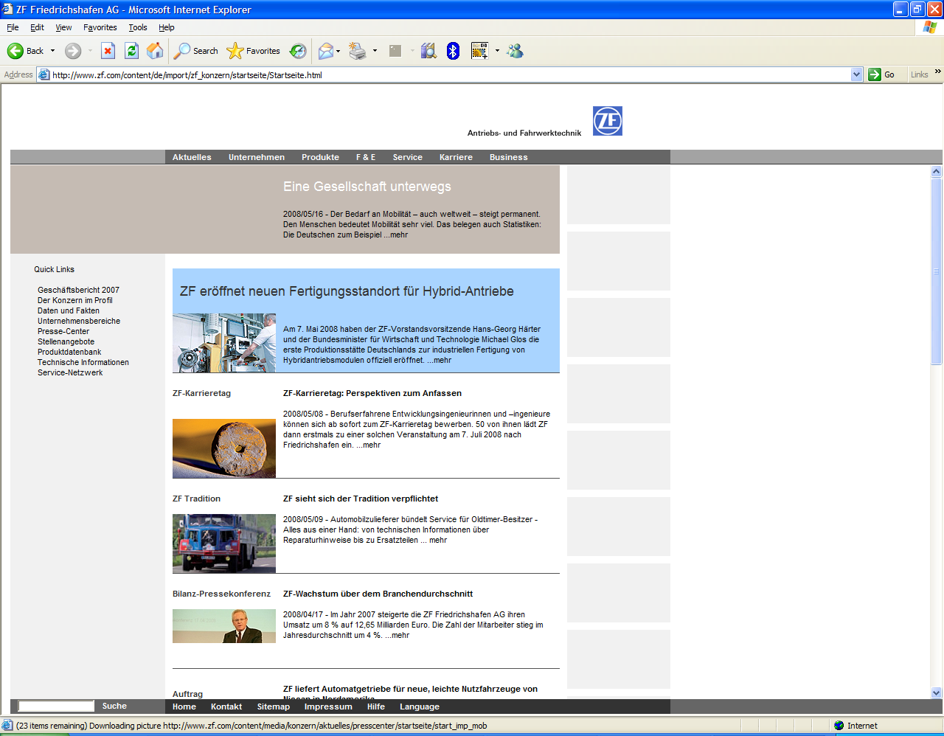


















Fusion Applications

Slide 20
Summary and Takeaways
Upgrade
to Latest Oracle
Applications Release
Optimize
Performance with Oracle Technology & Systems
Extend
Business Value with
Co-existence Opportunities
E-Business
Suite 12.1
VCP 12.1
Demantra 7.3
Oracle SOA Suite and AIA
Oracle
OBIEE
BI Apps
SCM
Apps
JD Edwards
E1 9.0
OTM 6.1
WMS 12.1
Oracle ADF & WebCenter
Oracle Identity
Mgmt
Hyperion
EPM
Fusion
Apps
JD Edwards
World A9.2
Agile
PLM 9.3
Oracle Content Management
Oracle Enterprise
Mgr
GRC
CRM
Cloud
PeopleSoft
Enterprise 9.1
Agile PLM for Process 6
Exadata
Exalogic
ATG
HCM
Cloud
Siebel
CRM 8.2
ATG
Commerce 10
Industry
Apps
Notes:
Recommendations – 2 minutes
Steve: So, we are just about out of time and I’d like to close with a couple of things. First, you’ve heard about all the value of new releases, additional solutions you can leverage and the choices you have for deployment. But, you may be wondering what does Oracle recommend that you do to get the most out of your applications?
We recommend that customers consider the following:
1) Upgrade to the latest applications version in order to benefit from the functional and technology advances in every one of the new releases. Each of these releases delivers business value, and each one is certified with Fusion Middleware, the same platform on which Fusion Applications are built.
2) Adopt optimized technology and systems, Fusion Middleware components if you plan to optimize your existing applications, whether it’s standardizing on an enterprise business intelligence platform; implementing a SOA-based approach to process integration; or adding a composite application. Your investment in any of these Fusion Middleware components is protected, since they are identical to what you get in Fusion Applications. In addition, you can start developing new IT skill-sets that will be critical in the future. Exadata and Exalogic will help you maximize your applications performance.
3) If you have a business challenge and identify a Fusion module that fits, then you can adopt a co-existence strategy without having to upgrade or modify your existing applications. Then, over time, you can choose to move to a Fusion product family.

Slide 21
What is Oracle’s Fusion Applications Early Adopter Program

Slide 22
Oracle Fusion Early Adopter Program (EAP)
  Customer Profile
  Interested in moving to Fusion in incremental fashion, perhaps focused on 1-2 product families or individual products initially
  Functionally matched for Fusion Applications v1 offering
  Active, leader in industry.
  EAP Benefits
  Partnership and collaboration with Oracle Fusion development team
  Advanced insight, earlier access, and knowledge transfer
  Hosted non-production environments provided by oracle at no cost to the customer
  Commercial incentives available in alignment with sales teams
  Try THEN Buy; take the car for a spin before deciding!!
  EAP Nomination Steps
  Determine if client would be a fit for a Fusion Apps product (Deloitte)
  Deloitte to create a nomination -> Oracle reviews nomination
  Oracle teams with Deloitte to approach the client, to discuss Fusion Apps.
  Next steps will be determined

Slide 23
How does Fusion Applications look and feel?

Slide 24
Look and Feel
Jinitiator is no more (for EBS customer).
EBS technologies such as Oracle Forms and Oracle Reports are not in Fusion, replaced by WebCenter, ADF and BI Publisher.
Come to the demo-ground navigation/look and feel session.

Slide 25
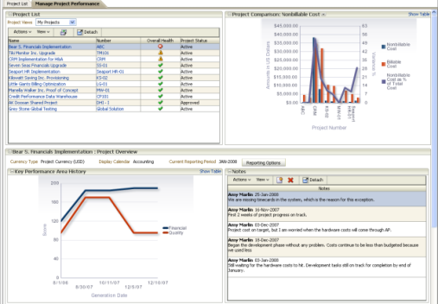
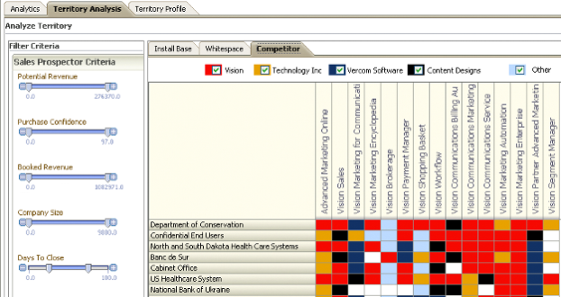
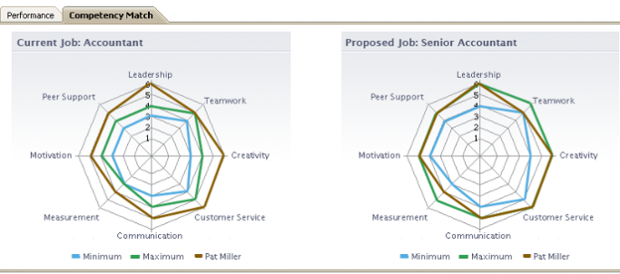
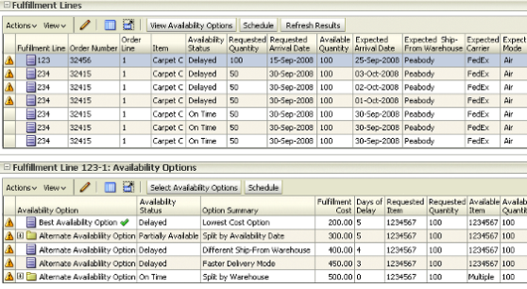
Look and Feel Concepts
Dashboards
Multi-dimensional Calculations
How are my projects performing?
What products should I position to which install base customers?
Decision Support Queries
Real-time Optimization Calculations
Should I promote this employee?
What options do I have for fulfilling a priority customer order?

Slide 26
Where are the Deloitte Fusion Applications Implementations?

Slide 27
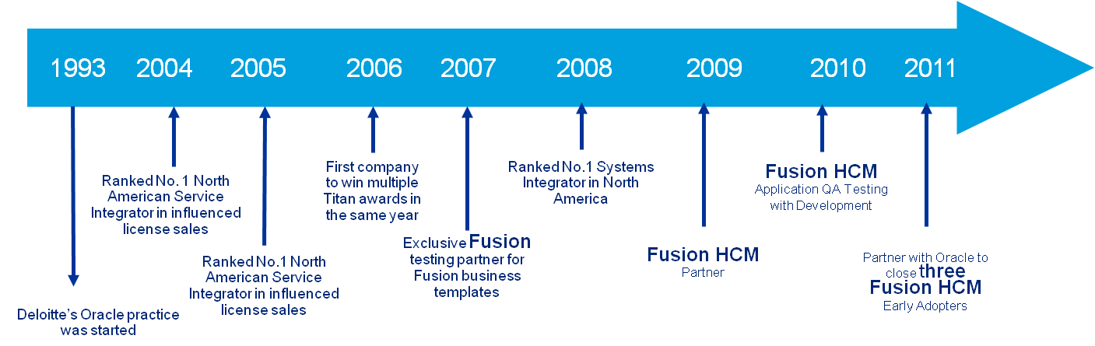
Partnering with Oracle from the beginning
Committed
Actively involved with Oracle providing review and guidance on the Fusion suite of products
Early Adopter Alliance relationship with Oracle
Active participation in the Fusion Ramp-up Partner Program gaining access to the next-generation Fusion Applications software
Direct access to product family developers
Hands-on development-led training and Quality Assurance Testing.
Active participation with the Fusion Development, Strategy, and Product Management teams in the UK.
Developed business flow and training material to offer differentiated services to clients.

Slide 28

Deloitte Early Adopter Fusion implementations
Committed
Full Suite
Global – 5000 Employees
PeopleSoft Migration
Co-existence
Global – 25k Employees
EBS Co-existence
Global
1000 Employees
HR, BEN, Comp, Perf Mgmt
Global Process Design
Eight Months Duration
Performance Mgmt
Five Months Duration
Global Process Design
International
Compensation, Perf Mgmt
Global Process Design
Seven Months Duration

Slide 29








Eaton is a global leader across the power management spectrum
Eaton Provides reliable, efficient and safe power management for…
Cities & Buildings
Industrial & Machinery
Information Technology
Transportation
Infrastructure
Energy &
Utilities
Founded in 1911 by J.O. Eaton
World Headquarters in Cleveland, Ohio USA
Regional Headquarters in Shanghai, China; Morges, Switzerland; Mexico City, Mexico
Innovation Centers in the USA, China and India
Customers in more than 150 countries
2009 sales of $11.9 billion, 55% of sales outside the U.S.
Approx. 70,000 employees
Chairman & CEO –Alexander M. Cutler

Slide 30
Common Business Challenges:
Lack of single face to the customer
  Customers cannot order all products from a single consistent interface
  Product lines may require a customer to go through a completely different ordering process
  Getting a MTO, ETO order status can be a slow, inconsistent manual process
Time to market for acquired products
  Limited ability to sell new products in all markets across all channels
  Long lead time to create fulfillment processes for new products
  Diminishing ROI for acquisitions
Lack of single face to the customer
  Customization to ERP/CRM systems to support a distributed ordering environment
  Fulfillment systems must be directly connected to each customer facing channel
  Highly specialized skills to manage non-standard interfaces to legacy systems
Notes:
Current Environments
45% of customers place orders through multiple channels
Avg. company ha s5.2 order capture applications
Avg. company has 4.3 order fulfillment applications
60% have partial or no integration
50% have no or limited data standardization
Resulting ROI opportunities
Inventories have increased 15%
Order Cycle time has tripled from 1 to 3 days
Order Accuracy is belo 85%, often near 70%
Fulfillment costs now >50% of supply chain
High inefficiencies in creating, tracking & expediting fulfilment
Lower customer satisfaction due to unmet promises

Slide 31
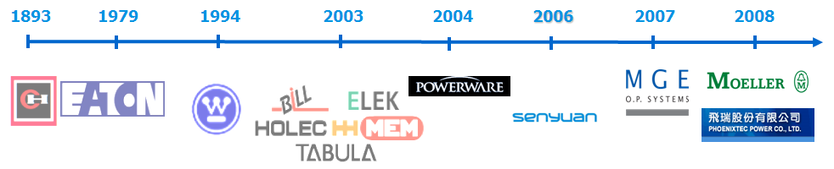
The Challenge: Linking a Disparate Landscape
Notes:
30

Slide 32
The Vision: Single Global DOO Instance
Central Orchestration of a Disparate Heterogeneous Landscape
Notes:
31

Slide 33
The Approach: Proving the Architecture with a DOO Pilot
Goal
Pilot Identified
Target a low-risk pilot that can prove the functional/technical feasibility and business value
      Single manufacturing site
      Small set of products
      Limited customers, order volume
*integrated to existing MDM solution
Order Capture
Order Orchestration
Order Fulfillment
Legacy Order Mgmt
  Front-office order management
  Billing and credit
  Analytics
  Finished Goods Financials
DOO
  Orchestration engine for line items
  Global availability & order promising
  Use of customers & products from the data hubs
Oracle ERP
  Manufacturing
  Planning
  Financials
Notes:
32

Slide 34
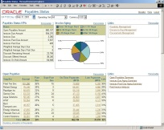
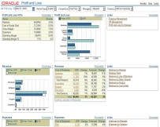

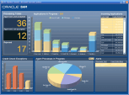
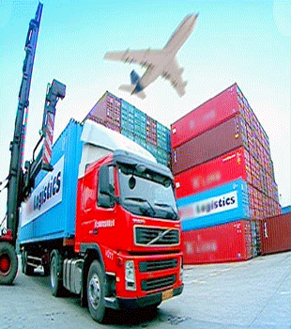




DOO Workbench – Dashboards to only manage by Exception, saving considerable amount of time....
User interface to manage orders
Dashboards Analytics
Scarcity Management
Change Management
Holds Management
Exceptions Management
Activity Management

Slide 35
The Benefits: Future Global Rollout
Benefits
Enablers
Improved Customer Satisfaction
More accurate order promising
Faster exception response
More immediate response to status inquires
Faster time to Revenue for the Business
Reduce fulfillment time
Faster time to market for product
Optimize fulfillment priorities
Lower Cost of Ownership for IT
Increased architectural flexibility
Decrease in legacy code footprint
Transferrable IT skills
Global view of supply
Centralized, proactive exception monitoring and resolution
A single, consolidated view of order status
Consistent business process definition and execution
Highly adaptable & flexible business processes
Strategic customer / demand segmentation
Standards based integration framework for ERP decoupling
Declarative web based administration
SOA based infrastructure

Slide 36
Asia Pacific Implementations
More than ten implementations started.
Australia
New Zealand.

Slide 37
What are the Next Steps to be taking now?

Slide 38
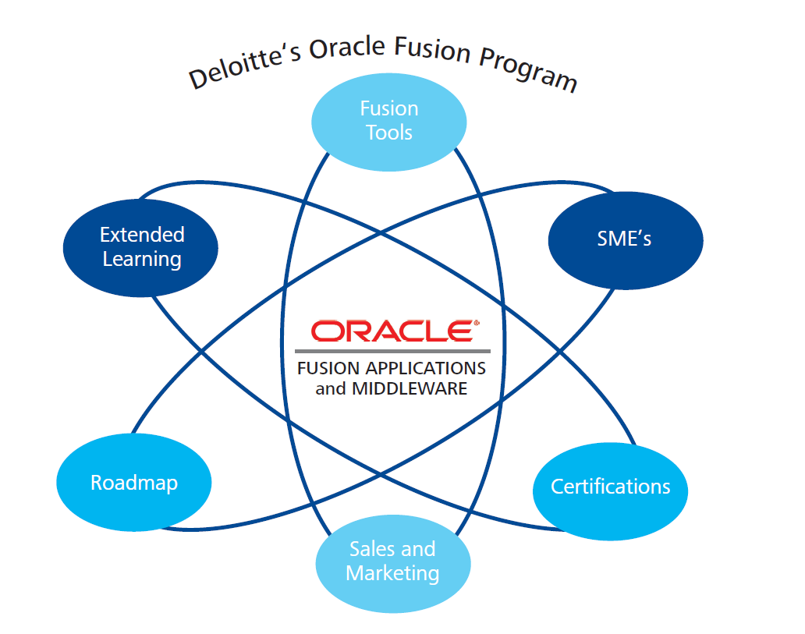

Slide 39
What You Would Like to Achieve with Your Fusion Implementation – Roadmap example
Implement Oracle HR Analytics & data warehouse and use your information to drive value
Transform your ability to deliver service to leaders and employees
Implement new Fusion technology for Compensation Mgt
Leverage New Fusion Functionality and Eliminate PeopleSoft Bolt-on’s
Avoid upgrade to PeopleSoft v9.1 with Fusion upgrade
Extend the Fusion platform to include remaining HCM
(upgrade from PeopleSoft)
Investment
Transparency of Performance, Talent Review, and Comp transactions
Provide for Global and Local Decision Making
Implement new Fusion technology for Performance Mgt, Talent Review
Remain on a PeopleSoft HCM supported release
Results
Notes:
Phased approach starting with Talent Mgt followed by Compensation.
Eliminating PSFT Bolts ons along the way..

Slide 40
Next Steps – Call to Action
Applications Review
  Review Application Landscape
  Review Application Versions
  Conduct an Applications Roadmap
  Enterprise Technology Review
  Review Middleware Layer
  Review Reporting Layer
  Co-Existence Opportunities

Slide 41

Questions and Answers

Slide 42

Deloitte refers to one or more of Deloitte Touche Tohmatsu Limited, a UK private company limited by guarantee, and its network of member firms, each of which is a legally separate and independent entity. Please see www.deloitte.com/about for a detailed description of the legal structure of Deloitte Touche Tohmatsu Limited and its member firms.
Deloitte provides audit, tax, consulting, and financial advisory services to public and private clients spanning multiple industries. With a globally connected network of member firms in more than 140 countries, Deloitte brings world-class capabilities and deep local expertise to help clients succeed wherever they operate. Deloitte's approximately 169,000 professionals are committed to becoming the standard of excellence.
This publication contains general information only, and none of Deloitte Touche Tohmatsu Limited, Deloitte Global Services Limited, Deloitte Global Services Holdings Limited, the Deloitte Touche Tohmatsu Verein, any of their member firms, or any of the foregoing’s affiliates (collectively the “Deloitte Network”) are, by means of this publication, rendering accounting, business, financial, investment, legal, tax, or other professional advice or services. This publication is not a substitute for such professional advice or services, nor should it be used as a basis for any decision or action that may affect your finances or your business. Before making any decision or taking any action that may affect your finances or your business, you should consult a qualified professional adviser. No entity in the Deloitte Network shall be responsible for any loss whatsoever sustained by any person who relies on this publication.
Notes:
41

