Slide 1
Performance by Design
Guy Harrison
Director, R&D Melbourne
www.guyharrison.net

Slide 2


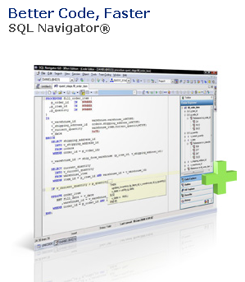
Introductions

Slide 3
Core message
Design limits performance
Architecture maps requirements to design
Make sure performance requirements are specified
Make sure architecture allows for performance
Make sure performance requirements are realized
Notes:
Telsa vs Masserati
Latency vs throughput
Volume?
Economics?

Slide 4
Elements of Performance by Design
Methodology
Database Design
Logical and Physical
Indexing, partitioning, clustering
Application Architecture
Minimize requests
Optimize requests
Denormalization
Define requirements
Measurement and instrumentation
Benchmarking
Prototype
Notes:
Methods
Requirements
Measurement
Prototype
Benchmark
Data model
Optimize physical model to query
Denormalize
Indexing, clustering, partition
Application
Minimize database access
Optimize database access

Slide 5
Methodology
Requirements analysis
Prototype
Benchmark
Response time
Data model
Key transactions
Data volumes
Concurrency
Throughput
Data volumes
Hardware budget
Data volumes
Transaction rates

Slide 6
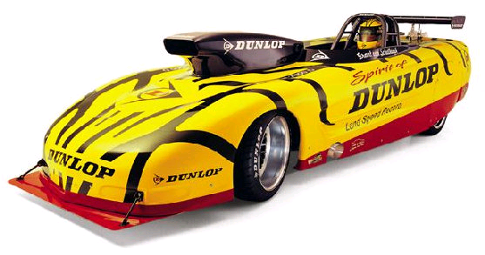
High performance can mean different things
Speed: response time
Notes:
http://www.steveschmidtracing.com/our-team-5.html

Slide 7
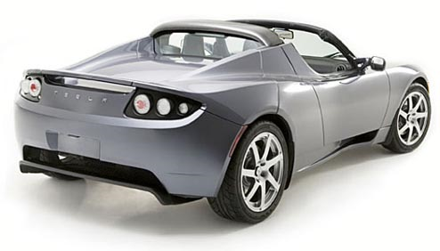
Efficiency: power consumption

Slide 8

Power: throughput

Slide 9

Not usually easy to change architectures
Notes:
Generally not easy to change architectures.....

Slide 10

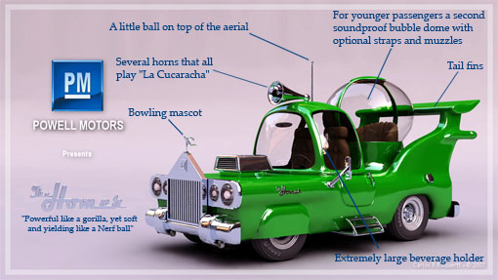
Poorly defined requirements lead to this:

Slide 11





The fail whale

Slide 12
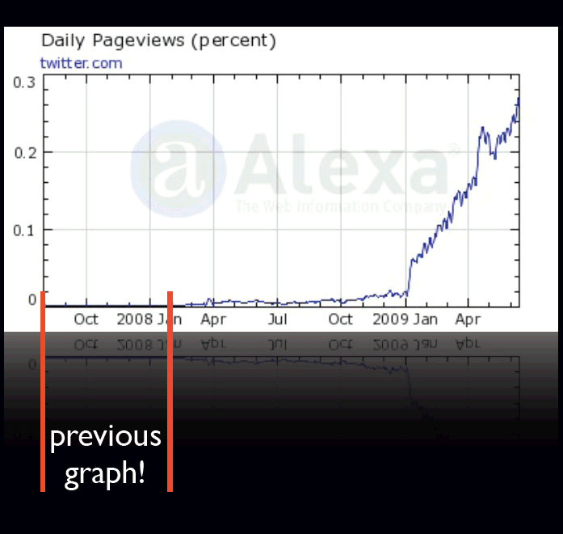
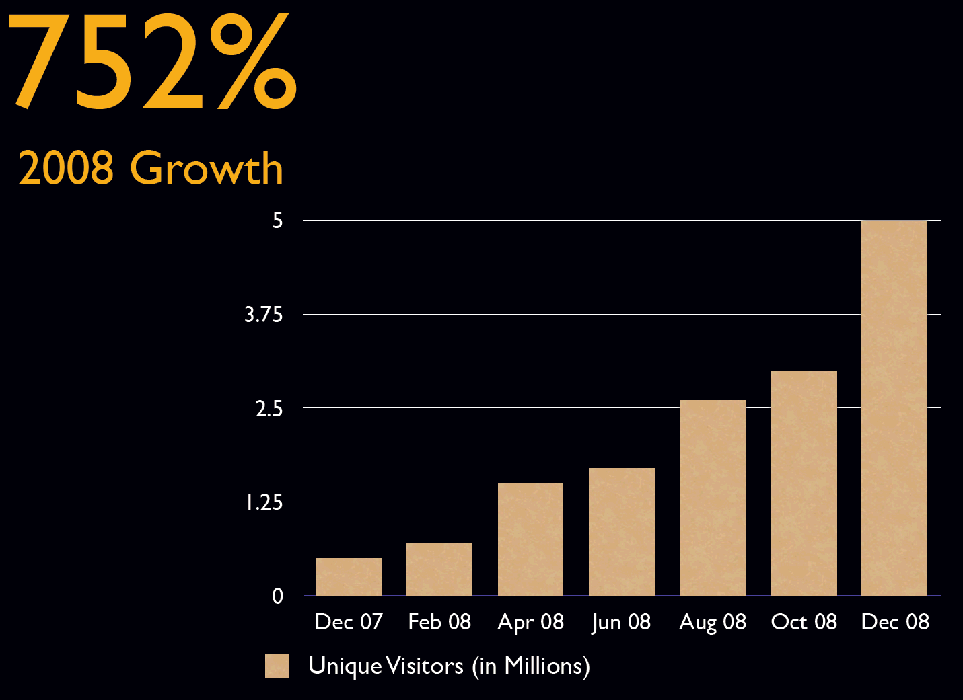
Twitter growth

Slide 13

“Twitter is, fundamentally, a messaging system. Twitter was not architected as a messaging system, however. For expediency's sake, Twitter was built with technologies and practices that are more appropriate to a content management system.”

Slide 14
Patterns of database performance
Hard to distinguish patterns at low levels

Slide 15
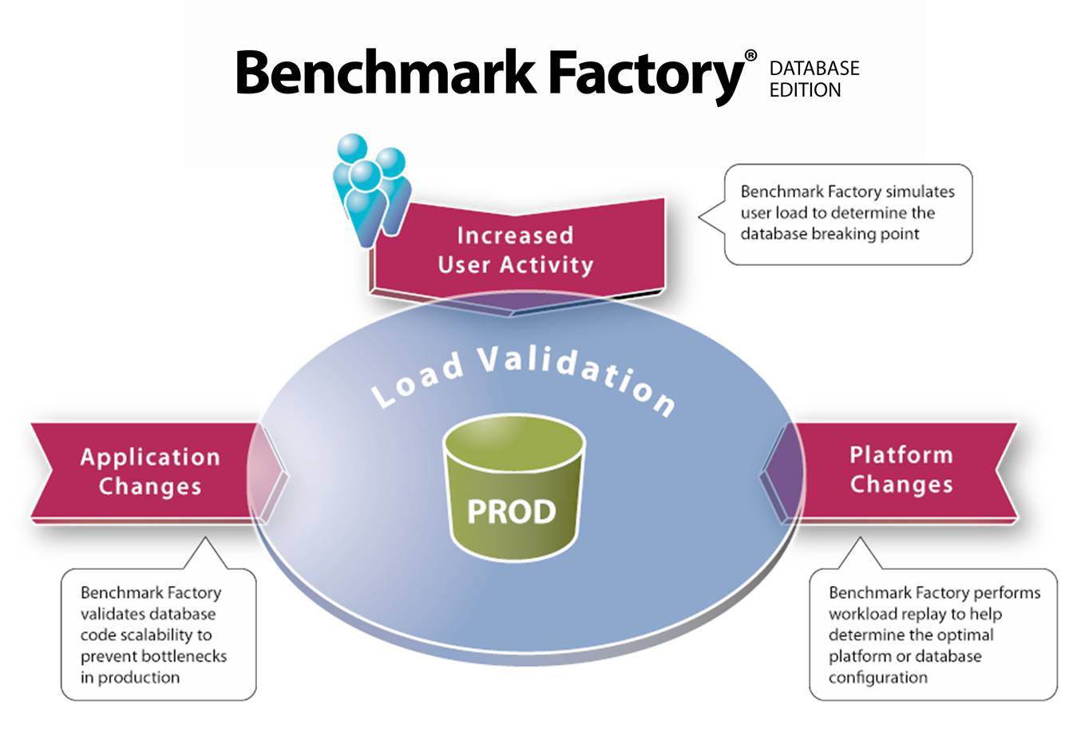

Slide 16
Database Design
Logical Modelling
Logical to physical
Denormalization
Normalize (enough but no further)
Data types
Artificial keys
Subtypes
Table types (clustered, nested, heap)
Nulls
Indexing and physical storage
Index and clustering strategies
Partitioning

Slide 17
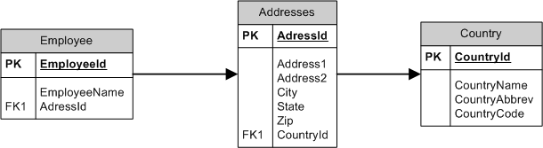
Normalize, but not too far!
"Make everything as simple as possible, but not simpler."
Notes:
Normal form is the best starting point for an efficient database design. However, don’t go overboard in eliminating redundancy.
A normalized data model is one in which any data redundancy has been eliminated
and in which data and relationships are uniquely identifiable by primary
and foreign keys. Although the normalized data model is rarely the final destination
from a performance point of view, the normalized data model is almost always
the best starting point. Indeed, failing to normalize your logical model is
frequently a recipe for a poorly performing physical model.
Relational theory provides for various levels of normal form, some of which
are of academic interest only. Third normal form is the most commonly adopted
normalization level, and it has the following characteristics:
❏ All data in an entity (table) is dependent on the primary key.
❏ There should be no repeating groups of attributes (columns).
❏ No data in an entity is dependent on only part of the key.
❏ No data in an entity is dependent on any nonkey attribute.
These characteristics are often remembered through the adage “the key, the
whole key, and nothing but the key.”

Slide 18
Other logical design thoughts
Artificial keys
  Generally more efficient than long composite keys
Null values
  Not a good idea if you intend to search for “unknown” or “incomplete” values
  Null should not mean something
  But beneficial as long as you don’t need to look for them.
Data types
  Constraints on precision can sometimes reduce row lengths
  Variable length strings usually better
  Carefully consider CLOBs vs long VARCHARs

Slide 19
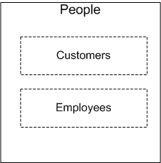
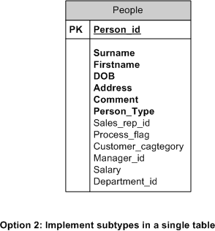
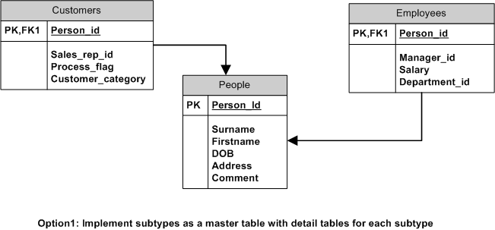
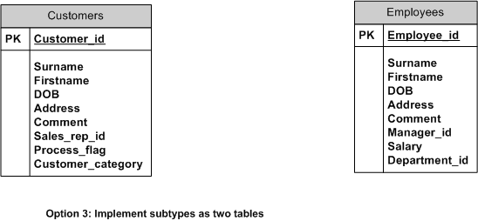
Logical to Physical: Subtypes
“Customers are people too”
Notes:
Subtypes categorize or partition a logical entity and help to classify the
types of information that is within the entity. A subtype usually has a set of attributes
that are held in common with the parent entity (the super-type) and
other attributes that are not shared with the super-type or other subtypes. Figure
4-1 shows how a PEOPLE entity could be split into subtypes of CUSTOMERS
and EMPLOYEES.
When translating entity subtypes into tables, we have the following options:
❏ Create tables for the super-type and for each subtype. The super-type table
contains only columns that are common to both subtypes.
❏ Create a table for the super-type only. Attributes from all subtypes become
columns in this super-table. Typically, columns from subtype attributes will
be nullable, and a category column indicates the subtype in which a row belongs.
❏ Create separate tables for each subtype without creating a table for the
super-type. Attributes from the super-type are duplicated in each table.
The three solutions result in very different performance outcomes. In particular,
creating tables for the super-type and each subtype is likely to reduce performance
in most circumstances, except where only the super-type is subject to a
full table scan. Table 4-1 compares the performance of each of the three solutions
for common database operations.

Slide 20
Indexing, clustering and weird table types
Lots’ of options:
  B*-Tree index
  Bitmap index
  Hash cluster
  Index Cluster
  Nested table
  Index Organized Table
Most often useful:
  B*-Tree (concatenated) indexes
  Bitmap indexes
  Hash Clusters

Slide 21
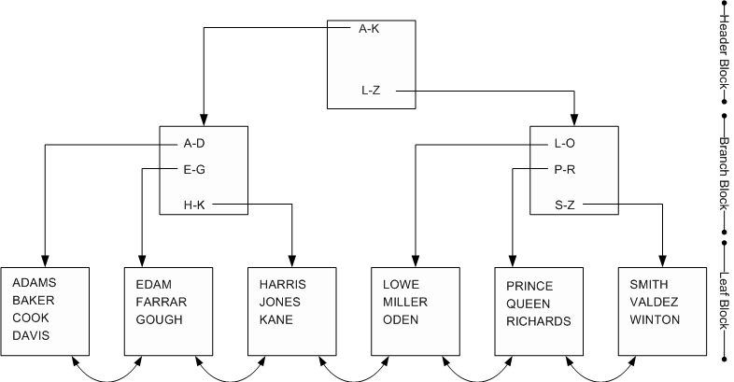
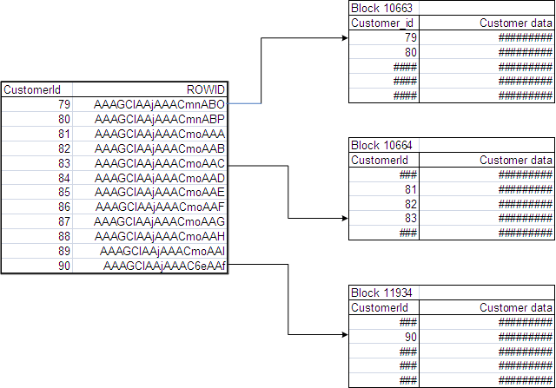

Slide 22
Concatenated index effectiveness
SELECT cust_id
FROM sh.customers c
WHERE cust_first_name = 'Connor'
AND cust_last_name = 'Bishop'
AND cust_year_of_birth = 1976;

Slide 23
Concatenated indexing guidleines
Create a concatenated index for columns from a table that appear together in the WHERE clause.
If columns sometimes appear on their own in a WHERE clause, place them at the start of the index.
The more selective a column is, the more useful it will be at the leading end of the index (better single key lookups)
But indexes compress better when the leading columns are less selective. (better scans)
Index skip scans can make use of an index even if the leading columns are not specified, but it’s a poor second choice to a “normal” index range scan.

Slide 24
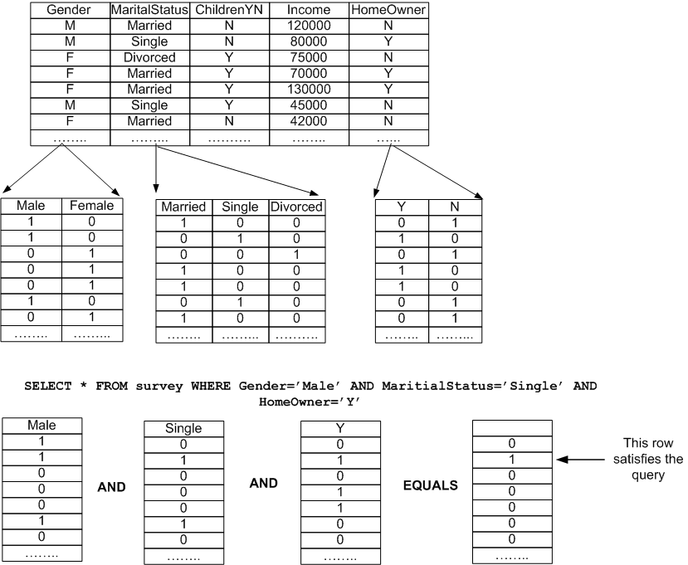
Bitmap indexes

Slide 25
Bitmap indexes

Slide 26
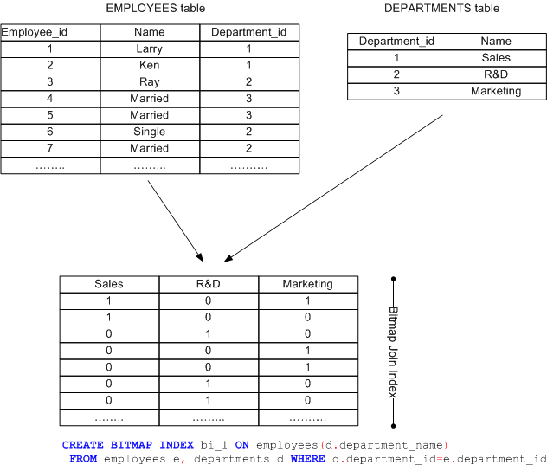

Slide 27
Bitmap join performance
SELECT SUM (amount_sold)
FROM customers JOIN sales s USING (cust_id) WHERE cust_email='flint.jeffreys@company2.com';

Slide 28
Index overhead

Slide 29
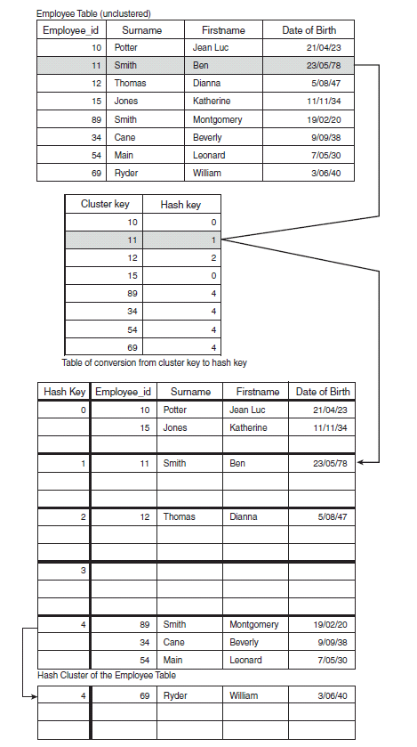
Hash Cluster
Cluster key determines physical location on disk
Single IO lookup by cluster key
Misconfiguration leads to overflow or sparse tables
Sparse
Overflow

Slide 30
Hash Cluster vs B-tree index

Slide 31
Hash cluster table scan

Slide 32
Denormalization and partitioning
Repeating groups – VARRAYS, nested tables
Summary tables – Materialized Views, Result cache
Horizontal partitioning – Oracle Partition Option
In-line aggregations – Dimensions
Derived columns – Virtual columns
Vertical partitioning
Replicated columns - triggers

Slide 33
Summary tables
Aggregate queries on big tables often the most expensive
Pre-computing them makes a lot of sense
Balance accuracy with overhead
Aggregate Query
MV on COMMIT
Result set cache
Accuracy
Manual Summary
MV stale tolerated
Efficiency

Slide 34
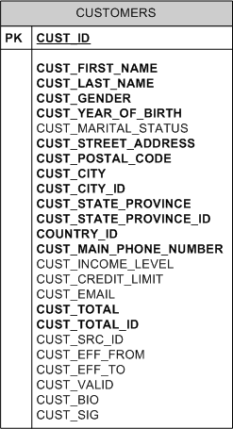
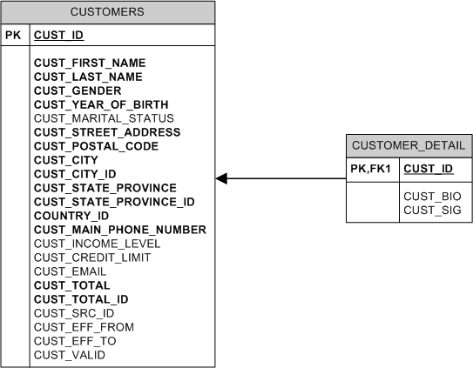
Vertical partitioning

Slide 35
Physical storage options
LOB Storage
PCTFREE
Compression
Block size
Partitioning

Slide 36
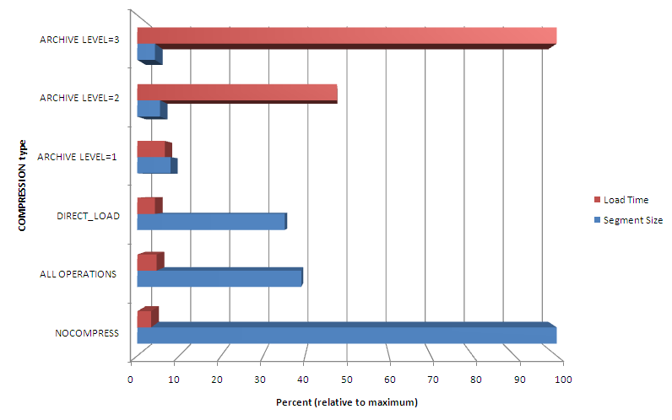

Slide 37
Application Architecture and implementation
SQL Statement Management
Network overhead
Reduce requests though application caching
Reduce “hard” parsing using bind variables
Transaction design
Array fetch and Insert
Stored procedures
Minimize lock duration
Optimistic and Pessimistic locking strategies

Slide 38

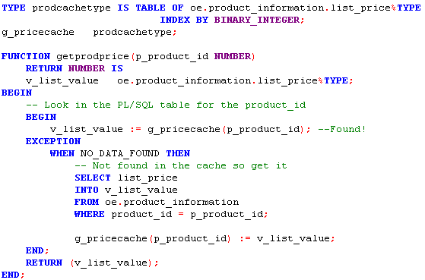
The best SQL is no SQL
Avoid asking for the same data twice.

Slide 39
11g client side cache
CLIENT_RESULT_CACHE_SIZE: this is the amount of memory each client program will dedicate to the cache.
Use RESULT_CACHE hint or (11GR2) table property
Optionally set the CLIENT_RESULT_CACHE_LAG

Slide 40
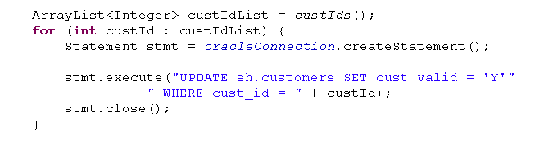
Parse overhead
It’s easy enough in most programming languages to create a unique SQL for every query:

Slide 41
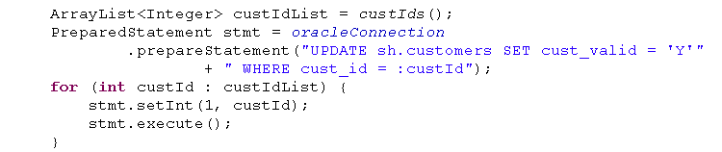
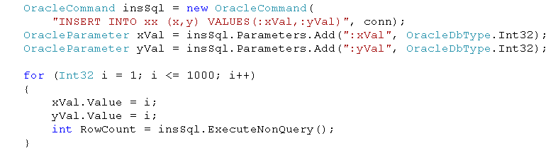
Bind variables are preferred

Slide 42
Parse overhead reduction

Slide 43
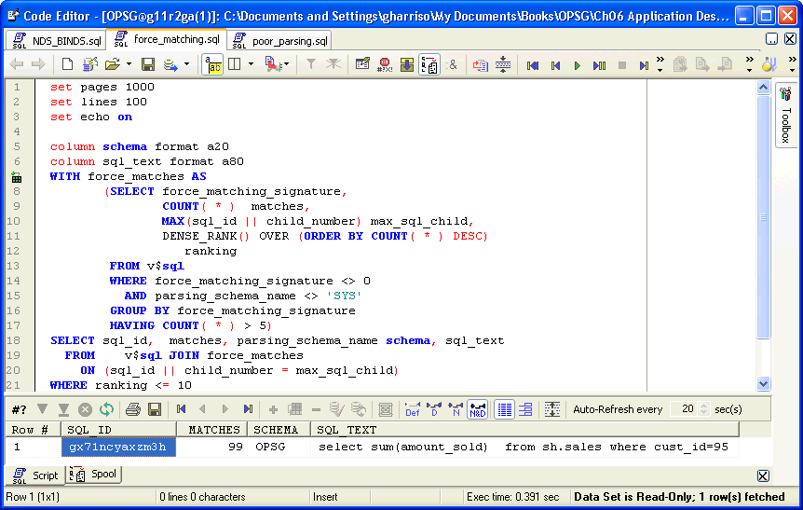
Identifying similar SQLs
See force_matching.sql at www.guyharrison.net

Slide 44
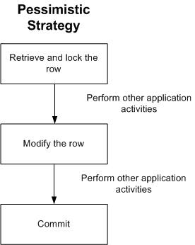
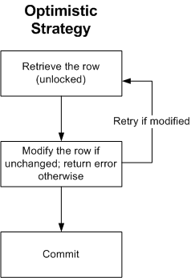
Transaction design
Optimistic vs. Pessimistic

Slide 45
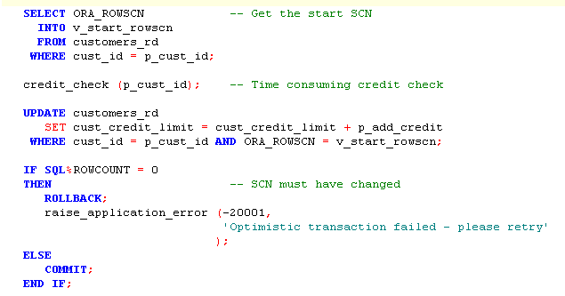
Using ORA_ROWSCN
Setting ROWDEPENDENCIES will reduce false fails

Slide 46
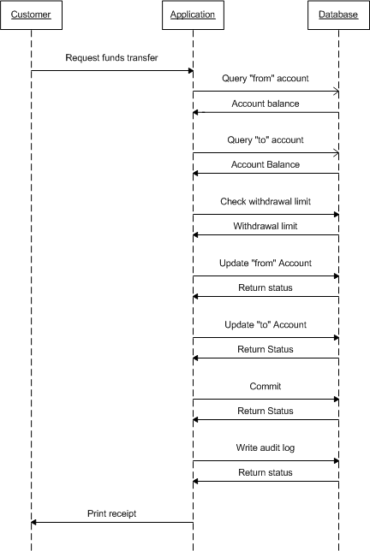
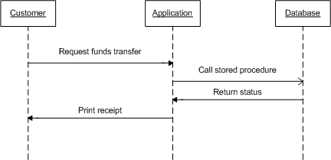
Network – stored procedures
Notes:
Remember, you don’t always have control over the network – in particular client side code may sometimes be located anywhere

Slide 47
Network traffic example
Notes:
The further the code is (in network terms) from the database, the more the network effects will magnify. You can’t get any closer to the database than being inde the database as PL/SQL

Slide 48
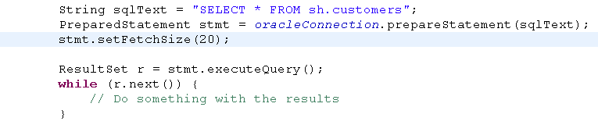

Array processing - Fetch

Slide 49
Network overhead – Array processing

Slide 50
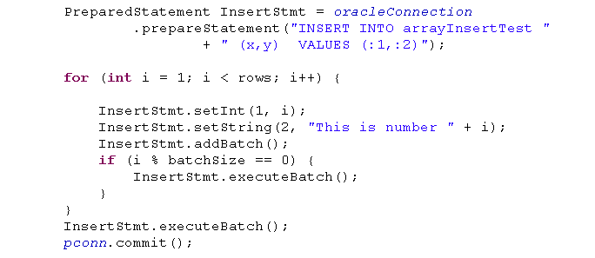
Array Insert (Java)

Slide 51
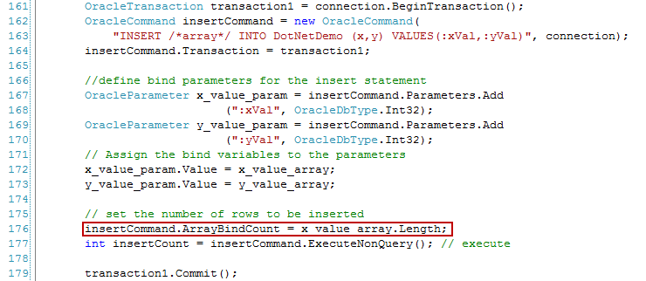
Array Insert: (.NET)

Slide 52
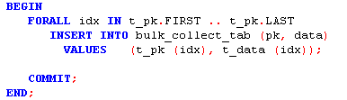
Array Insert – PL/SQL

Slide 53
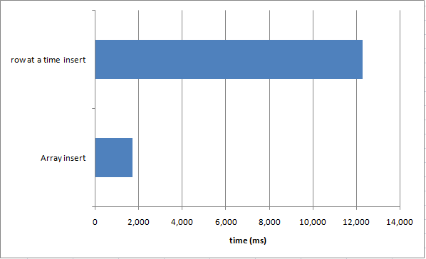
Array Insert Performance

Slide 54
너를 감사하십시요 | Thank You | Danke Schön
Gracias | 有難う御座いました | Merci
Grazie | Obrigado | 谢谢
Notes:
I hope you’ve had a great conference and thanks for listening.

