Slide 1
High Performance PL/SQL
Guy Harrison
Chief Architect, Database Solutions

Slide 2
PL/SQL top tips
Optimize network traffic
Array processing
Set PLSQL_OPTIMIZE_LEVEL
Loop processing
Recursion
NoCopy
Associative arrays
Bind variables in NDS
Number crunching
Using the profiler
G

Slide 3
Tip 0: It’s usually the SQL
Most PL/SQL routines spend most of their time executing SELECT statements and DML
Tune these first:
Identify proportion of time spent in SQL (profiler, V$SQL)
Use SQL Trace+ tkprof or the profiler to identify top SQL
SQL tuning is a big topic but:
Look at statistics collection policies
In development AND in production
Consider adequacy of indexing
Learn hints
Exploit 10g/11g tuning facilities (if licensed)
Don’t issue SQL when you don’t need to

Slide 4
PLSQL_OPTIMIZE_LEVEL
Introduced in 10g
Controls transparent optimization of PL/SQL code similar to reorganizing code
Level 0: No optimization
Level 1: Minor optimizations, not much reorganization
Level 2: (the default) Significant reorganization including loop optimizations and automatic bulk collect
Level 3: (11g only) Further optimizations, notably automatic in-lining of subroutines

Slide 5
Motivations for stored procedures
Historically:
Security
Client-Server division of labour
Separation of business logic
Manageability
Portability ?
Network overhead
Divide and conquer complex SQL
Today
Middle tier provides most of these
Network traffic is perhaps the strongest remaining motivation

Slide 6
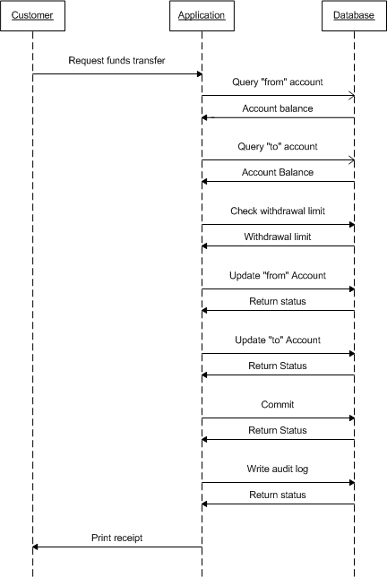
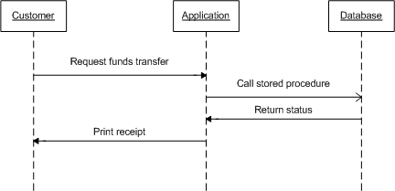
Optimizing network traffic
PL/SQL routines most massively outperform other languages when network round trips are significant.

Slide 7
Network traffic
Routines that process large numbers of rows and return simple aggregates are also candidates for a stored procedure approach

Slide 8
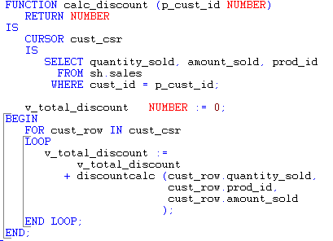
Stored procedure alternative

Slide 9
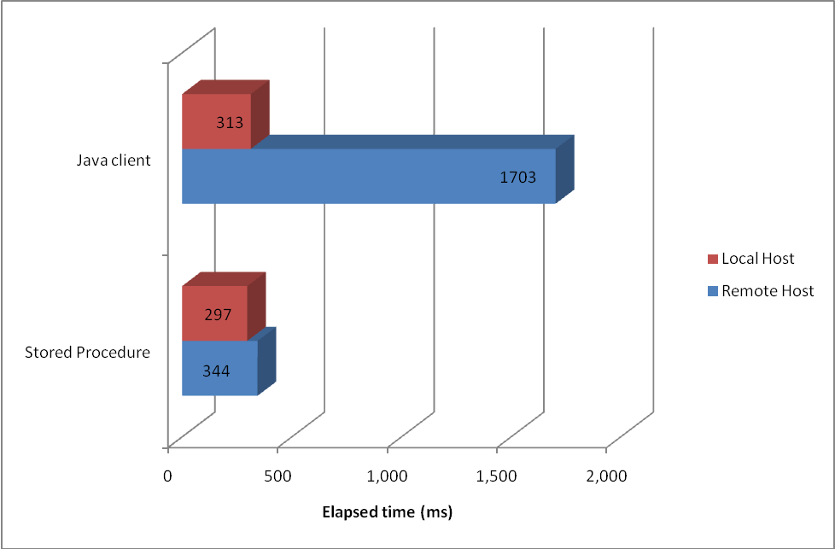
Network traffic example

Slide 10
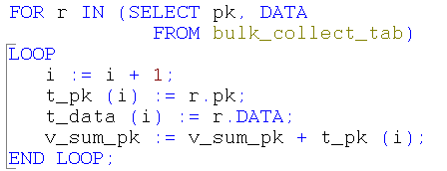
Array processing
Considered bad:
Excessive loop iterations
Increases logical reads (rows in the same block fetched separately)

Slide 11
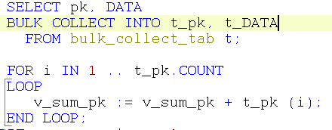
Array processing
Considered better:
Selects all data in a single operation
Large result sets might take longer as memory grows
Other concurrent sessions may have limited memory for sorts, etc.
Out of memory errors are possible

Slide 12
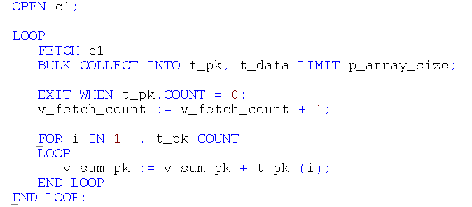
Array processing
Considered best:
Never more that p_array_size elements in collection
Best throughput, acceptable memory utilization

Slide 13
Array processing (plsql_optimize_level=1)
No bulk collect
Bulk collect without LIMIT

Slide 14
Bulk Collect and PLSQL_OPTIMIZE_LEVEL
PLSQL_OPTIMIZE_LEVEL>1 causes transparent BULK COLLECT LIMIT 100
This means that FOR loops can actually be more efficient that unlimited BULK COLLECT!
********************************************************************************
SQL ID : 6z2hybgm1ahkh
SELECT /*+ cache(t) */ PK, DATA
FROM
BULK_COLLECT_TAB
call count cpu elapsed disk query current rows
------- ------ -------- ---------- ---------- ---------- ---------- ----------
Parse 1 0.00 0.00 0 0 0 0
Execute 1 0.00 0.00 0 0 0 0
Fetch 25000 3.26 12.49 73530 98241 0 2499998
------- ------ -------- ---------- ---------- ---------- ---------- ----------
total 25002 3.26 12.49 73530 98241 0 2499998
Misses in library cache during parse: 1
Optimizer mode: ALL_ROWS
Parsing user id: 88 (recursive depth: 1)

Slide 15
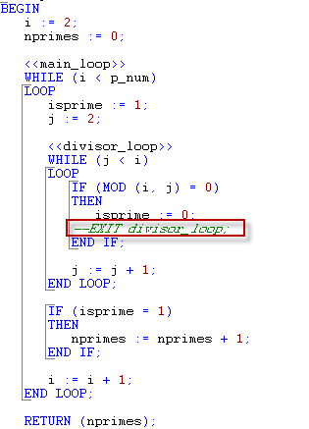
Reduce unnecessary Looping
Unnecessary loop iterations burn CPU

Slide 16
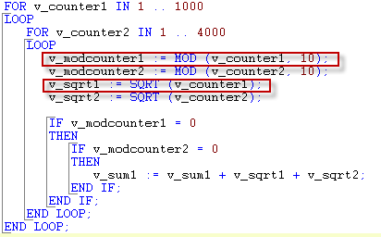
Remove loop Invariant terms
Any term in a loop that does not vary should be extracted from the loop
PLSQL_OPTIMIZE_LEVEL>1 does this automatically

Slide 17
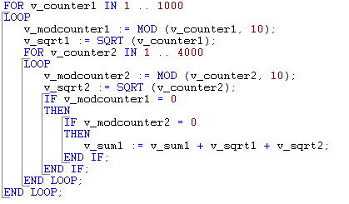
Loop invariant terms relocated

Slide 18
Loop invariant performance improvements

Slide 19
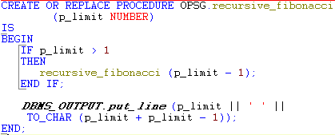
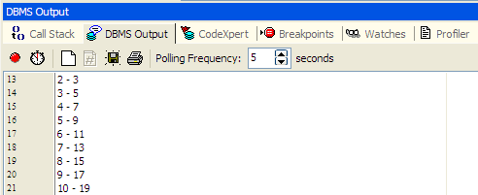
Recursive routines
Recursive routines often offer elegant solutions.
However, deep recursion is memory-intensive and usually not scalable

Slide 20
Recursion memory overhead

Slide 21
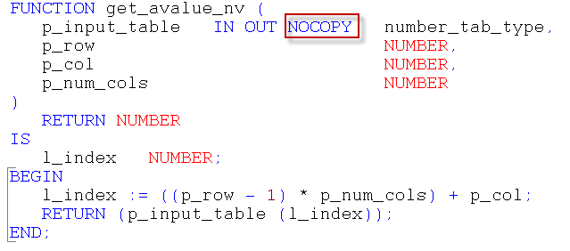
NOCOPY
The NOCOPY clause causes a parameter to be passed “by reference” rather than “by value”
Without NOCOPY, a copy of each parameter variable is created within the subroutine
This is particularly expensive when collections are passed as parameters

Slide 22
NoCopy performance gains
4,000 row, 10 column “table”; 4000 lookups:

Slide 23
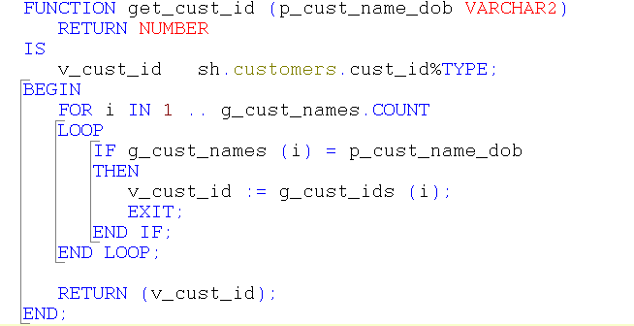
Associative arrays
Traditionally, sequential scans of PLSQL tables are used for caching database table data:

Slide 24
Associative arrays
Associative arrays allow for faster and simpler lookups:

Slide 25
Associative array performance
10,000 random customer lookups with 55,000 customers

Slide 26
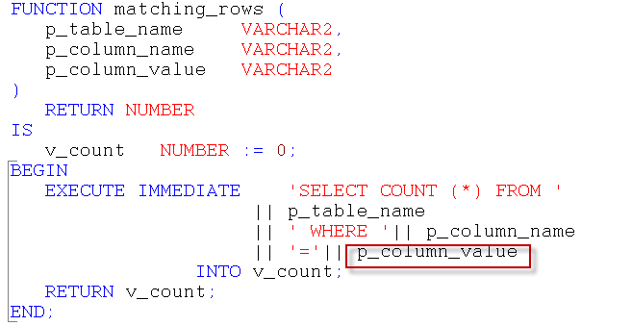
Bind variables in Dynamic SQL
Using bind variables allows sharable SQL, reduces parse overhead and minimizes latch contention
Unlike other languages, PL/SQL uses bind variables transparently
However, dynamic SQL makes it easy to “forget”

Slide 27
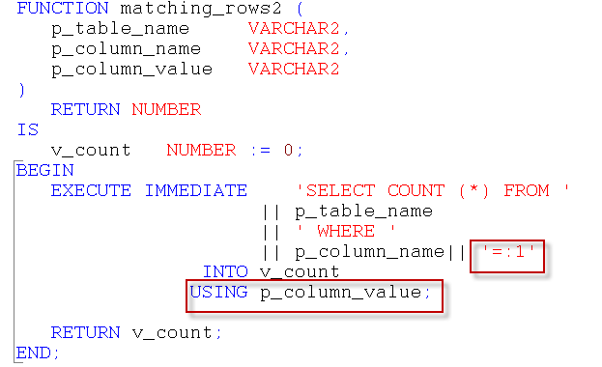
Using bind variables

Slide 28
Bind variable performance
10,000 calls like this:

Slide 29
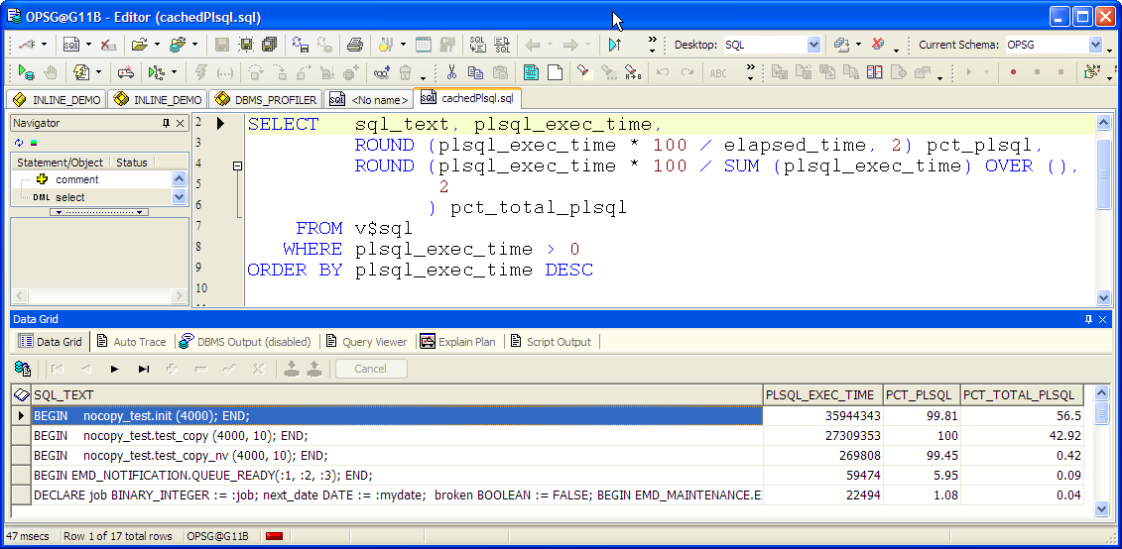
Number crunching
Until recently, it’s been hard to determine how much time is spent in PLSQL code, vs time in SQL inside PLSQL:

Slide 30
Java for computation?
Your results will vary

Slide 31
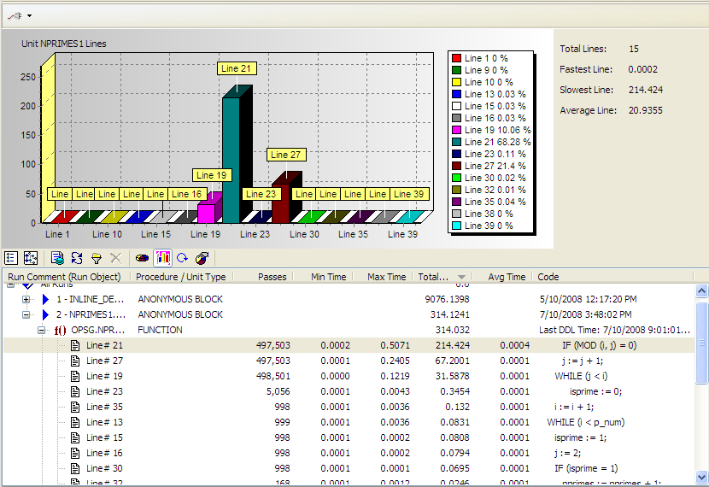
Why Native didn’t work well for me…
I need a routine with no SQL and no built in functions!

Slide 32
The profiler
DBMS_PROFILER is the best way to find PL/SQL “hot spots”:

Slide 33
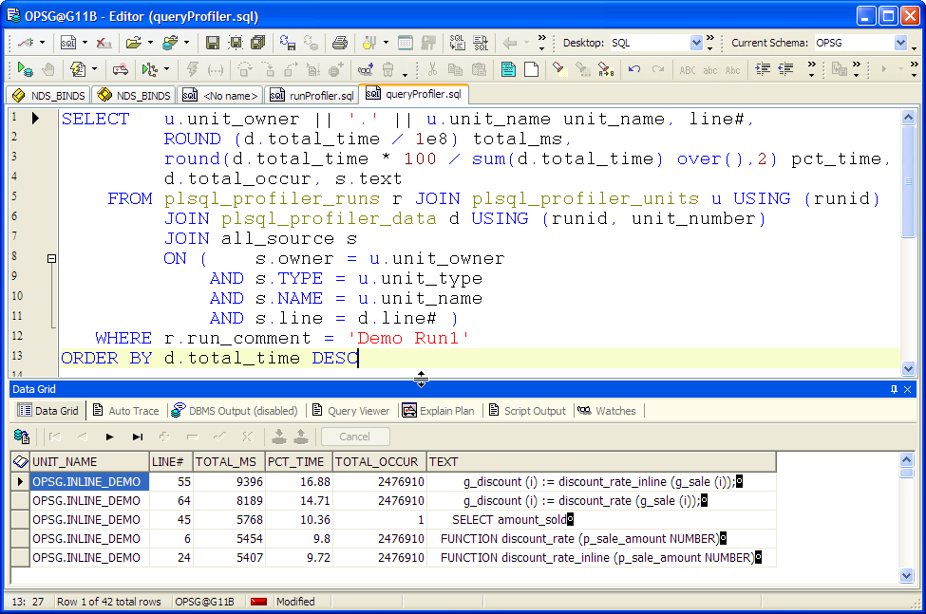

Slide 34
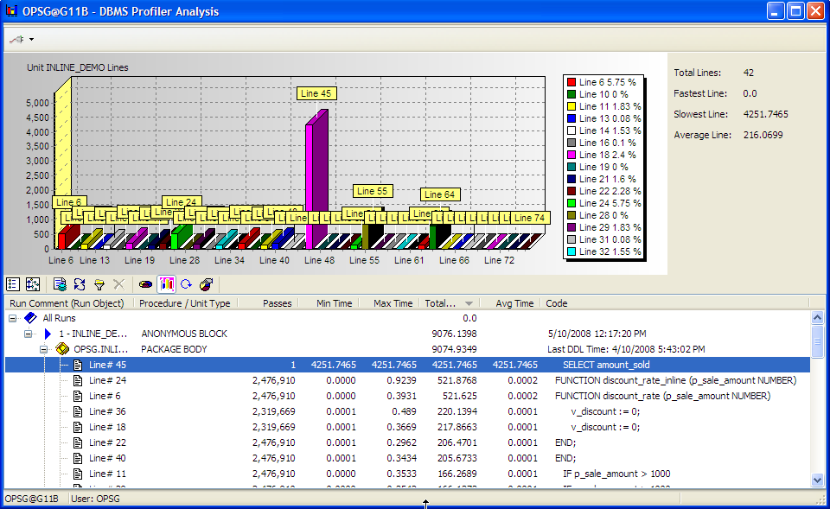
Toad profiler support

Slide 35
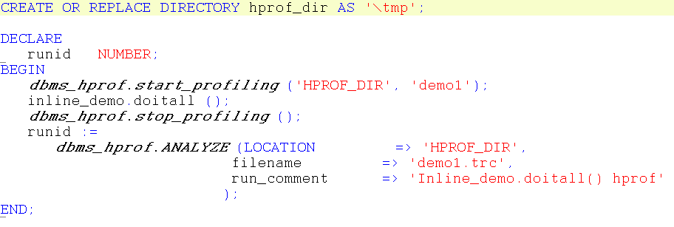
Hierarchical profiler
$ plshprof -output hprof demo1.trc

Slide 36
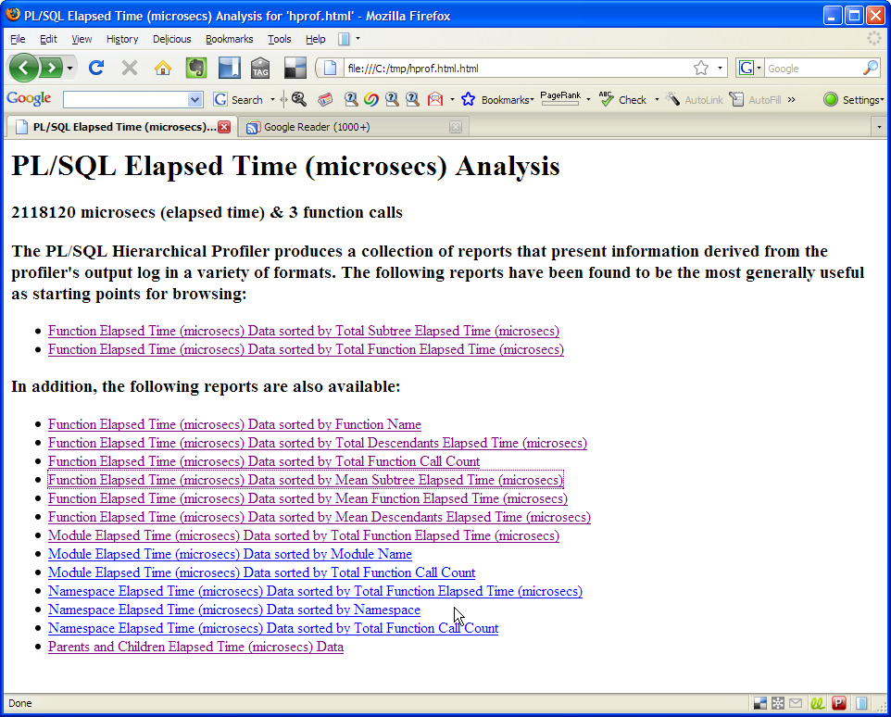
Plshprof output

Slide 37
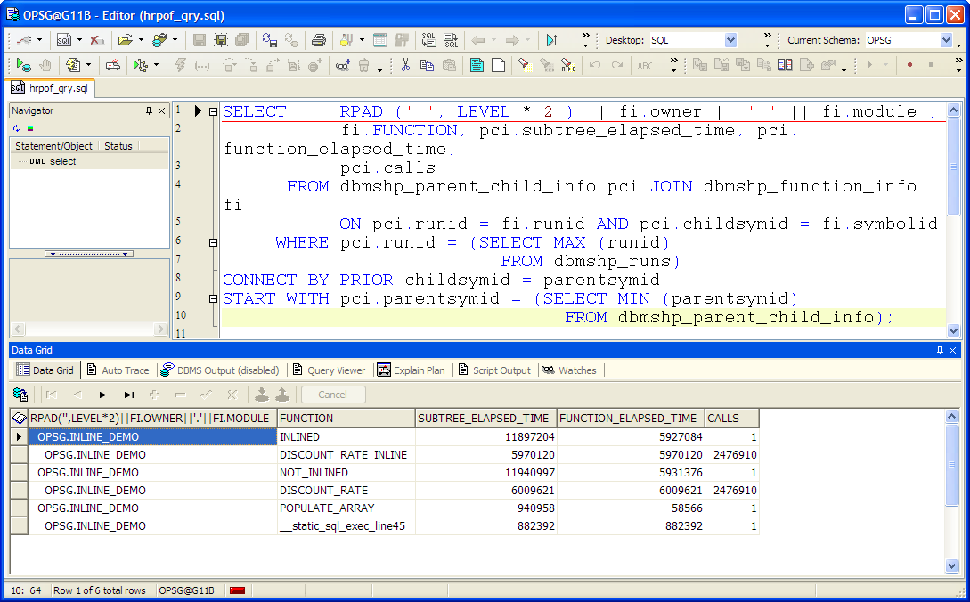
DBMS_HPROF tables

Slide 38
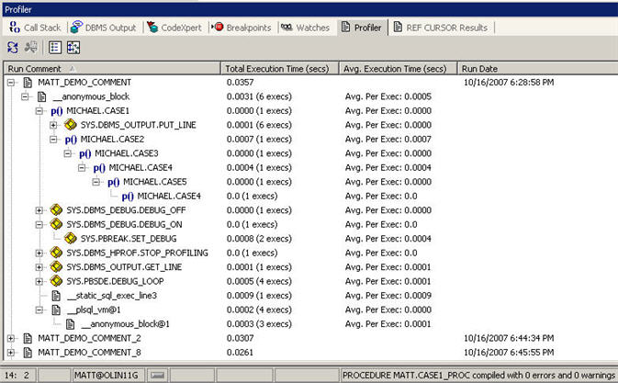
Toad Hierarchical profiler

Slide 39
11g and other stuff
11g Native compilation
11g In-lining
Data types (SIMPLE_INTEGER)
IF and CASE ordering
SQL tuning (duh!)
PLSQL Function cache

Slide 40
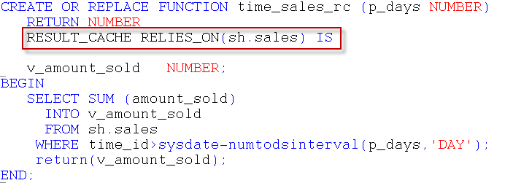
Function cache example
Suits deterministic but expensive functions
Expensive table lookups on non-volatile tables

Slide 41
100 executions, random date ranges 1-30 days:

Slide 42
Thank You – Q&A

