Slide 1
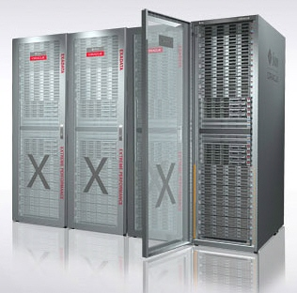


The Sun Oracle Database Machine
Barry Hodges
Senior Solution Architect
Oracle New Zealand

Slide 2
The following is intended to outline our general product direction. It is intended for information purposes only, and may not be incorporated into any contract. It is not a commitment to deliver any material, code, or functionality, and should not be relied upon in making purchasing decisions.
The development, release, and timing of any features or functionality described for Oracle’s products remain at the sole discretion of Oracle.

Slide 3

Demonstration

Slide 4
Sun Oracle Database Machine
Demonstration
Business Case: Analyzing food retail point of sale (POS) data using Exadata
Schema Design: 3NF part of the Oracle Retail Data Warehouse Model
Data: Generated test data representing a full day of POS data for the US
Demo leverages Exadata Storage software but is not running on a real DB Machine

Slide 5

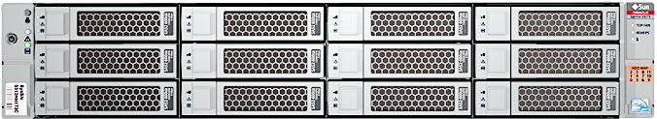
Sun Oracle Database Machine
Demonstration – Scenario 1
  Goal – show that a query completes twice as fast if the data is spread across twice as manner storage servers
Query 1
1.7 million rows
= time 1
1.7 million rows
= time 1 / 2
Query 2

Slide 6
Sun Oracle Database Machine
Demonstration – Scenario 2
  Goal – show how performance is maintained as increasing data volumes are offset by expanding the storage hardware
Query 1
1.7 million rows
= time 1
3.4 million rows
= time 1
Query 2
Query 3
5.1 million rows
= time 1

Slide 7
Sun Oracle Database Machine
Demonstration – Scenario 1
  Goal – show the difference required in network traffic when not utilising smart scans, storage indexes and other Exadata features
1.25 GB returned
Query 1
CELL.SMART_SCAN_CAPABLE = "TRUE"
Query 2
CELL.SMART_SCAN_CAPABLE = "FALSE"
27 GB returned

Slide 8
Some Performance Results

Slide 9
Sun Oracle Database Machine
Singapore Customer – POC – Full Rack V2
Task |  | Rows Returned | Time in Current Environment | POC Time | Improvement
Multiple computations and group by clause |  | 693822 | 752 secs (12.5 mins) | 28.53 secs | 26X
Simple Query, Predicate Offload |  | 430080 | 3117 secs (51.9 mins) | 28.53 secs | 109X
Joins of smaller tables |  | 5233 | 7021 secs (117.0 mins) | 6.16 secs | 1139X
Spooling large number of rows to file. CTAS benefit |  | 2070993 | 743 secs (61.9 mins) | 14.91 secs | 50X
Insert..Append. Parallel insert, IO capacity used |  | 6229 | 908 secs (15.1 mins) | 7.93 secs | 114X
 |  |  |  |  | Average 321X

Slide 10

Sun Oracle Database Machine
Giant Eagle
One of the largest, privately owned and family-operated companies in the U.S. with annual sales of approximately $7.1 billion
223 Supermarket locations and 125 GetGo® fuel stations located in Ohio, Pennsylvania, West Virginia and Maryland
More than 3.8 million active customers are enrolled in the Giant Eagle Advantage Card® their loyalty card program
5 million unique customers served annually
Participated in the Exadata Beta Program

Slide 11
Sun Oracle Database Machine
Giant Eagle – Beta Test – Half Rack V1
Task | Time in Current Environment | POC Time ( No Index) | Improvement
All GetGos for 13 weeks All Transactions | 4010 secs (66.8 mins) | 87 secs | 45X
Bananas - Movement 8 weeks | 200 secs (3.3 mins) | 18 secs | 10X
Bananas - Category 2009 | 440 secs (7.3 mins) | 10 secs | 43X
Coupon Movement Type | 1264 secs (21.0 mins) | 16 secs | 78X
Date to Date Movement Comparison - 53 weeks | 10980 secs (183.0 mins) | 229 secs (3.8 mins) | 46X
Department Sales for GetGo | 2588 secs (43.1 mins) | 23 secs | 111X

Slide 12
Sun Oracle Database Machine
Giant Eagle – Beta Test – Half Rack V1
Task | Time in Current Environment | POC Time ( No Index) | Improvement
OBI-EE: Merchandising Level 1 Detail: Current - 4 weeks | 26 secs | 3 secs | 7X
OBI-EE: Merchandising Level 1 Detail: Current - 52 weeks | 437 secs (7.3 mins) | 28 secs | 14X
Promotion Items for 1 week | 42 secs | 26 secs | 0.6X
Sales and Customer Counts | 582 secs (9.7 mins) | 30 secs | 18X
Gift Card Movement | 75 secs (1.2 mins) | 7 secs | 9X
Top Movers | 5525 secs (92 mins) | 179 secs (3 mins) | 29X

Slide 13
The Propeller Head Stuff

Slide 14
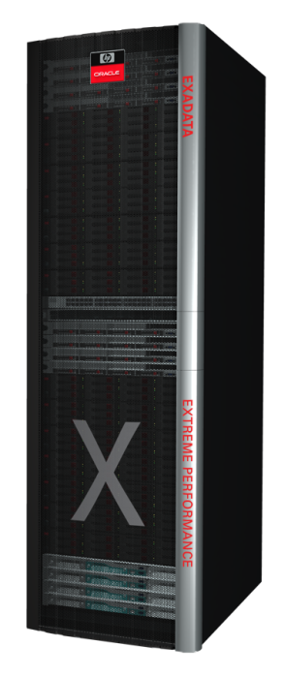
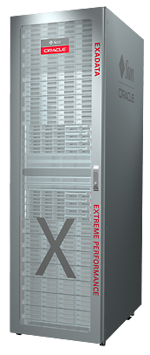
Sun Oracle Database Machine
Best Machine for Data Warehousing
Version 1
  World’s Fastest Machine for Data Warehousing
  Extreme Performance for Sequential I/O
  10x Faster than other Oracle D/W Systems
Version 2
  5 x Version 1 Data Warehousing Performance
  World’s Fastest Machine for OLTP
  Extreme Performance for Random I/O
  Dramatic new Exadata Software Capabilities

Slide 15
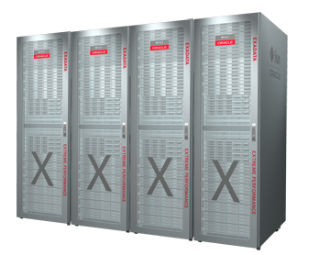
Sun Oracle Database Machine
Best Machine for Data Warehousing

Slide 16
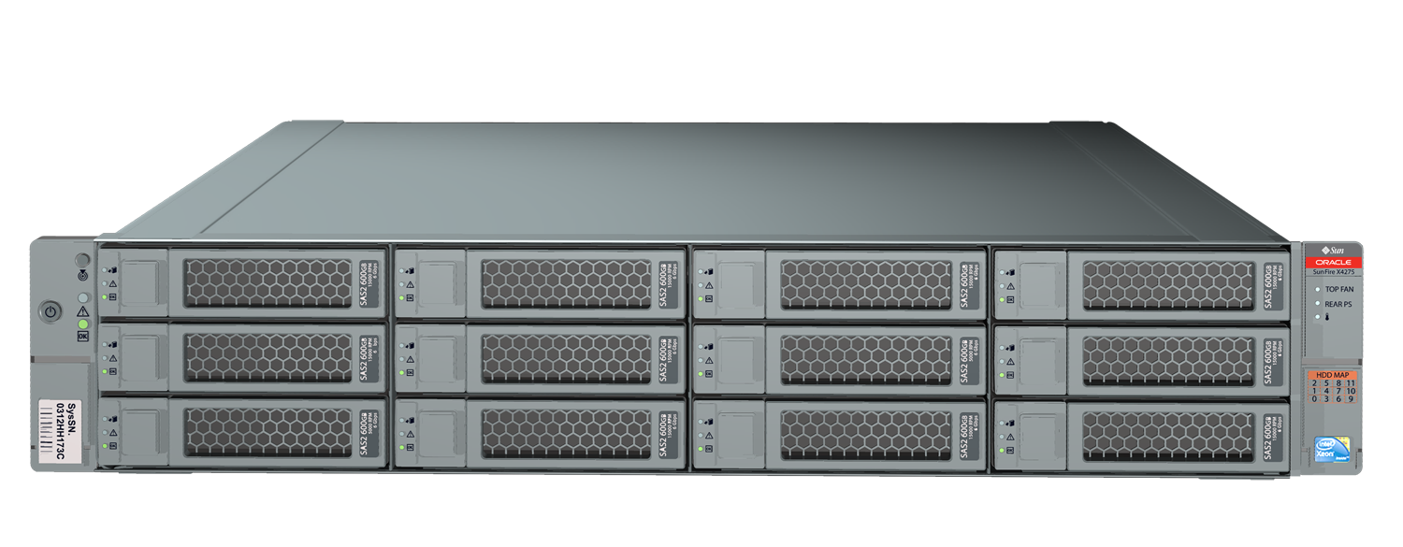

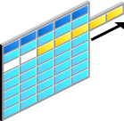
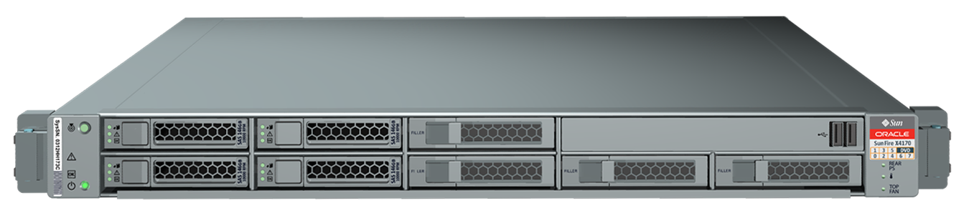

Sun Oracle Database Machine
A Simple Query Example
What were my sales yesterday?
Optimizer Chooses Partitions and Indexes to Access
Exadata Storage Grid
Oracle Database Grid
Scan compressed blocks in partitions/indexes
Retrieve sales amounts for
Sept 24
select sum(sales)
where
date = '24-SEPT'
SUM
10 TB scanned
1 GB returned to servers

Slide 17
Sun Oracle Database Machine
Exadata Hybrid Columnar Compression
Data is grouped by column
and then compressed
Query Mode for data warehousing
  Optimised for speed
  10X compression typical
  Scans improve proportionally
Archival Mode for infrequently accessed data
  Optimized to reduce space
  15X compression is typical
  Up to 50X for some data

Slide 18
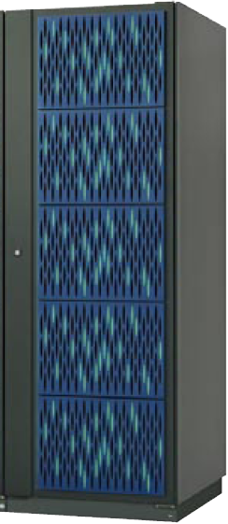


Sun Oracle Database Machine
Flash
50
Flash storage more than doubles scan throughput
  50 GB/sec
Combined with Hybrid Columnar Compression
  Up to 50 TB of data fits in flash
  Queries on compressed data run up to 500 GB/sec
Query Throughput
GB/sec Uncompressed Data
Flash
Disk
HITACHI
USP V
TERADATA
2550
NETEZZA
TwinFin 12
SUN ORACLE
Database Machine

Slide 19
Sun Oracle Database Machine
Exadata Storage Indexes
Exadata Storage Indexes maintain summary information about table data in memory
Store MIN and MAX values of columns within disk stripe
Eliminates disk I/Os if MIN and MAX can never match “where” clause of a query
Completely automatic & transparent
Table
Index
A | B | C | D
 | 1
 | 3
 | 5
 | 5
 | 8
 | 3
Min B = 1
Max B =5
Min B = 3
Max B =8
select * from table where B < 2 - Only first set of rows can match

Slide 20
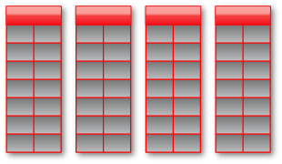
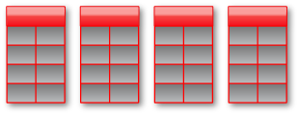
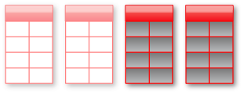

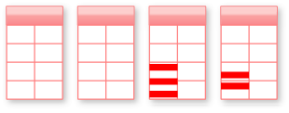
Sun Oracle Database Machine
Benefits Multiply
10 TB of user data
Requires 10 TB of IO
1 TB
with compression
100 GB
with partition pruning
Subsecond
On Database Machine
20 GB
with Storage Indexes
5 GB Smart Scan on Memory or Flash
Data is 10x Smaller, Scans are 2000x faster

Slide 21

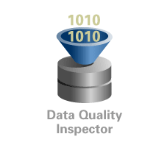
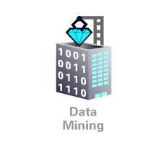
Sun Oracle Database Machine
Benefits Multiply
Massively parallel high volume hardware to quickly process vast amounts of data
  Exadata runs data intensive processing directly in storage
  Row filtering based on “where” predicate, Column filtering, Join filtering, Incremental backup filtering, Storage Indexing, Scans on encrypted data, Data Mining model scoring
Most complete analytic capabilities
  OLAP, Statistics, Spatial, Data Mining, Real-time transactional ETL, Efficient point queries
Powerful warehouse specific optimizations
  Flexible Partitioning, Bitmap Indexing, Join indexing, Materialized Views, Result Cache
OLAP
ETL
Data Mining

Slide 22
Sun Oracle Database Machine
Best Machine for OLTP

Slide 23



Sun Oracle Database Machine
Best Machine for OLTP
Only Oracle runs real-world business applications “on the Grid”
Unique fault-tolerant scale-out OLTP database
  RAC, Data Guard, Online Operations
Unique fault-tolerant scale-out storage suitable for OLTP
  ASM, Exadata
Dramatic New OLTP Capabilities

Slide 24

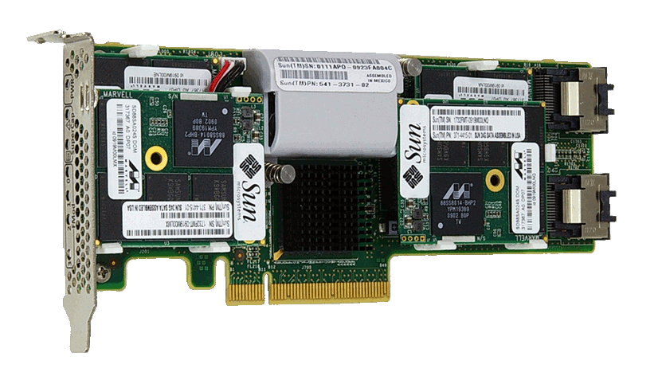
Sun Oracle Database Machine
Flash
Disk drives hold vast amounts of data
  But are limited to about 300 I/Os per second
Flash technology holds much less data
  But can run tens of thousands of I/Os per second
Ideal Solution
  Keep most data on disk for low cost
  Transparently move hot data to flash
  Use flash cards instead of flash disks to avoid disk controller limitations
  Flash cards in Exadata storage
    High bandwidth, low latency interconnect
300 I/O per Sec
Tens of Thousands of I/O’s per Second

Slide 25
Sun Oracle Database Machine
Extreme Performance for Random I/O
Sun Oracle Database Machine has 5 TB of flash storage
  4 high-performance flash cards in every Exadata Storage Server
Smart Flash Cache caches hot data
  Not just simple LRU
    Knows when to avoid caching to avoid flushing cache
  Allows optimization by application table
Oracle is the First Flash Optimized Database

Slide 26
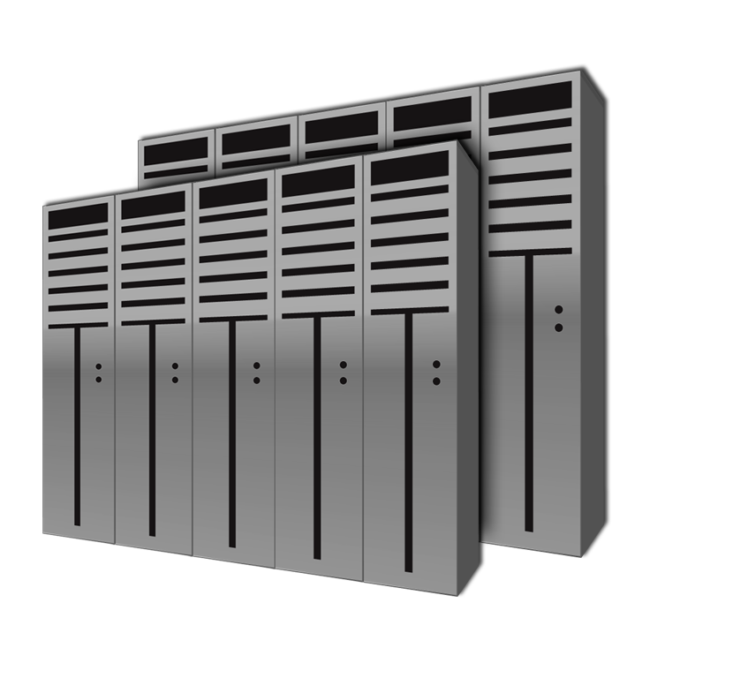
Sun Oracle Database Machine
Extreme Performance for Random I/O
Database Machine achieves:
20x more random I/Os
  Over 1 million per second
2x faster sequential query I/O
  50 GB/sec
10x better I/O response time
  Sub-millisecond
Greatly Reduced Cost
  10x fewer disks needed for I/O
  Lower Power
5X More I/Os than 1000 Disk Enterprise Storage Array

Slide 27
Sun Oracle Database Machine
Best Machine for Consolidation

Slide 28
Typical Oracle Deployment Model

Slide 29
Sun Oracle Database Machine
Best Machine for Consolidation

Slide 30
Sun Oracle Database Machine
Best Machine for Consolidation
Consolidation mixes many different workloads in one system
  Warehouse oriented bulk data processing
  OLTP oriented random updates
  Multimedia oriented streaming files
The Sun Oracle Database Machine handles any combination of workloads with extreme performance
Dramatic new consolidation capabilities

Slide 31
Sun Oracle Database Machine
Best Machine for Consolidation
Exadata and ASM allow all storage servers to be shared across databases
Shared Configuration
  Advanced ASM data striping spreads every database across all storage servers
  Eliminates hot-spots and captive unused space
  Full storage grid performance available to all databases
  Database or cluster level storage security
Predictable Performance
  Exadata I/O resource manager prioritizes I/Os to ensure predictable performance at user, job, application, or database level

Slide 32
Sun Oracle Database Machine
Best Machine for Consolidation
Many databases can run on Database Machine servers
Shared Configuration
  Applications connect to a database service that runs on one or more database servers
    Services can grow, shrink, & move dynamically
  Large databases can span nodes using RAC
  Multiple small databases can run on a single node
Predictable performance
  Instance caging provides predictable CPU resources when multiple databases run on the same node
    Restricts a database to subset of processors

Slide 33
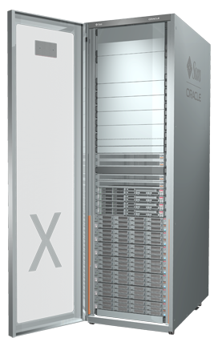
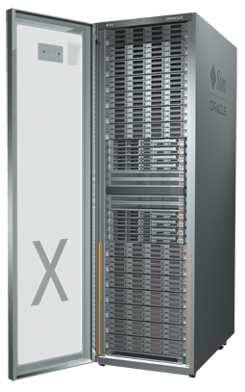
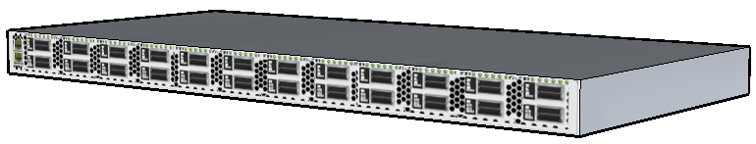
Sun Oracle Database Machine
Product Family
 | Basic | Quarter Rack | Half Rack | Full Rack | 2-8 Full Racks
Database Servers | 1 | 2 | 4 | 8 | 16-64
Exadata Storage Servers | 1 | 3 | 7 | 14 | 28-112
Total Disk Capacity | 7.2 TB | 21 TB | 50 TB | 100 TB | 200 – 800TB
User Data (uncompressed) | 2 TB | 6 TB | 14 TB | 28 TB | 56 – 224 TB
I/O Throughput (disks) | 1.5 GB/sec | 4.5 GB/sec | 10.5 GB/sec | 21 GB/sec | 42 - 168 GB/sec
I/O Throughput (flash) | 3.6 GB/sec | 11 GB/sec | 25 GB/sec | 50 GB/sec | 100 - 400 GB/sec
I/O per Second (IOPS) | 75,000 | 225,000 | 500,000 | 1,000,000 | 1M – 8M
Racks | N/A | 1 | 1 | 1 | 2-8

Slide 34
Sun Oracle Database Machine
Product Family
 | Basic | Quarter Rack | Half Rack | Full Rack | 2-8 Full Racks
Database Servers | 1 | 2 | 4 | 8 | 16-64
Exadata Storage Servers | 1 | 3 | 7 | 14 | 28-112
Total Disk Capacity | 7.2 TB | 21 TB | 50 TB | 100 TB | 200 – 800TB
User Data (uncompressed) | 2 TB | 6 TB | 14 TB | 28 TB | 56 – 224 TB
I/O Throughput (disks) | 1.5 GB/sec | 4.5 GB/sec | 10.5 GB/sec | 21 GB/sec | 42 - 168 GB/sec
I/O Throughput (flash) | 3.6 GB/sec | 11 GB/sec | 25 GB/sec | 50 GB/sec | 100 - 400 GB/sec
I/O per Second (IOPS) | 75,000 | 225,000 | 500,000 | 1,000,000 | 1M – 8M
Racks | N/A | 1 | 1 | 1 | 2-8

Slide 35

Sun Oracle Database Machine
What’s the Value?
Extreme
Performance
Extreme performance for data warehousing and OLTP, powered by Sun Oracle Exadata Storage Servers
Pre-Installed
and Pre-Configured
Enterprise ready for rapid customer success and high return on investment. One number to call for all aspects hardware, software, operating system.
Complete
Functionality
Complete functionality, with in-database ETL, analytics (OLAP, Data Mining) and more

Slide 36
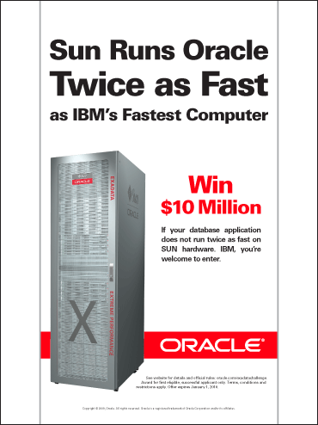
Sun Oracle Database Machine

