Slide 1
Developing on AWS
Our experience of its potential
Notes:
Murray Cambie, I am a Solutions Architect for Fronde Systems group and director of OceanEarth consulting, and today Im going to talk about Amazon Web services as a development platform, take a look on how we are using it, and review some of our experiences with it.

Slide 2
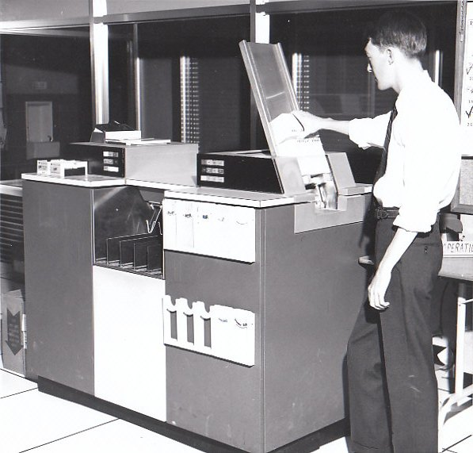
Commercial in confidence | Copyright © 2012 Fronde Systems Group Limited
Notes:
In my first commercial IT job for a large Wellington Insurance company I was using punch cards and Mainframes. Today build systems every day on a global scale with never seeing a piece of hardware past my keyboard and screen. And give it ten years – I’ll probably be doing it ‘minority report’ style with waving hands and voice recognition. We all know IT is changing rapidly – but its photos like this that remind us just how FAST that change is accelerating.
What am I doing now: So at Fronde – We are Platform and provider agnostic with strategic partnerships with Oracle, Microsoft, Google, Salesforce, AWS.
In any given week I am seeing multiple proposals from the market or internal Fronde teams for various “Stuff”, and I try and make sense of what people are trying to do, come up with some architectural frameworks for people to get excited about, and then work through delivering that. My role as a solution architect is a little different from an enterprise architect role, in that I actually have to DELIVER with my own hands what I promise on paper.
And our platform of choice to now deliver most anything on is AWS.
This isn’t me btw – I used to be that skinny – had to run around the shower to get wet.

Slide 3
Agenda
Discussion around AWS particularly VPC service
Lightbulb moments
Examples of how its changing the way we work
Our experience with the technology
A look to the future
Commercial in confidence | Copyright © 2012 Fronde Systems Group Limited
Notes:
RUN THROUGH AGENDA:
THEN BEFORE CLICKING TO NEXT SLIDE:
When I was asked to present at this conference about our experience using the AWS platform, My mind kept wandering back to a real life experience I had last year.

Slide 4
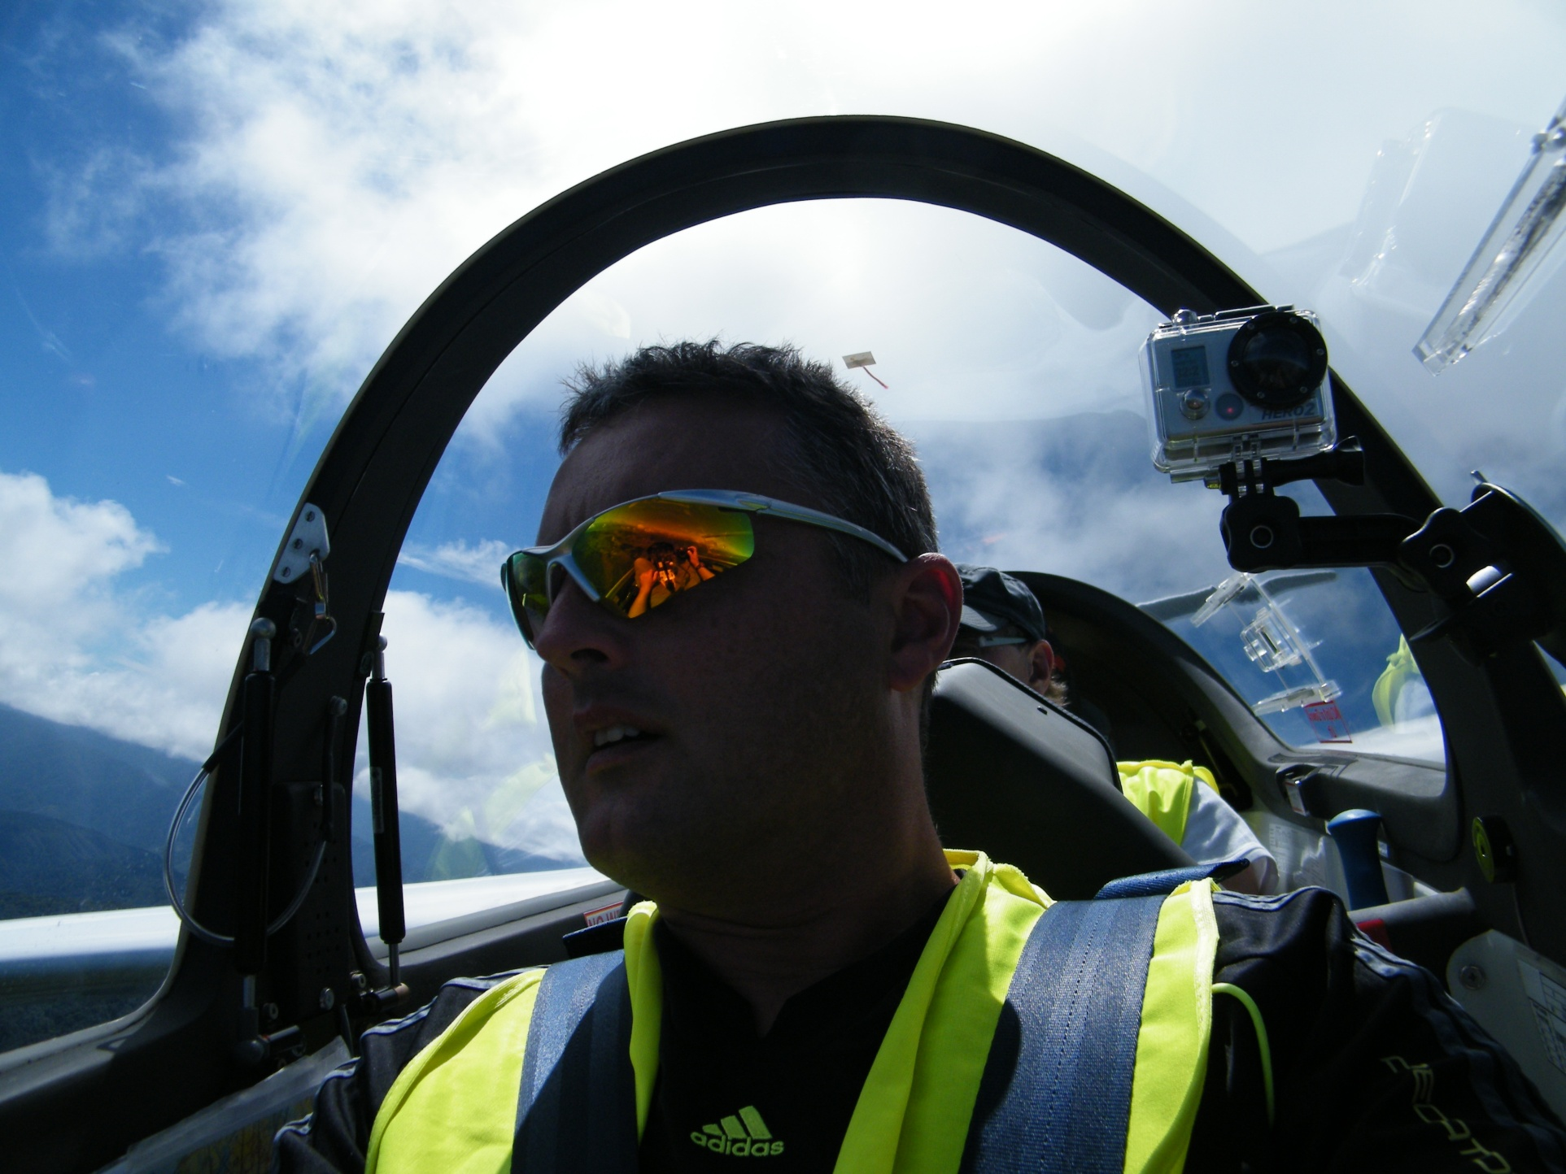
Commercial in confidence | Copyright © 2012 Fronde Systems Group Limited
Notes:
So this is me - in a glider at 4000 feet flying over the Kapiti coast.
This was like no flying as a passenger in a plane I had ever experienced before – I was in the absolute nose of this aircraft surrounded in a perspex canopy with this whole view of the world around me.

Slide 5
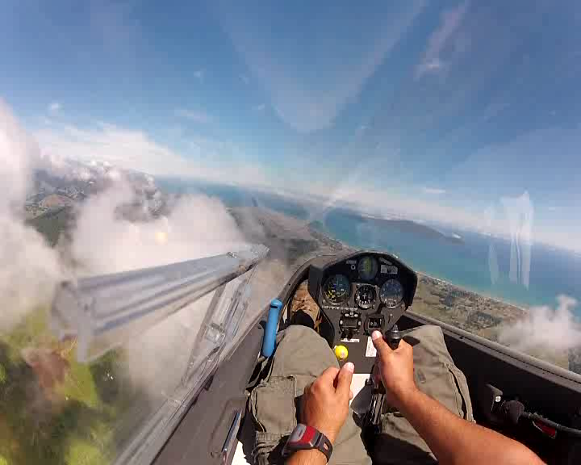
Commercial in confidence | Copyright © 2012 Fronde Systems Group Limited
Notes:
And 20 minutes later – I’m flying. This is me flying in the clouds…. I had control over everything I did.
And that’s the type of experience that my involvement has been with implementing solutions on the Amazon platform.
Compared to my whole lifetime experience in IT so far, the last 2 years have seen a radical shift in how I see and think and work in IT.
I no longer NEED to rely on other people to invent and implement solutions for me.
I don’t need a network team to provision networks and subnets and configure virtual switches.
I don’t NEED our VMWare guys to have anticipated my workload for the next 12 months and purchased a bunch of storage and local compute power and have it just sitting there idle waiting for me
I can do all that myself. I can do it cheaper, faster, more efficiently and in ways I had never experienced before. AWS has given me the ability to CONTROL building entire solutions across the infrastructure stack in exactly the way I want and with no constraint on resource. I am flying Free.
And not only for me – Im changing the way our whole orginisation works based on this experience.

Slide 6
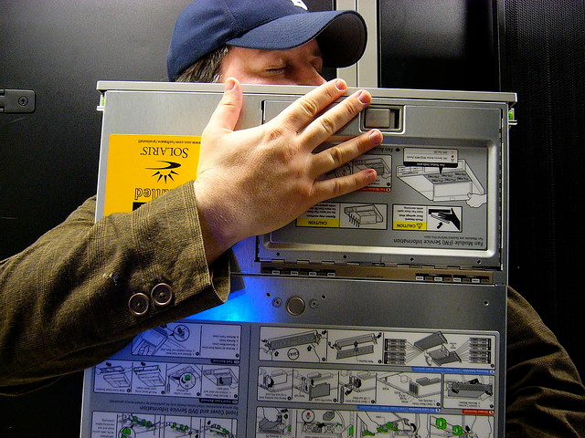
In a previous life…
…I was the guy you loved to hate
Commercial in confidence | Copyright © 2012 Fronde Systems Group Limited
Notes:
So in my previous role as an infrastructure architect, business units would come to me with their projects and resource requests, I would then go out to either our own team who provided the network resource, Firewall mapping and virtualised instances, or depending on the project - to our local datacentre providers to provide the resource required. This is what is referred to as “private cloud” offering. In reality it has nothing to do with cloud and is all about simply provisioning more stuff on more Tin.
In THEORY this is all well and good, but in practice this was a hair pulling experience in my ability to deliver what the business asked me to. Sometimes to the point of embarrassment.
It was VERY difficult to provide ongoing extra capacity for every potential project that might come in, and typically we would be the last ones to know about stuff until it landed - so our window to deploy the resources required was often very small. The IT component of projects was sometimes a bit of an afterthought to project teams. Their anticipation was that IT was unlimited – the reality is that it was not.
Because it was all still based on Tin, and someone had to justify and pay for that, and then it had to be provisioned and installed and become available – all requiring this large backend team of people – even to keep it running. And often our team would be busy with other projects or support issues, and unable to commit to getting things done, and customers would have priority over internal business. It was just painful.
And Licensing – I know more about microsoft SQL server licensing than I ever wished I knew, it is so freakin difficult and every person you ask has a different opinion usually based on how much they are expecting to pay. but why do I even care about that? Its not even a core part of my role.
…If it was frustrating for me extracting IT resource from the own department I worked in, you can imagine the frustrations of the other business units or external customers.

Slide 7

Snapper and AWS, and our own experience at that point
Commercial in confidence | Copyright © 2012 Fronde Systems Group Limited
Notes:
In 2009 Snapper came to us wanting some assistance with their existing AWS deployment.
If you don’t know, Snapper is a Wellington firm who implement the Snapper smart card system for public transport. They are a highly innovative company and have one of the best systems for smartcard travel I have seen in the world.
Fronde’s existing AWS projects at that time had been building these separate project bubbles of Ec2 instances, but there was a new AWS service that allowed you to section of a slice of AWS public cloud and bridge that to your existing local network.
What Snapper wanted was to build some large datawarehouse instances into AWS and for them to be referencable from their existing environment as if they were simply sitting alongside the Tin they already had in a local datacentre.
THIS WAS NEW. And as I completed this small piece of work lightbulbs started flashing in my head over the possibilities at play. No longer did an AWS solution have to be 100% appropriate for every part of a project, you could share and utilise existing resources already in place. You didn’t have to duplicate the same type of services for every single project.
And you could easily migrate existing workloads into AWS – Vmware servers for one example – you can port them straight into AWS.

Slide 8
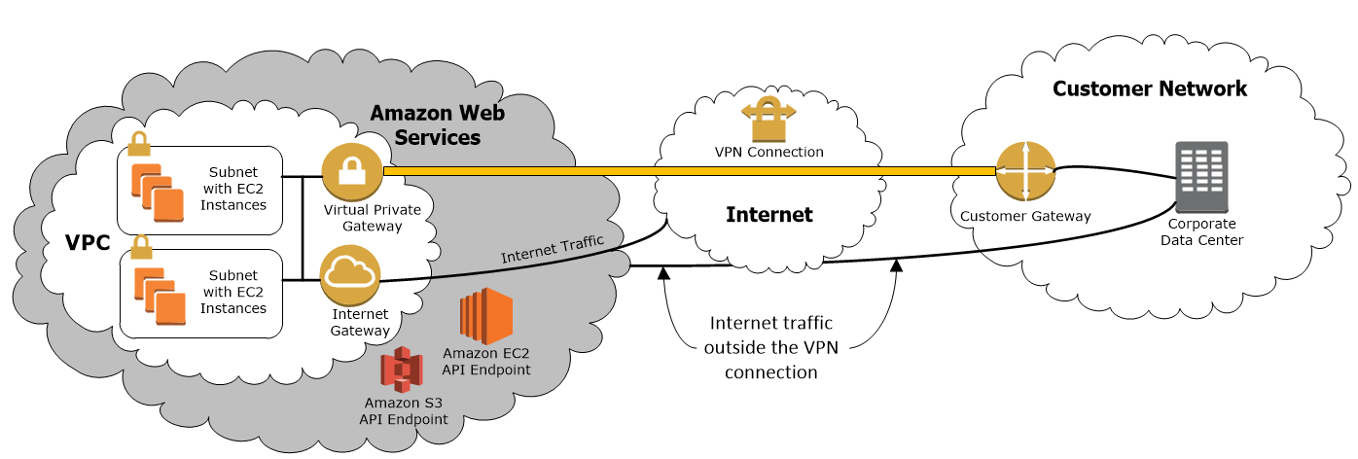
VPC – what is it, and why its important.
Commercial in confidence | Copyright © 2012 Fronde Systems Group Limited
Notes:
Whereas in the past you would simply provision EC@ instances into AWS public cloud and everything was secured, but publically accessible – POINT –
Amazon Virtual Private Cloud (Amazon VPC) lets you provision a private, isolated section of the Amazon Web Services (AWS) Cloud where you can launch AWS resources in a virtual network that you define. – POINT -
you can create a public-facing subnet for your webservers that has access to the Internet – POINT - , and place your backend systems such as databases or application servers in a private-facing subnet with no Internet access. - POINT -. You can leverage multiple layers of security, including security groups and network access control lists, to help control access to Amazon EC2 instances in each subnet.
Additionally, you can create a Hardware Virtual Private Network (VPN) connection between your corporate datacenter and your VPC and leverage the AWS cloud as an extension of your corporate datacenter.
VPC provides a much more realistic server environment than just having a pool of resource in the AWS cloud as was only available before.

Slide 9

Step back – What is AWS
Commercial in confidence | Copyright © 2012 Fronde Systems Group Limited
Notes:
TIMING – ¼ way through – should be 2:12ish

Slide 10

Commercial in confidence | Copyright © 2012 Fronde Systems Group Limited
Notes:
I was Looking for an image of the single word I would summarise my experience with AWS.
The first 500 google image results of that word were all dogs jumping around things, any ideas?
It is Agile. Amazon Web Services is the most mature, Agile, secure, public cloud platform in the world. And if your business is not using it yet you should be at the least evaluating it, and if you are not, your competitors most likely are.
Yes Amazon Web Services is all about happy dogs

Slide 11
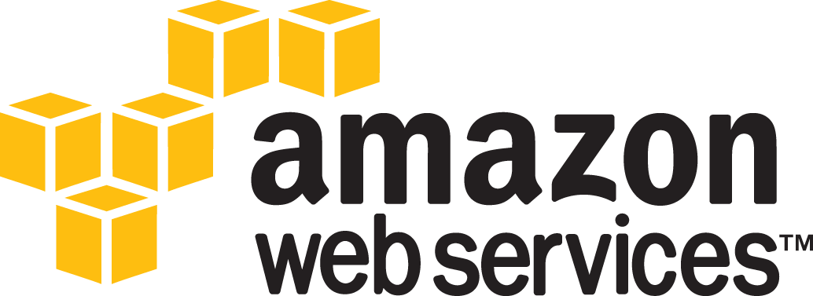
Low Cost
Secure
No Physical Tape
Scalable
Highly Available
Fast Deployment Time
Global Infrastructure and CDN
Commercial in confidence | Copyright © 2012 Fronde Systems Group Limited
Notes:
But beyond the happy dogs…
LOW COST: Its also known cost, You pay only for the cloud resources used per hour you use it, For everything – there is no up front fees and licensing is built into the per hour charge for a large range of OS and Applications. In terms of Oracle - options to BYO licensing or license Oracle as part of hourly running cost.
SECURE: Highly Secure and durable technology platform with industry-recognized certifications and audits.
Hundreds of security experts, Highly redundant and secure datacentres, Security is Amazons number 1 priority across all its AWS services.
compliance: ISO27001 based on 27002, SOC1, SOC2, SSAE16, ISAE 3402, US Govt FISMA, DIACAP, FedRamp, PCI Level 1(Payment card industry)
BACKUPS: Eliminate hard to maintain tape backup processes and infrastructure. (sounds small but you wouldn’t believe the cost savings and speed to recovery getting rid of backup tapes forever will give) – Continuous Accessibility the same as local stored backups but with durability, Better reliability, cost savings.
SCALABILITY - Unprecedented scalability. Add new AWS cloud infrastructure services on demand in minutes, or automatically based on load, scale up, scale down, turn off and not pay for usage.
AVAILABILITY: Highly reliable services and multiple fault-tolerant Availability Zones for robust disaster recovery implementations. DR or HA on AWS is huge.
DEPLOYMENT: fast time to market, reduced wait times for business - deploy Oracle-based business applications quickly without waiting for hardware, or license purchases.
GLOBALLY – 8 user deployable regions around the world for a Global presence and smart content delivery network, all under the same compliance standards.
AWS is all about “Buying into a small part of something, greater than anything you could ever provision yourself”

Slide 12

and
Customers can not only build enterprise-grade solutions hosted by Amazon Web Services (AWS) using database and middleware software by Oracle, but they can also launch entire enterprise software stacks from Oracle on EC2.
You can use Oracle Database 11g and Oracle Enterprise Linux to build enterprise-grade solutions in the cloud, leveraging the virtually unlimited compute power and storage of Amazon Web Services (AWS)
Amazon RDS for Oracle provides managed Oracle database deployments that are easy to set up and operate, freeing you up to focus on application development by managing time-consuming database administration tasks including provisioning, backups, software patching, monitoring, and hardware scaling.
Commercial in confidence | Copyright © 2012 Fronde Systems Group Limited
Notes:
Apologise for this busy slide – Im not an oracle DBA, and my Oracle experience is minimal – As we are here I wanted to highlight the strategic relationship Oracle has with AWS, and Joe Ziegler From Amazon itself talked yesterday about some of the best practice stuff with Oracle deployments on the AWS platform.
READ from slide then
What is the nature of relationship between Oracle and Amazon Web Services?
Oracle considers Amazon Web Services the leading Cloud infrastructure provider today and is the first Cloud vendor that Oracle has partnered with.
What kind of support does Oracle provide for its offerings on AWS?
Oracle fully supports Oracle E-Business Suite, Oracle’s PeopleSoft Enterprise, Oracle’s Siebel CRM, Oracle's JD Edwards and other Oracle Enterprise Applications certified on Oracle VM, and Oracle Enterprise Manager, Oracle Fusion Middleware, Oracle Database, and Oracle Linux..
There are pre-built certified AMI’s for Oracle so you can save lots of deployment time over doing a standard machine build
Also a good story around using AWS as your DR platform for Oracle DB. Using data guard replication to duplicate your primary DB into the AWS cloud

Slide 13
The lightbulb moments…
Commercial in confidence | Copyright © 2012 Fronde Systems Group Limited
Notes:
When I started to understand the implications of having basically unlimited resource at my fingertips I began to think what I could do with it. How could I improve the way I deliver services within Fronde, and through to our external customers.
The lights really started to go off when I attended an overbooked Wellington conference about cloud computing and hearing some of the questions from the floor. “do we still need to backup our data? Was one I remember”
Clearly there was a knowledge gap in the IT industry, and because of this I started to notice that it tended to be the business tail wagging the IT dog – Business got the idea quickly and loved it, They were screaming for reduced costs and quicker deployment opportunities. It appeared that IT departments themselves were blocking the uptake, and unwilling to embrace a technology that they basically COULDN’T embrace.
It takes time to get your head around ‘unlimited’. I was so used to traditional server farms, SAN’s, network switches. I was a near lone voice in our company 2 years ago. This annoying squeek that wouldn’t go away, and then having to address our SLT and one on one with the CEO to REALLY express the fact that Public cloud was one of the greatest inflection points in the IT industry in 30 years, and people needed to get their head around that quickly. But when multiple people sparked to some of the same agile concepts, its become a snowball of ideas and interest and utilising the platform in ways I hadn’t considered.
By end of next month we will have 40 staff trained in AWS architecture. Threatened by that?
AWS provides the building blocks, Really what you do with them and how you utilise them – and how efficiently you do so – is up to you.

Slide 14
Examples of what we are doing
Development – Devs and DBA’s building their own resources as needed.
Testing – Parallel testing
Google – demo environments
Salesforce – S3 buckets
POC projects – spin up and down low cost
DBA’s sandpit environments
Providing for Developers version of “Agile deployment”
Changing the way we work, Utilising the VPC framework to build secure cloud environments, and still utilise the existing local resources we have invested in.
Commercial in confidence | Copyright © 2012 Fronde Systems Group Limited
Notes:
DEVELOPMENT: Handed over the keys to our developers
TESTING - DESCRIBE PHOENIX Parallel testing internal,Qual IT, External Security audit.
GOOGLE - DESCRIBE GOOGLE DEMO – GSA (Premier ASPAC partner)
SALESFORCE: DESCRIBE Fronde CV site
POC: We have run a number of POC’s for government projects. As government prefers to do things as expensively and inifficiently as possible these POCS run for a short time, then project moves off onto traditional TIN architecture. So Fronde reduces its initial unrecoverable cost in order to prove a project.
DBA Sandpit environments – now the MS SQL guys are ahead of our oracle Devs in this – is that fairly normal?
AGILE: Describe Phoenix – changing customer requirements

Slide 15
How its changing the way we work
One real world example
Commercial in confidence | Copyright © 2012 Fronde Systems Group Limited
Notes:
HALF WAY MARK Should be 2:25pm (25 mins in)
Cover off:
Twist fronde connectivity
Customer DC connectivity
Multi AZ even in Dev
Connectivity pain all sorted before prod

Slide 16
Other commercial examples
Mighty River Power “Glowbug”
NakedBus
Snapper
Backups to S3 via Whitewater Riverbed appliance
Fronde is building large multi-million $ customer deployments on AWS
Finding more and more ways of utilising existing technology in smarter and more cost effective ways
Commercial in confidence | Copyright © 2012 Fronde Systems Group Limited
Notes:
Describe projects:
MRP – realtime system for controlling payments ofr power usage on a pre-pay type system with a device that sits on users benchtop advisng of power status
NakedBus – Booking system for national bus network
Snapper – Datawarehouse linked back to local data centres and complex ring network linking bus depots. Busses wirelessy transmit payment information for processing and distribution to third party payment providers.PCI Compliance in particular was important for Snapper. Along with continuing to migrate other workloads from hosted tin onto AWS We are also building their website on AWS using silverstripe.
Citrix Xenapp
Longstanding technology but expensive to provision, and you had to anticipate useage carefully because you were going to be buying Tin that would be around for three years.
2 things we have experienced putting XenAPP on AWS.
Speed to deploy
Scale to need

Slide 17

Machining a good idea
Commercial in confidence | Copyright © 2012 Fronde Systems Group Limited
Notes:
Our CEO wakes up at 3am with an Eureka moment, I’ve had this great idea – make it so!

Slide 18
Superbike Architecture
Commercial in confidence | Copyright © 2012 Fronde Systems Group Limited
Notes:
So how would we quickly provision a small POC web environment. Three tier with Web, app and Oracle DB. We want to utilise our existing development tools already inhouse, maybe Authenticate with our existing AD, Devs ask to use the existing local Team Foundation server for source control.
So I sign into our AWS console. And we will deploy it into Sydney our closest AWS region. Its only a POC so we could just deploy into one Availability zone – or Datacentre (Best practice for anything production or business critical we would architect over two AZ’s)

Slide 19
Superbike Architecture
Commercial in confidence | Copyright © 2012 Fronde Systems Group Limited
Notes:
We will build a VPC so we can proportion of a nice chunk of private IP addresses and have them directly accessable to our developers via the customer gateway. Subnet it off for good security and make a public subnet for our web UI

Slide 20
Superbike Architecture
Commercial in confidence | Copyright © 2012 Fronde Systems Group Limited
Notes:
Technical specs:
Web and App servers M1 Large 8GB RAM, 100GB drive, Windows OS
Oracle RDS – Standard edition including License [QUALIFY – Oracle enterprise requires BYO licensing for RDS], M! large instance with 8GB RAM, 200GB Drive
Oracle RDS Database instance: again, my experience with Oracle is very thin, but I can tell you this around using Oracle RDS
RDS is the AWS managed DB service – you can also provision stand alone oracle database instances - Oracle Database 11g and Oracle Enterprise Linux
You can run Amazon RDS for Oracle under two different licensing models – “License Included” and “Bring-Your-Own-License (BYOL)”
Pricing starts at 4 cents per hour
One of the biggest advantages is its built in ability to replicate into an alternate AZ with built in failover, and the Automated Backups and patching
Leave the developers banging away at their keyboards for 4 weeks

Slide 21

But, what if that ‘great idea’ wasn’t?
Commercial in confidence | Copyright © 2012 Fronde Systems Group Limited
Notes:
Oh…

Slide 22
The cost of failure.
Commercial in confidence | Copyright © 2012 Fronde Systems Group Limited
Notes:
So lets look at the cost of what we have done – spun up a whole new environment for a month, only our our great idea ended up a dead end.
The biggest cost is actually the time to provision the environment, but in fact the that VPC connection and subnetting setup is re-useable. It can sit there for $50 a month and the next great idea could slot straight on top of it.
AWS allows you to fail cheaply. No Capex, one off costs, or delays to test ideas waiting on provision of IT resource.

Slide 23
The cost of failure.
Commercial in confidence | Copyright © 2012 Fronde Systems Group Limited
Notes:
And what if we use that resource smarter – powering our servers and DB on only 8 hours a day, business days.
You pay only for what you use.
TALK ABOUT Keeping the VPC up for future projects. $1200 the next time.

Slide 24
Scooter production architecture
Commercial in confidence | Copyright © 2012 Fronde Systems Group Limited
Notes:
But Wait!
So our superbike production system was a failure – but suddenly our sales guys found a market for kids scooters. So lets redesign our POC architecture for production deployment.
And if we are building production we will need a proper Development environment, probably a UAT environment, Maybe a customer demonstration environment we can turn off and on as needed.
Our change control from UAT to Production could be to snapshot the UAT instances and replicate into Production, We can spin up whole new environments with cloud formation templates.
Maybe one of those environments we have for destruction penetration testing? (you have to tell AWS first), or a whole environment built on Huge server instances for customer demos that you maybe just spin up for an hour at a time and demonstrate lightening performance.
TALK ABOUT DR – Doesn’t have to be idle unused resource – talk about the web servers

Slide 25
What our experience has been
New technology
Issues – whats different –
Guys washing the car
Not all workloads are suitable
Its changing rapidly
Internal charging of business units. It was very difficult to allocate internal costs previously.
CIO.com article entitled Fear of Change Impedes Cloud Adoption by many companies
“It’s not just changing what people do all day in terms of how they use software, like moving to SaaS, but it’s also about infrastructure and about application developers and how they think about developing an application.”
Commercial in confidence | Copyright © 2012 Fronde Systems Group Limited
Notes:
New Technology: So there is often point and blame when speedbumps in projects encountered.
Issues: Not everything is familiar or intuitive in AWS. Try stick a SMTP server in with traffic on port 25. Or developers not being used to explicit deny ports on instances in the same subnet. DNS has been painful up to now – broadcast is filtered.
Guys washing the car: Existing internal IT – “Why would you want to fly when you can ride in our nice shiny VMWare car?”
Not all workloads suitable: Either through type of workload, size of data or sovereignty of data, But hybrid models using a VPC connection work well – Utilise the cheaper more agile resource where you can and keep your traditional workloads where they are better suited. You might have some huge graphic files that are constantly referenced – which would make no sense to move, or some highly complex network equipment like snapper that isnt able to be moved.
Personally I don’t care if customers put their data in the cloud or not. If they choose to believe that private cloud is actually a cloud solution, then that’s up to them. I’ll design a NZ based solution that in most cases will simply be a poor cousin to what could be achieved on AWS.
It’s a hugely feature rich, multiple service offering. Even keeping up with the additional services or improvements is hard, so there is a definite learning curve, and if I hit walls I design around them knowing very likely things will change and walls will go away at some point – Hostfile DNS for example.
The ability to allocate exact costs of environment running costs against individual projects or customers is a huge advantage. It was very very difficult to understand and allocate our own internal IT costs previously – there was just too many factors.
Read final comment

Slide 26
What our experience has been
Most of my licensing and compliance headachs go away…
Empowering our development teams with a new and faster way of working.
When things DO go wrong - generally they are not catastrophic, and if you have architected properly - possibly of no impact.
Take advantage of Managed DB services where possible - RDS, DynamoDB.
The financial aspect alone is compelling but there are even greater returns in development agility and speed to deploy.
Commercial in confidence | Copyright © 2012 Fronde Systems Group Limited

Slide 27
The Future
AWS is a rapidly maturing product, what I design today most likely will be superseded in the future.
I am templating deployments based on the experience we have. Subnetted VPC with best practice tiered and multi- environment deployments due to lower cost in AWS
Sydney data center – Far far! greater interest across NZ for the uptake of public cloud compute.
Lots of useful tools from 3rd party vendors for integrating cloud services (Riverbed Whitewater appliance, Salesforce.com and AWS, Yuruware AMI regional instance exporter, Skeddly scheduler, etc)
Changing the IT resource required. Spend more time innovating than locked into support and maintenance.
Commercial in confidence | Copyright © 2012 Fronde Systems Group Limited
Notes:
READ off slide

Slide 28
Summary
Adoption of public cloud is being stifled by IT in many instances mostly out of fear. Fear of losing jobs; fear of being irrelevant; fear of the unknown.
Business leaders need to get hands on with what the cloud really is and start evaluating their options, because in most cases the solutions available are much more worthy of pursuit then they might know or are being told.
Building on the Public cloud is not a like for like solution over traditional IT deployments. It’s a door to radically changing the way you can develop, and how you utilise your IT spend.
Commercial in confidence | Copyright © 2012 Fronde Systems Group Limited
Notes:
READ OFF SLIDE THEN:
AWS is about Agility, and its about Buying into a small part of something greater than anything you could ever provision yourself”
It’s a rapidly maturing technology that already has strategic support of the likes of Microsoft and Oracle etc.
Don’t let the fear of something new stifle the potential you will find through using the platform.

Slide 29
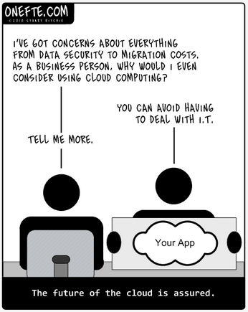
murray.cambie@fronde.com
Commercial in confidence | Copyright © 2012 Fronde Systems Group Limited
Notes:
This is my final slide – thanks for your attention today. Feel free to drop me an email if you would like to know more, im here for the rest of the afternoon over by the Fronde stand,
Should be 2:50pm

