Slide 1
Making the most of Solid State Disk in Oracle 11g
Guy Harrison
Director, R&D Melbourne
Email: guy.harrison@quest.com
Twitter: @guyharrison
Web: http://www.guyharrison.net

Slide 2
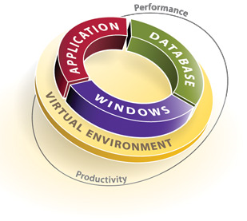
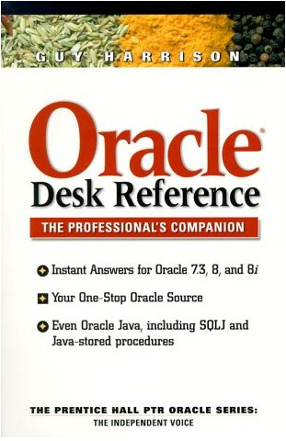
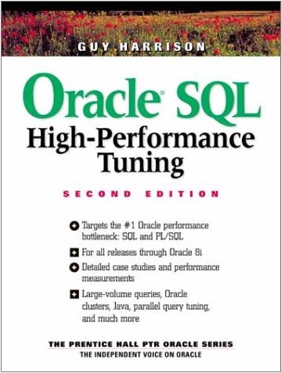
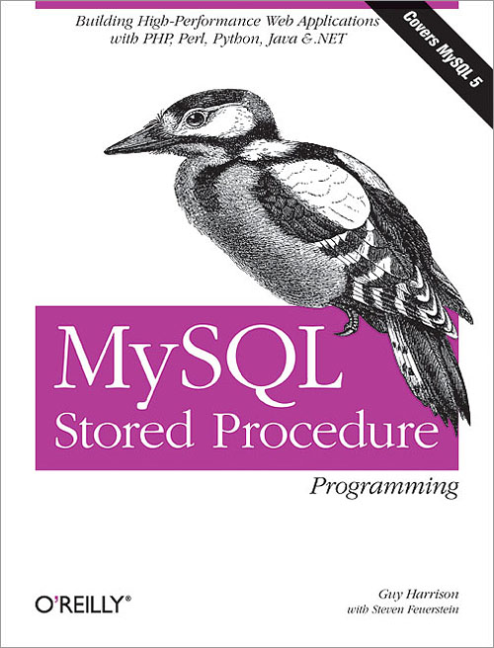
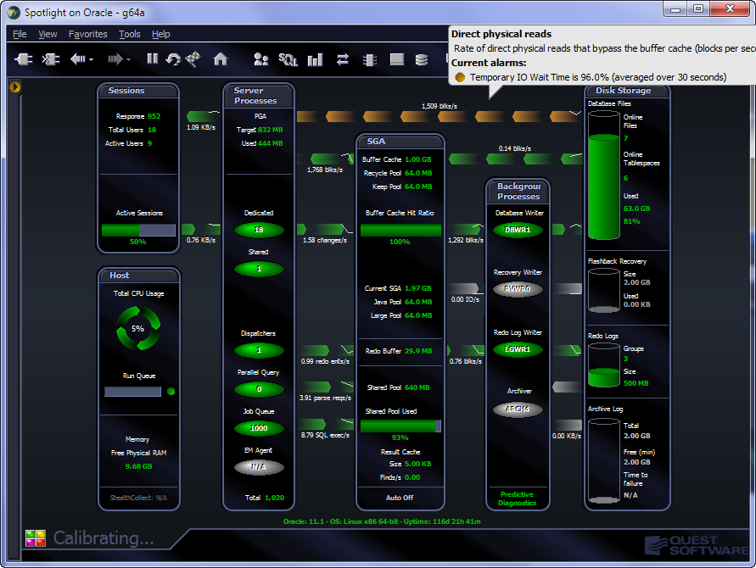
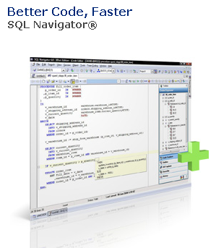
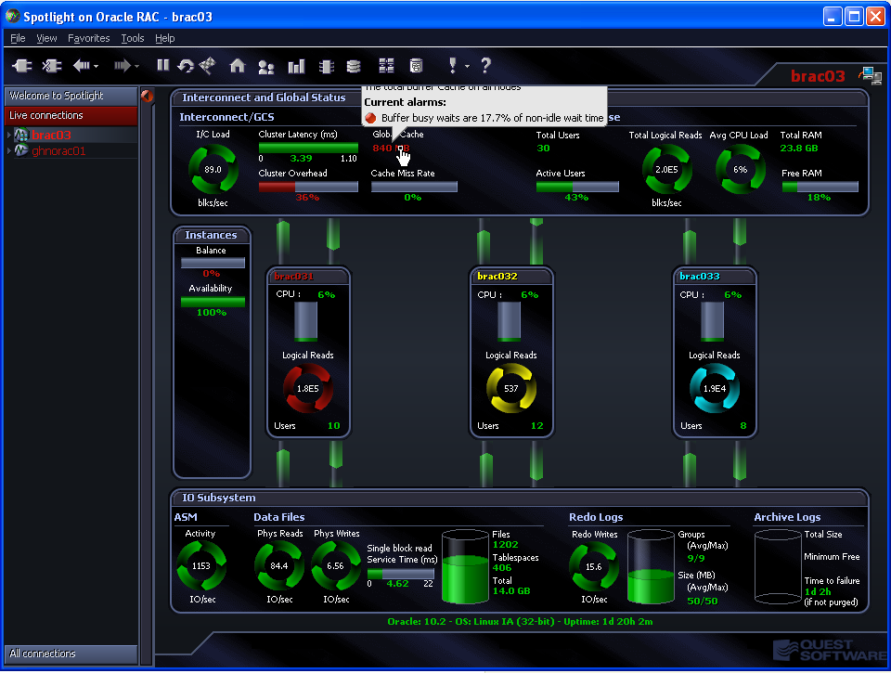
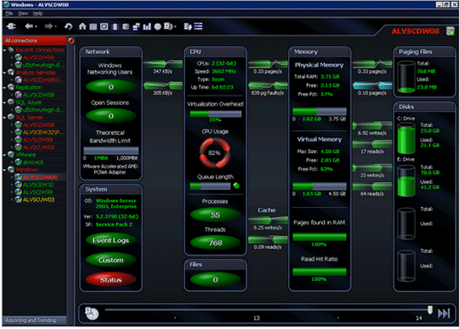
Introductions
Notes:
Apologies, I’m a database type.....
Quest is best known for toad, but we also have enterprise monitoring across all levels of the stack
In Melbourne, SQL Navigator + the spotlights.
It’s not a complete co-incidence about the star trek theme.

Slide 3
Notes:
Insanely popular – literally millions of users

Slide 5
Agenda
Brief History of Magnetic Disk
Solid State Disk (SSD) technologies
SSD internals
Oracle DB flash cache architecture
Performance comparisons
Recommendations and Suggestions

Slide 6
A brief history of disk

Slide 7
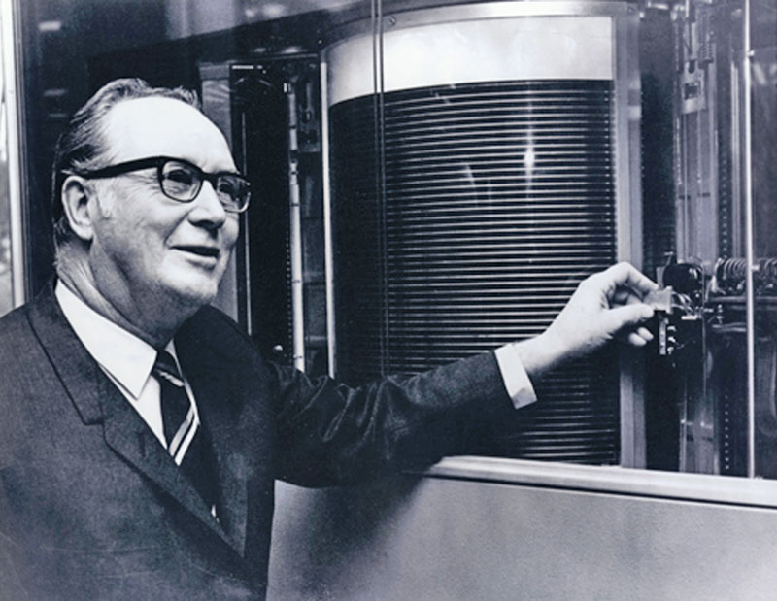
5MB HDD circa 1956

Slide 8
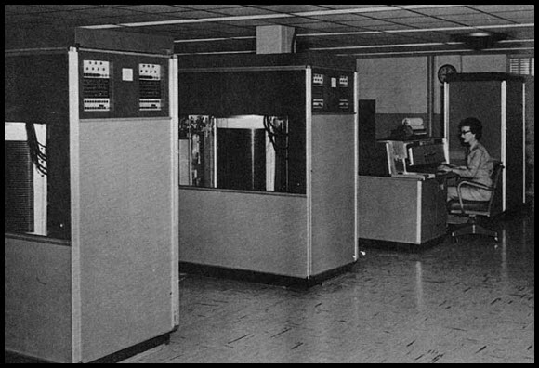
28MB HDD - 1961
1800 RPM

Slide 9
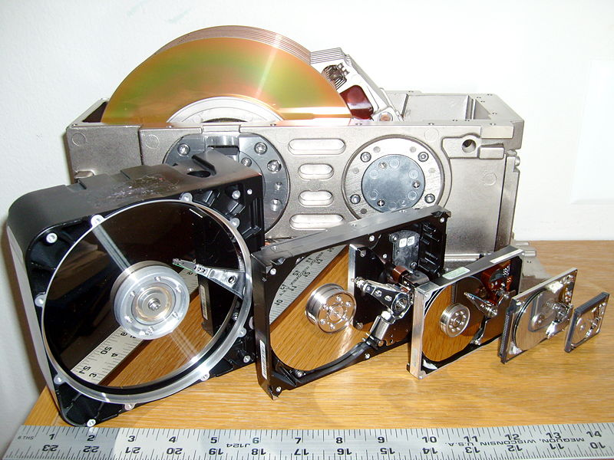
The more that things change....

Slide 10
Moore’s law
Transistor density doubles every 18 months
Exponential growth is observed in most electronic components:
CPU clock speeds
RAM
Hard Disk Drive storage density
But not in mechanical components
Service time (Seek latency) – limited by actuator arm speed and disk circumference
Throughput (rotational latency) – limited by speed of rotation, circumference and data density

Slide 11
Disk trends 2001-2009

Slide 12
Solid State Disk

Slide 13
SSD to the rescue?

Slide 14
Power consumption

Slide 15
Economics of SSD
$/IOPS
$/GB

Slide 16
Tiered storage management
$/GB
$/IOP
Main Memory
DDR SSD
Flash SSD
Fast Disk (SAS, RAID 0+1)
Tape, Flat Files, Hadoop
Slow Disk (SATA, RAID 5)

Slide 17
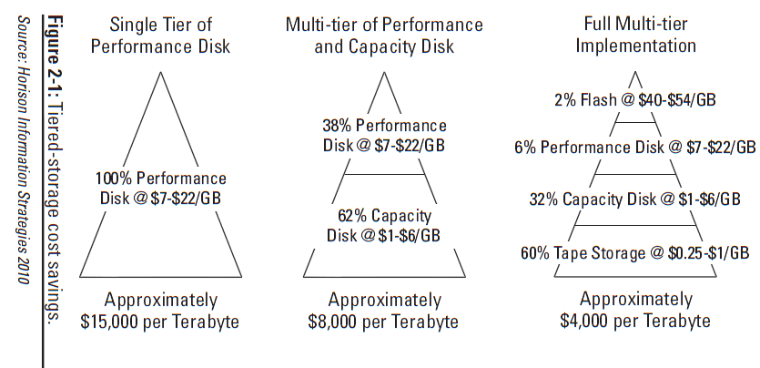
Storage Tiering
Storage Tiering For Dummies,® Oracle Special Edition, Wiley 2011

Slide 18
SSD technology and internals

Slide 19
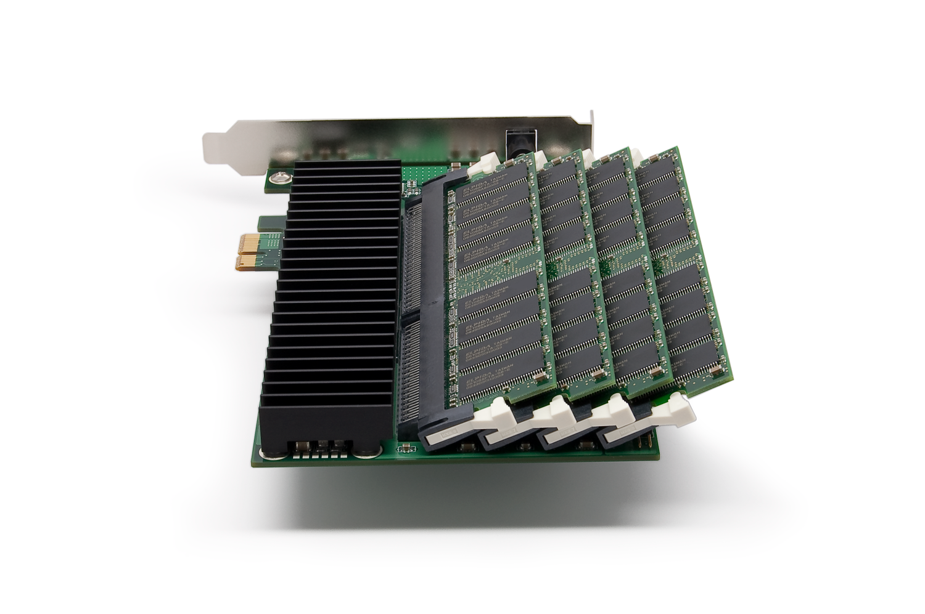
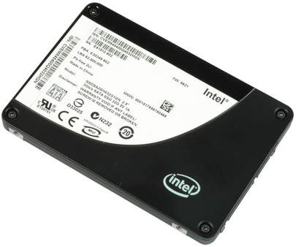
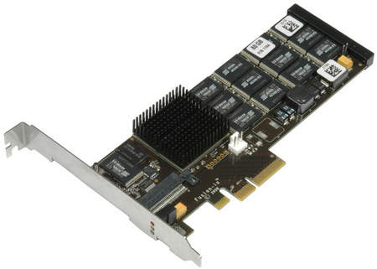
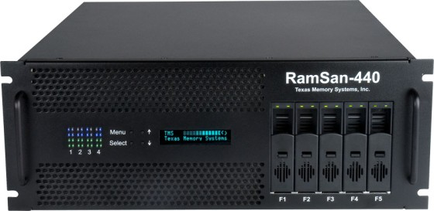
Flavours of Flash SSD
DDR RAM Drive
SATA flash drive
PCI flash drive
SSD storage Server

Slide 20
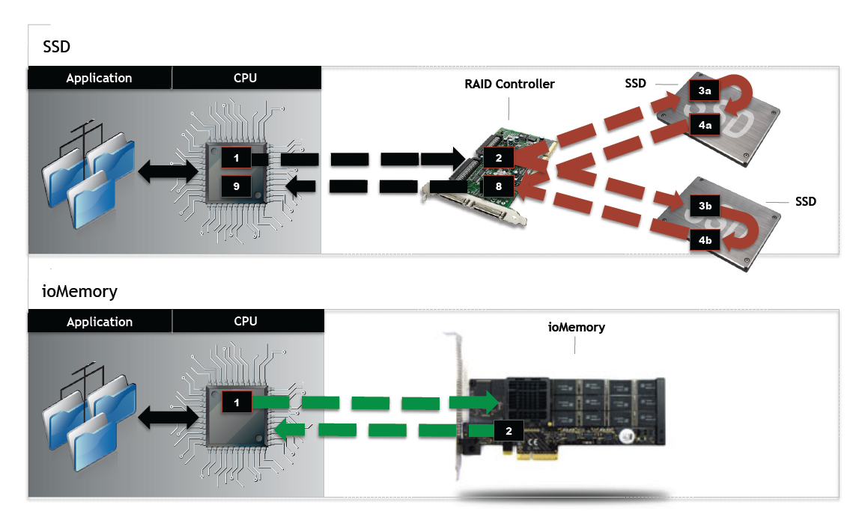
PCI SSD vs SATA SSD
PCI vs SATA
SATA was designed for traditional disk drives with high latencies
PCI is designed for high speed devices
PCI SSD has latency ~ 1/3rd of SATA

Slide 21
Booth 1107

Slide 22
Flash SSD Technology
Storage Hierarchy:
Cell: One (SLC) or Two (MLC) bits
Page: Typically 4K
Block: Typically 128-512K
Writes:
Read and first write require single page IO
Overwriting a page requires an erase & overwrite of the block
Write endurance:
100,000 erase cycles for SLC before failure
5,000 – 10,000 erase cycles for MLC

Slide 23
Flash SSD performance

Slide 24
Flash Disk write degradation
Empty
Partially Full
All Blocks empty:
Write time=250 us
25% part full:
Write time= ( ¾ * 250 us + 1/4 * 2000 us) = 687 us
75% part full
Write time = ( ¼ * 250 us + ¾ * 2000 us ) = 1562 us

Slide 25
Data Insert
Free Block Pool
Insert
SSD Controller
Used Block Pool
Empty Data Page
Valid Data Page
InValid Data Page

Slide 26
Data Update
Free Block Pool
Update
SSD Controller
Used Block Pool
Empty Data Page
Valid Data Page
Invalid Data Page

Slide 27
Garbage Collection
Free Block Pool
SSD Controller
Used Block Pool
Empty Data Page
Valid Data Page
Invalid Data Page

Slide 28
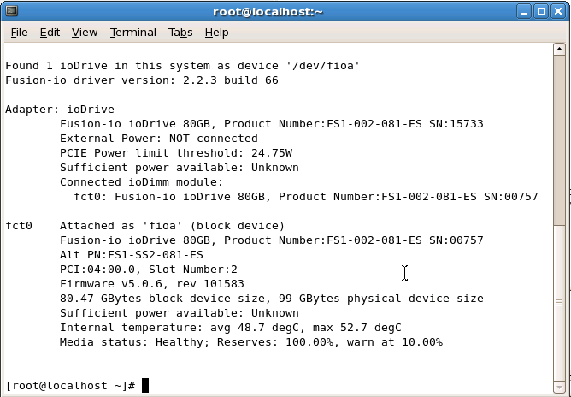

Slide 29
11g DB flash Cache

Slide 30
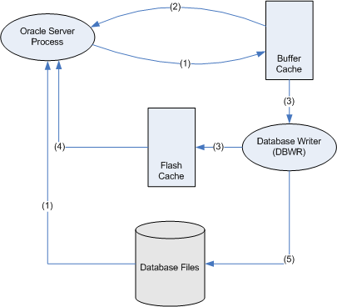
Oracle DB flash cache
Introduced in 11gR2 for OEL and Solaris only
Secondary cache maintained by the DBWR, but only when idle cycles permit
Architecture is tolerant of poor flash write performance

Slide 31
Buffer cache and Free buffer waits
Buffer
cache
Read from buffer cache
Free
Buffer
Waits
Oracle process
Write to buffer cache
Free buffer waits often occur when reads are much faster than writes....
DBWR
Read from disk
Database
files
Write dirty blocks to disk

Slide 32
Flash Cache
Buffer
cache
Oracle process
Read from buffer cache
Write to buffer cache
Read from flash cache
Flash Cache
DBWR
Write clean blocks (time permitting)
DB Flash cache architecture is designed to accelerate buffered reads
Database
files
Read from disk
Write dirty blocks to disk

Slide 33
Configuration
Create filesystem from flash device
Set DB_FLASH_CACHE_FILE and DB_FLASH_CACHE_SIZE.
Consider Filesystemio_options=setall

Slide 34
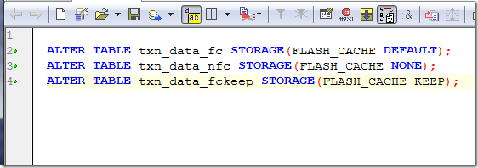
Flash KEEP pool
You can prioritise blocks for important objects using the FLASH_CACHE clause:

Slide 35
Oracle Db flash cache statistics
http://guyharrison.squarespace.com/storage/flash_insert_stats.sql

Slide 36
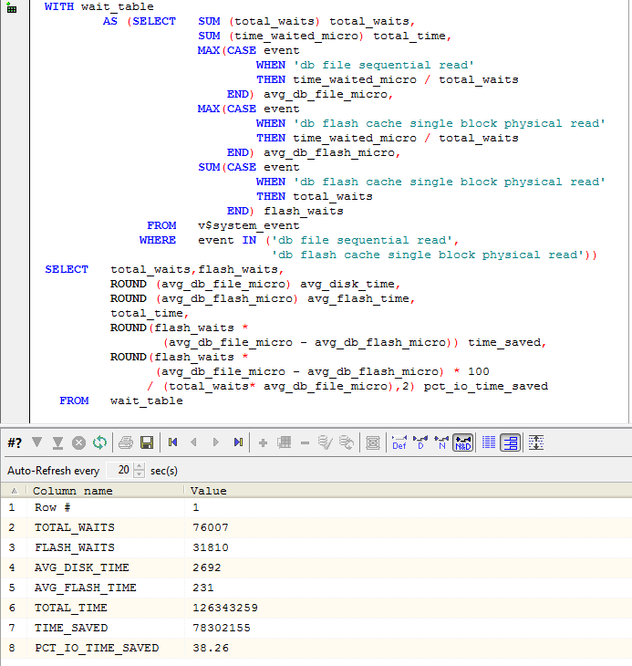
Flash Cache Efficiency
http://guyharrison.squarespace.com/storage/flash_time_savings.sql

Slide 37
Flash cache Contents
http://guyharrison.squarespace.com/storage/flashContents.sql

Slide 38
Performance tests

Slide 39
Test systems
Low end system:
Dell Optiplex dual-core 4GB RAM
2xSeagate 7500RPM Baracuda SATA HDD
Intel X-25E SLC SATA SSD
Higher end system:
Dell R510 2xquad core, 32 GB RAM
4x300GB 15K RPM,6Gbps Dell SAS HDD
1xFusionIO ioDrive SLC PCI SSD

Slide 40
Performance: indexed reads(X-25)

Slide 41
Performance: Read/Write (X-25)
Notes:
The higher logical read rate overwhelms the HDD

Slide 42
Random reads – FusionIO

Slide 43
Updates – Fusion IO

Slide 44
Full table scan – FusionIO

Slide 45
Sorting – what we expect
Multi-pass
Disk Sort
Single Pass
Disk Sort
Memory Sort

Slide 46
Disk Sorts – temporary tablespace
Multi-pass
Disk Sort
Single Pass
Disk Sort

Slide 47
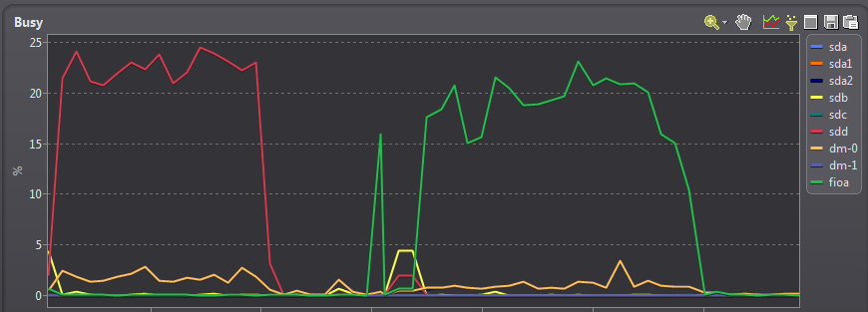
Redo performance – Fusion IO

Slide 48
Concurrent redo workload (x10)

Slide 49
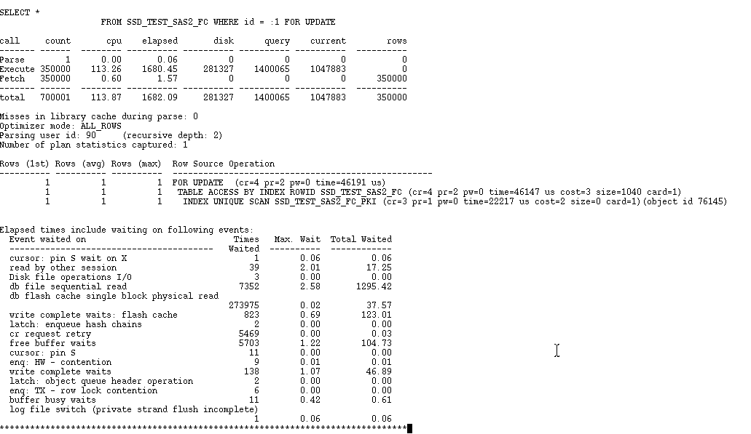
Buffer Cache bottlenecks
Flash cache architecture avoids ‘free buffer waits’ due to flash IO, but write complete waits can still occur on hot blocks.
Free buffer waits are still likely against the database files, due to high physical read rates created by the flash cache

Slide 50
Write degradation
In theory, high sustained write IO can lead to SSD degradation when GC fails to cope with the block erase/update cycle
In practice, this is rarely noticeable from Oracle:
Oracle write IO is largely asynchronous (DBWR)
Almost all write activity has at least an equal amount of read activity
Garbage collection and wear levelling algorithms are sophisticated in decent SSD drives

Slide 51
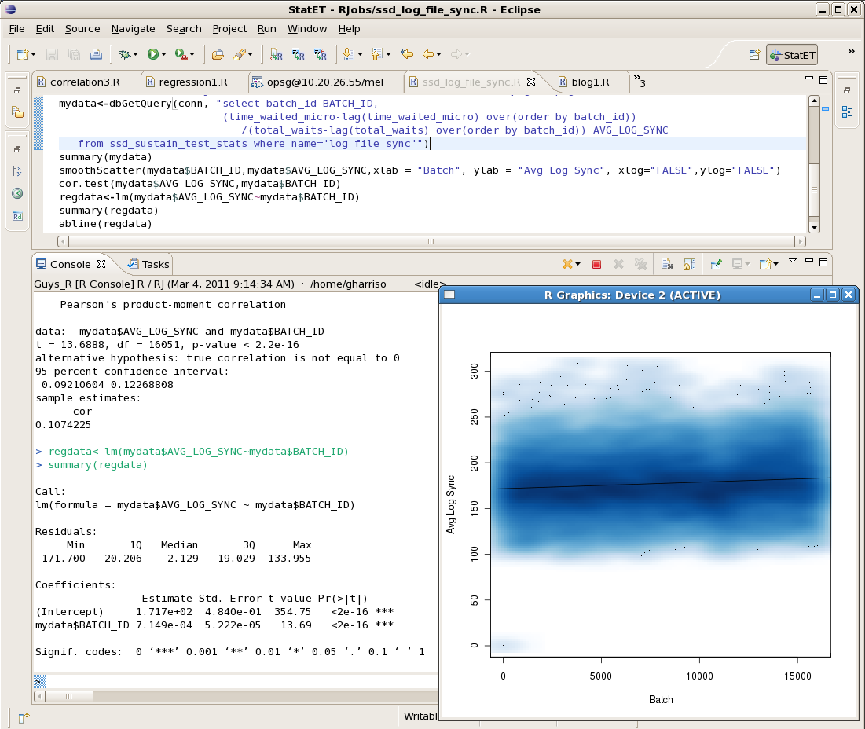

Slide 52
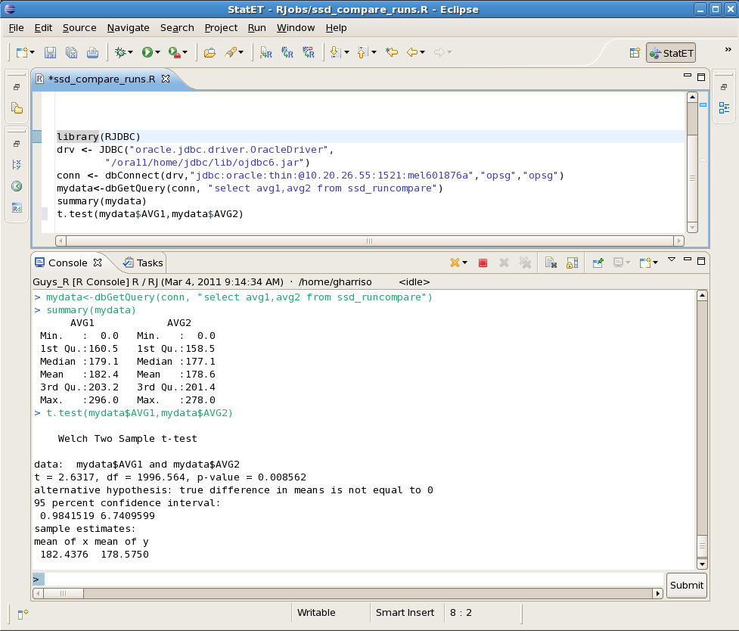
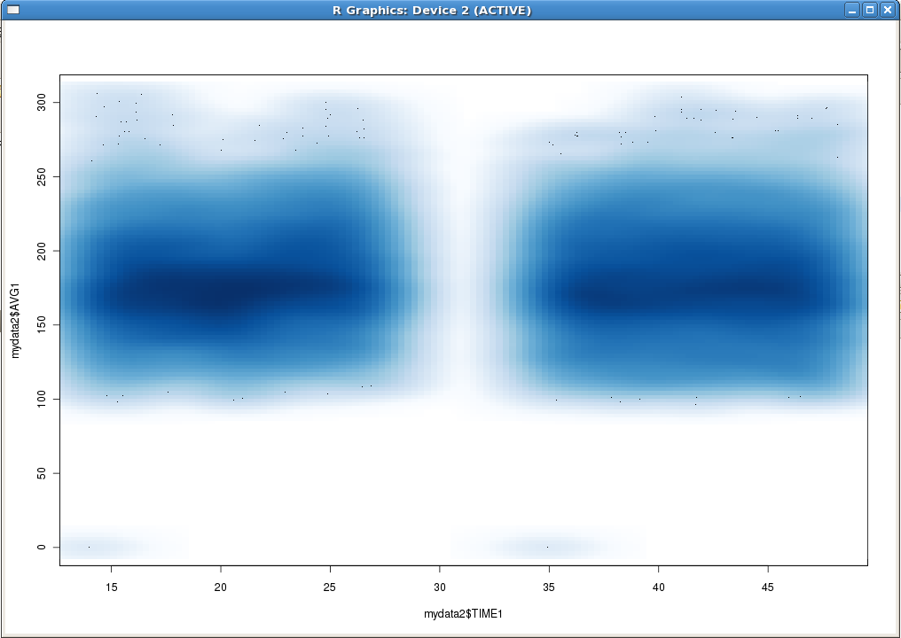

Slide 53
Fusion IO direct cache
Temp Tablespace
Hot Segments
Hot Partitions
DB Flash Cache
(limited to the size of the SSD)
File System/ Raw Devices/ ASM
File System/ Raw Devices/ ASM
Read-intensive, potentially massive tablespaces
Regular Block Device
Caching Block Device
directCache
ioMemory VSL
ioMemory VSL
LUN

Slide 54
Fusion IO direct cache – Table scans

Slide 55
Exadata

Slide 57
Exadata flash storage
4x96GB PCI Flash drives on each storage server
Flash can be configured as:
Exadata Smart Flash Cache (ESFC)
Solid State Disk available to ASM disk groups
ESFC is not the same as the DB flash cache:
Maintained by cellsrv, not DBWR
DOES support full table scans
DOES NOT support smart scans
Unless CELL_FLASH_CACHE= KEEP,
Statistics accessed via the cellcli program
Considerations for cache vs. SSD are similar

Slide 58
Exadata: Flash grid disk vs ESFC
100M row table, 200,000 random PK lookups, 1M possible keys

Slide 59
Exadata: SSD disk for Redo

Slide 60
Summary

Slide 61
Recommendations
Don’t wait for SSD to become as cheap as HDD
Magnetic HDD will always be cheaper per GB, SSD cheaper per IO
Consider a mixed or tiered storage strategy
Using DB flash cache, selective SSD tablespaces or partitions
Use SSD where your IO bottleneck is greatest and SSD advantage is significant
DB flash cache offers an easy way to leverage SSD for OLTP workloads, but has few advantages for OLAP or Data Warehouse

Slide 62
How to use SSD
Database flash cache
If your bottleneck is single block (indexed reads) and you are on OEL or Solaris 11GR2
Flash tablespace
Optimize read/writes against “hot” segments or partitions
Flash temp tablespace
If multi-pass disk sorts or hash joins are your bottleneck
FusionIO direct cache
If you want to optimize both scans and index reads OR you are not on OEL/Solaris 11GR2

Slide 64
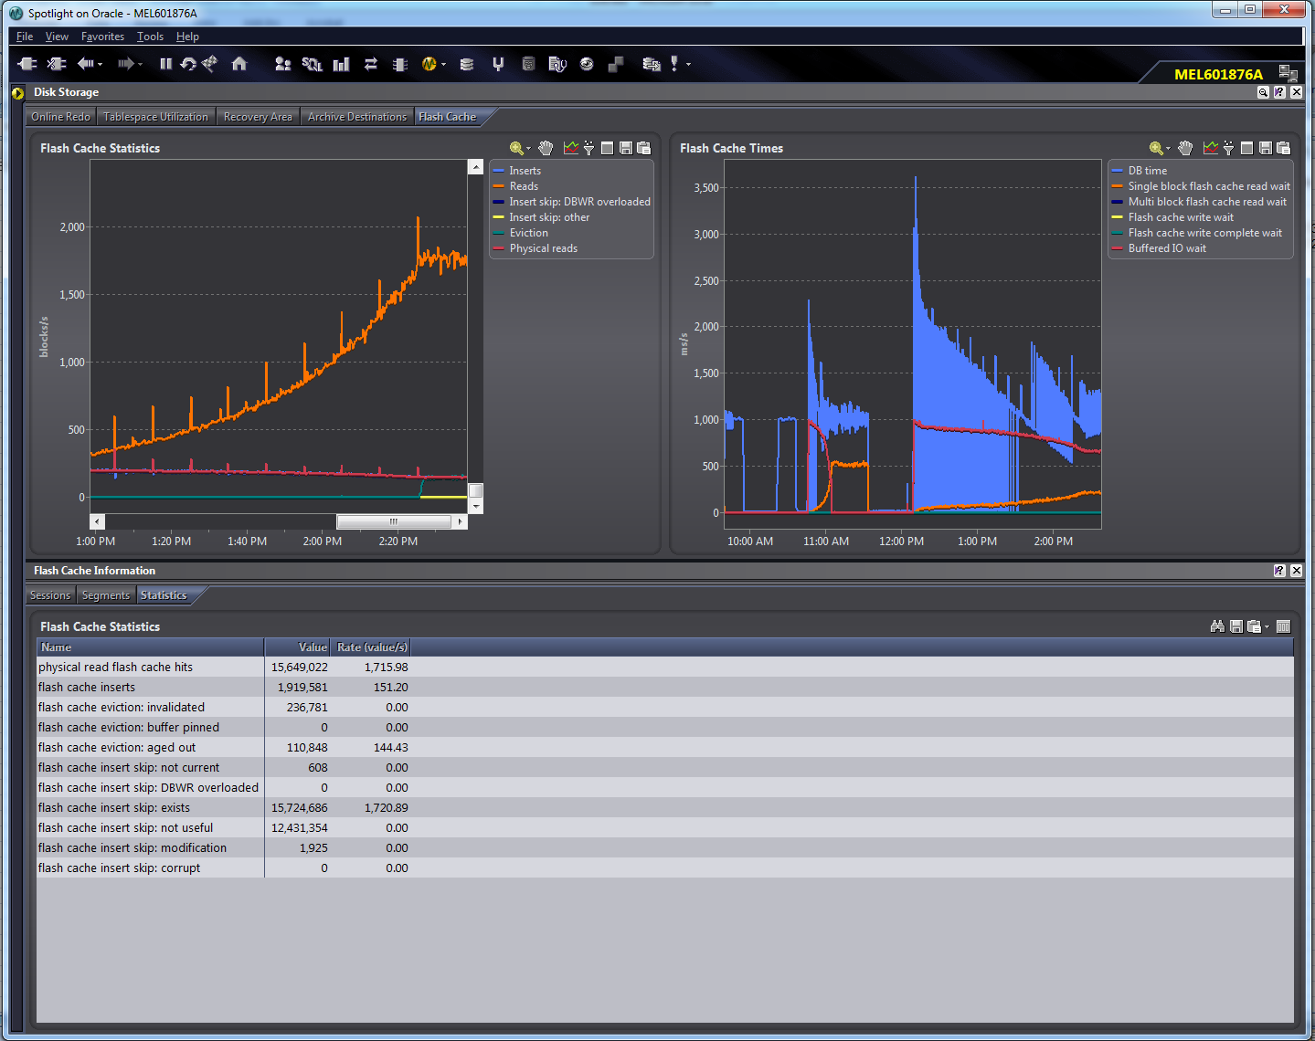

Slide 65
References
Latest version of this presentation:
http://www.slideshare.net/gharriso/ssd-and-the-db-flash-cache
Quest whitepaper:
http://www.quest.com/documents/landing.aspx?id=15423
Guy’s SSD guide
http://guyharrison.squarespace.com/ssdguide/

