Slide 1
DBMS.next:
Next generation Database Systems
Guy Harrison,
Chief Architect, Database Solutions

Slide 2
Agenda
The last Database Revolution
Recent trends in (Oracle) RDBMS
  Grids and Utility computing
  RAC and ASM
  Virtualisation
  “GRID 2.0”
  Times10 and ExaData
Clouds, Grids and VMs
“Cloud” Databases
Column based databases
H-Store

Slide 3
The last DBMS revolution
During the late 1970s, DBMS systems used hierarchical or network models:
  Rigid access paths
  Programmer-only access
Relational model first proposed in 1970
First Commercial implementation by Oracle in 1977
Rapid uptake (10-15 years) due to:
  Improvements in computer hardware which reduced performance overhead
  Revolution in the economics of data analysis
  Ability to run the new databases on new, more economical non-mainframe platforms
  Mindshare shift (Relational==Good)

Slide 4
Fast Forward: The Grid/Utility computing vision
Computing resources (IO, storage, memory, CPU) allocated on demand
Analogous to the electricity grid
Economic and availability benefits will be irresistible once the technical challenges overcome
Grids have been viable only for CPU-bound applications until recently
To create a database-enabled grid we need:
  A way to shift CPU/memory efficiently between databases
  A way to shift IO bandwidth efficiently between databases
  Without requiring constant data re-organization

Slide 5
Grids, RAC and Virtualization
RAC is a step towards CPU and memory on demand
  Shared disk architecture allows CPU and memory to be reallocated without data rebalance
  However, the reallocations are primarily manual at present
  In some future release, we expect automatic reallocation of instances to clusters
ASM provides a disk/Storage-grid solution
  non-Oracle technologies can provide a heterogenous solution
RAC and ASM are not quite there yet
  Nevertheless, RAC changes the economics of providing highly available, high throughput or VLDB database in a way that competitors cannot currently address

Slide 6
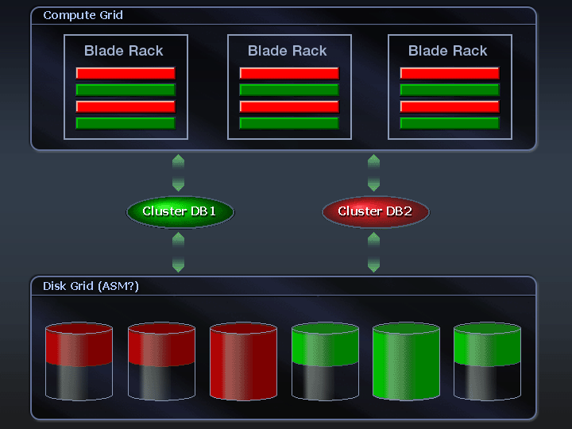
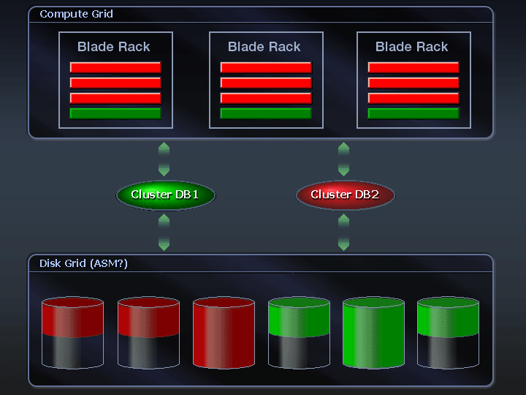
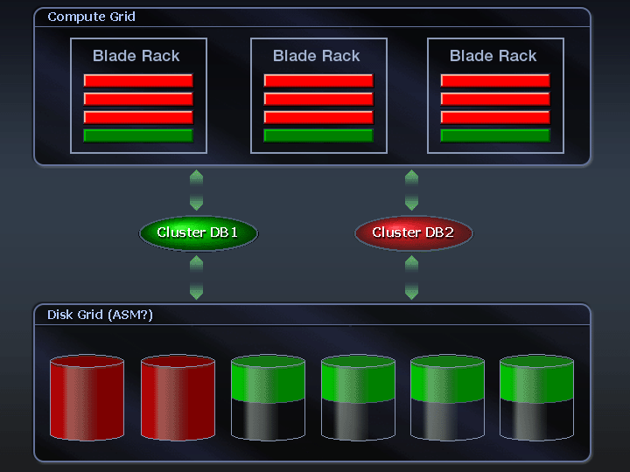
Technical trends – grids

Slide 7
Virtualization vision
Virtualization offers a competing utility vision
Resources can be shifted between VMs (and therefore applications) on demand
However, cannot split a VM across physical hosts
  Limits the scope of a (non RAC) VM DB
Performance concerns (semi-justified)
  Multiple levels of abstraction between DB and disk
  (Sometimes) limited virtual IO channels
  IO virtualization is already provided by Hardware arrays
  Concurrency primitives have higher overhead (latches)
VM DB performance will improve
  In the meantime, a hybrid Virtualization/Grid architecture can provide the best of both worlds.

Slide 8
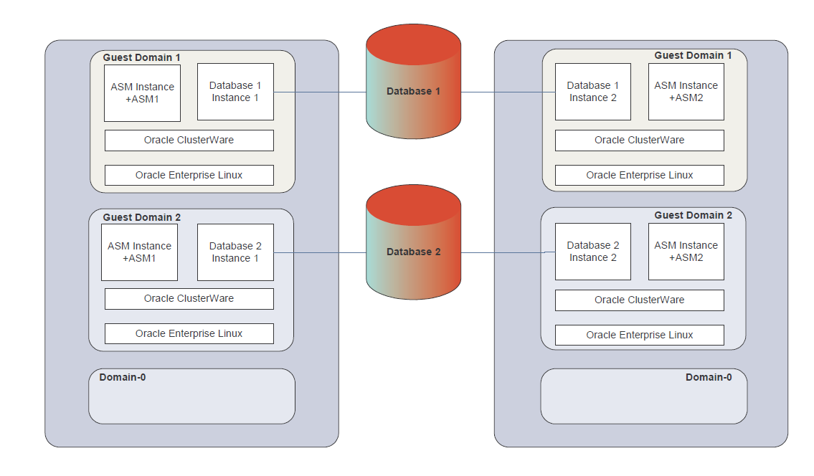
Grids and VMs: Oracle vision
http://www.oracle.com/technology/products/database/clusterware/pdf/oracle_rac_in_oracle_vm_environments.pdf

Slide 9
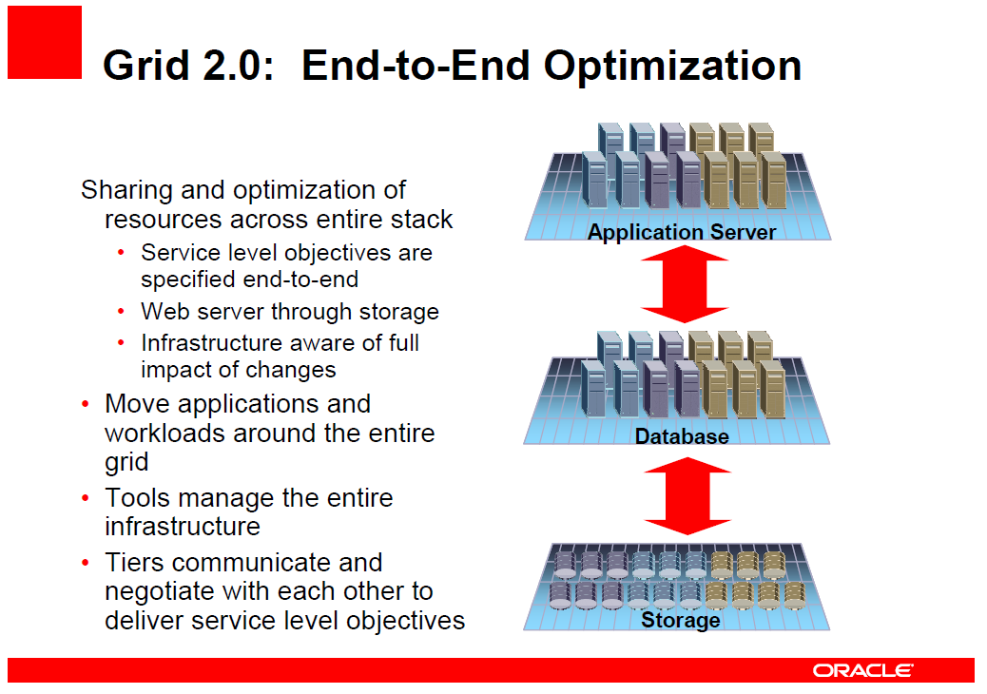
GRID 2.0

Slide 10
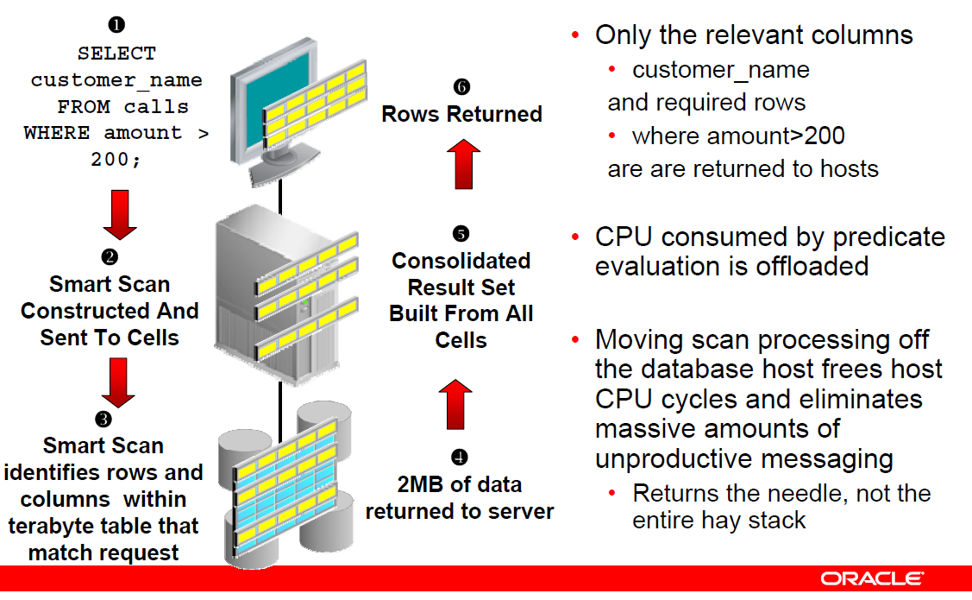
Other Oracle technologies
TimesTen
  Application server layer SQL compliant caching layer
Coherence
  Distributed object cache, similar to memcached (more on that soon)
Exadata storage server
  Intelligent storage management server
  Cut down version of Oracle DBMS that can partially resolve queries within the storage layer (predicate filtering)
  Infiniband network connection to RDBMS layer.
  Coupled with RAC blades in the HP/Oracle “database machine”

Slide 11


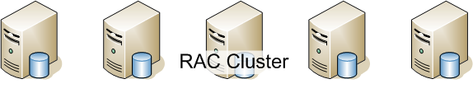
Oracle maximal license stack, circa 2008
TimesTen can provide a IMDB cache with SQL and PL/SQL compliance on the app server host
Coherence provides an object-oriented distributed data cache that persists to the DB
Exadata storage servers embed Oracle software to partially satisfy queries within the storage layer

Slide 12
Cloud mania 2008
the provision of virtualized application software, platforms or infrastructure across the network, in particular the internet.
Major public clouds:
  Amazon Web Services (AWS), an Infrastructure As A Service Cloud (IAAS)
  Google App Engine (GAE), a Platform As A Service Cloud (PAAS)
  Microsoft “Red Dog” AKA “Windows Strata”. To be Announced at Microsoft’s PDC late October; possibly both IAAS and PAAS elements
  Sun: network.com ; IAAS
  Hosting providers: Joyent, etc.

Slide 13
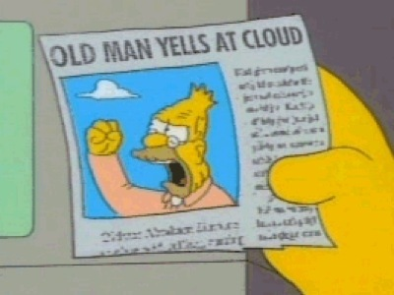
Larry, Richard and the cloud
Oracle Cloud Computing Center (OOW 2008):
  “Oracle is pleased to introduce new offerings that allow enterprises to benefit from the developments taking place in the area of Cloud Computing” (Amazon partnership)
Larry Ellison (Sep 08):
  “we’ve redefined cloud computing to include everything that we already do … It’s complete gibberish. It’s insane. When is this idiocy going to stop?:
Richard Stallman (Oct 08):
  "It's worse than stupidity:
  it's a marketing hype campaign."
http://feeds.feedburner.com/~r/Elasticvapor/~3/409837100/stupid-redux-old-man-gnu-yells-at-cloud.html

Slide 14
Grids, VMs and Clouds

Slide 15
Grid on the cheap: Memcached and Sharding
Oracle’s Enterprise architecture may suit Fortune 500 companies, but…
  Web 2.0 startups needed a more cost effective solution.
  A scalable architecture that leverages Open Source Software stacks and which can be actively scaled within Clouds
Memcached is a distributed object cache that reduces load on the database.
  Most reads can complete without a database access
“Sharding” is a technique for distributing data across multiple database servers without clustering
  Analogous to manual hash partitioning.
  All data relevant to a particular customer or user is hashed to specific servers
  Often coupled with master-slave replication to create smaller number of updateable servers

Slide 16
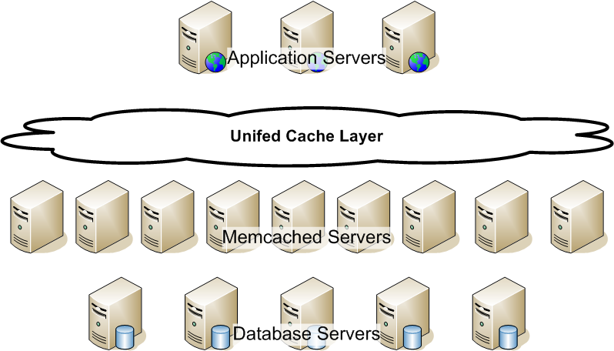
Memcached and sharding
Applications utilize data that appears as a single unified object cache.
Objects are maintained in a distributed collection of memcached servers
Typically many read-only replicated servers and fewer read-write masters
Data is persisted into database servers. Data is “sharded” across multiple servers

Slide 17
Cloud databases
Memcached and sharding have proven viable in many large Web 2.0 applications
  Facebook, Flickr, YouTube, Digg, etc.
However, the solution is high-maintenance. A transparently scalable datastore would be preferable.
RAC is theoretically suitable, but proprietary, overkill and NQTY¹
Cloud and OSS developers wanted cheaper, scalable, low maintenance datastores, even if missing key relational attributes
¹ Not Quite There Yet

Slide 18
Cloud Databases
Simpler, non-transactional, non-relational, distributed “databases”:
  Google’s Bigtable (tinyurl.com/yooofv )
  Amazon’s SimpleDB (tinyurl.com/23l97d )
  Microsoft SQL Server Data Services (SSDS) (http://www.microsoft.com/sql/dataservices )
  Hypertable (www.hypertable.org/ )
  Hbase (Hadoop database) (http://hadoop.apache.org/hbase/)

Slide 19
Cloud databases (continued)
Logical appearance: single table with primary key index.
Physical implementation: resembles a B-tree Index-organized-table in which header, branch and leaf blocks can be distributed within the cloud
Access via HTTP web services or simple API
Geo-redundant storage
Dynamic or loosely typed attributes:
  (In some cases) Multi-version, time-stamped copies of data
  (In some cases) multi-value attributes
  (In some cases) variable attributes per row
Joins, transactions, referential integrity, etc must be implemented in application code

Slide 20
The big hash table in the clouds
VM2
VM2
VM1
VM5
VM4
VM3

Slide 21
Stonebraker (et al) vision
One Size Fits All RDBMS architecture cannot meet the needs of current and emerging demands:
  OLTP
  Stream processing (Telco, web)
  OLAP/Data Warehousing
  Unstructured, mobile, embedded, multi-dimensional, etc
Specialized databases can provide orders of magnitude better performance in each scenario
C-Store and H-Store are proposed as Data Warehouse and OLTP specialized DBMS

Slide 22
C-Store: Data Warehouse optimized DB
C-Store characteristics:
  Column - rather than row - optimized
  Optimized for reads over writes
  Physical storage of projections with distinct columns and sort-key (a little like Materialized views)
  Shared nothing clustering
  Transactions, SQL, read consistency
  Orders of magnitude more efficient for common data warehousing implementations
Commercial implementations:
  MonetDB
  Vertica (with cloud option)

Slide 23
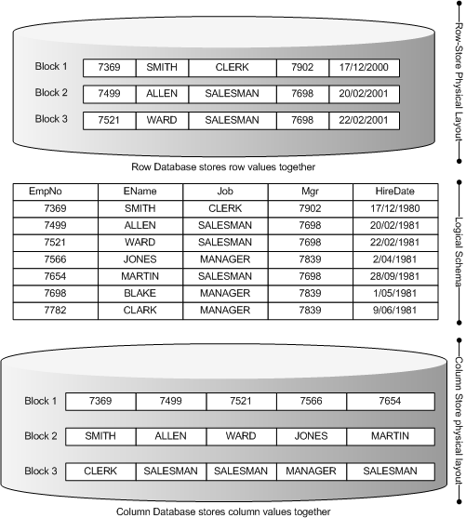
C-Store
Individual blocks to hold data for a particular column, not a specific row
This improves FTS aggregate queries
Massive benefits in compression ratios

Slide 24
H-Store: OLTP Optimized DB
A “complete re-write” of OLTP DBMS
Hierarchical data model
  Perfect partitioning and shared-nothing clustering
  Similar to Cloud DBs but allows for complex schema
Atomic stored transactions only
  No users “going to lunch” with a lock
Single threaded
  No complex latching algorithms
  Almost no lock contention
  But multiple “sites” per physical machine (each core has its own H-Store)
Limited consistent read
  Undo is discarded on commit

Slide 25
H-Store (continued)
Memory is primary storage
  Durability and availability guaranteed by 2PC replication
  No redo/transaction log on disk
  Long term data shipped to C-Store (don’t keep the non-OLTP data)
No SQL? (!)
  Propose instead a scripting language with data access extensions: such as Ruby on Rails/ActiveRecord
80x TPC-C benchmark improvements with H-Store prototype
H-Store feels like an evolutionary direction for Cloud databases

Slide 26
Conclusions
Oracle continues to lead in enterprise relational technologies
RAC, ASM and “Grid 2.0” represent real leadership in Utility computing, BUT:
Evolving Cloud databases and Open Source patterns represent disruptive innovations at the low end
H-Store suggests a model for the future of the simple cloud databases
C-Store represents an alternative physical model for Data Warehousing that Oracle will probably adopt

