Slide 1
Procure to Pay Automation
Bevan Wright
Fusion5
NZ Oracle User Group

Slide 2
Common Faults in Procure to Pay Process
Not keeping pace with technology - Many organisations continue to follow manual purchasing and accounts payable processes with their modern IT systems.
This can extend to:
‘Paper Pushing’ of Accounts Payable Invoices throughout the organisation for coding and approval
Use of Carbon Copy Purchase Order books
Limited match of Order to Invoice
Checking of Delegated Authority at random
Adhoc addition of Supplier Address Book records
Many of these processes have not been altered for up to 20 years.

Slide 3
Areas for Improvement
Control - find areas that are weak in control, or have gaps that are taken advantage of, or have potential for problems
Set clear rules for where a Purchase Order should be used within your organisation
Use electronic Purchase Orders, and match to Invoices, approve variances
All items should be approved against delegated authority
Have the ability to route non Purchase Order related invoices for coding and approval
Discourage post Invoice creation of Purchase Orders
Give business users visibility of past invoices

Slide 4
Areas for Improvement continued….
Have processes and system controls to enforce separation of duties and allow for Audit reporting
Consider business management of Invoice Disputes, Staff on leave, email reminders etc to help keep the process moving – where possible empower business users to manage their business
Addition of Address Book Master Information should be tightly controlled:
Best practice is to allow for request / approval by business to add a new supplier, followed by reporting of additions on a regular basis
Addition of bank accounts require deposit slip
Limited number of staff who can create / modify records
Payee approval activated on your ERP

Slide 5
Areas for Improvement continued….
Increase efficiency with emailed invoices, collation of transactions into less invoices, and particularly with Purchase Order match
All payments by Direct Credit, less payment runs, remittance advice sent out by email

Slide 6
Solution - ApprovalPlus
ApprovalPlus is a workflow solution, designed to streamline the accounts payable and procurement process
ApprovalPlus interfaces to your existing finance system to source items such as Supplier information, General Ledger codes, Work Orders and potentially Purchase Orders
Accounts Payable staff scan and route invoices for coding and approving before export to the finance system for payment
ApprovalPlus is designed to replace the paper based, non-purchase order related invoice flow in the organisation, and gives the option of a user friendly Purchase Order module
Different to most options that tend to be ‘Document Management’ solutions, ApprovalPlus is a system designed for Business users to manage Financial information

Slide 7
ApprovalPlus - Benefits

Slide 8
Fusion5 ApprovalPlus Customers
Notes:
8

Slide 9
ApprovalPlus Customers Continued……
Who is a typical ApprovalPlus Customer?
Mid Sized Organisation
20 to 500 staff who are involved in Purchasing or Approval of Invoices
Often have multiple physical locations
May have encountered a Fraud / Loss
Desire to increase financial controls
Range from Not for Profit, to Government Departments, Councils and Commercial Organisations
Started as a system designed for JDE customers, and extended to Oracle E Business, Navision, BPCS, and others

Slide 10
ApprovalPlus – Invoice Process

Slide 11
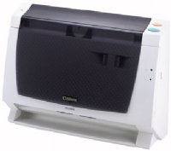
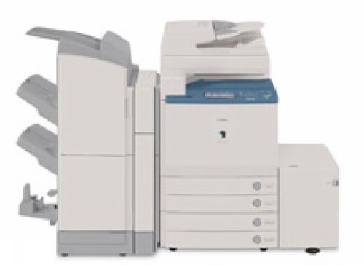
ApprovalPlus – Scanning Invoices
Options:
Outsource Service
OCR Engine (Optical Character Recognition)
Manual Entry
Network Drive

Slide 12
ApprovalPlus – Manual Invoice Entry

Slide 13
ApprovalPlus – Manual Invoice Entry
Assign Preparer (may auto assign)
System Manages Payment Terms, GST, Exchange Rates

Slide 14
ApprovalPlus – Task Notification
Email per document, or emails batched
Email contains URL link to ApprovalPlus

Slide 15
ApprovalPlus – User Interface
User Activity through online ‘To-do’ list

Slide 16
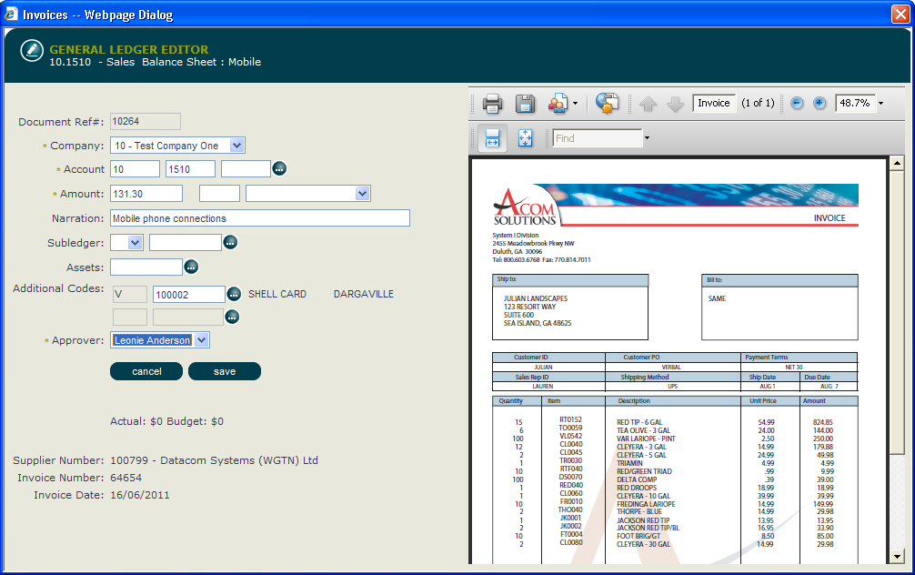
ApprovalPlus – Preparing Invoice
Preparer presented with invoice image, task is to code, provide narration and select approver
GL code list restricted per user
Approver list determined by relationship, Account Code and Amount

Slide 17
ApprovalPlus – Additional Information
Preparer or Approver can attach additional documentation

Slide 18
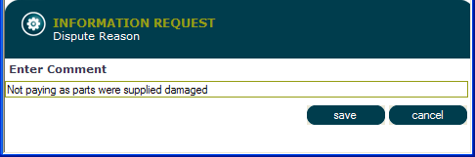
ApprovalPlus – Dispute Management
Business User Manages Disputes
Users can add comments as dispute progresses
Information visible to Accounts Payable or Business users at any time

Slide 19
ApprovalPlus – Invoice Approval
Approver receives emails, or uses ‘To-do’ list
One Screen for Review and Approve

Slide 20
ApprovalPlus – Batching of Approved Invoices
Invoices Batched and sent to Finance system for payment

Slide 21
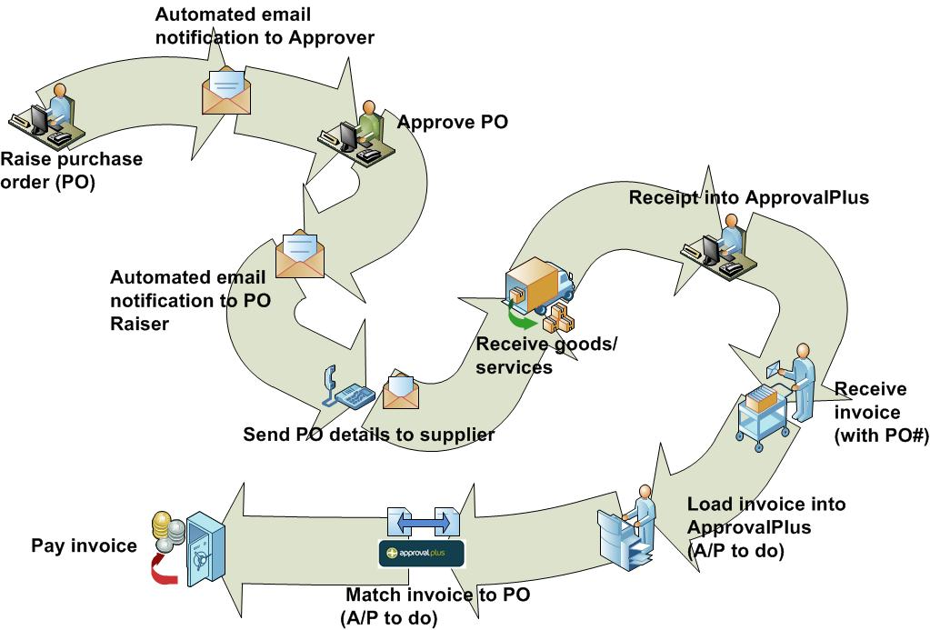
ApprovalPlus Purchasing Process

Slide 22
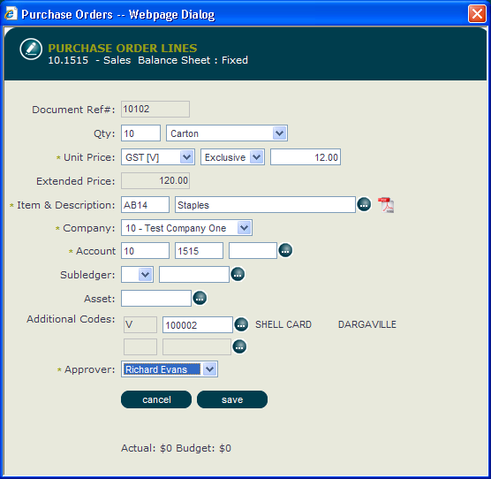
ApprovalPlus – Purchase Order Entry
Orders can be quantity or dollar based
Price Books can be imported or attached as images

Slide 23
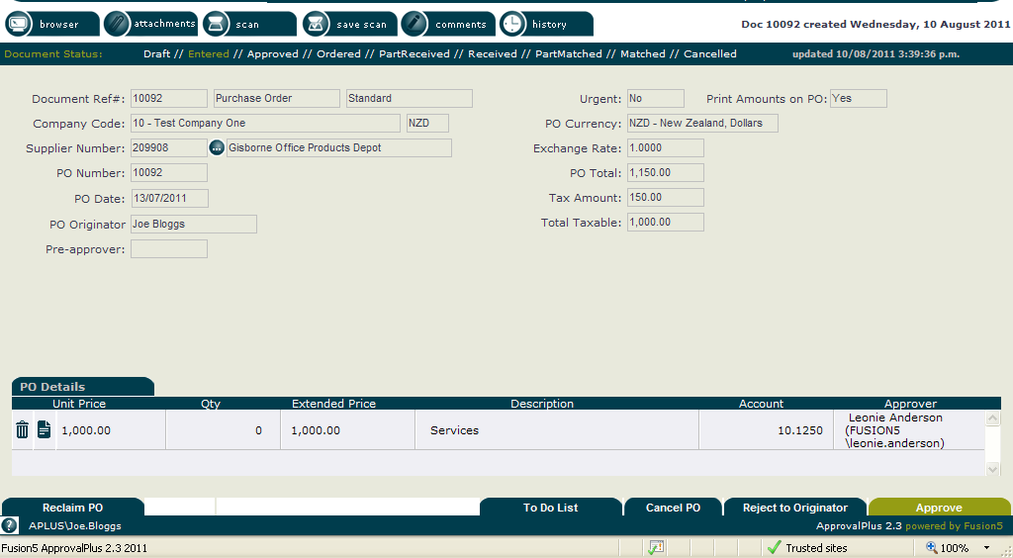
ApprovalPlus – Purchase Order Approval
Purchase Order Approver receives email, and works off ‘To-do’ list

Slide 24
ApprovalPlus – Placing the Order
The PO Originator will receive notification of Approval, and can place their order
Orders can be made by email, printed, or phoned through

Slide 25
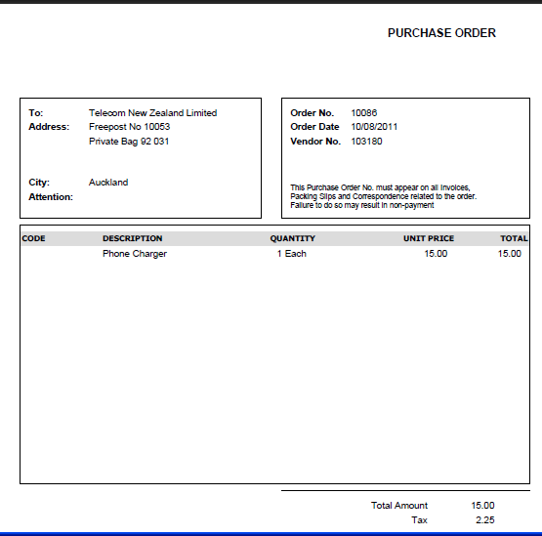
ApprovalPlus – Purchase Order
A standard PO format is provided, but can be customised for your organisations requirements

Slide 26
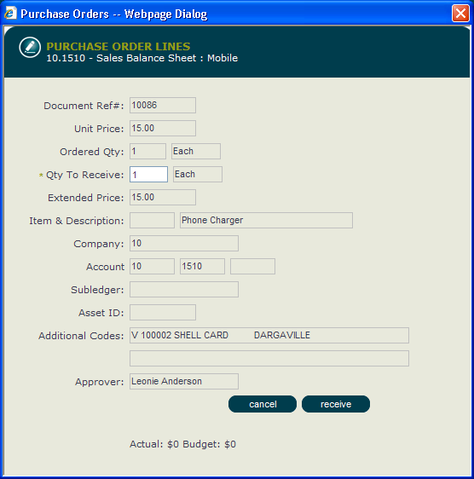
ApprovalPlus – Receipting
Users access orders from their ‘To-do’ list and receipt goods or services

Slide 27
ApprovalPlus – PO Match
Accounts Payable enter invoice and match to Purchase Order items.
If there is an overspend, this is routed for additional coding and approval.
If matched – invoice inherits coding and approval from PO and is batched with invoices to send to the Finance system

Slide 28
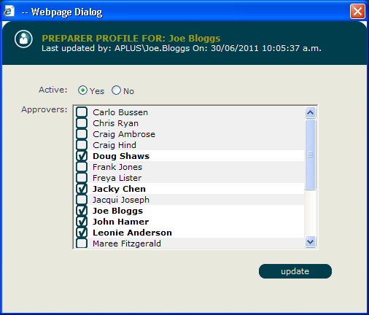
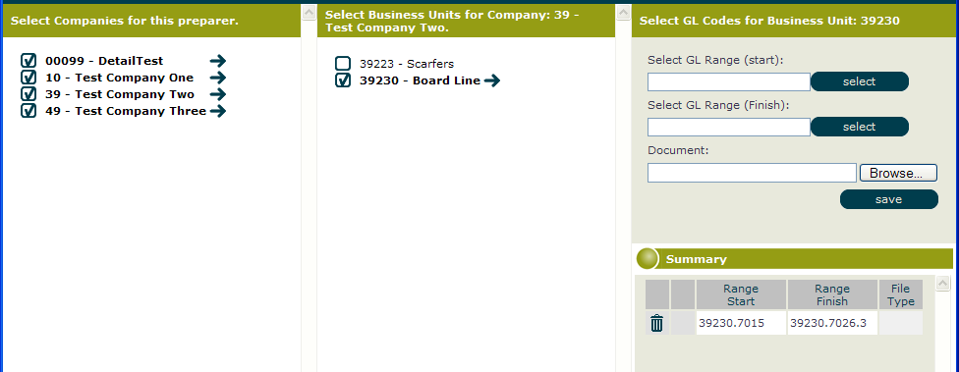
ApprovalPlus – User Setup
Easy assignment of Approvers to each Preparer
Customisable Account picklist per Preparer
Delegation of approval limits by:
Capex and Opex costs
Override by Company, Business Unit, GL Account or Supplier

Slide 29
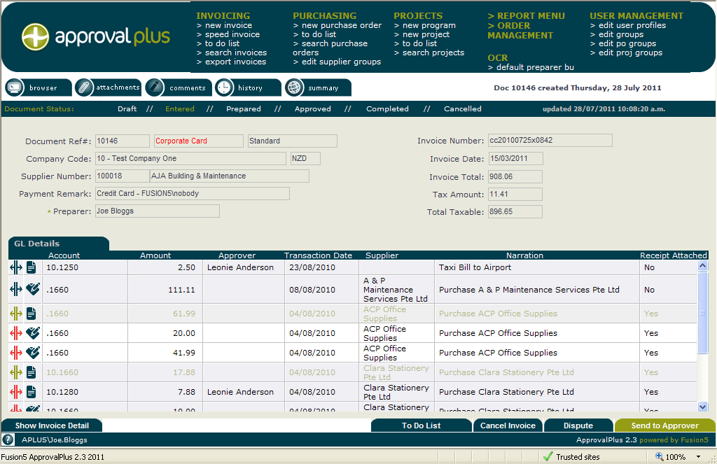
ApprovalPlus – Other Modules
Other Modules available:
Corporate Cards – import of spend from Credit Card Companies, Taxi Charge, Phone Company E-bill
Projects (approval of budgets, and track of spend within capital or operating projects)
Coming soon… staff expense claims

