Slide 1


Oracle BI Apps - Recommandations for Effective Implementation
John Hooker
Senior Consultant Asparona
NZOUG March 2013

Slide 2
My Background
Senior Consultant at Asparona with focus on delivery of Business Intelligence Applications
Previously held senior management roles globally in a high tech manufacturing and distribution environment.
Over 20 years systems experience, including 15 years implementation and delivery of Oracle E-Business suite and further specialization and expertise in Business Intelligence and B2B applications.
Contact: john.hooker@asparona.com

Slide 3
Objectives
What it is & what it does
Likely challenges
Critical factors for successful implementation
Lessons learned
Functional perspective
Applicable to other BI solutions

Slide 4

Oracle BI Applications –
What is it?
What Does it Do?

Slide 5
Oracle BI Applications
Pre-Built Application Containing:
Interactive dashboards
Full ad-hoc queries and analysis
Pro-active intelligence delivery and alerts
High-volume production reporting
Predictive intelligence
Integration with Microsoft Office
Integration with iPad and iPhone

Slide 6
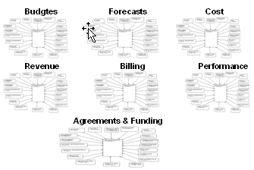
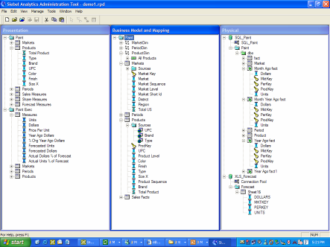
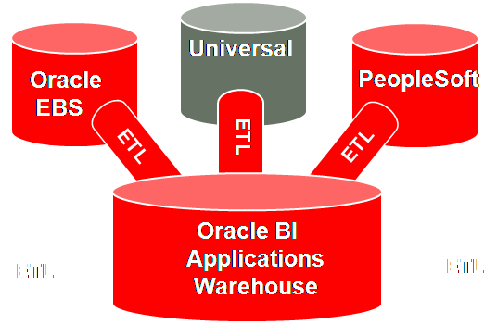
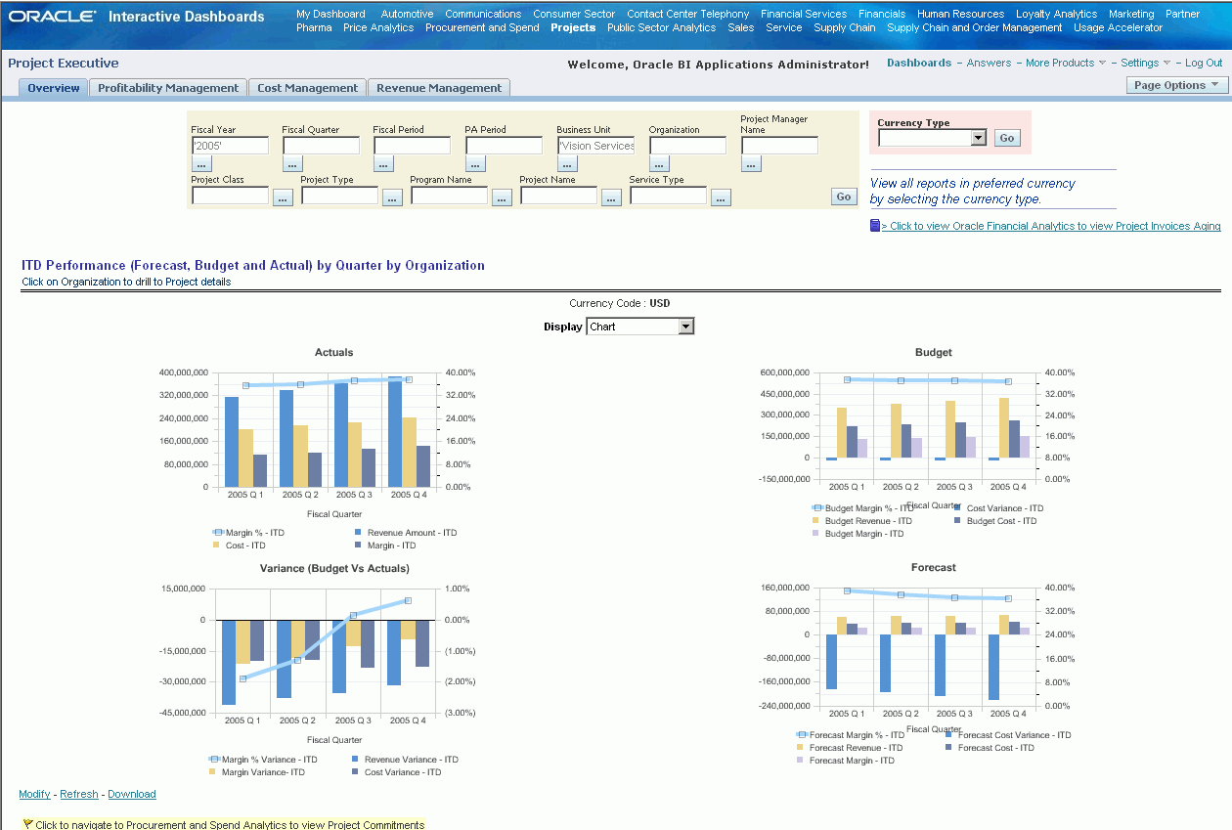
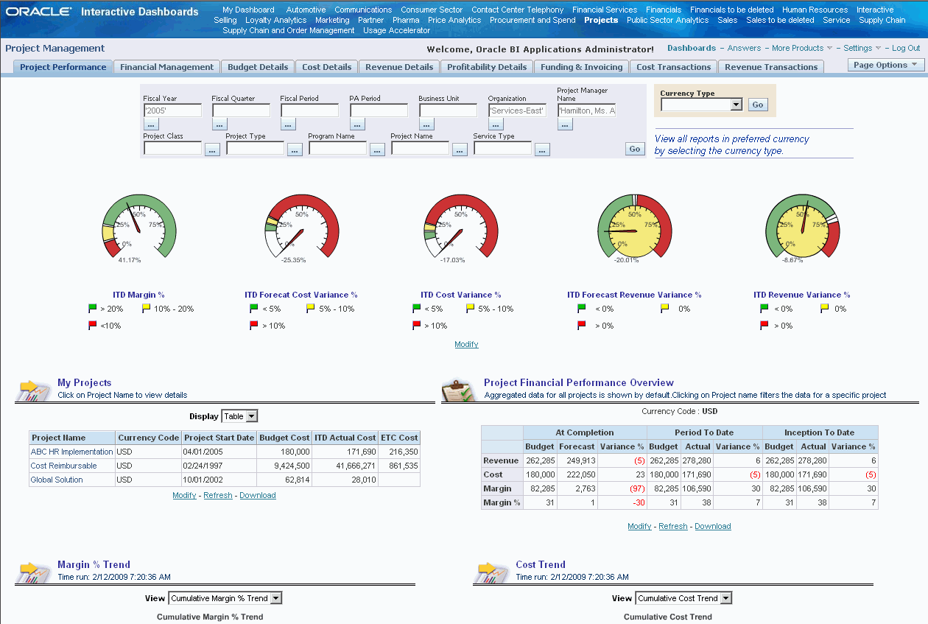
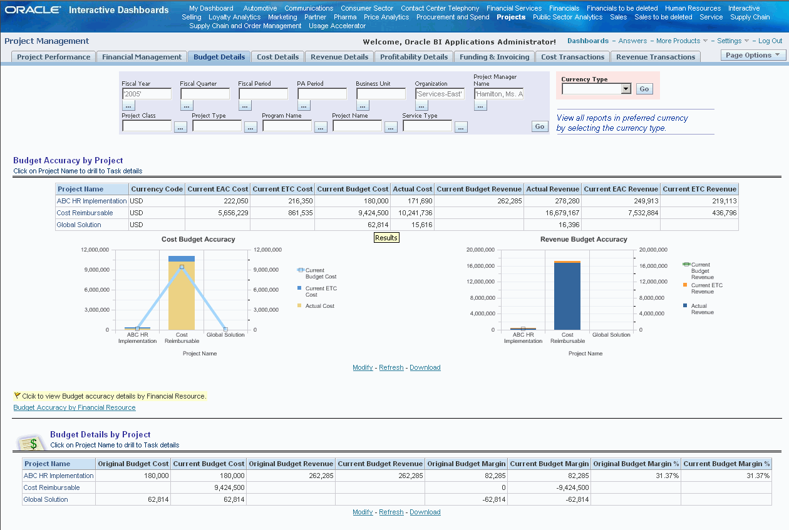
What’s in the Box – Pre-Built Components
1
3
Pre-built warehouse with multiple star-schemas designed for analysis and reporting on all aspects of the business.
Pre-mapped metadata, including embedded calculations, and hundreds of pre-built metrics
2
4
Pre-built ETL with thousands of operation tables to extract data from a large number of operational tables and load it into the Data Warehouse, sourced from EBS and elsewhere.
An extensive library containing hundreds of pre-built intelligence dashboards, reports and alerts targeted across all levels of business user and business function.

Slide 7
Pre-Built Analytics Components – Some Numbers
 | Dashboards | Dashboard Pages | Reports | Metrics
Financials | 6 | 36 | 255 | 488
Procurement | 4 | 23 | 234 | 335
Supply Chain | 3 | 22 | 165 | 364
Projects | 3 | 18 | 146 | 500+
Source: Release 7.9.6.3

Slide 8

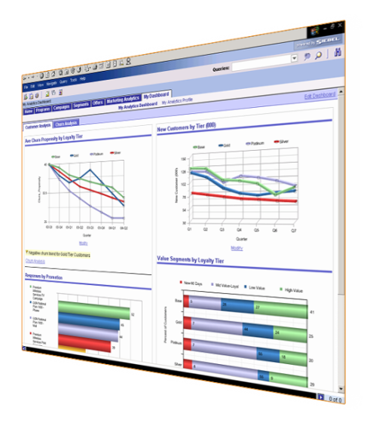
So NOT Only Dashboards and Reports
Much more lies under the surface
DASHBOARDS & REPORTS
Extensive prebuilt library
“One size does NOT fit all”
SUBJECT AREAS
Many metrics and dimensional attributes not surfaced by prebuilt dashboards and reports
Incremental work to build more content from this foundation

Slide 9

Benefits of BI Apps

Slide 10
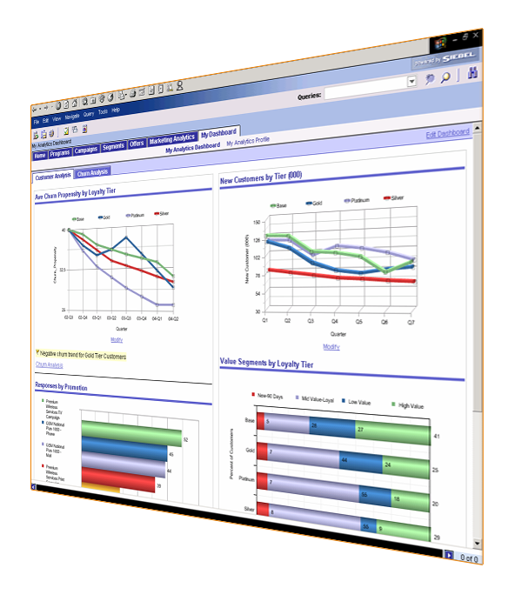
Key Benefits of Oracle BI Applications
  Comprehensive integrated BI suite – no need to reinvent the wheel
  Single, consistent view of enterprise information across functions & data sources
  Reduced time and cost compared to serial deployment
    Access to Oracle and non-Oracle data sources and applications
      Flexible and Extensible - Built on a 100% open platform
      Reduced load on the ERP system

Slide 11
Initial Implementation Challenges

Slide 12
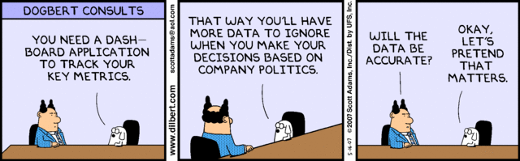
Close to the Truth?

Slide 13
Where Are You Today?
Organizations considering moving to a new BI tool will typically have a combination of the following:
Siloed data
Inconsistent data definitions
Variable data quality
Report centric – focus on operational reporting
Excel spreadsheet focused
Multiple BI tools
Multiple data sources
User resistance - we like what we have
Reports bottlenecks – IT managed and controlled
BI implementation as part of a wider ERP implementation

Slide 14
Getting Started – Critical Success Factors
Cross-Organizational Collaboration
Business Sponsors – retain their commitment through bad times and good
Dedicated Business Representation – choose the right people and hold on to them – retain their motivation
Available IT Resources - choose people with the right skill set and hold on to them – retain their motivation
BI Application Methodology - BI methodologies and deliverables differ from OLTP projects
Careful Planning – although it’s an iterative process the initial project plan must be created with as much detail as possible

Slide 15
Critical Success Factor - Don’t Play Catch-Up
If implementing Oracle BI Apps as part of an ERP upgrade or implementation, don’t be left behind !!
Often BI is almost an afterthought
Common problem – requirements hard to come by in the early phases as business processes are being defined.
Be part of the initial business process and business requirements gathering for the ERP system
Starting too late may lead to a rushed and incomplete implementation

Slide 16

Starting to Build

Slide 17
Approach to Mapping Reporting Requirements against BI Apps Content
Despite the extensive pre-built nature of Oracle BI Apps, traditional requirements gathering sessions are still necessary
Suggested 3-Stage Process:
Workshop
Document
Review

Slide 18
Workshop
Analyse the business process flows
Determine the key process touch points that requires BI
Determine what information is required to support the process
What specific metrics are required
Do the metrics drive further analytical reporting requirements?
Business Process | Business Question | Who is Asking | What is the Importance | Who/What benefits from the answer | What is the metric / measurement? | Does this measurement/answer drive additional questions?
Inventory | How long does inventory sit in the warehouse? | Inventory Manager, Sales VP, Marketing VP | Drives improving inventory turns, lowers cost of Inventory | Corporate expense, inventory manager, marketing – marketing promotions to move inventory | Inventory turns – defined by time in and time out in number of days | What items should we purchase? Do we need to run promotions? Is the pricing appropriate?

Slide 19
Document
Mapping and Gap analysis
Does the requirement exist currently in BI Apps?
If not, what in addition is required?
Identify the effort required
Document the proposed solution – may be more than one solution for a requirement

Slide 20
Review
Review the proposed solution
Review the Gaps, open issues
Business sign-off
Prioritisation – phased roll out
Identify and focus on the quick wins
Note: Document and Review steps can loop where appropriate

Slide 21
Requirements Gathering Pitfalls
Don’t fall into the trap of just replicating what you have today
Too much focus on operational reporting
Not prioritising effectively – identify “must-have’s” from the “nice to have’s”
No user exposure to BI Apps environment to review pre-built content for suitability
Over elaboration and building the “Perfect Solution”

Slide 22

Data Considerations

Slide 23
It’s ALL About The Data
Evaluate Your Data Sources
– The more sources the more complex it is likely to be
– Understand where it comes from, what it really means
– Understand how best to use it
Know your data and Identify:
– Incomplete data
– Inconsistent data
– Duplicate
– Poorly organized data
Understand your data
– Establish the single source of truth
– Establish consistency and standards, common definitions
– Effective data management and data integrity processes
“What starts right, stays right”

Slide 24

Customising BI Apps

Slide 25
Customising Oracle BI Apps
Why Customise?
If it’s all “prebuilt” why do I need to customise?
Simple reality is that customisation is unavoidable and will have an impact – never just – never just “plug and play”
Out of the box solution likely to address 70-80% of your immediate BI needs and requirements
As with other Oracle application products, try to keep it to a minimum and use the out-of-the-box functionality where possible

Slide 26
Aspects of Customisation
Pre-built solution will NOT contain all that you need – at all levels there will be content gaps
Does not include all the data you’ll want
- Key and Descriptive flexfields
- New facts, dimensions, hierarchies
No standard ETL mappings for some ERP data
Not all pre-built content may be relevant
Unsupported Source System(s)
Accommodating ERP Source System Specific Configurations
BI Application Specific Configurations

Slide 27
Typical Effort and Customisation Balance
Additional dashboards and reports, guided and conditional navigations, iBots, etc.
Dashboards & Reports
Easy
Additional derived metrics, custom drill paths, exposing extensions in physical, logical and presentation layer, etc.
OBIEE Metadata
Moderate
Extension of DW Schema for extension columns, additional tables, external sources, aggregates, indices, etc.
DW Schema
Intermediate
Extension of ETL for extension columns, descriptive flexfields, additional tables, external sources, etc.
ETL
Involved
Degree of Customization
Level of
Effort

Slide 28
Why a Pilot Can Make Sense
Beginning with a Pilot phase is an excellent strategy to build an initial but powerful foundation
Two of the biggest failings in BI projects are lack of user adoption and over-implementation
A Pilot allows you to meet and overcome your challenges in a structured and cost-effective manner
It affords the opportunity for exploration and familiarisation - no need to take a great leap into the unknown
It allows you to assess functionality and identify additional requirements for future deployment
Can be implemented in a matter of weeks

Slide 29
Why a Pilot Can Make Sense – Example
Initial roll-out was a small portion of Supply Chain covering:
A few standard OM and Inventory out of the box reports
- On-time Shipping
A few out of the box reports customised
  - Sales Cycle
Re-created existing Discoverer reports in BI Apps
- Billings, Bookings, Backlog
Created new report requiring customisation at the Data Model, ETL and metadata level
- Order Source Analysis
Phase 2 was to extend the Supply Chain offering and beyond that a similar roll-out for other modules

Slide 30
Implementation Lessons Learnt
Adopt good design standards – leverage from the foundation provided by BI Apps
- Naming conventions and standards
- ETL routines
Use the documentation available – there is a lot out there:
- Oracle standard reference manuals
- Oracle Support/Forums
- Oracle BI blogs
Data/Report validation is a critical element - make sure your test scenarios and scripts are robust enough
After go-live keep close centralised control of report management – there should not be a reporting free-for-all

Slide 31
Implementation Lessons Learnt
Have a demo version available quickly for socialisation and familiarity and to help with GAP analysis
Drill-down functionality is useful – but too much may impact system performance and user experience
Consider instead to use filters in the report
Geography | Value
Worldwide | WW
Region | Asia Pacific
Sub Region | Oceania
Area | Australasia
Country | New Zealand
Country Region | North Island
Country Area | Northland
City | Whangarei
Store | 277 Broadway

Slide 32
Implementation Lessons Learnt
Data security within BI Apps is comprehensive but be careful if customising and adding your own security
- Integrate BI Apps and ERP data security to minimize
user maintenance
Load data by need to optimise performance - if I update the data will I use it?
- Inventory transactions/balances – hourly
- SO/PO transactions – once or twice per day
- GL Balances – weekly
Performance management generally should not be underestimated and should form a large part of your implementation and post go-live focus

Slide 33
Dashboard Customisation – Lessons Learnt
Implement Dashboard standards to ensure consistent look and feel across the application
Don’t have too much clutter – less is more
When designing dashboards display a combination of data in an easy to follow and logical flow
Design dashboards for specific roles and their needs
Include reports that include export capability to other formats like Excel or CSV
Only show reports that actually help the business – don’t have reports just for the sake of it

Slide 34
Summary and Conclusions
Oracle has packaged most of what you need – the hard part has been mostly done for you
Pre-built elements give you a head start - use what’s beneath the surface
The level and degree of customization around data management and exception is where most time is spent
Understand your bottlenecks and what makes your business flows and processes unique AND how to treat them – understand the GAPS
It’s as much about instigating cultural change

Slide 35
Summary and Conclusions
Don’t just replicate what you have already today - design and build for the future. “Show me something that I don’t know or that I need to know”
A measured, phase-by-phase implementation approach is recommended
Have the right resources at your disposal
A good implementation partner is important - but take ownership of the processes and tasks where ever possible
Option always exists to go it alone and build from scratch – BUT that comes with its own unique risks, challenges, costs and timelines.

Slide 36

- Q & A

Slide 37
THANK YOU !!

