Slide 1
ORACLE DBA Some Tips and Best Practices
By:
Francisco Munoz Alvarez
Rotorua, March 2010

Slide 2
ORACLE DBA Some Tips and Best Practices
Francisco Munoz Alvarez
Oracle ACE Director
Author: Oracle 11g: Novice DBA Survival Guide – by Packt Publishing – Feb/2010
8/9/10g/11g OCP, RAC OCE, AS OCA, E-Business OCP, SQL/PLSQL OCA, Oracle 7 OCM
Oracle 7 & 11GR2 Beta Tester
ITIL Certified
Blog: www.oraclenz.com - Email: franciscoa@dbisonline.com – Twitter : fcomunoz
Comunidad Oracle en Espanol: www.oraclemania.ning.com
CEO at DBIS ™
Database Integrated Solutions
www.dbisonline.com
www.dbis.co.nz

Slide 3
The Rule:
“The most important rule with respect to data is to never put yourself into an unrecoverable situation.”
The importance of this guideline cannot be stressed enough, but it does not mean that you can never use time saving or performance enhancing options.

Slide 4
Backup, Backup and Backup
Normal Approach
Nothing bad will happen … is a easy change…
I test it before and nothing happens …
Recommendation
Remember each environment is different
Always Backup before a change
Always Backup after a change
If possible Encrypt Backups for your security
Why
Reduce Risks
Allow an easy Rollback if needed
Will save your job

Slide 5
Backup, Backup and Backup
Edition-Base Redefinition
Auto Trace
Check lists
DEV/TEST/PROD Environments
2 or more Tyer Environments
Change Controls

Slide 6
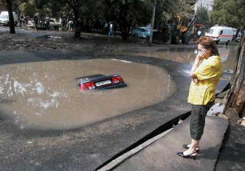
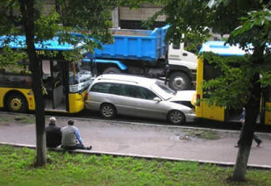
Have a good Backup Strategy Because Bad Things happens…

Slide 7
Have a good Backup Strategy
Normal Approach
I have a daily full backup, that’s enough!
Recommendation
Backup your Archivelogs to tape several times a day
Generate a daily Datapump for logical recover, just in case…
Why
Reduce Risks
Will have your users happy when ask you to recover a table from last week…
Always be proactive, use the “What if…” Methodology

Slide 8
WHAT’S AN INCIDENT?
“A Incident is always when something affects the business continuity or the business revenue”

Slide 9
Incident is Always a Priority
Normal Approach
I will do it early in the morning when back to the office…
It can wait a few minutes more, I’m on break now…
It’s lunch time, will take a look when back…
Recommendation
Investigate and solve it as soon as possible
After solved, create an Incident report, it will help you to:
Detect the root cause of the problem
Document how it can be prevented to happen again
Document all steps to solve the problem
Why
Reduce Company Revenue losses
Will save your job
Shows that you really care about your Employer

Slide 10
Avoid Dead Locks
Normal Approach
Dead Locks are Developers fault…
Recommendation
Create Index on Foreign Keys (Script on www.oraclenz.com)
Check for Bitmap Indexes on OLTP Environment
Why
Improves DB Performance
Will help you to have a good relationship with Developers

Slide 11
Oracle Homes
Normal Approach
/u01/app/oracle/product/10.2/db_1
Patches are applied to the same Oracle Home
Recommendation
Use a different Oracle Home for each upgrade or Patching, example:
/u01/app/oracle/product/10.2/db_02
For the next patch, use a new Oracle Home
/u01/app/oracle/product/10.2/db_03
Why
Reduce Risks
Allow an easy Rollback if needed
All versions Catalog scripts will be preserved

Slide 12
AUDITING
Normal Approach
Audit is not necessary, it affects performance and use a lot of storage
.
Recommendation
Set Audit_trail=db
only issue audit comments if necessary
Create and implement a purge strategy
11g already set if by default
Why
Ready to go if necessary

Slide 13
AUDT DDLs

Slide 14
DB INIT PARAMETERS
Normal Approach
Will change them only when required!
.
Recommendation
Be proactive, set all parameters your environment will need now, specially the ones you can’t not modify later using ALTER SYSTEM.
Remember to set _trace_files_public = TRUE, soon or later you will need to give access to some trace files to the developers.
Why
Will avoid inconvenient restarts of the DB.
Will save you time and headaches.
Be proactive always will improve your DB performance and availability.

Slide 15
Non OFA Layout
Normal Approach
Let’s Oracle manage all using OFA, that way all will be standard on all environments.
.
Recommendation
/oracle/(prod/qa/test/dev)/SID/*
/u01/udump – for user files
/proddata/SID/*
/prodbackup/SID/*
/prodlogs/SID/*
Why
Easy to manage and keep organized
Allow you to use different mount points
Reduce Riks

Slide 16
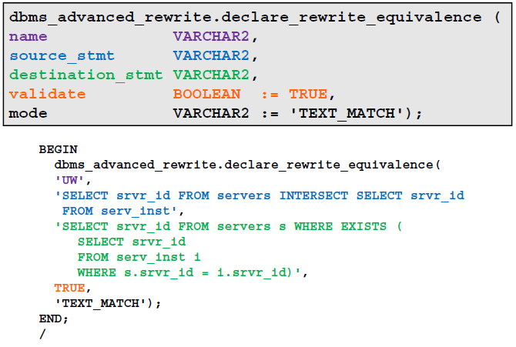
Fix External Applications Queries

Slide 17
Fix External Applications Queries

Slide 18
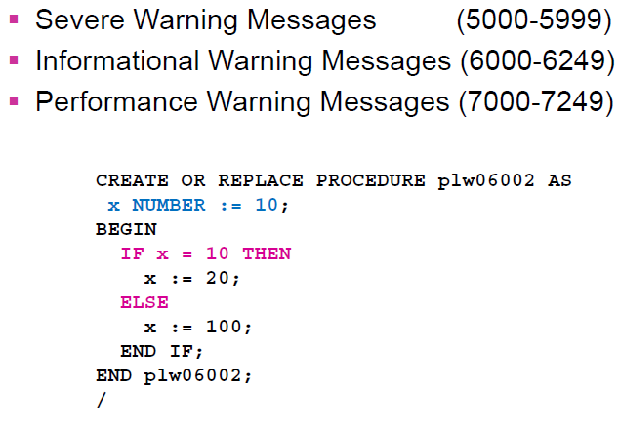
Use PL/SQL Warnings

Slide 19
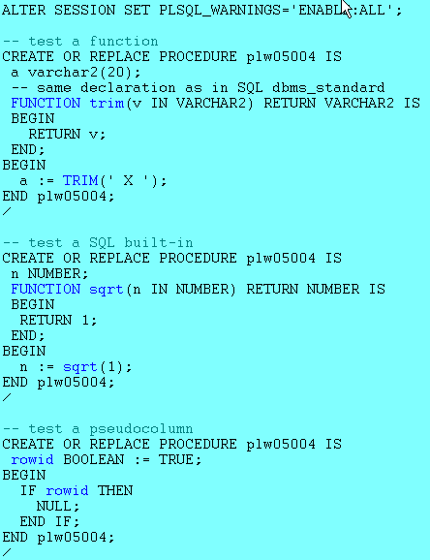
Use PL/SQL Warnings

Slide 20
Study, Study and Study
Normal Approach
I know everything I need…
.
Recommendation
Read Manuals
/Read the official documentation at http://tahiti.oracle.com
Read and practice OBE at OTN website
Help others at OTN Forums (Fantastic way to learn)
Participate at OUG Activities (If possible try to speak)
Why
Will keep you up to date
You never know when you will need to use it
Will help with your professional development

Slide 21
3 Kinds of DBA’s
The Firefighter
The Proactive
The Balanced

Slide 22
Questions?

Slide 23
Thank you !

