Slide 1
INTERNAL – PRESENTATION OBJECTIVE
Audience & Overview: Human Resource Professionals, CxO or LOB manager
  This presentation is intended to be a cloud for HCM overview delivered to a LOB audience, and summarizes Oracle’s Cloud apps strategy and SaaS (cloud services) for HCM and Talent Mgmt. (aka Taleo.)
  This presentation is about cloud and HCM, not product functionality/features. For the latter, please consult the HCM Solutions Event Kit.
  Target venue: breakout session at an HCM event or an HCM Cloud overview at an Oracle Apps Day, or customer CVC
Speaker Tips
  This presentation is intended to be a 60 minute presentation (you may or may not use all of the slides)
  Familiarize yourself with speaker notes as there is very little text, and lots of animation builds to engage the audience and tell a “story”
  Consider leveraging this supporting VIDEO (Customer Facing): Oracle HCM Cloud Service Overview: Game Changing HR
Presentation Objective
  Map key transformational technology trends like social, mobile, big data, etc. in the context of Oracle’s Cloud applications and strategy
  Build awareness that Oracle offers a complete suite of HCM and Talent Mgmt. Cloud Services (SaaS)
  Emphasize that customers can get the richest HCM /talent capabilities fast, and that it’s SIMPLE, FLEXIBLE, and SECURE,
Key Messages
  SIMPLE: Adopt complete HCM & Talent capabilities faster and more easily in the cloud
  FLEXIBLE: Deliver rich functionality with the flexibility to quickly scale to any employee or worker requirements
  SECURE: Protect sensitive employee data across the enterprise across Oracle Cloud and other systems and cloud services
More Help
  Author(s): Yaldah Hakim: yaldah.hakim@oracle.com; Anke Mogannam: anke.mogannam@oracle.com (cloud.oracle.com)
  Oracle.com/cloud or my.oracle.com/cloud
Notes:
Oracle offer a complete suite of HCM and Talent Mgmt. Cloud Services – the best, and richest functionality that is easy and fast to start using, scales to any employee and worker requirements, and protects sensitive employee data across the enterprise and is integrated with payroll, and other financial applications.
Imagine giving your users relevant, secure content to information they need, where they need it. Interactive organizational charts, collaborative tools, embedded analytics, and comprehensive employee views that are natively delivered out-of-the-box to enable a rapid deployment of critical HR functionality. This is Oracle’s HCM Cloud Service.
What about attracting and retaining your top talent?
Oracle’s Talent Mgmt. Cloud Services enables enterprises and midsize businesses to recruit top talent, align that talent to key goals, manage performance, develop and compensate top performers, and turn today's best performers into tomorrow's leaders.
The industry's broadest cloud-based talent management platform, Oracle Talent Mgmt Service collects relevant talent information throughout the employee's entire lifecycle, empowering HR, managers, and employees to leverage talent insights to drive improved performance and business success.

Slide 2

Oracle Cloud For HR Professionals
Linda Hemsworth
Master Principal Solution Consultant
Notes:
Cloud computing is in many ways a key enabler for the different transformational technologies we are talking about today. And it’s important to delivering elevate one’s cloud strategy beyond the IT discussion around capEx avoidance and utilization metrics, and focus more on how cloud is really a business transformation enabler –the capability to better focus on customers, business execution, and engagement.

Slide 3
Safe Harbor Statement
The following is intended to outline our general product direction. It is intended for information purposes only, and may not be incorporated into any contract. It is not a commitment to deliver any material, code, or functionality, and should not be relied upon in making purchasing decisions. The development, release, and timing of any features or functionality described for Oracle’s products remains at the sole discretion of Oracle.
Notes:
Safe Harbor

Slide 4
15%
13%
time spent on
actually performing
strategic activities
HR officers say
they have the proper analytics and tools
Can we keep up with innovation & technology ?
Notes:
Only 13% of HR officers say that they have the analytics and tools they need to properly drive their functions. {Source: Cornell Center for Advanced Human Resource Studies (CAHRS) State of HR Analytics, 2010)}
Only 15 percent of HR time is spent on strategic activities, while 71 percent I still spent on service delivery, recordkeeping, compliance and internal management, {Source: HR Transformation in EMEA, Mercer 2010}

Slide 5
Cloud Computing
“A Big Deal for HR.”
Source: Deloitte: Human Capital Trends, 2011
Notes:
HR in the cloud: It’s inevitable. Deloitte: Human Capital Trends, 2011
“Cloud computing and SaaS. They’re changing how many parts of the business operate — and they really are a big deal for HR. Especially SaaS.”

Slide 6
Social. Mobile. Complete. HR In the Cloud
End to End Solutions
Workforce Insights
Talent Management
Social and Mobile
Global Capabilities
6
Copyright © 2012, Oracle and/or its affiliates. All rights reserved.
Insert Information Protection Policy Classification from Slide 13
Notes:
Technology is now able to deliver on the promise of:
Cloud Services
Oracle offer a complete suite of HCM and Talent Mgmt. Cloud Services – the best, and richest functionality that is easy and fast to implement and use, scales to any employee and worker requirements, and protects sensitive employee data across the enterprise and is integrated with payroll, and other financial applications.
Imagine giving your users relevant, secure connection to information they need, where they need it. Interactive organizational charts, collaborative tools, embedded analytics, and comprehensive employee views that are natively delivered out-of-the-box to enable a rapid deployment of critical HR functionality. This is Oracle’s HCM Cloud Service.
What about attracting and retaining your top talent?
Oracle’s Talent Mgmt. Cloud Services enables enterprises and midsize businesses to recruit top talent, align that talent to key goals, manage performance, develop and compensate top performers, and turn today's best performers into tomorrow's leaders.
The industry's broadest cloud-based talent management platform, Oracle Talent Mgmt Service collects relevant talent information throughout the employee's entire lifecycle, empowering HR, managers, and employees to leverage talent insights to drive improved performance and business success.
In summary:
Predict
Workforce profile, performance, and attrition trends
Align
Talent in a collaborative, visual, data-driven environment
Collaborate
With people in an enterprise social network
Lead
HCM programs with a flexible organizational model

Slide 7
1 OUT OF EVERY
5 MINUTES IS SPENT
SOCIAL NETWORKING
7
Copyright © 2012, Oracle and/or its affiliates. All rights reserved.
Notes:
New technologies such as Social are influencing the way we interact. In fact, 1 out of every 5 online minutes online is spent on social networking

Slide 8

Yet…
Only 3% of the workforce is using social technologies today.
Source: Cedar Crestone 2011-2012 HR Systems Survey
Notes:
The Cedar Crestone 2011-2012 HR Systems Survey
stated : Given the extensive and continuous coverage on social technologies by the general and HR press, it is surprising to see that respondents indicated that overall only 3% of the workforce is using these technologies today

Slide 9
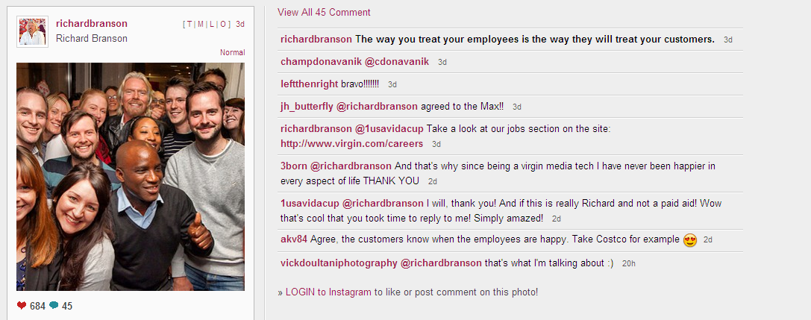

Slide 10
23%
Probability of turnover for disengaged employees
Source: Corporate Leadership Council
Notes:
The Corporate Leadership Council found that disengaged employees have a 23% probability of turnover within 12 months, compared to less than a 1% probability among highly engaged employees.
Disengaged employees cost their employers on average 46% of their salaries in lost productivity.

Slide 11

Engaged Employees are Brand Ambassadors
12%
increased customer satisfaction
78%
likely to recommend the products
or services of their company
67%
likely to be company advocates publicly
* Source: Madison workforce engagement and incentive marketing
Notes:
We know that social is not only about engagement with your customers and prospects, it is also about engagement across your enterprise with your employees and prospective employees. It’s imperative for companies to figure out how to use social effectively for employees. Engaged employees are positive ambassadors, who can help increase customer satisfaction and sales.

Slide 12
HR in the cloud: It’s inevitable
“Cloud computing and SaaS. They’re changing how many parts of the business operate — and they really are a big deal for HR. Especially SaaS.”
Source: Deloitte: Human Capital Trends, 2011
Notes:
HR in the cloud: It’s inevitable. Deloitte: Human Capital Trends, 2011
“Cloud computing and SaaS. They’re changing how many parts of the business operate — and they really are a big deal for HR. Especially SaaS.”

Slide 13

Cloud Is About Enabling Greater:
Access
Interaction
Innovation
13
Copyright © 2012, Oracle and/or its affiliates. All rights reserved.
Notes:
Importantly cloud is ENABLING incredible increases:
Information access, anywhere, anytime (mobile)
New models of interaction (social)
Innovation and scale

Slide 14

TRANSFORM YOUR BUSINESS INTO A
SOCIAL BUSINESS
Collaborative
Work Environment
Real-Time,
Consistent
Data Access
Unified,
Personalized
Embedded and
“Process Aware”
14
Copyright © 2012, Oracle and/or its affiliates. All rights reserved.
Notes:
Social relationship management – to build relationships with people even before they become customers, and to continuously improve those relationships so they’ll be better customers.
“Social relationship management means using modern media – Facebook, Twitter, Google+, so on – to see what people are saying about our products, to establish a presence on Facebook, to establish a presence on Twitter, to drive them to our store, to inform them about our products, all using social media.” LJE, June 6th 2012
Social capabilities embedded directly into cloud-based business processes make it easier for people to share information.
Collaborative work environment seamlessly connects users and content within a social network, no matter where people are located or which devices they prefer to use.
Unified, personalized UX across processes and customer channels
Real-time and consistent data access/entry across apps and mobile devices
Embedded and “process aware” social collaboration – social capabilities that makes sense based on your role and where you are in the business process – not just social for the sake of social.
Embed social capabilities throughout your applications to transform your processes"

Slide 15
Social Recruiting
Social Worker Profile
Social Learning
Social Performance and Goal Management
15
Copyright © 2012, Oracle and/or its affiliates. All rights reserved.
Notes:
Oracle HCM Cloud Services deliver rich social enabled HR processes to maximize productivity, deliver better insight, and great employee experience.
With the rise of the internet and availability of social tools, people communicate and interact with each other in innovative ways. You can
Connect with workers and expand work relationships
Drive innovation through collaboration in an open and transparent way
Find job candidates and career opportunities
Give kudos to peers and follow their professional progress
Find expertise and share knowledge to be more productive
"

Slide 16

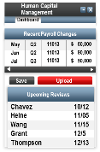
Access on Any Device
Human Capital Management
⁻
×
Dashboard
HR Management
Recent Payroll Changes
11013
11013
11013
May
Jun
Jul
Q2
Q2
Q3
$ 50,000
$ 90,000
$ 50,000
Re: Job Ticket #1529
Starting next quarter HR will be rolling out cloud based services.
Recruiting, performance reviews, and compensation management will all be available on the Cloud.
Human Capital Management
Budget Manager
$
⁻
×
Dashboard
⁻
×
Save
Upload
Dashboard
Top 5 Products
Top Customers
Upcoming Reviews
Attrition Risk
AA
A2
AA2
B3
BX2
4.95%
2.27%
1.99%
1.61%
1.58%
Thomson
Jones
Graham
James
10
8
Upcoming Reviews
Chavez
Heine
Wang
Grant
Thompson
10/12
11/05
11/15
12/5
12/13
Chavez
Heine
Wang
Grant
Thompson
10/12
11/05
11/15
12/5
12/13
-7
-10
Bottom 5 Products
P&L: Largest +/-
10
8
BB2
BA
AX2
AC3
AC
-5.91%
-4.45%
-0.70%
-0.66%
-0.32%
ADV
GGG
INTC
MSFT
File Report & Close
-7
-10
Submit to Line Managers
16
Copyright © 2012, Oracle and/or its affiliates. All rights reserved.
Notes:
Oracle Cloud HCM Services can be accessed on any mobile device anytime, anywhere.
This helps empower HR professionals and line managers with actionable insights they need to run their business – no matter where they or employees do business.
Embedded analytics, dashboards and reports provide real-time visibility into key metrics and measurements from key HR and financial system
And because your HCM solutions are running in the cloud, you have the flexibility to adapt rapidly to business and HR process changes.

Slide 17
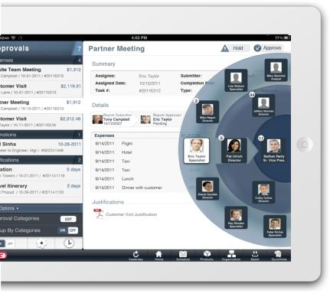
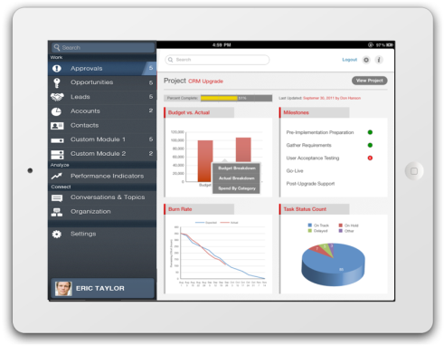
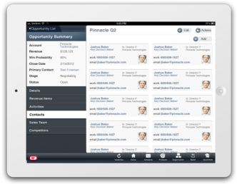
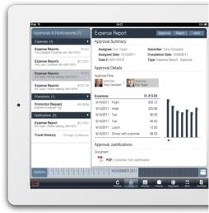
Oracle Tap: Your Mobile App, Your Way
WORK.
ANALYZE.
CONNECT.
LEARN.
Notes:
Key Message: With Oracle Fusion, we add to simplicity by providing mobile applications when and where you need them.
This tablet based App (initially available for the iPAD and later for other tablet devices) was designed with the road warrior, manager, executive in mind. You download one app, and based on your role and user profile you get access to as much or as little of the apps that you need to see.

Slide 18
Social. Mobile. Complete. HR In the Cloud
End to End Solutions
Workforce Insights
Talent Management
Social and Mobile
Global Capabilities
18
Copyright © 2012, Oracle and/or its affiliates. All rights reserved.
Insert Information Protection Policy Classification from Slide 13
Notes:
Technology is now able to deliver on the promise of:
Cloud Services
Oracle offer a complete suite of HCM and Talent Mgmt. Cloud Services – the best, and richest functionality that is easy and fast to implement and use, scales to any employee and worker requirements, and protects sensitive employee data across the enterprise and is integrated with payroll, and other financial applications.
Imagine giving your users relevant, secure connection to information they need, where they need it. Interactive organizational charts, collaborative tools, embedded analytics, and comprehensive employee views that are natively delivered out-of-the-box to enable a rapid deployment of critical HR functionality. This is Oracle’s HCM Cloud Service.
What about attracting and retaining your top talent?
Oracle’s Talent Mgmt. Cloud Services enables enterprises and midsize businesses to recruit top talent, align that talent to key goals, manage performance, develop and compensate top performers, and turn today's best performers into tomorrow's leaders.
The industry's broadest cloud-based talent management platform, Oracle Talent Mgmt Service collects relevant talent information throughout the employee's entire lifecycle, empowering HR, managers, and employees to leverage talent insights to drive improved performance and business success.
In summary:
Predict
Workforce profile, performance, and attrition trends
Align
Talent in a collaborative, visual, data-driven environment
Collaborate
With people in an enterprise social network
Lead
HCM programs with a flexible organizational model

Slide 19
Complete Solutions
Application Services for Every Area of Business
Human Capital
Management
Talent
Management
Sales and
Marketing
Customer Service
and Support
Financial Management
Procurement, Sourcing, Inventory
Project Portfolio
Management
Governance, Risk, Compliance
Social Services
Platform Services
Common Infrastructure Services
Notes:
Oracle has the broadest cloud portfolio in the industry, delivering a complete range of production-level, cross-functional business applications running in the cloud for industries including sales and marketing, customer service, enterprise resource management, human capital, and talent management—all enriched with social and mobile? collaboration tools and an intuitive user interface.

Slide 20






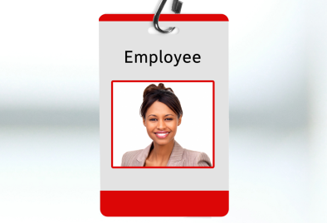

Application Services
Human Capital Management Services
Global Human Resources
Compensation
Benefits
Payroll
Absence Management
Network@Work
Worker Portrait
Time and Labor
Notes:
Realize the power of your employees
Global Human Resources
Global payroll
Workforce Modeling & Staffing
Compensation & Benefits
Global Payroll
Workforce Lifecycle Management
Workforce Planning & Prediction
Worker Portrait
Network@Work
Talent Profiles
Workforce and Talent Intelligence

Slide 21
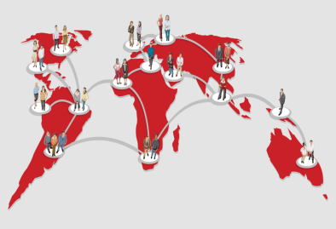




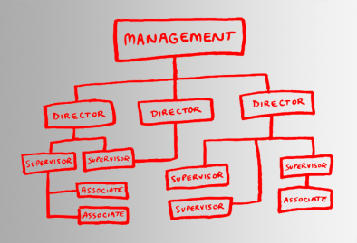


Application Services
Talent Management Services
Candidate Sourcing
Recruiting
Learning & Development
Onboarding
Performance Management
Talent Review
Goal Management
Succession Management
Notes:
Empower People, Source, recruit, develop, & retain
Candidate sourcing
Recruiting
OnBoarding
Learning and development
Performance Management

Slide 22

loud enables new, innovative models to flourish.”
“While 16% of executives showed current usage of cloud capabilities for innovation…the same share will rise to 35% by 2015.”
C
“
2011 Economist Intelligence Unit Report
Notes:
As mentioned earlier, Cloud is continuing to be a key enabler of innovation. In fact the EIU found that the usage of cloud for innovation is expected to more than double by 2015.

Slide 23


PRIVATE
HYBRID
PUBLIC
Notes:
No matter your role, the cloud is becoming integral to how you do your job
Oracle Has Complete Solutions for YOU
IT Professionals - who are building and managing clouds in house, want to be able to flexibly meet business needs while controlling costs
Business Managers – who want instant access to applications on any device
Application Developers - who want rapid and flexible access to environments for building and deploying apps in the cloud
There are also Industry requirements, country and regional requirements are all unique, which is why Oracle provides a multitude of cloud solutions for its customers.

Slide 24
ONE SIZE
DOES NOT FIT ALL
24
Copyright © 2012, Oracle and/or its affiliates. All rights reserved.
Notes:
Oracle also believes that in addition to being able to change your cloud, an enterprise must be able to consume cloud services any way they want in order to best map their cloud to their specific business needs. For instance, some customers will want to have certain business applications and data in a public cloud – others in private cloud – or most likely, a combination of different clouds – often referred to as a hybrid cloud. We also have customers that want to keep their data in their own data center, or a partner’s data center for more control. Maybe you are a global bank or a government institution. Your needs are different from say a big box retailer.
But with a “one size fits all cloud model” = like most niche clouds – you are essentially grouped all together, with the assumption that your business requirements are the same for each business process, and across customers. This may be work out great for the cloud provider – but Oracle’s feels the focus should be on the cloud consumer – you.

Slide 25
INCOMPLETE VIEW
HCM
FRAGMENTED PROCESSES
PLATFORM
CRM
SOCIAL
ERP
Notes:
Today, many of your options are incomplete, inflexible and isolated.
Many clouds are specialized, offering limited functionality and lack modern social and mobile capabilities.
Or if the Cloud providers does offer modern capabilities like social, they are a separate platform rather than being embedded with the business process or application.
If you just string together a bunch of individual or point technologies, you’ll only see your cost savings erode
You’ll have data and business process fragmentation, integrations to manage, expensive bolt-on solutions
You’ll still fail to produce the enterprise views demanded by executives

Slide 26
Flexible
& Modern
Mobile
Social
Intelligence
26
Copyright © 2012, Oracle and/or its affiliates. All rights reserved.
Notes:
Nearly seven years ago, Oracle embarked on an effort to completely rewrite and modernize all of our applications.
Very few tech companies cross the chasm from one generation of technology to the next because it a huge undertaking & requires significant vision and commitment .
“almost seven years of innovation, plus key strategic acquisitions have gotten us into a position where we can launch the most comprehensive cloud on the planet Earth, the most enterprise-grade applications, the most complete platform and the most modern socially-enabled technologies and applications” LJE, June 6th 2012
Define What Modern = (probably Social + Mobile + BI….where each cube is 3-D (vs. others clouds that are only 1D or 2D)

Slide 27
Choose Degree of Control, Visibility and Adoption Speed
CRM
ERP
HCM
Private
Hybrid
Public
Notes:
Adopt anywhere along the cloud continuum based on the amount of control you desire over things like customizations, upgrades, and data location, with the flexibility to adapt your cloud strategy as your business changes
For example, you can deploy and uptake new updates fastest with Oracle Cloud application services by subscribing to Oracle apps –updates can be automatic
Managed Cloud Services provides a good balance for customers wanting more control while still benefiting from Oracle running and managing the Oracle apps for them
Or on-premise – provides the most control, but you there will be a compromise on agility and adoption speed.

Slide 28
Oracle Cloud Adoption Patterns and Trends
Co-existence
Full suite
Notes:
• Co-existence
Customers typically adopt new functionality that will co-exist easily with existing systems ( very low risk way to add capabilities; customer can just turn it off/on) while continuing to get value from existing investments
Very similar situation is where customers replace existing functionality over time; a good choice if say Fusion is a fit for the customer, but they want to take it slow
Example: PSFT HCM plus Fusion/Taleo Talent Management
•Full Suite:
All in and want to retire customizations, etc.
For example, replacing Seibel CRM with Fusion CRM Suite - don’t want to goof around with upgrading, integration,…I am just going to take care of it all at once
Example: replace PSFT with fusion hcm saas

Slide 29
Herbalife Combines Oracle Private and Public Cloud
“It was important for us to work with a vendor that offered multiple deployment options…Whether it's on-premise, or whether it's a managed service, or whether it's software as a service, depending on our business circumstances, that answer changes. And it might change over time, as well.”
- Mark Schissel, SVP and CIO
Herbalife
Notes:
Herbalife is a global nutrition company that helps millions of people to pursue healthy, active lives. Its nutrition, weight-management and personal care products are available in more than 75 countries around the world. Five years ago, Herbalife began a global roll-out of the Oracle ERP suite, starting with on-premise solutions for order entry, supply chain, and financials. The company began to change its deployment mix in the last several years to leverage more of Oracle Cloud in order to get new products to market quickly and drive more innovation for the company.
Before selecting Oracle Fusion as its global HCM platform, Herbalife examined a number of application software products, both on-premise and cloud based. The company needed cloud solutions that could integrate easily with its other business applications and processes. The people in the HCM system have to tie into all the other business processes. “Having a vendor that can provide business solutions and not just stovepipe solutions was important to us,” says Mark Schissel, Senior Vice President and CIO at Herbalife.
Herbalife also required the complete range of deployment flexibility that only Oracle’s Cloud solutions offer. “It was important for us to work with a vendor that offered multiple deployment options,” says Schissel. “Whether it's on-premise, or whether it's a managed service, or whether it's software as a service, depending on our business circumstances, that answer changes. And it might change over time, as well. It's important to work with a vendor that understands all of those deployment options and can maximize it and make sure all of our systems are working together while they're in different states.”

Slide 30

25
MILLION
USERS RELY ON ORACLE CLOUD EVERYDAY
Notes:
And it works. And Our customers seems to really like it.
Today we have over 10,000 customers and more than 25 million users of the Oracle Cloud. We will explore some of their stories in just a bit…

Slide 31
Customer Results
1 Day
$5.3M
300%
Implementation Time
Saved in 3 months
Improvement in
compliance data
collections
Notes:
Variety of customer results – All SaaS customers. Emphasize accelerated time to value and decreased operational risks.

Slide 32
Zillow Case Study
“Oracle HCM Cloud Service was a natural choice for us given the ease of use and the depth of the suite. With Oracle’s continuous innovation, we are excited to take advantage of the best technology and functionality in the cloud.”
Sarah Bilton, SR Director of HR
Notes:
“As the leading real estate information marketplace, Zillow is rapidly growing our employee base and needed a platform to deliver more streamlined HR operations to our employees and managers,” said Sarah Bilton, senior director of human resources. “Oracle Fusion HCM was a natural choice for us given the ease of use and the depth of the suite. With Oracle’s continuous innovation, we are excited to take advantage of the best technology and functionality in the cloud.” (Simplify Managing Your People)

Slide 33




Welcome to
Rain Coat Supply Co.
1
33
Copyright © 2012, Oracle and/or its affiliates. All rights reserved.
Notes:
One of the most powerful benefits of deploying in the cloud , and in particular with HCM and talent mgmt. solutions - is the ability to scale very rapidly to changing business requirements – be it either up or down. A great example of this can be illustrated with a seasonal retailer – such as a company that sells umbrellas and rain coats.
In this illustration, Rain Coat Supply Co is much slower during the warm summer months, and therefore requires less sales and support staff. But when the winter months approach and the weather turns wet, It can be as simple as turning the dial and expanding their cloud to map to growing requirements. It’s an op Ex expense, it’s almost immediate.
Oh and by the way – this scalability must be mapped to both the sales and support staff as relates to Rain Coat’s CRM and CX cloud service, as well as their HCM and Talent cloud services. With Oracle – this can all be easily coordinated for max value and simplicity.

Slide 34
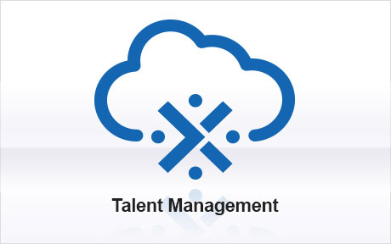
“A company the size of [ours] with a highly seasonable business needs to scale up in its business and down.
When we have to scale up, they do it for us, because we’re hosted externally, and when we come down, they can come down.”
Oracle Cloud
- Global Retail HCM Executive
Notes:
For a real life example of this – take one of the largest retailers in the world. This organization uses Oracle’s Talent Cloud service and flexible infrastructure to quickly, and cost effectively expand and contract to meet seasonal fluctuations in their headcount, which grows approximately twenty percent during the holiday season.

Slide 35


Elizabeth Arden
Before
After
Solution: Oracle HCM Cloud Service
  Fusion Core HR
  Fusion Talent Management
Result: Comprehensive and fully integrated HCM solution that aligns compensation with performance and enhances workforce motivation and retention
Situation: Elizabeth Arden lacked a comprehensive, fully integrated HCM solution to manage its global workforce.
Challenge: Get all locations worldwide on a single, integrated HCM platform that can handle core HR needs as well as compensation and performance management
Notes:
Elizabeth Arden is a global prestige beauty products company with an extensive portfolio of prestige beauty brands sold in over 100 countries. The company's brand portfolio includes Elizabeth Arden skincare, color and fragrance products, Prevage anti-aging formulas, & celebrity fragrance brands.
Partner Deloitte
Challenges:
No current HR System in international locations
Require basic employee management and compensation/performance management planning
Full Suite Adoption-Fusion HCM
Benefits:Implementing a comprehensive, fully integrated HCM solution will enable Elizabeth Arden to reduce the long cycle time and errors inherent in their current manual solution.
A solid HR solution will empower managers and HR professional to better align compensation with performance, enhancing workforce motivation and retention

Slide 36
Social. Mobile. Complete. HR In the Cloud
End to End Solutions
Workforce Insights
Talent Management
Social and Mobile
Global Capabilities
36
Copyright © 2012, Oracle and/or its affiliates. All rights reserved.
Insert Information Protection Policy Classification from Slide 13
Notes:
Technology is now able to deliver on the promise of:
Cloud Services
Oracle offer a complete suite of HCM and Talent Mgmt. Cloud Services – the best, and richest functionality that is easy and fast to implement and use, scales to any employee and worker requirements, and protects sensitive employee data across the enterprise and is integrated with payroll, and other financial applications.
Imagine giving your users relevant, secure connection to information they need, where they need it. Interactive organizational charts, collaborative tools, embedded analytics, and comprehensive employee views that are natively delivered out-of-the-box to enable a rapid deployment of critical HR functionality. This is Oracle’s HCM Cloud Service.
What about attracting and retaining your top talent?
Oracle’s Talent Mgmt. Cloud Services enables enterprises and midsize businesses to recruit top talent, align that talent to key goals, manage performance, develop and compensate top performers, and turn today's best performers into tomorrow's leaders.
The industry's broadest cloud-based talent management platform, Oracle Talent Mgmt Service collects relevant talent information throughout the employee's entire lifecycle, empowering HR, managers, and employees to leverage talent insights to drive improved performance and business success.
In summary:
Predict
Workforce profile, performance, and attrition trends
Align
Talent in a collaborative, visual, data-driven environment
Collaborate
With people in an enterprise social network
Lead
HCM programs with a flexible organizational model

Slide 37



SVP
CEO
CFO
HCM
Think of what it could
do for your business
Notes:
Now, when you get calls on labor costs or attrition rates, it’s easy to find the information and answer questions.
It’s also simple to find actionable information on how to take steps to address problems that arise, whether they happen domestically or in an overseas office.

Slide 38
SOCIAL. MOBILE. COMPLETE.
Public
Private
ORACLE CLOUD SOLUTIONS
Hybrid
BUILT FOR YOUR ENTERPRISE
Notes:
To summarize, with Oracle you get a complete cloud solution.
You can reduce cost and complexity with a fully integrated stack, while maximizing user productivity and innovation with the richest functionality.

Slide 39


oracle.com/cloud
facebook.com/OracleCloudComputing
twitter@OracleCloudZone
#oraclecloud
CONTACT US

