Slide 1
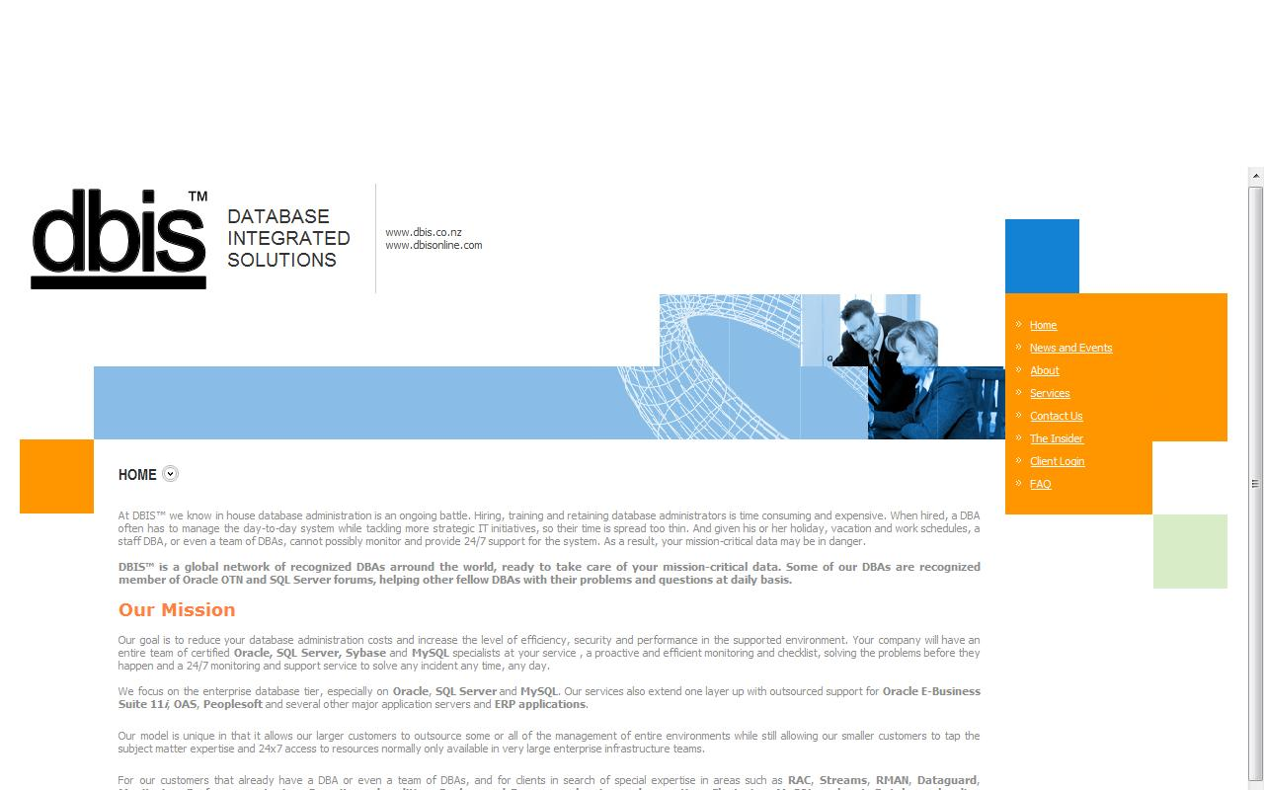
ORACLE SECURITY TIPS
NZOUG’ 2010
Rotorua, NZ
By:
Francisco Munoz Alvarez

Slide 2
ORACLE SECURITY (Based on Oracle EMEA Security Workshop)
Francisco Munoz Alvarez
Oracle ACE Director
President CLOUG, LAOUC & NZOUG
8/9/10g/11g OCP, RAC OCE, AS OCA, E-Business OCP, SQL/PLSQL OCA, Oracle 7 OCM
Oracle 7 & 11GR2 Beta Tester
ITIL Certified
Blog: www.oraclenz.com - Email: franciscoa@dbisonline.com – Twitter : fcomunoz
Blog: www.oracleenespanol.com - Comunidad Oracle: www.oraclemania.ning.com
CEO at DBIS ™
Database Integrated Solutions
www.dbisonline.com
www.dbis.co.nz

Slide 3
The Rule:
“The most important rule with respect to data is to never put yourself into an unrecoverable situation.”
The importance of this guideline cannot be stressed enough, but it does not mean that you can never use time saving or performance enhancing options.

Slide 4
Information Security Has Changed

Slide 5
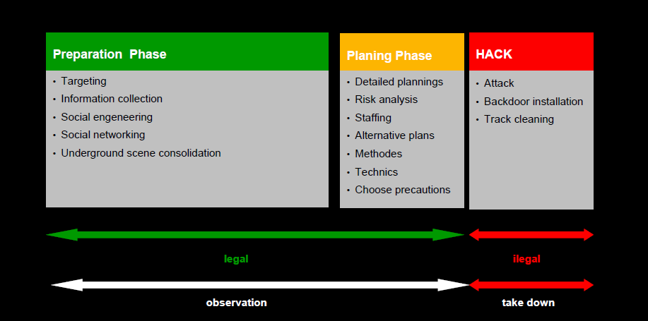
Hacking Steps

Slide 6
OFFICIAL STATISTICS from Secret Service Germany

Slide 7
SOME SHORT FACTS

Slide 8
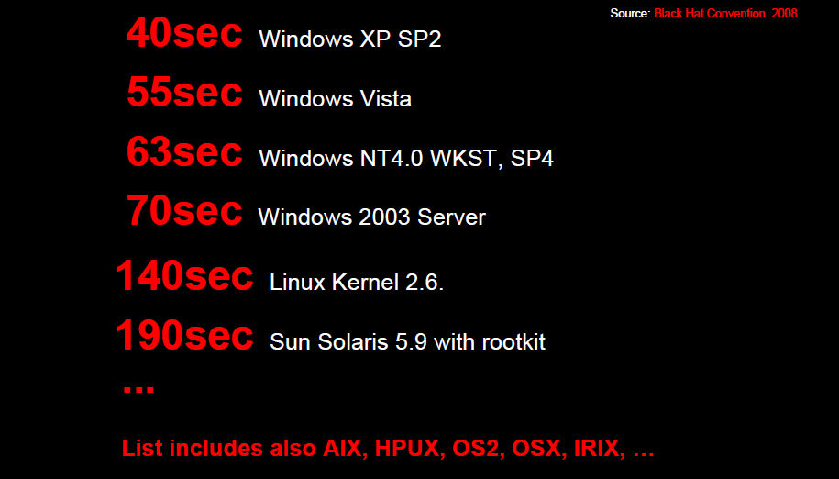
HIGH SCORE LIST

Slide 9
2007/2008 SHOPPING LIST

Slide 10
CRISIS SHOPPING LIST 2009

Slide 11
CONCLUSION

Slide 12
Some Oracle Security Tips
1) Grant privileges only to a user or application which requires the privilege to accomplish necessary work. Excessive granting of unnecessary privileges can compromise security.

Slide 13
Some Oracle Security Tips
2)No administrative functions are to be performed by an application. For example create user, delete user, grant role, grant object privileges, etc.

Slide 14
Some Oracle Security Tips
3) Privileges for schema or database owner objects should be granted via a role and not explicitly. Do not use the “ALL” option when granting object privileges, instead specify the exact privilege needed, such as select, update, insert, delete.

Slide 15
Some Oracle Security Tips
4)Password protected roles may be implemented to allow an application to control access to its data. Thereby, end users may not access the application’s data from outside the application.

Slide 16
Some Oracle Security Tips
5)Access to Administrative or System user accounts should be restricted to authorized DBAs.

Slide 17
Some Oracle Security Tips
6) Do not grant system supplied database roles. These roles may have administrative privileges and the role privileges may change with new releases of the database.

Slide 18
Some Oracle Security Tips
7) Database catalog access should be restricted. Example: Use “USER_VIEWS” instead of “DBA_VIEWS” for an Oracle database.

Slide 19
Some Oracle Security Tips
8) Privileges granted to PUBLIC are accessible to every user and should be granted only when necessary.

Slide 20
Some Oracle Security Tips
9) Any password stored by applications in the database should be encrypted.

Slide 21
Some Oracle Security Tips
10) Applications should not “DROP”, “CREATE” or “ALTER” objects within the application.

Slide 22
Some Oracle Security Tips
11) Utilize the shared database infrastructure to share cost whenever possible.

Slide 23
Some Oracle Security Tips
12) Applications should not access the database with the same security as the owner of the database objects. For example on SQL Server do not grant the “dbowner” role and on Oracle do not use the Schema userid to connect to the database. Setup another userid with the necessary privileges to run the application.

Slide 24
Some Oracle Security Tips
12) Database integrity should be enforced on the database using foreign keys not in the application code. This helps prevent code outside the application from creating orphan records and/or invalid data.

Slide 25
Some Oracle Security Tips
12) Do not hard code username and passwords in the application source code.

Slide 26
Some Oracle Security Tips
13) Ensure external users have the least privilege possible.

Slide 27
Some Oracle Security Tips
13) Ensure external users have the least privilege possible.

Slide 28
Some Oracle Security Tips
14) Ensure external users have the least privilege possible.

Slide 29
Oracle Security Solutions

Slide 30
Oracle Security Components

Slide 31
DB ENVIRONMENT

Slide 32
Security Data in Rest/Access Control

Slide 33
WHAT IS ASO?

Slide 34
What Security Problems does ASO solve?

Slide 35
ASO BENEFITS

Slide 36
TDE – Transparent Data Encryption

Slide 37
TDE – Transparent Data Encryption

Slide 38
TDE – Transparent Data Encryption

Slide 39
SECURING DATA IN MOTION

Slide 40
NETWORK ENCRYPTION

Slide 41
SECURING BACKUP

Slide 42
SECURING BACKUP Examples

Slide 43
DATAMASKING

Slide 44
WHAT IS DATAMASKING?

Slide 45
PREVENT MODIFICATIONS BY UNAUTHORIZED USERS

Slide 46
WHAT IS DATA VAULT?

Slide 47
DATA VAULT HELP TO SOLVE:

Slide 48
DATA VAULT Vs VPD and OLS

Slide 49
DATABASE VAULT Realms and Rule

Slide 50
DATA VAULT REPORTS

Slide 51
DATA VAULT EXAMPLES

Slide 52
HIGHLY SECURED ENVIROMENTS AUDIT VALT

Slide 53
AUDIT VAULT EXAMPLES

Slide 54
AUDIT VAULT REPORTS Who, What, When, Where

Slide 55
AUDIT VAULT DASHBOARD

Slide 56
AUDIT VAULT SUMMARY

Slide 57
PROGRAM
The Oracle ACE Program is designed to recognize and reward members of the Oracle Technology and Applications communities for their contributions to those communities. These individuals are technically proficient (when applicable) and willingly share their knowledge and experiences.
The program comprises two levels: Oracle ACE and Oracle ACE Director.
The former designation is Oracle's way of saying "thank you" to community contributors for their efforts; we (and the community) appreciate their enthusiasm. The latter designation is for community enthusiasts who not only share their knowledge (usually in extraordinary ways), but also want to increase their community advocacy and work more proactively with Oracle to find opportunities for the same. In this sense, Oracle ACE is "backward looking" and Oracle ACE Director is "forward looking."

Slide 58
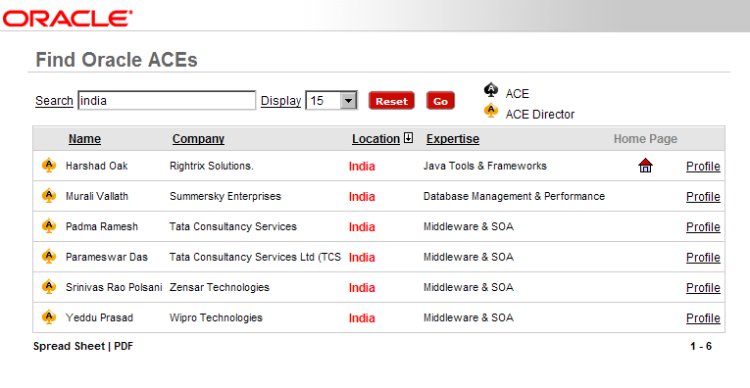
PROGRAM

Slide 59
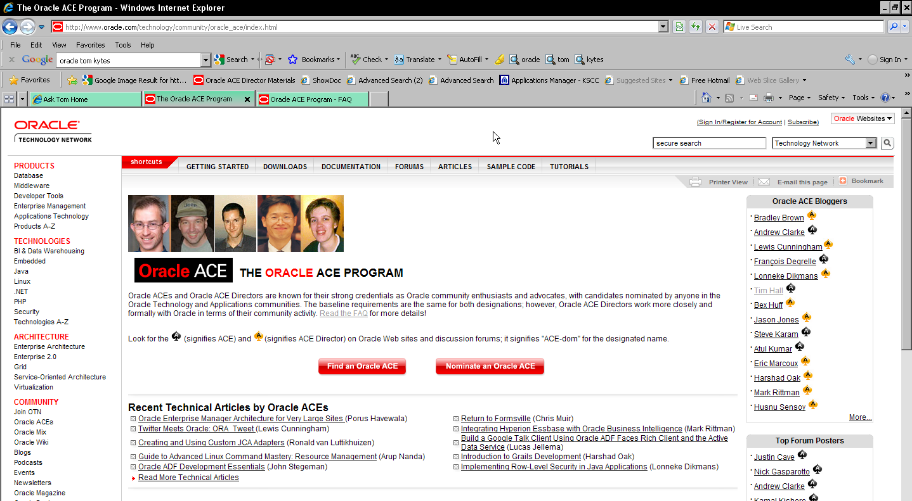
PROGRAM

Slide 60
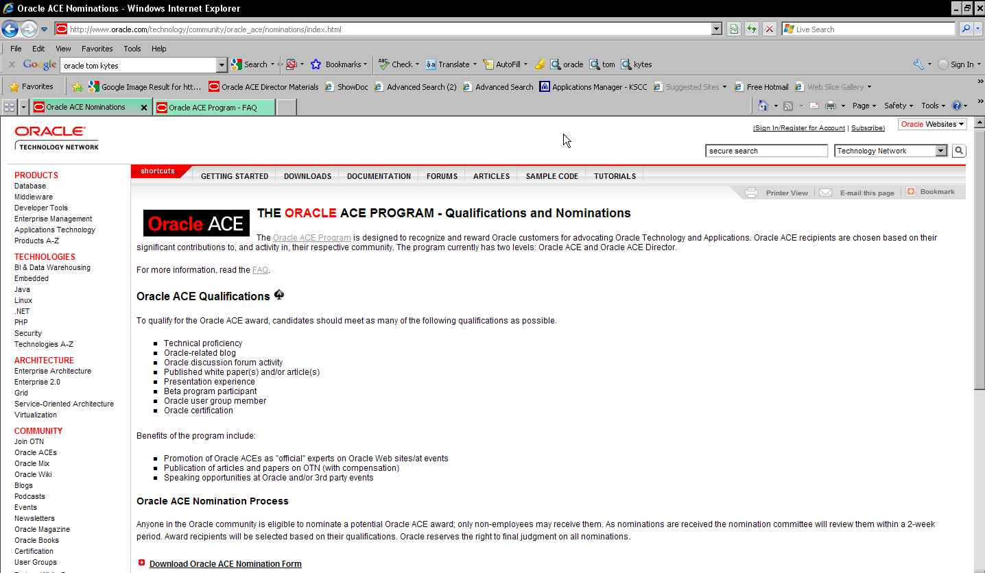
PROGRAM

Slide 61
Questions?

Slide 62
Thank you !

