Slide 1
Architecting a world class enterprise performance management (EPM) solution Sefton Thesing Director Indigo NZ Limited
NZOUG Conference 2008 – Ask an Expert

Slide 2
Introduction
20 years of consulting in IT, 15 years specialising in management information area
Business intelligence
Data Warehousing
Financial Planning/Consolidation
Co-founder of Indigo New Zealand
Specialises in Enterprise Performance Management solutions
Consulting experience across range of technologies
Sale and support Oracle/Hyperion toolset for NZ

Slide 3
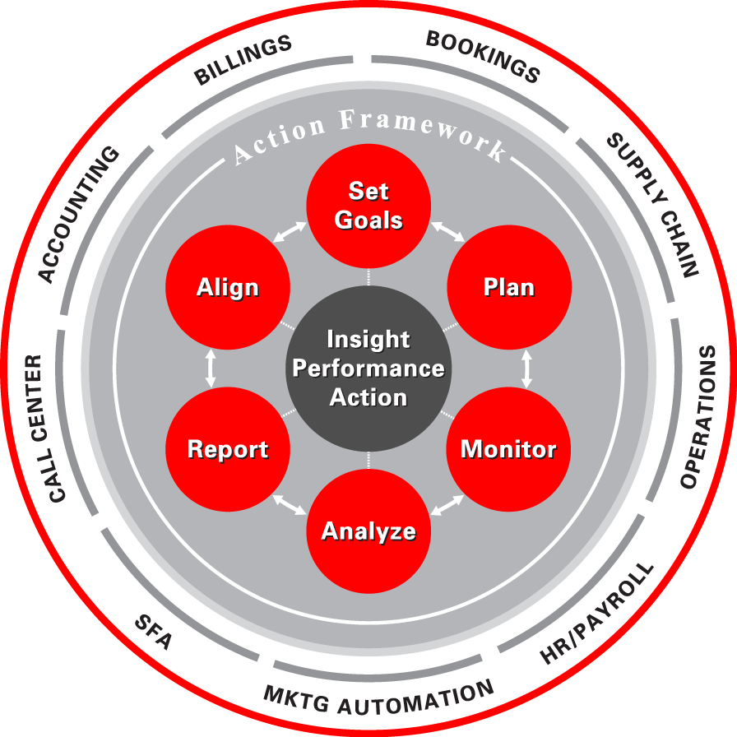
What is Enterprise Performance Management?
Link strategic goals to operational decisions
Integrates all management processes
Deliver consistent, reliable insights to drive action
Lower costs and reduces system complexity
Single version of the truth

Slide 4
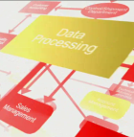
Integrates Transaction, Intelligence, Financial Systems
Modeling
Planning & Budgeting
Financial Management
Financial & Statutory Reporting
Metrics & Scorecards
Financial Performance Management
Enterprise Performance Management System
Transactional Systems
Business Intelligence
Operational Business Intelligence
Sales & CRM
Financials
Supply Chain
HR
Procurement
Data Warehouse
Data
Integration
Query & Analysis
OLAP
Dashboards
Enterprise/ Operational Reporting
Alerts & Workflow
Notes:
4

Slide 5
The Paradigm shift from multiple reporting to enterprise
Traditional Approach to Reporting
Enterprise Performance Management
Sales &
Distribution
Planning &
Reporting
Sales &
Distribution
Finance
Planning &
Reporting
Finance
Integrated
Planning
& Reporting
Procurement
Planning &
Reporting
Procurement
Human
Resources
Planning &
Reporting
Human
Resources

Slide 6
Current Best Practices EPM – The Spreadsheet
Most common solution for planning, reporting & analysis
Error-prone
Non-collaborative
Maintenance intensive
Fragile, easy to break
Little centralized control
Poor data integrity—audit trails
Unmanageable consolidation
Lack of security
Notes:
Typically spreadsheets are still used,
(Quickly run through the list of bullets added color where needed)
In fact, depending on the survey you read, between 65 and 85% of companies are STILL using spreadsheets as their main business planning solution.

Slide 7
Oracle’s Enterprise Performance Management System
EPM Workspace
Financial Management
Applications
BI Applications
Business Intelligence Foundation
Fusion Middleware
OLTP & ODS
Systems
Data Warehouse
Data Mart
OLAP
SAP, Oracle, Siebel,
PeopleSoft, Custom
Excel
XML
Business
Process
Notes:
Hyperion were the first to integrate both planning and management reporting solutions into a single workspace. Since the acquisition by Oracle and the reason for acquisition this has been further advanced to include additional capabilities acquired from Siebel that now father distinguish this model as the most complete best of breed solution in this space.

Slide 8
Pervasive Information Access Through a Multi-Channel EPM Workspace
EPM WORKSPACE
Desktop
Web
Search
Office
Alerts
Mobile
Financial Management
Applications
BI Applications
Business Intelligence Foundation
Fusion Middleware
OLTP & ODS
Systems
Data Warehouse
Data Mart
OLAP
SAP, Oracle, Siebel,
PeopleSoft, Custom
Excel
XML
Business
Process
Notes:
Access to the solution is via any one or more of the following means: desktop, web ….and even enabled mobile devices. Complete MS office integration allows for pervasive user adoption.

Slide 9
Financial Management Applications
Hyperion Strategic Finance
Financial & Operational Planning
Set Strategic Objectives
Cascade Targets
Treasury Strategies
Long-Term Planning
Forecasting
Detailed Budgeting
Corporate
Development
Allocate Resources
Master Data
Business Rules
Metrics/KPIs
Targets, Plans & Actuals
Financial Consolidate & Close Process
Cost and Profitability Management
Define Costing Methods
Data Cleansing
Consolidate
Internal Reporting & Analysis
External Reporting & Compliance
Report & Analyze
Define Cost Drivers
Perform
Allocations

Slide 10
Most Comprehensive Suite of BI Applications
Auto
Comms & Media
Complex
Mfg
Consumer Sector
Energy
Financial Services
High Tech
Insurance
& Health
Life Sciences
Public Sector
Travel & Trans
Sales
Service & Contact Center
Marketing
Order Management & Fulfillment
Supply Chain
Financials
Human Resources
Pipeline Analysis
Triangulated Forecasting
Sales Team Effectiveness
Up-sell / Cross-sell
Cycle Time Analysis
Lead Conversion
Churn Propensity
Customer Satisfaction
Resolution Rates
Service Rep Effectiveness
Service Cost Analysis
Service Trends
Campaign Scorecard
Response Rates
Product Propensity
Loyalty and Attrition
Market Basket Analysis
Campaign ROI
Order Linearity
Orders vs. Available Inventory
Cycle Time Analysis
Backlog Analysis
Fulfillment Status
Customer Receivables
Supplier Performance
Spend Analysis
Procurement Cycle Times
Inventory Availability
Employee Expenses
BOM Analysis
A/R & A/P Analysis
GL / Balance Sheet Analysis
Customer & Product Profitability
P&L Analysis
Expense Management
Cash Flow Analysis
Employee Productivity
Compensation Analysis
HR Compliance Reporting
Workforce Profile
Turnover Trends
Return on Human Capital
Prebuilt adapters:
Other Operational & Analytic Sources
Oracle BI Suite Enterprise Edition Plus
Notes:
Here we have the breadth and range which can be integrated with existing systems. If we consider financials for example the fit is around 90% for most organisations and require minimal customisation, resulting in fast implementation.
These are still applicable for organisations not running stated erp applications as there are adaptors provided to customise the mappings from any erp or source system

