Slide 1

Notes:
Bring up on stage two customers to tell the audience about their experiences.
Manpower Associates is a $14.9B global company with 27,000 employees in the temporary staffing business. Manpower runs a combined PeopleSoft Enterprise and JD Edwards EnterpriseOne shop. These experts in human resources use Enterprise HCM for their own staffing and EnterpriseOne Payroll and Service Billing for handling the large volumes of US-based temporary staff. Manpower is very happy with Oracle’s support since purchasing PeopleSoft and is looking forward to a long relationship with Oracle.
Spokesperson will be Jay Schaudies, Vice President, Global eCommerce.
Welch Foods is the food processing and marketing arm of National Grape Cooperative Association. Organized in 1945, National Grape is a grower-owned agricultural cooperative with 1,461 members. The company, headquartered in Concord, Massachusetts, operates six plants located in Michigan, New York, Pennsylvania and Washington. The company was running a mix of legacy, home grown, and manual systems that failed to provide senior management with accurate and timely cost and production information. Welch’s required a centralized manufacturing and financial information system to improve management decision making. The solution had to be hot-pluggable with existing technologies, for example, Welch’s Plumtree portal.
Welch Foods chose Oracle over SAP for this business-critical application. The key to the customer’s business problem was their ability to manage costs. The company’s costs are driven by fruit solid content in each of their products, and they use a specialized technique called BRIX for measuring and calculating the cost of materials. Welch’s compared SAP and Oracle SAP’s software was too rigid and, therefore, unable to include the BRIX calculation in their manufacturing solution. Only Oracle’s OPM could bind this custom cost method into the Quality Management Process.
Technology customer yet to be determined. Current possibilities include eBay and FTD Florists.

Slide 2

Keynote – NZ Oracle User Group Conference 2011
Peter Idoine
Managing Director Oracle New Zealand

Slide 3


Oracle Corporation
Scale
    $36.5B in revenue on a trailing twelve-month basis*
    #1 in 50 product or industry categories
    380,000 customers in 145 countries
    20,000 partners
    108,000 employees
    14 million developers in Oracle online communities
Innovation and Investment
    32,000 developers and engineers
    18,000 customer support specialists, speaking 27 languages
    17,000 implementation consultants
    1.5 million students supported annually
    850 independent Oracle user groups with 800,000 members
* GAAP revenue reported in USD as of August 31, 2011

Slide 4

Leader in Key Segments
Technology
Database
Database on Linux
Database on SAP
Database on Solaris
Data Warehousing
Embedded Database
Development Language - Java
Middleware
Application Servers
Identity and Access Management
Hardware
Unix Server
Applications
CRM
Enterprise Performance Management
Project Portfolio Management
Transportation Management
Industries
Communications
Construction
Discrete Manufacturing
Life Sciences and Healthcare
Professional Services
Public Sector
Retail
Transportation

Slide 5
The Enterprise Challenge - our customers face
Difficult to extend or modify business processes
Proprietary interfaces, architectures, tool sets
Custom, labor-driven, expensive integration
Fragmented service and support
Complicated and risky upgrades
Unlimited configurations
Unplanned outages
Best practices difficult to determine

Slide 6
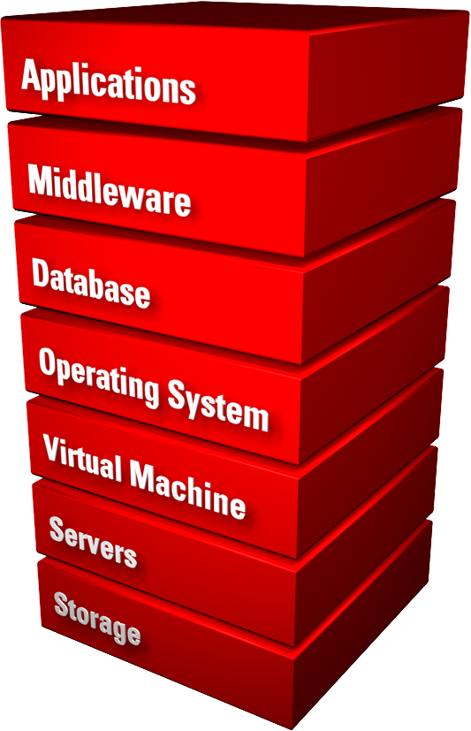
Oracle + Sun
Complete, Open, Integrated Systems
Engineered to work together
Tested together
Certified together
Packaged together
Deployed together
Upgraded together
Managed together
Supported together

Slide 7
Oracle + Sun
Complete, Open, Integrated Systems
Customer Benefits:
Open and standards-based
Innovation delivered faster
Better performance, reliability, security
Shorter deployment times
Easier to manage and upgrade
Lower cost of ownership
Reduced change management risk
One-stop support
Reduced down time

Slide 8
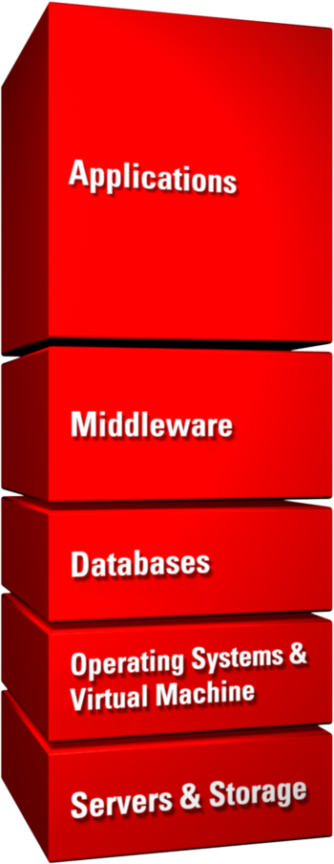













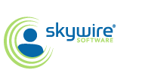






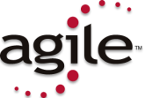






































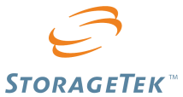
Oracle Acquires Best-in-Class Companies
Middleware Platform and Management
Business Intelligence
Data Integration
Identity & Access Management
Performance Management
Enterprise Content Management
(Pending)
Operating Systems
Systems Management
Virtual Machines
Notes:
One of the ways which Oracle is able to deliver complete industry footprints on a complete stack is through acquisitions of market leading applications and technology.
In the last five years, Oracle has invested more than $40 billion in over 60 acquisitions. We acquire technology and domain experts that complete components of our product stack, resulting in a best-in-class portfolio of software and hardware capabilities.
We invest in companies that our customers have already “voted” for with their IT dollars and then we work on integrating them, so that you don’t have to. This is a very different approach than our competitors who have taken a “build it all” approach, but fail to deliver those best in class solutions.

Slide 9
Oracle Makes Commitment To Customer Choice
Lifetime Support
The most comprehensive support policy available.
Applications Unlimited
Commitment to ongoing enhancements to and support for your existing Oracle applications.
Co-Existence
Applications that are designed to add value to and work with your existing investments.
Since
2005
Applications Unlimited
Fusion Middleware
New Applications
Since
2006
Since
2007
Premier
Extended
Sustaining
0
5
8
Years from Release G/A
Notes:
The JD Edwards case study made it clear that offering customer choice is the best long-term strategy. In 2005, we announced Oracle’s Lifetime Support policy, which lets customers choose how and when to upgrade. Premier Support is available for five years from the time of a release and can be extended for another three years. After that, Lifetime Sustaining Support provides bug fixes forever. Applications Unlimited is our commitment to ongoing enhancements to applications in our portfolio. Finally, Co-Existence is how we intend to make applications work together, so customers can choose from Oracle’s portfolio of applications to meet their particular business needs.
As the deputy CIO for the City of Orlando, Florida, put it, “What this offers me as a CIO is the gift of time and the freedom of choice. “
Slide 9

Slide 10
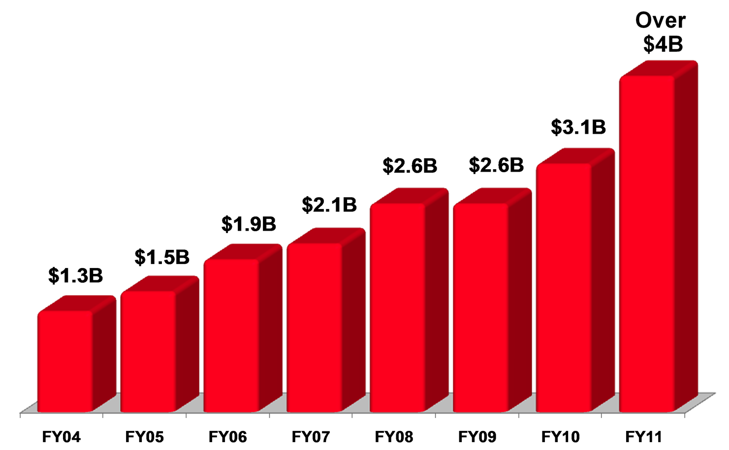
Oracle Invests in Continued Innovation and Integration
$19B
In R&D Since 2004
Notes:
Since 2004, Oracle has invested more than $19 billion dollars in continued innovation of our products – so we can ensure that each of our products is best of breed in the industry – and in integration, so we can deliver products that work together.

Slide 11

Oracle Invests In The Future
100% Open Standards
User Experience
Mobile Computing
Cloud Computing
Service Oriented Architecture
Modularity
Enterprise 2.0
Embedded Analytics
Private Clouds
Public Clouds
Cloud Services
Smartphones
Tablet PCs
Notes:
Starting with the first commercial relational database thirty years ago, Oracle has a long history of innovation. Today, we see a major technological shift happening and have invested in a number of areas. The first is strict adherence to open standards and service-oriented enterprise architecture. The second is the user experience. The third is cloud software and services, and the fourth is mobile computing.

Slide 12

Fusion Applications
Next Generation Applications Designed For the Cloud
Started with a Modern Platform
Industry-leading, standards-based, configurable, adaptive and secure Fusion Middleware
Built Best Practice Business Processes Based On Hundreds of Years of Learning
E-Business Suite, PeopleSoft, JD Edwards, Siebel
Reinvented the User Experience
Role-based user interface, embedded decision support, pervasive collaboration
Made Ready for the Cloud
Private or public cloud
All in Collaboration with Oracle’s Customers and Partners
Notes:
Oracle Fusion Applications represent a new generation of application software. Designed from the ground up using the latest technology advances, Oracle Fusion Applications run on 100% standards-based middleware. This modular suite of applications includes everything from ERP and Human Resources to CRM and Supply Chain. With a completely redesigned user experience, Fusion Applications integrate transactions, analytics and collaboration where appropriate in the business process. Fusion Applications are 100% cloud-ready and can be accessed as software-as-a-service or implemented on a private cloud.
Complete User Experience: A Role-Based Approach to Increasing Productivity
A tailored experience with built-in flexibility to improve the efficiency and effectiveness of your organization—from the executive leadership team to front-line workers and customers
Incorporating more than 4,000 hours of customer input and testing involving more than 1,000 businesses and public sector organizations
Embedded business intelligence accelerates the pace and accuracy of business decisions
Integrated collaboration connects teams with the processes in which they participate
Powerful Enterprise 2.0 technologies incorporate unstructured information—such as invoices, product manuals, and business documents—into structured processes for richer experiences and better-informed decisions

Slide 13

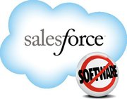


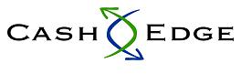


Oracle Announces The Next Generation Cloud
Oracle Enables Private Clouds
Oracle Powers Public Clouds
Oracle Delivers Cloud Services
Applications
Cloud Services
Platform
as a Service
Infrastructure as a Service
Hosted and Managed Applications & Technology
Cloud Management
Notes:
Oracle is powering the cloud with next generation cloud software and services. We have a complete stack for customers to build private clouds. Our technology is the foundation for many of the world’s best-known public clouds. Oracle also delivers a full-range of cloud services, including software as a service and platform as a service. Whether customers are looking to build a private cloud for a shared services center, leverage public cloud services to host a virtual private cloud or subscribe to software as a service or platform as a service —only Oracle has the breadth and scale to offer a range of solutions that allow customers complete choice.

Slide 14
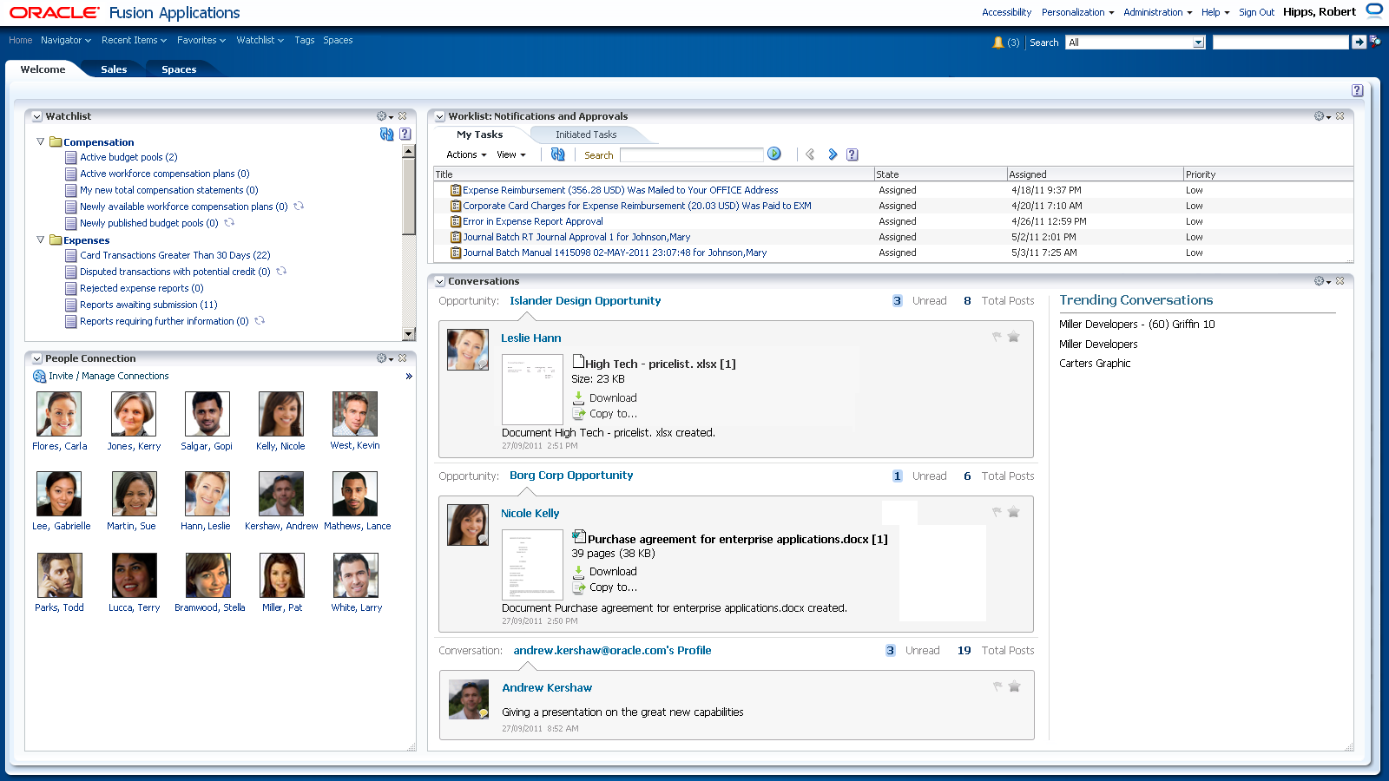

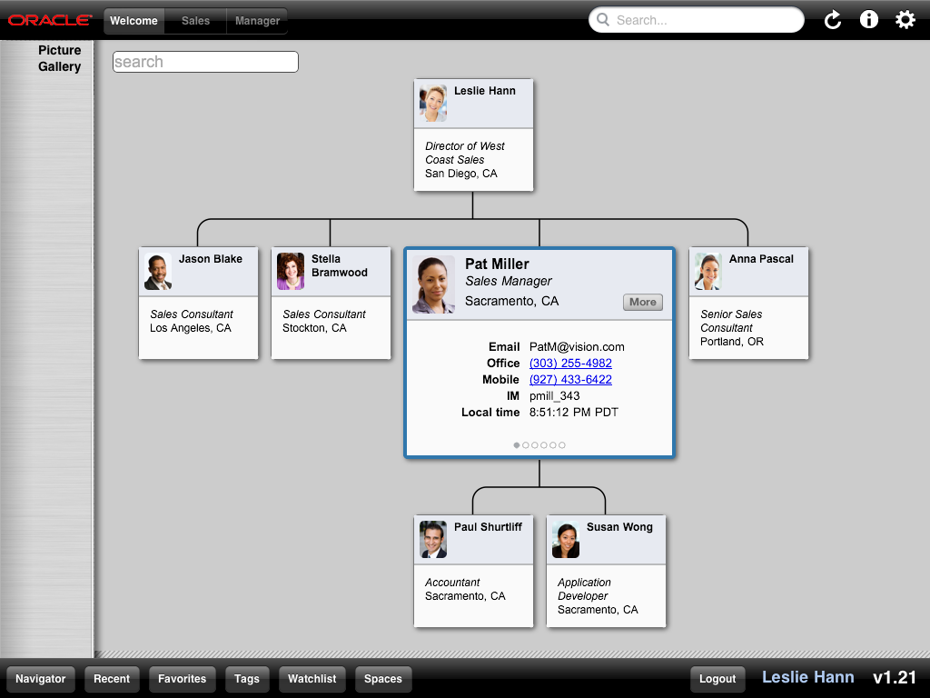
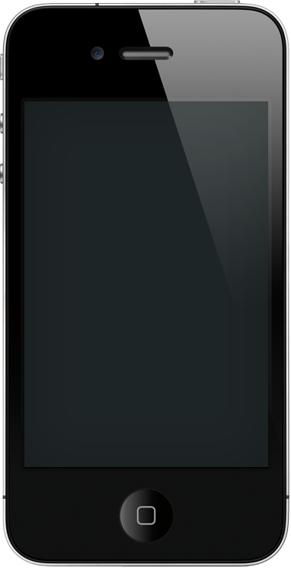
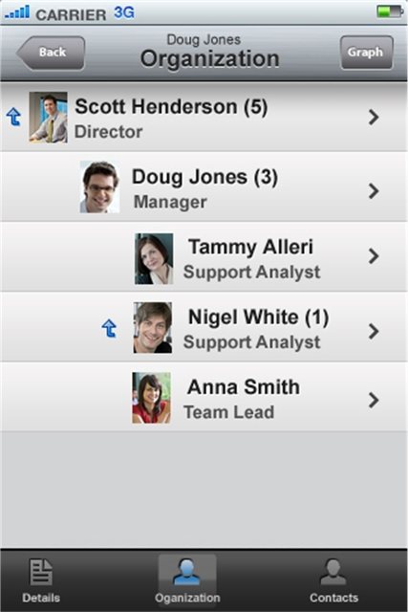

All Fusion Applications Run on Mobile Devices

Slide 15

Oracle Provides Evolutionary Path Forward
Current State
Future State
Integrated Suites
Co-Existence
Modular Solutions
On Premise
Hybrid
Cloud
Technology Components
Optimized Solutions
Engineered Systems
Notes:
We believe that customers should have the choice of if, how and when they move to next generation technologies. Our strategy provides an evolutionary path forward so that customers can make selective investments in the latest technologies while protecting their existing investments. For example, we offer modular solutions designed to co-exist with and create strategic business value around existing software suites. Customers have the choice to stay with their current portfolio – on premise or hosted, add cloud applications over time or upgrade to a cloud suite. We are the only vendor with cloud software that also can be deployed on premise. In addition, customers can take advantage of our optimized solutions, which provide pre-defined, high availability hardware and software configurations, as a stepping-stone from technology components to engineered systems.

Slide 16


Hardware Systems

Slide 17
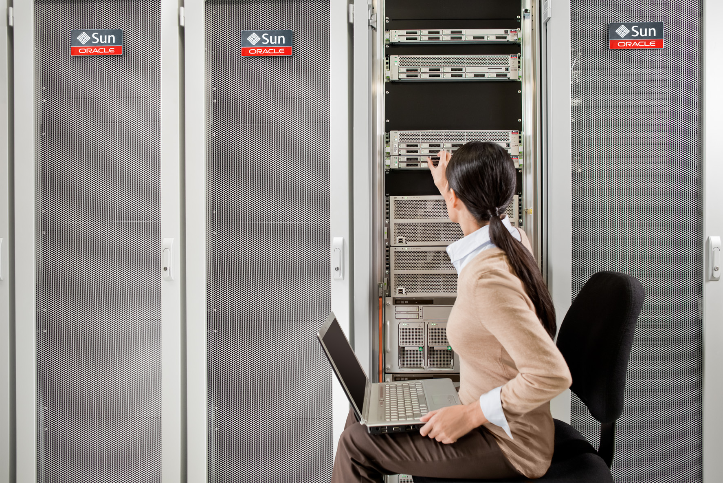
Sun Hardware
Mission Critical Apps In Demanding Environments
Server • Storage • Network • Solaris

Slide 18
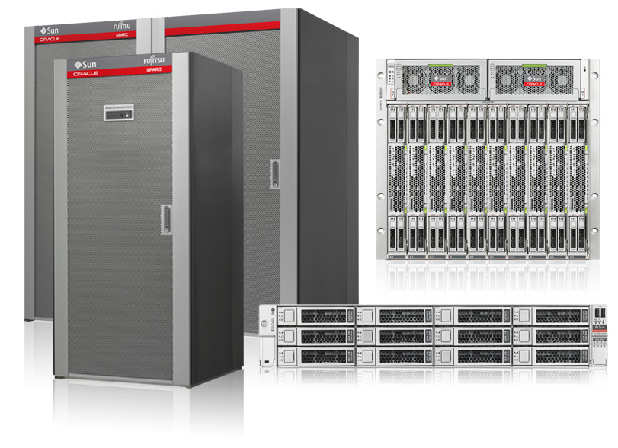
Server Strategy
Deliver the Best Platforms for Oracle Applications
Scale
Efficiency
Availability
Security
Leading application performance
Unmatched integration
Best serviceability
Sun SPARC Enterprise Servers
Sun Fire Servers

Slide 19
Sun Servers
Protecting Your Sun Systems Investments
Increasing investment in Solaris
    Leading mission critical OS
Accelerating SPARC innovation in a comprehensive family
of SPARC systems
    Next generation, high performance, reliable enterprise compute platforms
Focusing development on x86 enterprise-class integrated clusters
    Redundant, high performance, integrated clusters for distributed
    enterprise applications
Engineering from applications to disk

Slide 20
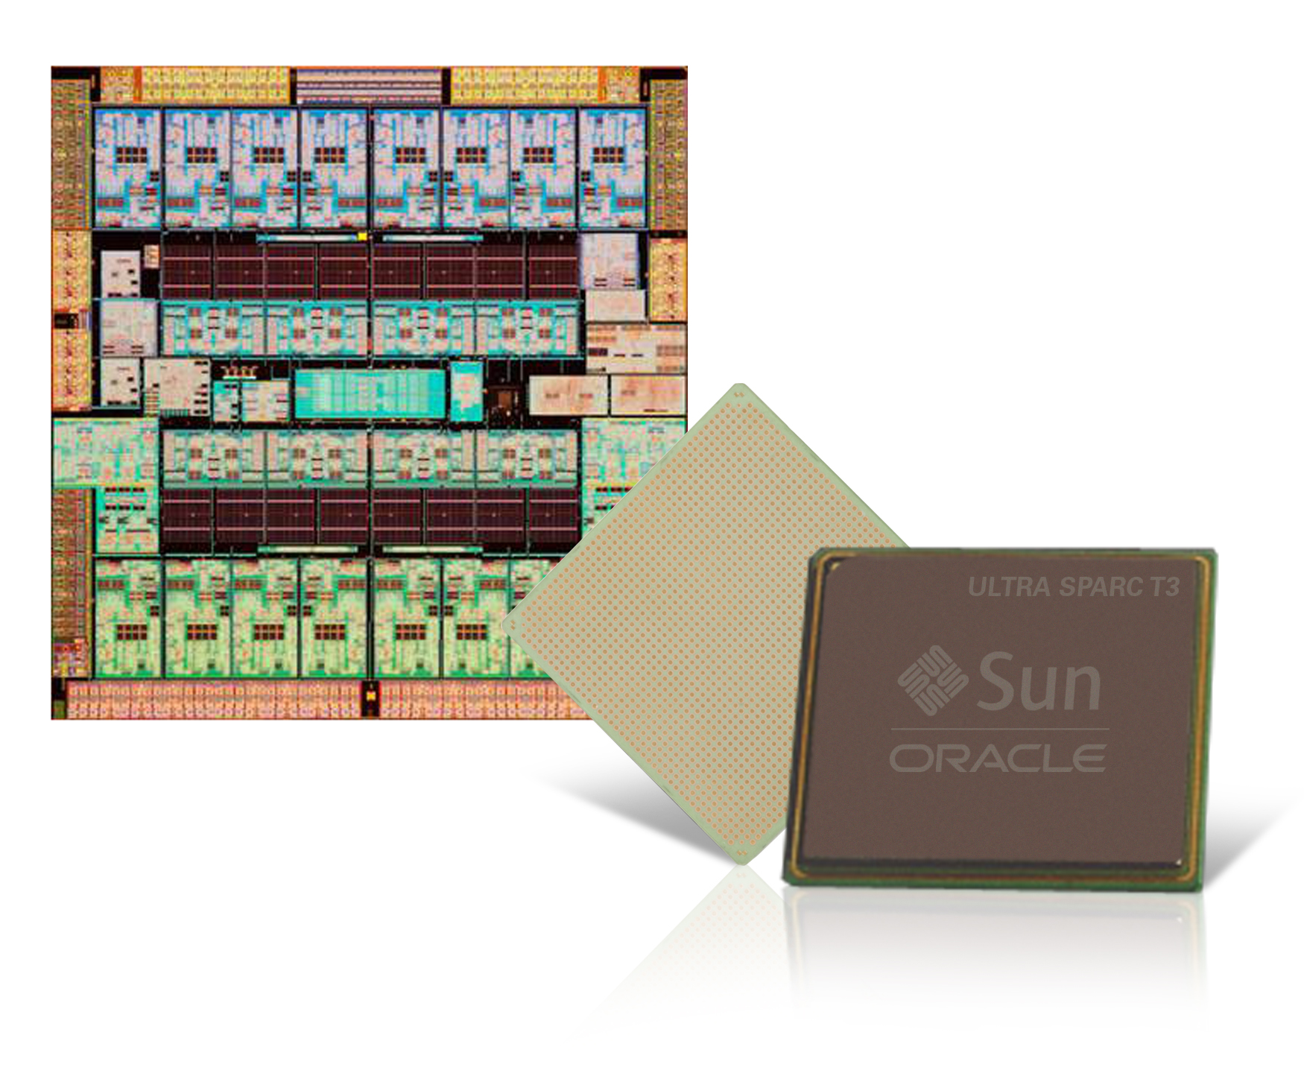
SPARC Strategy
Compatibility
Scalability
Efficiency
Availability
Security
Performance
Accelerated roadmap
Application performance
Co-engineered with Oracle Software

Slide 21

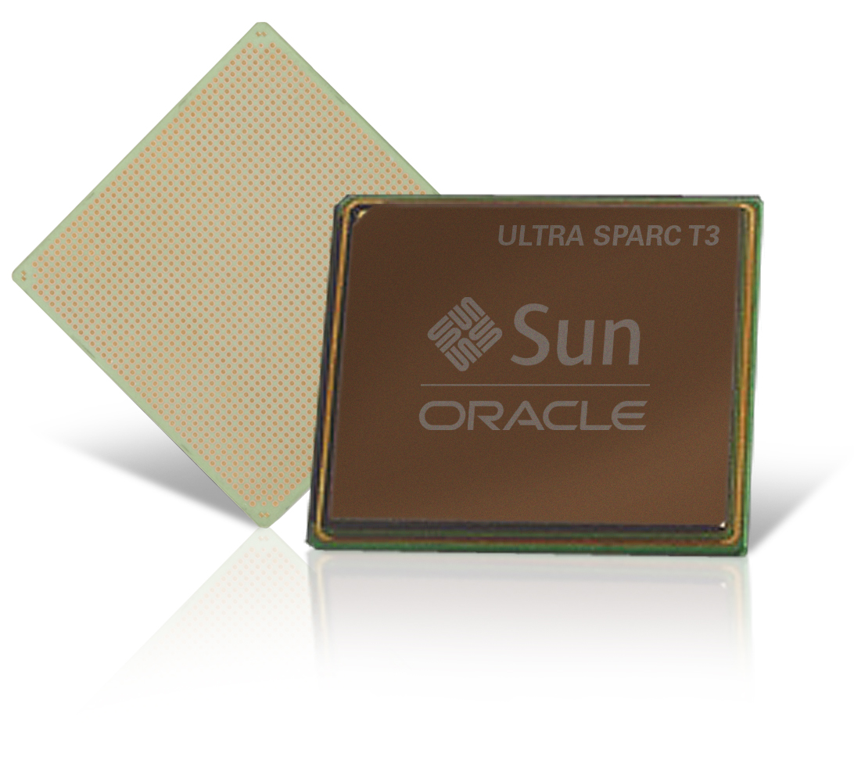
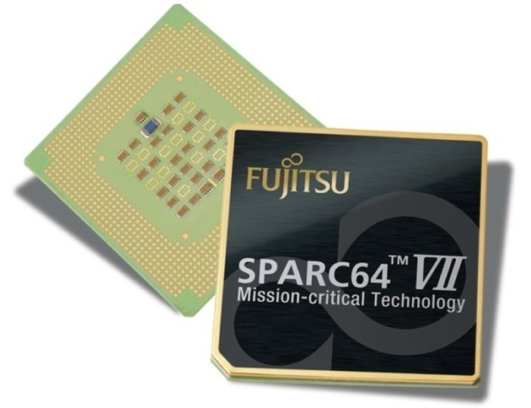
The World’s Best Processors For
Oracle Applications
UltraSPARC
1-4 Socket Systems
And Blades
SPARC64
Up To 64 Socket Systems
Best efficiency
Best security
Most available
Most scalable

Slide 22
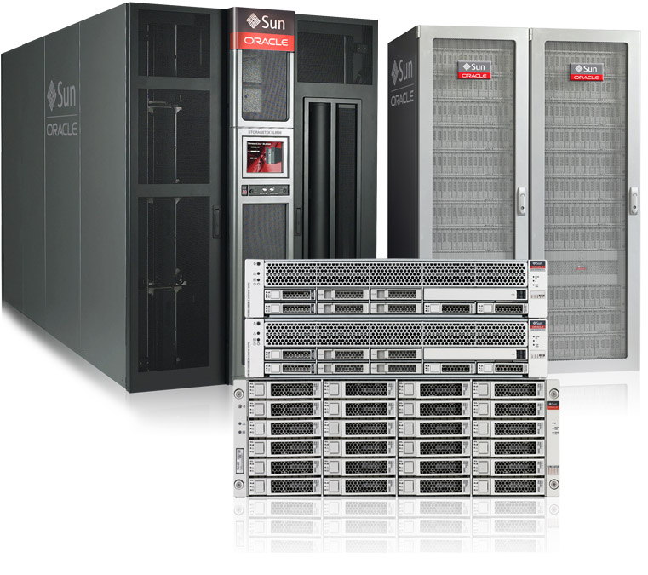
Storage Strategy
Delivering Technology Innovation
Leading cost performance
Reduce TCO
Increase reliability
Industry leading performance
Unmatched Integration
Serviceability

Slide 23

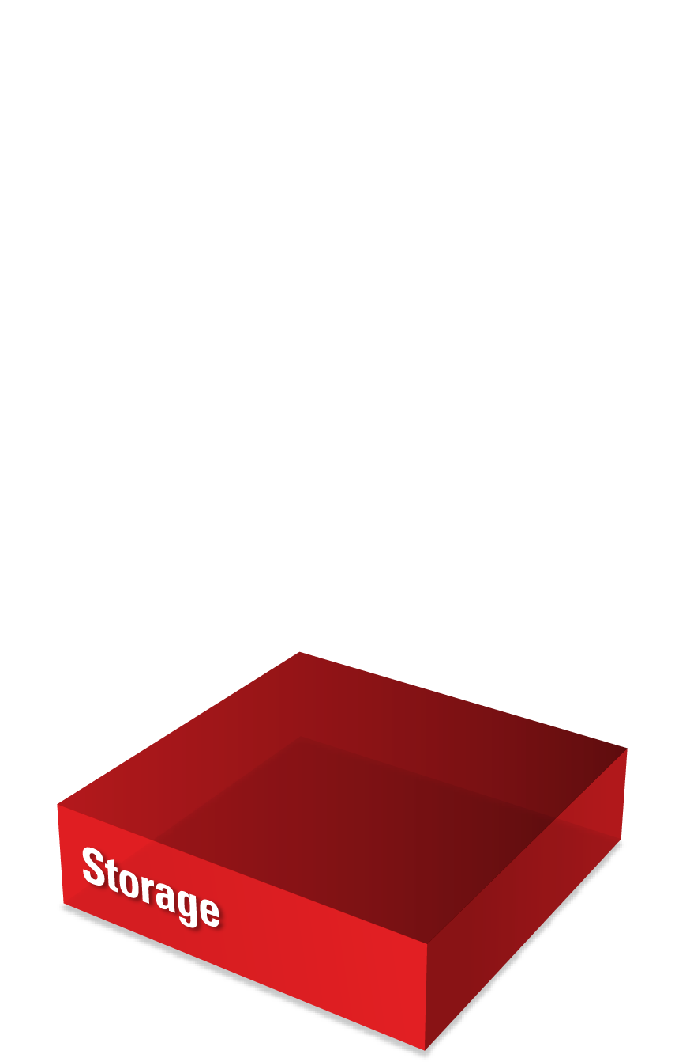
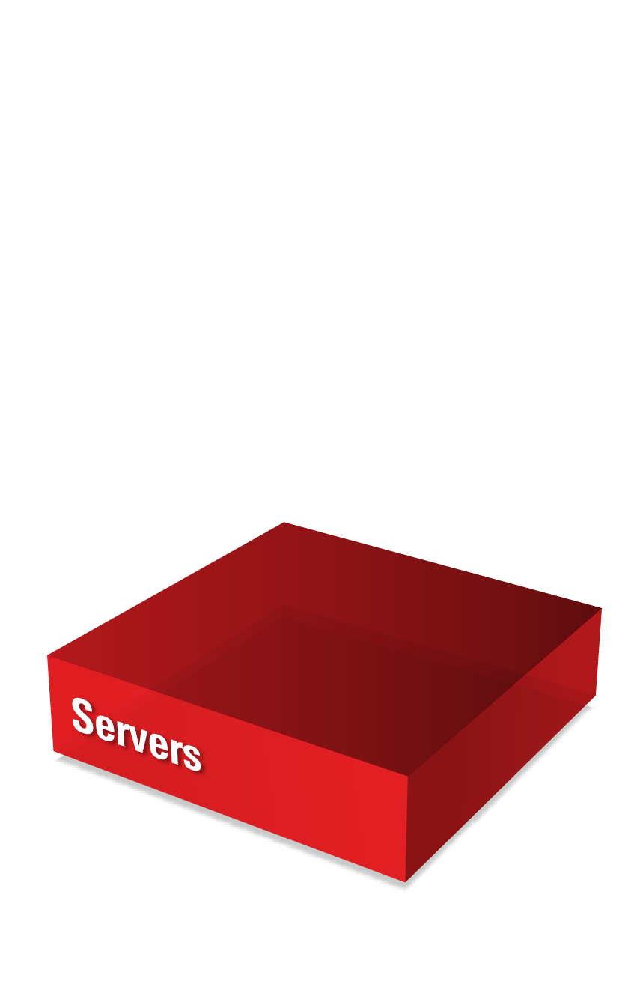
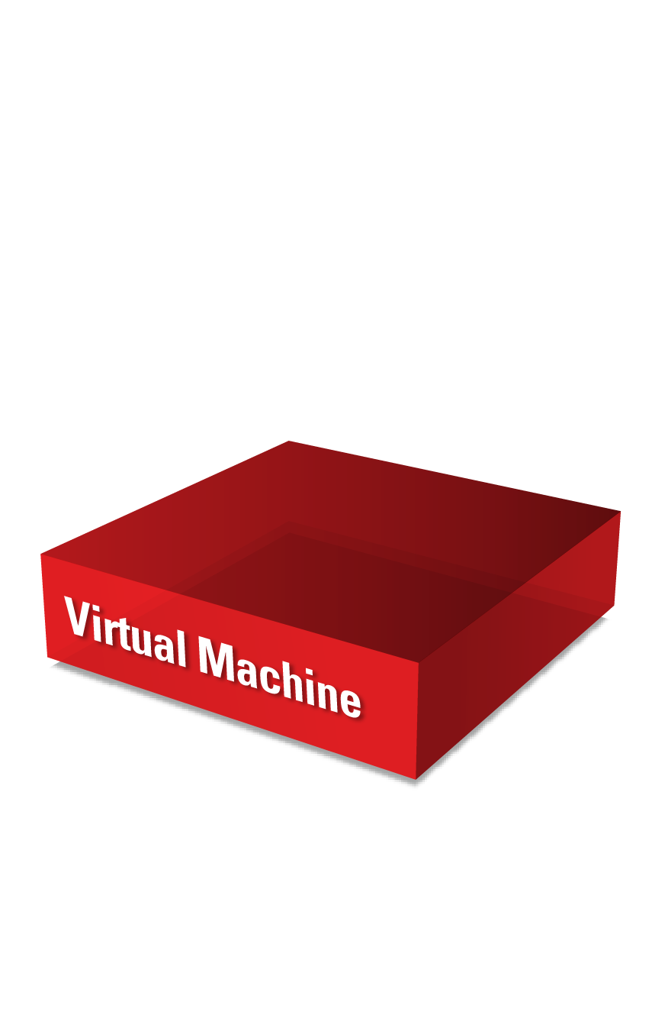
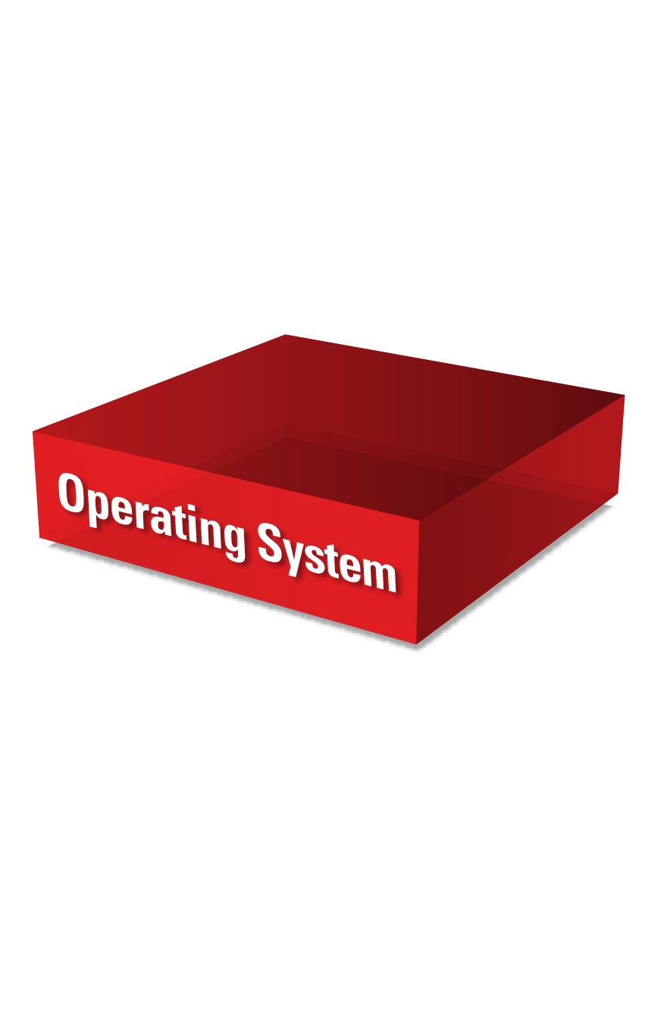
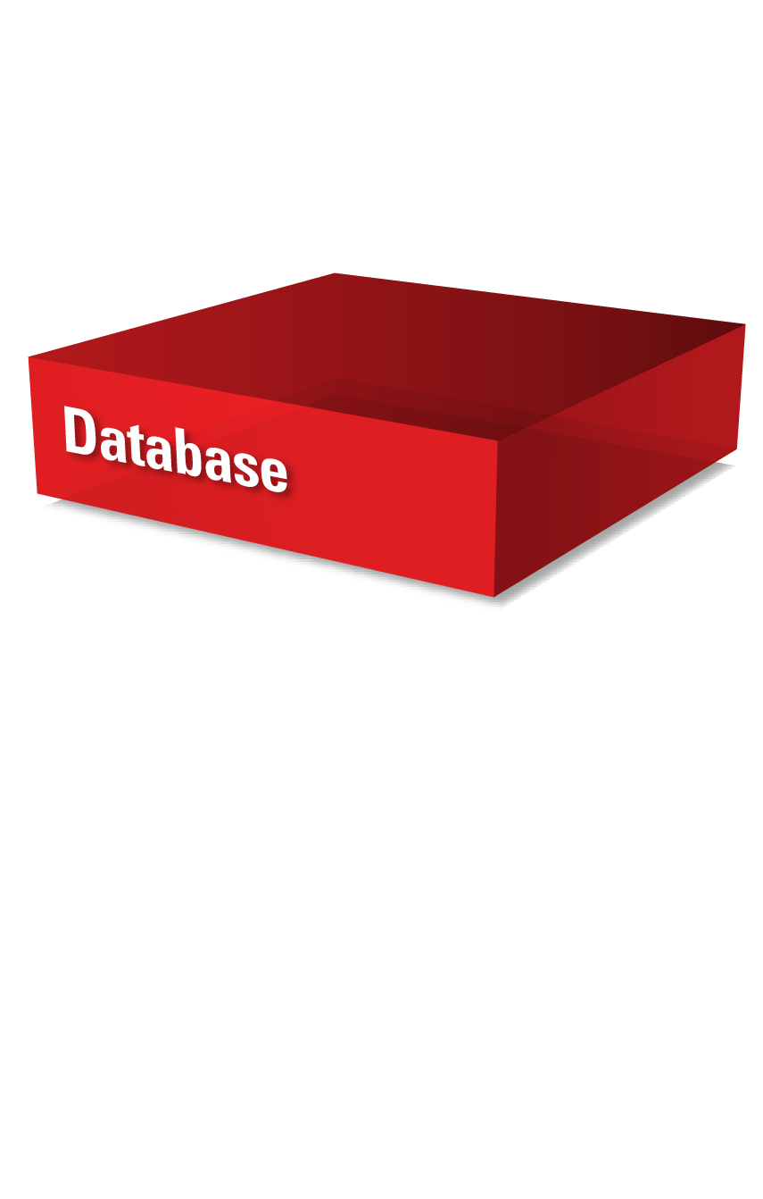
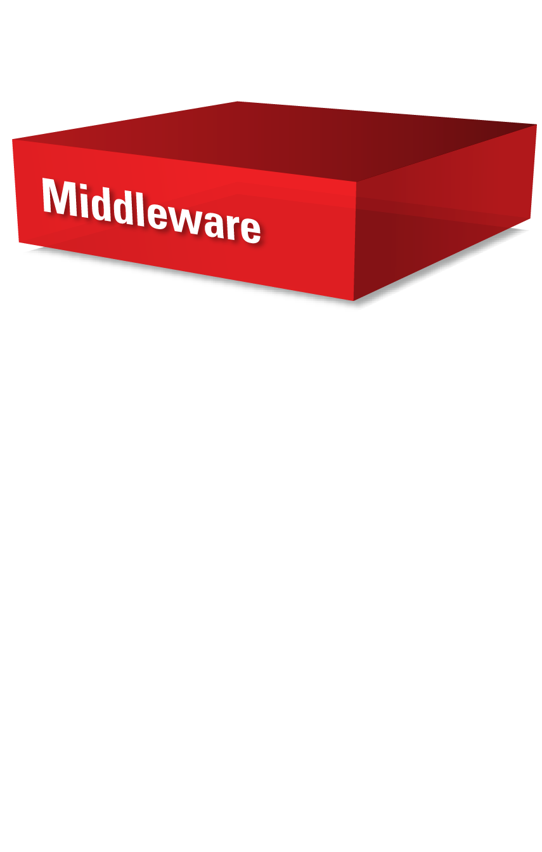

Engineered
For performance
Notes:
Slide Transition: Finally, the ultimate expression of hardware and software engineered to work together is Oracle’s engineered systems.
By increasing the level of engineering and optimization in these systems, Oracle can deliver exponential performance increases and massively simplified deployment and management capabilities.

Slide 24
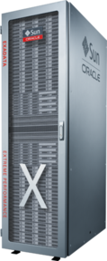
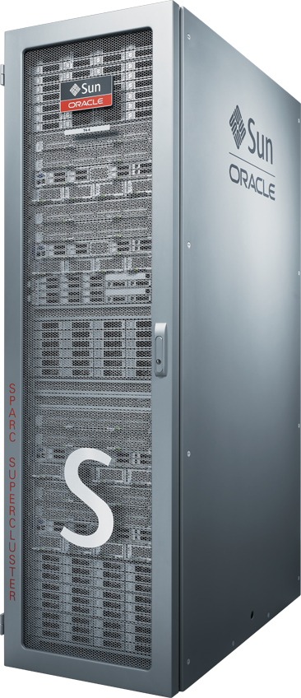
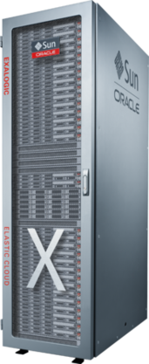
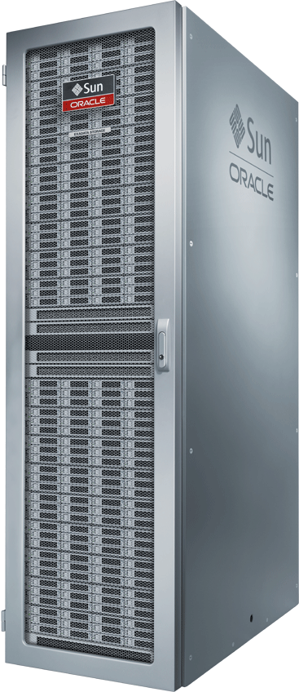
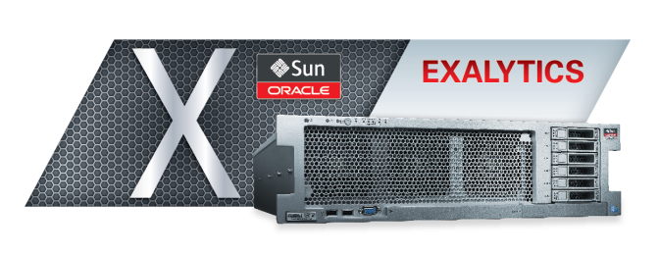
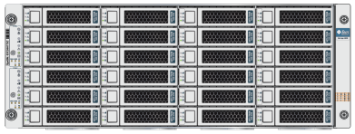
Engineered Systems & Appliances
Purpose
Built
General
Purpose
Exalytics In-Memory
Exadata
Exalogic
Big Data
Database Appliance
SPARC SuperCluster
Notes:
Slide Transition: The Oracle Exadata Database Machine and Oracle Exalogic Elastic Cloud were our first examples of engineered systems that include a complete package of servers, storage, networking, and software. Recently, we’ve introduced even more…
Our goal as a company is to add value to our hardware systems to meet our customer’s diverse needs. We understand that no workloads are the same. So, we have created “purpose built” machines that are optimized to handle particular types of workloads really well–for example, if customers require database optimized, we offer Exadata; if they want optimized middleware, we offer Exalogic – and now, we offer Exalytics In-Memory Machine for handling analytics.
On the other hand, there are customers who are looking to consolidate different workloads onto a single box. For example, a varied set of workloads with a system to run database, applications, some middleware and analytics. For these general purpose needs, we recently announced our SPARC SuperCluster.

Slide 25
Engineered Systems & Appliances
Exadata
10x-50x Faster Query Performance
6x Lower Cost Than IBM P795
Exalogic
10x Faster Response Time for Java Applications; 4x Faster for Oracle Apps
Exalytics
20x faster analysis
SPARC SuperCluster
9 world records over IBM and HP
Big Data Appliance
Most Comprehensive Big Data Platform for the Enterprise
Database Appliance High Availability made Simple, Reliable and Affordable
Notes:
High Availability Made Simple, Reliable and Affordable
SlideTransition: Here’s a quick look at performance and other metrics associated with these systems – our goal is to bring you SIMPLE system solutions “engineered to work together” to manage your IT environment.
Background notes on Engineered Systems:
Exadata - Extreme performance database system for consolidation, data warehouse, OLTP, and mixed workloads
Exalogic - Extreme performance Intel Linux/Solaris platform optimized for Oracle Apps, Oracle FMW, can run 3rd party apps
Exalytics - Extreme performing in-memory and middle tier analytics platform – the industry’s first in-memory hardware and software system engineered to run analytics faster than ever, provide real-time speed-of-thought visual analysis, and enable new types of analytic applications.
SPARC SuperCluster - Engineered clustered system for general purpose computing. Designed for enterprise consolidation of Oracle and third-party applications and database environments – The world’s fastest general-purpose engineered system.
Big Data Appliance - Hadoop and NoSQL based system, optimized for acquiring, organizing, and analyzing low density and unstructured data – Designed to help customers integrate and maximize the value of Big Data. In conjunction with Oracle Exadata Database Machine and the new Oracle Exalytics Business Intelligence Machine, delivers everything customers need to acquire, organize, analyze and maximize the value of Big Data within their enterprise.
Database Appliance - Complete, affordable HA database system for the mid-market, optimized for ease of use.

Slide 26
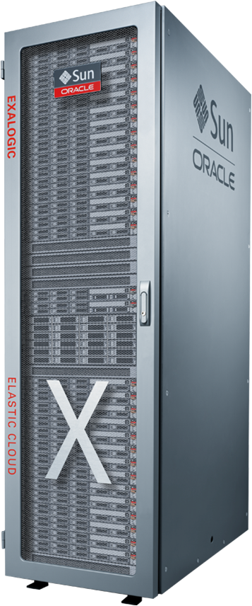
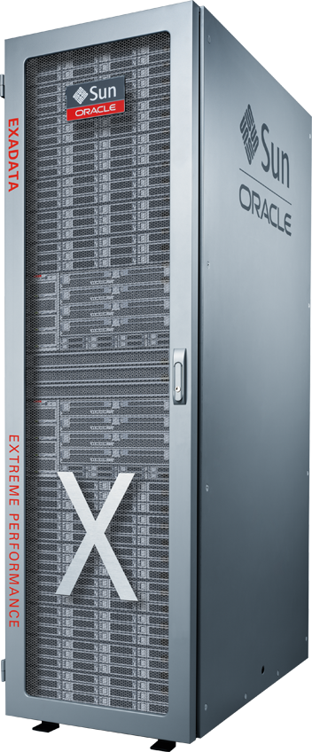
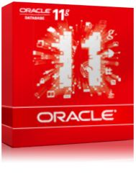
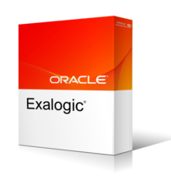
Oracle Delivers Systems Engineered To Work Together
Every unit is the same, from applications to disk
Open, standard, proven
Best performance, highest quality of service
Designed for supportability
Each Exa is optimized and balanced for specific workload requirements
Notes:
We deliver systems such as the Exadata Database Machine and the Exalogic Elastic Cloud that are engineered, tested, certified, packaged, deployed, upgraded, managed and supported together. With every unit the same, we can deliver the highest quality and most supportable product.
Because Oracle owns all the technology, not only do all the pieces in our engineered systems fit and work together out of the box, but our development teams can work together to optimize and balance different technologies for specific workload requirements. For example, we optimized the Exadata Database Machine for database and storage workloads. Exadata is the fastest system out there for running both online transaction processing and data warehousing. Another example is the Oracle Exalogic Elastic Cloud, which we optimized for middle-tier application workloads. Exalogic has the highest level of Java performance in the industry. The Exa platform also is ideal for consolidating databases and different types of application workloads. Customers have gone from 250 database servers, 400 application servers and 500 terabytes of storage to 20 Exadata machines, 10 Exalogic machines, and 150 terabytes of storage.

Slide 27
Operating Systems

Slide 28
Oracle Operating Systems Strategy
Invest significantly in both Solaris and Linux
Optimize both operating systems for full stack
from applications to disk
Deliver world class support at the lowest TCO
for both Solaris and Linux

Slide 29







































50,000+ Customers Run Solaris
Manufacturing

Slide 30























4,000+ Customers Run Oracle Enterprise Linux

Slide 31
Solaris And Linux Advantage
With Solaris and Linux, Oracle provides the industry’s
most complete and open operating systems offering
in the industry.
  With Solaris, Oracle offers industry-leading scalability,
  reliability, security and performance through superior
  technical innovation
  With Linux, Oracle delivers world-class support and
  technology leadership for the most widely deployed
  open source operating system

Slide 32
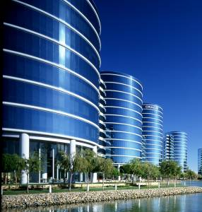
Database

Slide 33

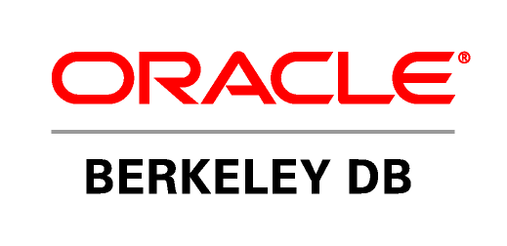


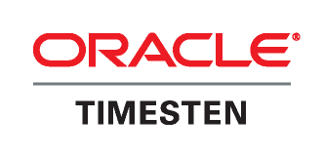


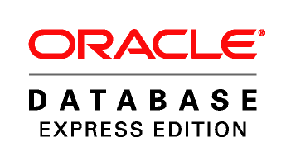
Oracle Database Offerings
11g Enterprise Edition
Mission critical deployments
Security, Scalability, Availability
World record TPC performance
11g Standard Edition
Full featured database
Small-medium business
Lower cost
Berkeley Database
Open-source developer databases
Fast, reliable with little or no administration
Deployed in the application tier as an
embedded database
11g Standard Edition One
Full-featured database
Departmental systems
Two-processor servers
$149 per user
TimesTen Database
Memory-optimized database for
Applications requiring instant
responsiveness.
Telecom, capital markets, and defense
11g Lite Edition
Complete solution for developing
and deploying applications for mobile
and embedded environments.
11g Express Edition (XE)
Entry-level, small-footprint
Free to develop, deploy, and distribute
Fast to download and simple to administer

Slide 34


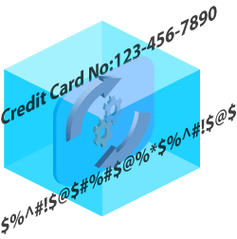

The Standard for Data Security
Database
Vault
Label
Security
Secure
Backup
Segmentation
of DBA Duties
Row level Security
Encrypted
Data on Tape
Audit
Vault
Advanced
Security
Heterogeneous
Database Firewall
Centralized audit trail
of database changes
Encrypted
Data
Flexible Policy
Enforcement

Slide 35

Fusion Middleware

Slide 36
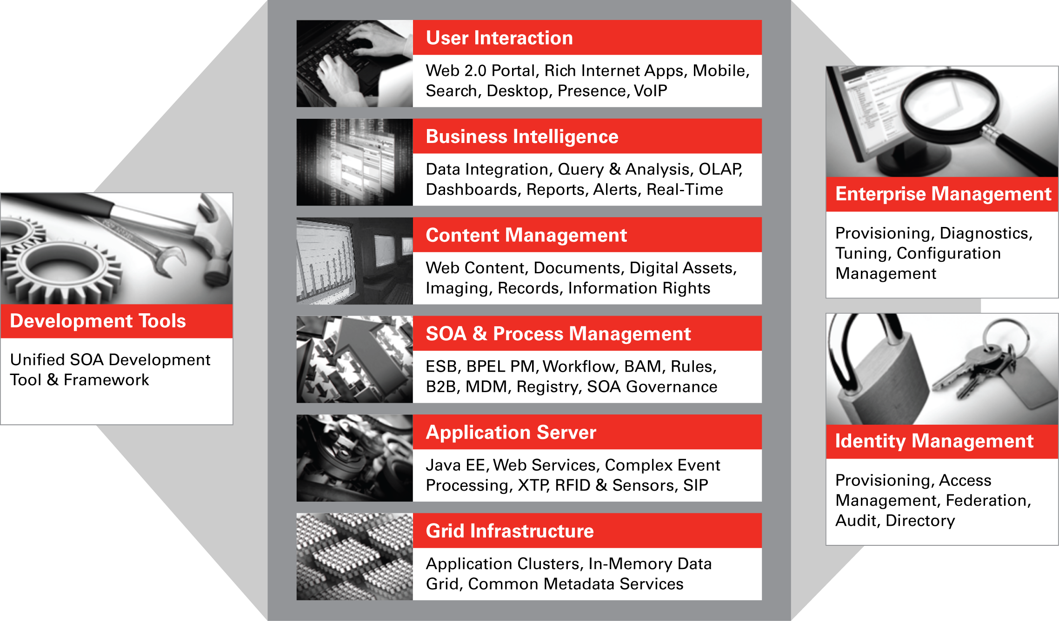
Oracle Fusion Middleware

Slide 37
World’s Best Middleware Suite
Gartner Magic Quadrants
Application Platform Suites
Application Infrastructure
SOA Application Infrastructure
Backend Integration
Development Tools
Application Server
Web Services Platform
Enterprise Portal
Enterprise Content Mgmt.
Enterprise Records Mgmt.
Enterprise Service Bus
Business Integration
Business Process Mgmt.
Business Intelligence
Corporate Performance Mgmt.
Access Management
Identity Provisioning
Web Services Management
Data Integration
LEADER
LEADER
LEADER
LEADER
LEADER
LEADER
LEADER
LEADER
LEADER
LEADER
LEADER
LEADER
LEADER
LEADER
LEADER
LEADER
LEADER
LEADER

Slide 38
Applications

Slide 39
Oracle Acquires Best-in-Class Companies
Notes:
One of the ways which Oracle is able to deliver complete industry footprints on a complete stack is through acquisitions of market leading applications and technology.
In the last five years, Oracle has invested more than $40 billion in over 60 acquisitions. We acquire technology and domain experts that complete components of our product stack, resulting in a best-in-class portfolio of software and hardware capabilities.
We invest in companies that our customers have already “voted” for with their IT dollars and then we work on integrating them, so that you don’t have to. This is a very different approach than our competitors who have taken a “build it all” approach, but fail to deliver those best in class solutions.

Slide 40
Oracle Fusion Applications
Phase 1 – Critical Mass
  #1 CRM
  #1 Human Resources
  #1 Financial Consolidation
  #1 Analytic Applications
  #1 Supply Chain
Phase 2 – Beyond ERP to Line of Business Apps
  Core Banking
  Retail Merchandising
  Utility Billing
  Meter Data Management
  Communication Billing
  Network Inventory
  Insurance Claims
  Insurance Policy Management
  Anti money laundering
  Clinical trials data management

Slide 41

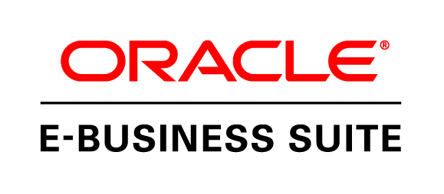
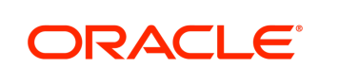

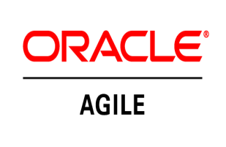
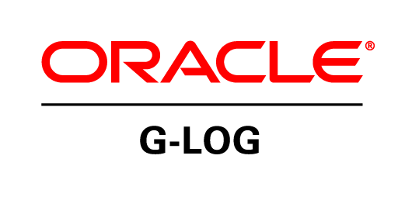
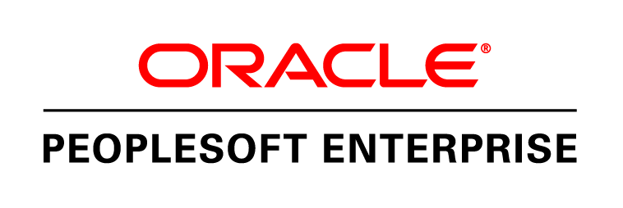

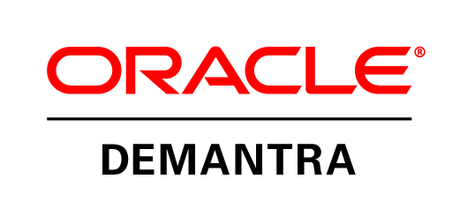
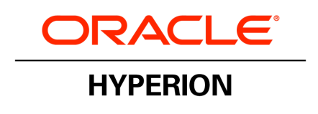
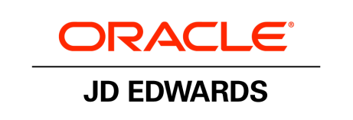
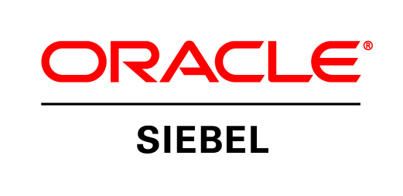
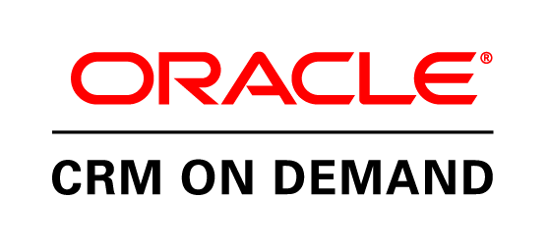
Feature Rich Releases
E-Business Suite 12.1
16 New Products
575 Enhancements
Agile PLM
4 New Products
500 Enhancements
5 New integrations
OTM/GTM 6.0, 6.1
2 New Products
30 Enhancements
3 New integrations
PeopleSoft 9.1
21 New Solutions
1,470 Enhancements
200 Industry specific
Demantra 7.3
40 Enhancements
2 New integrations
Hyperion 11.1.2
4New Products
752 Enhancements
JD Edwards
3 New Products
829 Enhancements
Siebel 8.1 & 8.2
36 New Products
469 Enhancements
9 Industry-specific solutions
CRM-OD 17 & 18
10 New Products
831 Enhancements
Notes:
Releases and metrics:
Additional notes
Siebel 8.1 & 8.2: 8.2 released under Controlled Availability until the planned date of Q4/2011 and is targeted for Public Sector customers. As of now we are still recommending customers upgrade to 8.1, which released in Nov 2009 (outside of our 18 month timeframe for this slide).
8.1: 22 new products, 366 enhancements
8.2: 14 new products, 103 enhancements, 9 industry-specific solutions
CRM On Demand split for Release 17 and Release 18:
Release 17: 4 new products, 493 enhancements (including customer-driven enhancements)
Release 18: 6 new products, 338 enhancements (including customer-driven enhancements)
JDE split for E1 and World:
E1: 2 new products, 524 enhancements
World: 1 new product, 305 enhancements
PeopleSoft Enterprise:
Total New Features: 1470
PeopleSoft 9.1 + PeopleTools 8.50: 1,350 Features
PeopleTools 8.51: 115 Features
PeopleSoft 9.1 Offcycle Features: 5 (ePerformance 9.1 (November 2009), Career and Succession Planning 9.1 (May 2010), eCompensation Manager 9.1 (May 2010), Recruiting 9.1 (August 2010), Project Summarization and Variance Pricing (May 2010))
Total New Products: 2
Event Management (in CRM 9.1)
Service Center for Higher Education (in CRM 9.1)
NOT Included:
Career and Succession Planning – new sku on the price list, but was just repackaging of existing functionality to align with EBS packaging in this area. No new functionality delivered.
Workforce Administration PIP – not part of the PSFT solution / stack, part of AIA
Global Payroll Argentina – not a separate sku on the price list, part of the Payroll bundle
IT Asset Management and Maintenance Management – new skus on the price list, but were just repackaging of formerly a single sku (Enterprise Asset Management)
Workforce Communications – new sku on the price list, but shipped in February 2009 (so just outside of the 18 month window)

Slide 42
Oracle Makes Commitment To Customer Choice
Lifetime Support
The most comprehensive support policy available.
Applications Unlimited
Commitment to ongoing enhancements to and support for your existing Oracle applications.
Co-Existence
Applications that are designed to add value to and work with your existing investments.
Since
2005
Applications Unlimited
Fusion Middleware
New Applications
Since
2006
Since
2007
Premier
Extended
Sustaining
0
5
8
Years from Release G/A
Notes:
The JD Edwards case study made it clear that offering customer choice is the best long-term strategy. In 2005, we announced Oracle’s Lifetime Support policy, which lets customers choose how and when to upgrade. Premier Support is available for five years from the time of a release and can be extended for another three years. After that, Lifetime Sustaining Support provides bug fixes forever. Applications Unlimited is our commitment to ongoing enhancements to applications in our portfolio. Finally, Co-Existence is how we intend to make applications work together, so customers can choose from Oracle’s portfolio of applications to meet their particular business needs.
As the deputy CIO for the City of Orlando, Florida, put it, “What this offers me as a CIO is the gift of time and the freedom of choice. “
Slide 42

Slide 43
Applications Unlimited
 |  |  |  |  | Fusion 11g
 |  |  |  |  | Hyperion EPM 11.x
 |  |  |  |  | E-Business Suite 12.x
 |  | Hyperion EPM 11.1.1 |  |  | PeopleSoft Enterprise 9.x
 |  | JD Edwards E1 9.0 | E-Business Suite 12.1 | E-Business Suite 12.1.3 | JD Edwards World A9.3
 |  | Demantra 7.2 | PeopleSoft Enterprise 9.1 | Agile PLM 9.3.1 | JD Edwards E1 9.1
 |  | Agile PLM 9.2.2.4 | JD Edwards World A9.2 | GTM 6.1 OTM 6.1 | Demantra 7.x GTM/OTM 6.x
 | E-Business Suite 12 | Agile PLM for Process 5.2 | Demantra 7.3 OTM 6.0 | Hyperion EPM 11.1.2 | Agile PLM 9.x
PeopleSoft Enterprise 9.0 | JD Edwards World A9.1 | Siebel CRM 8.1.1 | Agile PLM 9.3 | Siebel CRM 8.2 for Pub Sec | Agile PLM for Process 6.x
JD Edwards E1 8.12 | Siebel CRM 8.0 | CRM On Demand 15 | Agile PLM for Process 6 | CRM On Demand 18 | Siebel CRM 8.x
CRM On Demand 12 | CRM On Demand 13 | CRM On Demand 14 | CRM On Demand 16 | CRM On Demand 17 | CRM On Demand 19/20
CY2006 | CY2007 | CY2008 | CY2009 | CY2010 | CY2011+
Notes:
Here is a snapshot of how Oracle is delivering against our promise of continued releases under Applications Unlimited. Since calendar year 2006, we have had at least two major releases on every product line, some of which are quite substantial. The fact that 78% of our customers across all product lines are using the two most recent releases – which is three times better than our competitors’ upgrade results – is testimony that they see value in this continued investment.

Slide 44
Fusion Applications
Next Generation Applications Designed For the Cloud
Started with a Modern Platform
Industry-leading, standards-based, configurable, adaptive and secure Fusion Middleware
Built Best Practice Business Processes Based On Hundreds of Years of Learning
E-Business Suite, PeopleSoft, JD Edwards, Siebel
Reinvented the User Experience
Role-based user interface, embedded decision support, pervasive collaboration
Made Ready for the Cloud
Private or public cloud
All in Collaboration with Oracle’s Customers and Partners
Notes:
Oracle Fusion Applications represent a new generation of application software. Designed from the ground up using the latest technology advances, Oracle Fusion Applications run on 100% standards-based middleware. This modular suite of applications includes everything from ERP and Human Resources to CRM and Supply Chain. With a completely redesigned user experience, Fusion Applications integrate transactions, analytics and collaboration where appropriate in the business process. Fusion Applications are 100% cloud-ready and can be accessed as software-as-a-service or implemented on a private cloud.
Complete User Experience: A Role-Based Approach to Increasing Productivity
A tailored experience with built-in flexibility to improve the efficiency and effectiveness of your organization—from the executive leadership team to front-line workers and customers
Incorporating more than 4,000 hours of customer input and testing involving more than 1,000 businesses and public sector organizations
Embedded business intelligence accelerates the pace and accuracy of business decisions
Integrated collaboration connects teams with the processes in which they participate
Powerful Enterprise 2.0 technologies incorporate unstructured information—such as invoices, product manuals, and business documents—into structured processes for richer experiences and better-informed decisions

Slide 45




Fusion Applications
Role-Based User Experience
What do I need to DO?
What do I need to KNOW?
Exception-based Management
Embedded Business Intelligence
How do I get it DONE?
WHO do I need to reach?
Configurable Applications & Processes
Embedded Collaboration
Notes:
Oracle Fusion Applications which is a new generation of application software which includes more than 100 modules with everything from Financials, Human Resources to CRM and offers tremendous advantages over the current generation of applications. In fact there are 4 major areas of improvement.
The Fusion Applications are designed around the notion that business processes are important to our customers and that you need to do everything within the context of the business process that you are trying to run or the problem that you are trying to solve. So when you have a problem to solve you ask 4 basic questions:
What do I need to do?
What information do I need to know how to do what I want?
Who do I work with, who do I need to contact to solve my problem?
How do I actually get the job done?
The Oracle Fusion Applications are specifically designed to help you answer those questions. So, we have provided embedded transaction capability inside of the business processes so that you can stay within the context of the business issues that you’re trying to resolve even as you kick-off transactions specific to your problem. This means that you don’t have to change contexts all the time, moving between different applications, logging in, trying to figure out what steps to take.
We’ve also embedded businesses intelligence directly into the applications, that’s very powerful because it means you have the information on hand that you need to make decisions as part of the transaction that you are trying to do. So, in a human resources application, you might have information about, what is the average salary? How many employees are in the department? What’s the highest salary/lowest salary? All that information might be useful to you if you are looking at giving a new employee an additional raise.
Third, we have embedded collaboration services directly into the Fusion Applications. So imagine being in the middle of a business process and you have a question you don’t know how to answer and you would like to be able to contact an expert on that business process. Perhaps you are in the middle of a Human Resources transaction and you need to talk to somebody about employee benefits – who do you call? Well the Fusion Applications provide collaboration services directly in the application that let you see all of the relevant parties who are participating in the transaction, who are the suggested experts in the area that you’re working on and offers ways to contact them either by email, instant message, telephone so that you can work with them directly at the moment that you need them.
Finally we make the Fusion Applications far more configurable so that configuration changes do not require hard wired coding directly in the application, it allows you to modify the business processes at the upper layers and as the application changes are evolved over time it preserves your configuration changes and that means that it is much easier to maintain that application over time. So, it enables you to create more customized or specific ways to get the job done. All of these factors are extremely important as we move to a new generation of applications.
Today, Oracle Fusion Applications are in controlled availability, we are looking for customers that are interested in working with Oracle to uptake this product. You have a choice, you can continue to use your existing applications, you can add a few modules of Fusion Apps to run with your PeopleSoft or Siebel or E-Business suit, or you can chose simply to move entirely to Fusion Applications and run the entire application suite. It’s up to you, it’s your choice and general availability products will be available later this year.
Over 750 customers helped us to design these products so there is a tremendous amount of customer feedback that has gone into the user interface and the design of the systems to maximize the performance of the business processes and how customers interact with them.

Slide 46










Complete Solutions by Industry
Industry Leaders Rely on Oracle Applications
11 of Top 11
Over 300
OEMs & Suppliers
5 of Top 10 Global
20 of Top 20
Service Providers
65 of Top 100
Aero & Defense
Automotive
Chemicals
Communications
Consumer Products
9 of Top 10
Academic
Universities
4 of Top 5
Fortune 500
10 of Top 10
Global Banks
Over 300 Leading
Providers
25 of Top 25
Electronic OEMs
Education & Res.
Engr & Construction
Financial Services
Healthcare
High Technology
World’s Best Intellectual Property, Most Complete End-to-End Industry Solutions

Slide 47










Complete Solutions by Industry
Industry Leaders Rely on Oracle Applications
9 of Top 10 Global
20 of the Top 20
Global Insurers
20 of Top 20
Pharmaceuticals
All in Fortune’s
Global 500
6 of Top 7
Companies
Industrial Mfg
Insurance
Life Sciences
Media / Entertain.
Oil & Gas
9 of Top 10 Global
IT Services Firms
Over 1500
Organizations
12 of 13
Fortune 100
3 of Top 5 Airlines
in Fortune 500
13 of Top
20 Fortune 500
Professional Svcs
Public Sector
Retail
Travel & Transport
Utilities
World’s Best Intellectual Property, Most Complete End-to-End Industry Solutions

Slide 48
Complete. Open. Integrated.

Slide 49



Oracle Customer Services
Enabling the
success of your
Oracle software
and system investments through a
LIFECYCLE OF SERVICES
covering the complete
Oracle stack
Notes:
You’ve made a significant investment in Oracle Software and Hardware. We’re here to ensure you are successful.
We cover the full Oracle stack and adoption lifecycle with a portfolio of services focused on making your investment successful.
49

Slide 50







Oracle Lifecycle Services
Transforming your Business
Using Oracle Solutions
Complete Support for Oracle
Software, Hardware and Solutions
Personalized, Proactive Services for all
Oracle Applications and Technologies
Superior Oracle Product Knowledge
The Power of Oracle in the Cloud
Notes:
₅₀
Here is the list of services we provide, that cover the full lifecycle.

Slide 51
APPENDIX

Slide 52
Example Of Integration Within Stack Layers
Oracle Fusion Middleware 11g
Integrated suites of products
  SOA & Business Process Management Suites
  Business Intelligence Suite
  Content Management Suite
  WebCenter Suite
  Data Integration Suite
  Identity Management Suite
  Application Development Framework
Multi-year effort
  Tested with 3500+ Apps developers
  13 Million hours of automated testing
  1.4 Million hours of stress & cluster testing
  52,000+ automated test suites
  220,000 individual tests run nightly

Slide 53
Example Of Integration Across Stack Layers
Oracle Fusion Middleware 11g
Foundation For All Oracle Applications
eBusiness Suite
JD Edwards
PeopleSoft
Siebel
Fusion
SOA Suite 11g
BPM Suite 11g
Identity Mgmt Suite 11g
Data Integ. Suite 11g
Content Mgmt 11g
Business Intelligence 11g
Webcenter 11g
✓
✓
✓
✓
✓
✓
✓
✓
✓
✓
✓
✓
✓
✓
✓
✓
✓
✓
✓
✓
✓
✓
✓
✓
✓
✓
✓
✓
✓
✓
✓
✓
✓
✓
✓

Slide 54
Oracle Database 11g Release 2
Standard For All Enterprise Applications
Example Of Integration Across Stack Layers
eBusiness Suite
JD Edwards
PeopleSoft
Siebel
Fusion
Oracle Database 11g
Real Application Clusters
Partitioning
Advanced Compression
Advanced Security
Database Vault
Management Packs
✓
✓
✓
✓
✓
✓
✓
✓
✓
✓
✓
✓
✓
✓
✓
✓
✓
✓
✓
✓
✓
✓
✓
✓
✓
✓
✓
✓
✓
✓
✓
✓
✓
✓
✓

Slide 55
Oracle Server And Storage Systems
Standard For All Enterprise Applications
Example Of Integration Across Stack Layers
eBusiness Suite
JD Edwards
PeopleSoft
Siebel
Fusion
X86/Solaris & Linux Systems
SPARC/Solaris Systems
Oracle VM
Storage 6000
Storage 7000
StorageTek Tape
✓
✓
✓
✓
✓
✓
✓
✓
✓
✓
✓
✓
✓
✓
✓
✓
✓
✓
✓
✓
✓
✓
✓
✓
✓
✓
✓
✓
✓
✓

Slide 56

Notes:
56

