Slide 2

A Day of Real World Performance
Andrew Holdsworth, Graham Wood, Tom Kyte
The Real-World Performance Group

Slide 3
Today’s Themes
Numerate Debugging
Taking Control and Managing Resources
Big vs Little Data Techniques
Running SQL Optimally

Slide 4
Real-World Performance
Who We Are
Part of the Database Development Organization
Global Team: USA, France, Germany, UK, Denmark, Norway, China, India
300+ Man years of Oracle database experience
Our goal:
    Increase the performance of the Oracle Database in the Real-World
Our methods:
    Use the product as it was designed to be used
    Numerical and logical debugging techniques
    Educate others about the best performance methods and techniques
    Avoid and eliminate “tuning” by hacking/guessing/luck

Slide 5
Real-World Performance
Find Us on YouTube

Slide 6

Real World Performance
Find Us On The Road
Tour Dates:
2012
31st October Perth Australia
2nd November Bangalore India
2013
18th March Wellington New Zealand
19th March Melbourne Australia
2nd April Rio de Janeiro Brazil
4th April Santiago Chile

Slide 7
Agenda
http://asktom.oracle.com ->
  Files Tab ->
    RealWorldPerformanceNew.zip
11:00 - 13:15 session
13:15 - 14:00 lunch
14:00 - 16:00 session
16:00 - 16:30 break
16:30 ~ 18:00/18:30 session

Slide 8
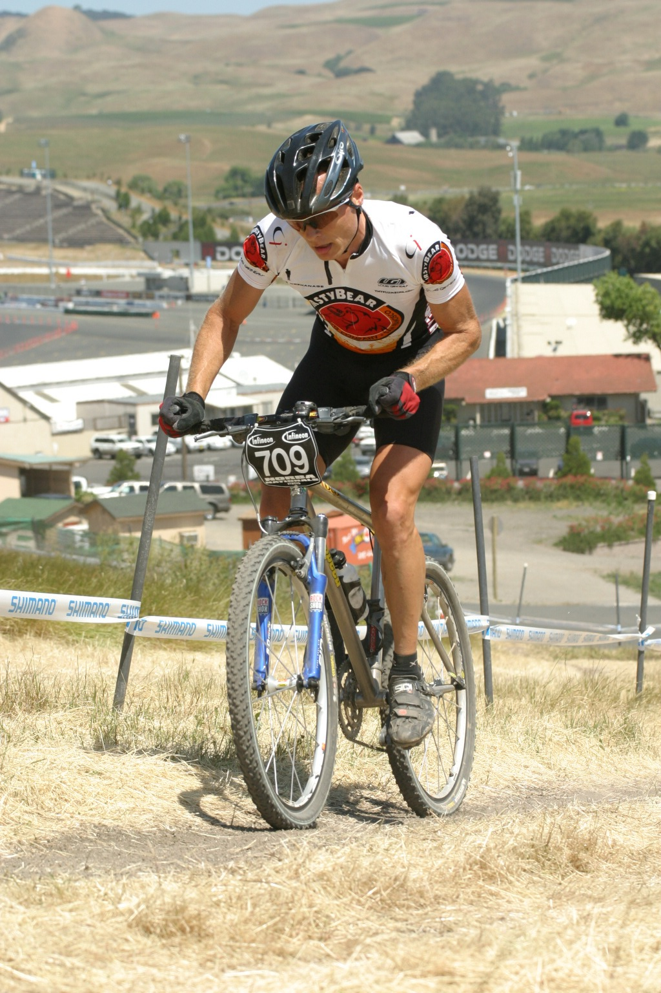


Andrew Holdsworth
Senior Director
Real World Performance
Server Technologies
Notes:
Talking about the limits of a machine and how many times it just comes down to ‘math’. We all think we are computer scientist – but not really. We are data processing people who happen to work with computers for the most part.

Slide 9
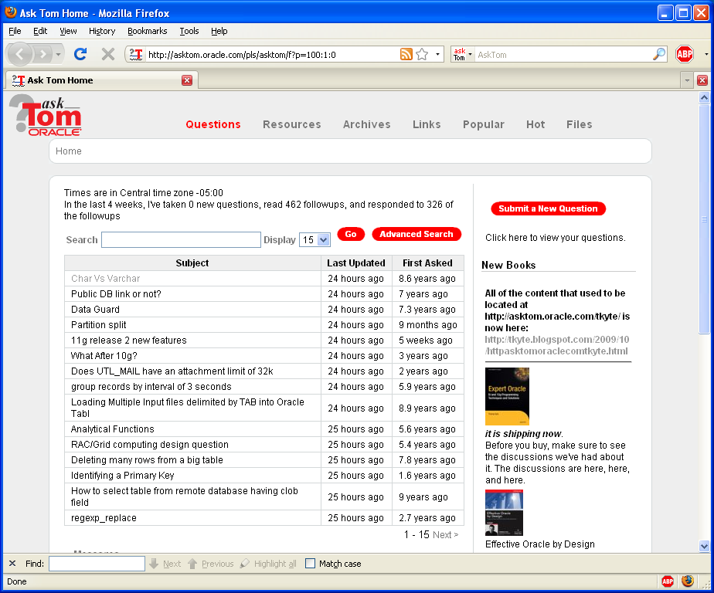



Tom Kyte
Been with Oracle since 1993
User of Oracle since 1987
The “Tom” behind AskTom in Oracle Magazine
  www.oracle.com/oramag
Expert Oracle Database Architecture
Effective Oracle by Design
Expert One on One Oracle
Beginning Oracle

Slide 10
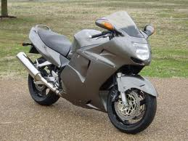
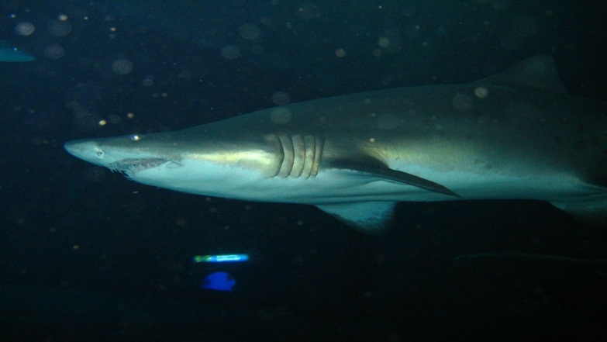





Graham Wood
Architect
Server Technologies
Notes:
Talking about the limits of a machine and how many times it just comes down to ‘math’. We all think we are computer scientist – but not really. We are data processing people who happen to work with computers for the most part.

Slide 11
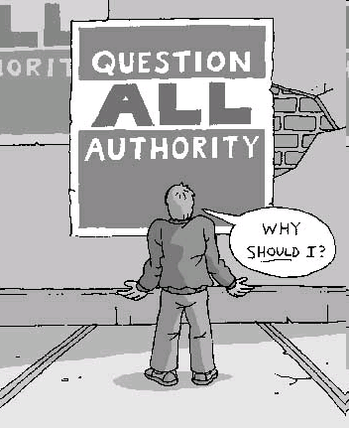
“Question Authority.”
Make the experts prove everything
Statements that should raise your eyebrows:
  It is my opinion...
  I claim...
  I think...
  I feel…
  I KNOW…
Everything can (and should) be proven
Things change, expect that
It only takes a single counter case
“It depends” or “Why” are the only answers you need
Notes:
I’d like to close up with a thought. There are lots of “experts” out there expousing “facts”. Many of the facts are really opinions or myths in disgiuse. I would encourage you to question them, make them prove things. It is something I do everyday on my site – i don’t just “say things”, I say something and then back it up. Sometimes – I find I have to change my initial answer before I publish it because the facts did not support my hypothesis. Everything that is true is provable – just ask for the proof. And remember – it only takes a single counter case to disprove something. I only need to show ONCE that having 10,000 extents does not materially affect performance – no matter how many times people say “but it must”.

Slide 12
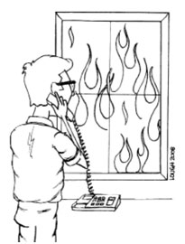
Part I: Response Time
To fill a shape with an image.
Use existing picture box, DO NOT delete and create new picture box.
Right click on the shape.
At the bottom of the submenu select
“Format Shape”
Select “Fill” at the top of the “Format Shape” dialog box.
Select “Picture or Texture fill” from the options.
And select “File” under the “Insert from” option.
Navigate to the file you want to use and
select “Insert”
On the “Format” tab, in the Size group, click on “Crop to Fill” in the Crop tool and drag the image bounding box to the desired size
DELETE THIS INSTRUCTION NOTE WHEN NOT IN USE

Slide 13
Today’s Theme:
Response Time
Response time defines your users (customers) experience
Response time is a measure of performance quality
Consistency of response time is an equally important measure of performance quality
If response time is not consistent, bad things happen !

Slide 14
Today’s Theme:
Response Time by Numbers
Multi hump indicating inconsistent response times
Frequency X 1,000,000
Single distinct spike of the majority of transactions
Long tail
Short tail
Response Time ms

Slide 15

OLTP Theory
A Good Reference
Notes:
The presenter should open with the preamble
For good OLTP performance any DB Request must satisfy the following
Immediate scheduling
Run optimally (eg coded perfectly) without being pre-empted or bumped from the CPU
When requesting systems services like locks, I/O etc they are granted immediately eg. No waiting
When the Request is finished it leaves and returns to the requester in the shortest period of time

Slide 16
Bad Performance #1
Observations
Users experiencing poor response time
Low overall system throughput
Wait events observed in the database
Culture of blame:
  Blame the database for all performance issues
  Development blames the DBA
  The DBA blames the SW/HW or system administrators

Slide 17
Bad Performance #1
Performance Data
Response Time > 3 seconds
Transaction rate at 3,000 TPS

Slide 18
Bad Performance #1
Application Server Performance Data
Majority of time spent in application logic
Application Server CPU at 95%

Slide 19
Bad Performance #1
Resolution
Response time ~ 2 ms, transaction rate ~ 20,000 TPS
Application server changes applied here

Slide 20
Bad Performance #1
Application Server Bottleneck
Data analysis shows:
  Small proportion of the actual response time is in the database
  Majority of response time spent in application logic
  CPU is overloaded on the application servers
  Potential root cause:
    Capacity planning mistake ?
    Application code change last week ?

Slide 21
Bad Performance #2
Observations
Users are experiencing erratic performance
  Good at times
  Unacceptable at others.
Database AWR reports do not indicate performance issues
Application server often time out or run out of connections when performance is poor

Slide 22
Bad Performance #2
Performance Data
Database slow down is magnified in application server
Erratic database performance

Slide 23

Bad Performance #2
Performance Data
Note smoothing effect of async logging.
Beware data integrity issues!
log file sync events have been replaced with log buffer space events

Slide 24
Bad Performance #2
Resolution
Performance is consistent as flash cache protects system from I/O surges
With uniform log file sync events, we now see a slight slow down of other DB I/O

Slide 25
Bad Performance #2
Data Analysis
Average response times for log writes mask outlier values of very high write times > 1 sec ( log file parallel write )
Investigation reveals surges in workloads on shared storage from unrelated workloads
The business requires full data integrity. Asynchronous logging is not an option due to potential data loss
There are three potential solutions:
  Eliminate background workloads
  Relocate log files to dedicated devices
  Use Exadata flash logging

Slide 26
Bad Performance #3
Observations
The current system performance is acceptable
New requirement: Capture transaction summary statistics and store data in a flattened “history” table for further analysis
Implementations of the INSERT statement causes a dramatic reduction in system performance
The accepted solution must scale, as the application will be deployed globally in the new year

Slide 27
Bad Performance #3
Performance Data
Transaction rate: 4,500 TPS
Response time: 13 ms
Dominant wait events: buffer busy waits and enq:TX–index contention

Slide 28
Bad Performance #3
Reverse Key Index
Transaction rate: 10,000 TPS Response time: 5 ms
Contention eliminated while the history table remains small. CPU increases with workload.

Slide 29
Bad Performance #3
Reverse Key Index
Transaction rate: 3,000 TPS
Response time: 30 ms
Contention shifts to I/O subsystem when the history table grows larger

Slide 30
Bad Performance #3
Hash Partition Index
Transaction rate: 10,000 TPS
Response time: 5 ms
Contention eliminated by hash partitioned history table index

Slide 31
Bad Performance #3
Add RAC node
Transaction rate: 13,000 TPS
Response time: 10 ms
RAC appears not to scale well with contention in cluster waits

Slide 32
Bad Performance #3
Composite Key Index
Transaction rate: 20,000 TPS
Response time: 5 ms
RAC configuration scales well with no contention or gc waits

Slide 33
Bad Performance #3
Data Analysis
INSERT statement results in index contention due to surrogate primary key generated by using a sequence
Solution 1: REVERSE KEY primary key index
  This proves unsatisfactory after the table has grown to a critical size
Solution 2: HASH PARTITION primary key index
  This proves unsatisfactory after moving to a RAC cluster
Solution 3: Code the sequence to ensure no index contention
  New sequence structure: instance# | session id | sequence
  Solution 3 demonstrates optimal scaling and response time characteristics

Slide 34
Bad Performance #3
Performance Testing Results

Slide 35
Today’s Theme:
Debugging by Numbers
Response time impacted by non database code
  Application server time
    Code problem
    Capacity planning
Response time impacted by platform
  Erratic I/O performance impacting LGWR
    Workload relocation
    Log file isolation
    Exadata Flash logging
Response time impacted by database internal contention
  Right growing index problem
    Reverse Key Index ( Good for small tables )
    Hash partitioned Index ( Good for large tables, poor with RAC )
    Non contentious primary key ( Good in all scenarios, application code change required )

Slide 36

Part II: OLTP Architecture
To fill a shape with an image.
Use existing picture box, DO NOT delete and create new picture box.
Right click on the shape.
At the bottom of the submenu select
“Format Shape”
Select “Fill” at the top of the “Format Shape” dialog box.
Select “Picture or Texture fill” from the options.
And select “File” under the “Insert from” option.
Navigate to the file you want to use and
select “Insert”
On the “Format” tab, in the Size group, click on “Crop to Fill” in the Crop tool and drag the image bounding box to the desired size
DELETE THIS INSTRUCTION NOTE WHEN NOT IN USE

Slide 37
Processes vs Cores
5
16000
14000
1 Proc/Core
12000
10 Proc/Core Avg
10000
50 Proc/Core Avg
8000
10 Proc/Core Max
6000
50 Proc/Core Max
4000
10 Proc/Core Min
2000
50 Proc/Core Min
0
4
8
12
16
20
24
28
32
Notes:
You can only do so much on a given machine. There are physical limits.
1 process per core = excellent scaling (ASSUMPTION: the process is scalable in the first place, more than one thing at a time can in fact be done)
N process’s per core = degrading scalability – the less our assumption of scalable processing is true – the wider the divergence. Compare “a program that computes prime numbers and prints them (very scalable – no shared resources)” and “a program that hard parses like mad – very cpu intensive like the prime number generator – but inherently non-scalable)

Slide 38
Database Performance Core Principles
To determine acceptable CPU utilization take a probabilistic approach to the subject.
  If a CPU is 50% busy the chance of getting scheduled is 1 in 2
  If a CPU is 66% busy the chance of getting scheduled is 1 in 3
  If a CPU is 80% busy the chance of getting scheduled is 1 in 5
  If a CPU is 90% busy the chance of getting scheduled is 1 in10
If the probabilities are used as indicator of the predictability of user response time, then the variance in user response time becomes noticeable at about 60-65%
This has been observed in production and laboratory conditions for many years.

Slide 39
Today’s OLTP Architectural Challenges
Connection Pools
This primary reason for escalation of OLTP systems into the Real-World Performance Group is poor connection pooling strategies.
Symptoms of a poor connection strategy:
  A high number of connections to the database ( 1,000s )
  A dynamic connection pool with a large number of logon/off to the database ( > 1/Sec )
  Periods of acceptable performance and then unexplainable/undebuggable periods of poor performance/availability
  The inability to determine what is happening in real time

Slide 40
Connection Pools#1
Performance Data
The workload is increased by doubling the load. System appears scalable up to 60% CPU on the DB server.

Slide 41
Connection Pools#1
Performance Data
A checkpoint is initiated, creating a CPU spike that results in unpredictable response time

Slide 42
Connection Pools#1
Performance Data
A slight increase to the workload results in a disproportionate CPU increase and response time degrades. System monitoring tools become unreliable

Slide 43
Connection Pools#1
Performance Data
Reducing the connection pool by 50% results in more application server queuing and less DB processes in a wait state. No observable improvement in response time or transaction rate (value or consistency)

Slide 44
Connection Pools#1
Performance Data
Connection pool reduced to 96. Note improvement in response time and transaction rate.
CPU utilization is reduced.

Slide 45
Today’s OLTP Architectural Challenges
Staying in Control
In order to stay in control of an OLTP system, the DBA must be able to:
  Query the system
  Extract trace files
  Debug issues
Without these tools, when a race condition occurs, it becomes impossible to determine the root cause of any problem or to prevent the problem from reoccurring
Resource Management: Learning how to manage and control resources
    RM is not a turbo, it is a gatekeeper
    RM will slow/stop some processes so that other process can run efficiently

Slide 46
Control#1
Performance Data
By reducing the CPU_COUNT in the resource manager, the database can be throttled back. Note the increase in response time and wait event resmgr: cpu quantum

Slide 47

Part III: How to Develop High Performance OLTP Applications
To fill a shape with an image.
Use existing picture box, DO NOT delete and create new picture box.
Right click on the shape.
At the bottom of the submenu select
“Format Shape”
Select “Fill” at the top of the “Format Shape” dialog box.
Select “Picture or Texture fill” from the options.
And select “File” under the “Insert from” option.
Navigate to the file you want to use and
select “Insert”
On the “Format” tab, in the Size group, click on “Crop to Fill” in the Crop tool and drag the image bounding box to the desired size
DELETE THIS INSTRUCTION NOTE WHEN NOT IN USE

Slide 48
Today’s Theme:
How to Develop High Performance Applications
The impact of how application code impacts system performance should never be underestimated
  This fact has been known for a long time
  It has been ignored for almost as long
Educating of developers on the correct way to write code is a continuous, repeating activity
  New developers graduate every year !
Poor coding techniques combined with classic programmer bugs can render investments in the system worthless

Slide 49
Bad Performance #1
Observations
A problematic application has never met performance objectives
Response time and throughput are poor
Everybody blames the database
  DBA sees no real issues
  DBA suggests adding more connections to drive up workload
The system must be able to execute a minimum of 24,000 transactions per second to survive Thanksgiving and Black Friday

Slide 50
Bad Performance #1
Performance Data
Transaction rate: 300 TPS
Response time: 150 ms
CPU profile shows equal system and user utilization

Slide 51
Bad Performance #1
Performance Data
Transaction rate: 3,000 TPS
Response time: 20 ms
Hard parsing and shared pool contention. Do we have a security issue with literals?

Slide 52
sqlplus
ops$tkyte%ORA11GR2> create or replace procedure inj( p_date in date )
2 as
3 l_rec all_users%rowtype;
4 c sys_refcursor;
5 l_query long;
6 begin
7 l_query := '
8 select *
9 from all_users
10 where created = ''' ||p_date ||'''';
11
12 dbms_output.put_line( l_query );
13 open c for l_query;
14
15 for i in 1 .. 5
16 loop
17 fetch c into l_rec;
18 exit when c%notfound;
19 dbms_output.put_line( l_rec.username || '.....' );
20 end loop;
21 close c;
22 end;
23 /
Procedure created.

Slide 53
sqlplus
ops$tkyte%ORA11GR2> exec inj( sysdate )
select *
from all_users
where created = '25-OCT-10'
PL/SQL procedure successfully completed.

Slide 54
sqlplus
ops$tkyte%ORA11GR2> alter session set
2 nls_date_format = 'dd-mon-yyyy"'' or ''a'' = ''a"';
Session altered.

Slide 55
sqlplus
ops$tkyte%ORA11GR2> exec inj( sysdate )
select *
from all_users
where created = '25-oct-2010' or 'a' = 'a'
C.....
B.....
A.....
FB_DEMO.....
BIG_TABLE.....
PL/SQL procedure successfully completed.

Slide 56
Bad Performance #1
Performance Data
Transaction rate: 25,000 TPS
Response time: 1 ms
No contention and no parsing. CPU is well utilized.

Slide 57
Bad Performance #1
Performance Data
Transaction rate: 34,000 TPS Response time: 1 ms
No contention, no parsing, CPU well utilized due higher transaction rate

Slide 58
Bad Performance #1
Incorrect Use of Sessions and Cursors

Slide 59
Bad Performance #2
Observations
Both the development and DBA teams are confused.
  Performance in the development and test systems is as anticipated
  Performance in production is nowhere near level of test system
  DBAs see shared pool contention but have coded diligently to ensure no parsing
  Development has confirmed the same code is running in both test and production

Slide 60
Bad Performance #2
Performance Data
Performance significantly reduced on production as compared to development and test
Contention in the shared pool

Slide 61
Bad Performance #2
Invalid SQL
A page refresh trigger attempts to set a non existent/deprecated init.ora parameter in production only
  This results in a failed parse
All users are frequently attempting parse the same SQL, sessions serialize within the shared pool
How to find invalid SQL:
  Look of parse count failures from v$sysstat
  Check session traces for error messages
  Look for SQL*Net Break/Reset
Notes:
Duplicate

Slide 62
Today’s Theme:
How to Develop High Performance Applications
Poor Programming Techniques
  Invalid SQL
    Can serialize a system
    Oracle exception handling
    Hard to detect
      parse count failures
      check session trace
      Look for SQL*Net Break/Reset

Slide 63
Bad Performance #3
Observations
Intermittent error: “ORA-01000: Maximum number of cursors exceeded”. Application server fails and must be restarted
The DBA has suggested that the init.ora parameter open_cursors be reset to 30,000 to make the problem “go away for a while”.
Symptoms of cursor leaking

Slide 64
Bad Performance #3
Performance Data
Error message:
ORA-01000 Maximum open cursors exceeded
“SQL*Net break/reset to client”

Slide 65
Bad Performance #3
OEM: Session Details
SQL*Net break/reset to client

Slide 66
Bad Performance #3
Cursor Data
Cursor list with Count > 1 implies “leaked” cursors

Slide 67
Bad Performance #4
Observations
After a period of time, the system performance begins to decline and then degrades rapidly
After rapid degradation, the application servers time out and the system is unavailable
The DBA claims the database is not the problem and simply needs more connections
  The init.ora parameter processes is increased to 20,000

Slide 68
Bad Performance #4
Performance Data
Load diminishes to zero

Slide 69
Bad Performance #4
Session Leaking
Due to coding errors on exception handling, the application leaks connections in the connection pool making them programmatically impossible to use
This reduces the effective size of the connection pool
The remaining connection are unable to keep up with the incoming workload
The rate of connection leakage is accelerated until there are no useable connections left in the pool
Potential indicators of session leaking:
  Frequent application server resets
  init.ora parameters process and sessions set very high
  Configuration of large and dynamic connection pools
  Large number of idle connections connected to the database
  Free memory on database server continually reduced
  Presence of idle connection kill scripts or middleware configured to kill idle sessions

Slide 70
Bad Performance #5
Observations
Without warning, the database appears to hang and the application servers time out simultaneously
The DBA sees that all connections are waiting on a single lock held by a process that has not been active for a while.
Each time the problem occurs, the DBA responds by running a script to kill sessions held by long time lock holders and allowing the system to restart.

Slide 71
Bad Performance #5
Performance Data
Leaked lock holder causes entire system to stall

Slide 72
Bad Performance #5
OEM Blocking Tree
Block tree reveals lock holder which can be killed

Slide 73
Bad Performance #5
Performance Data
enq: TX – row lock contention

Slide 74
Bad Performance #5
Performance Data
System returns to normal when lock is released. There could have been logical data corruption and it may happen again

Slide 75
Bad Performance #5
Lock Leaking
Lock leaking is usually a side effect of session leaking and the exception handling code failing to execute a commit or rollback in the exception handling process.
A leaked session may be programmatically lost to the connection while holding locks and uncommitted changes to the database.
Programming error impact:
  Potential system hangs: all connections queue up for the held lock
  Potential database logical corruptions: end users may have thought transactions were committed when in fact they have not been
  If sessions return to the connection pool but still have uncommitted changes, it is not deterministic, if and/or when the changes are committed or rolled back. This is a serious data integrity issue.

Slide 76
Today’s Theme:
How to Develop High Performance Applications
Poor Application Coding
  Bad Cursor management
    Frequent logons
    Hard parsing vs. soft parsing vs. parsing once
  SQL has been designed to fail, or may fail on upgrade
Developer Bugs
  Incorrect/untested exception handling
    Cursor, session and lock leaking
      High values for init.ora ( open_cursors, processes, sessions )
      Idle process and lock holder kill scripts
      Oversized connection pools of largely idle processes

Slide 77

Part IV: SQL
To fill a shape with an image.
Use existing picture box, DO NOT delete and create new picture box.
Right click on the shape.
At the bottom of the submenu select
“Format Shape”
Select “Fill” at the top of the “Format Shape” dialog box.
Select “Picture or Texture fill” from the options.
And select “File” under the “Insert from” option.
Navigate to the file you want to use and
select “Insert”
On the “Format” tab, in the Size group, click on “Crop to Fill” in the Crop tool and drag the image bounding box to the desired size
DELETE THIS INSTRUCTION NOTE WHEN NOT IN USE

Slide 78
Gathering Statistics
Strategy For New Databases
Create tables
Optionally Run (or explain) queries on empty tables
  Prime / Seed the optimizer
Enable incremental statistics
  For large partitioned tables
Load data
Gather statistics
  Use the defaults
Create indexes (if required!)
Notes:
78
You may need to talk for 10 mins on this slide while we run the stats process.
Things to elaborate on:
Seeding the optimiser, col_usage, histograms
New incremental stats in 11g; the problems of maintaining global and partition level stats; why you cannot simply “roll up” partition stats to the global level

Slide 79
Gathering Statistics
Incremental Statistics
One of the biggest problems with large tables is keeping the schema statistics up to date and accurate
This is particularly challenging in a Data Warehouse where tables continue to grow and so the statistics gathering time and resources grow proportionately
To address this problem, 11.1 introduced the concept of incremental statistics for partitioned objects
This means that statistics are gathered for recently modified partitions

Slide 80
Gathering Statistics
The Concept of Synopses
It is not possible to simply add partition statistics together to create an up to date set of global statistics
This is because the Number of Distinct Values (NDV) for a partition may include values common to multiple partitions.
To resolve this problem, compressed representations of the distinct values of each column are created in a structure in the SYSAUX tablespace known as a synopsis

Slide 81
Gathering Statistics
Synopsis Example
Object | Column Values | NDV
Partition #1 | 1,1,3,4,5 | 4
Partition #2 | 1,2,3,4,5 | 5
NDV by addition | WRONG | 9
NDV by Synopsis | CORRECT | 5

Slide 82
Wrong Plan => Wrong Cardinality
ops$tkyte%ORA11GR2> create table t
2 as select decode( mod(rownum,2), 0, 'N', 'Y' ) flag1,
3 decode( mod(rownum,2), 0, 'Y', 'N' ) flag2, a.*
4 from all_objects a
5 /
Table created.
ops$tkyte%ORA11GR2> create index t_idx on t(flag1,flag2);
Index created.
ops$tkyte%ORA11GR2> begin
2 dbms_stats.gather_table_stats
3 ( user, 'T',
4 method_opt=>'for all indexed columns size 254' );
5 end;
6 /
PL/SQL procedure successfully completed.
Notes:
82

Slide 83
Wrong Plan => Wrong Cardinality
ops$tkyte%ORA11GR2> select 'select * from t', num_rows
2 from user_tables where table_name = 'T'
3 union all
4 select 'select * from t where flag1 = "N"', num_rows/2
5 from user_tables where table_name = 'T'
6 union all
7 select 'select * from t where flag2 = "N"', num_rows/2
8 from user_tables where table_name = 'T'
9 union all
10 select 'select * from t where flag1 = "N" and flag2 = "N"', num_rows/2/2
11 from user_tables where table_name = 'T';
'SELECT*FROMT' NUM_ROWS
------------------------------------------------- ----------
select * from t 72726
select * from t where flag1 = "N" 36363
select * from t where flag2 = "N" 36363
select * from t where flag1 = "N" and flag2 = "N" 18181.5
Notes:
83

Slide 84
Wrong Plan => Wrong Cardinality
ops$tkyte%ORA11GR2> set autotrace traceonly explain
ops$tkyte%ORA11GR2> select * from t where flag1='N';
Execution Plan
----------------------------------------------------------
Plan hash value: 1601196873
--------------------------------------------------------------------------
| Id | Operation | Name | Rows | Bytes | Cost (%CPU)| Time |
--------------------------------------------------------------------------
| 0 | SELECT STATEMENT | | 36499 | 3635K| 301 (1)| 00:00:04 |
|* 1 | TABLE ACCESS FULL| T | 36499 | 3635K| 301 (1)| 00:00:04 |
--------------------------------------------------------------------------
Predicate Information (identified by operation id):
---------------------------------------------------
1 - filter("FLAG1"='N')
Notes:
84

Slide 85
Wrong Plan => Wrong Cardinality
ops$tkyte%ORA11GR2> select * from t where flag2='N';
Execution Plan
----------------------------------------------------------
Plan hash value: 1601196873
--------------------------------------------------------------------------
| Id | Operation | Name | Rows | Bytes | Cost (%CPU)| Time |
--------------------------------------------------------------------------
| 0 | SELECT STATEMENT | | 36227 | 3608K| 301 (1)| 00:00:04 |
|* 1 | TABLE ACCESS FULL| T | 36227 | 3608K| 301 (1)| 00:00:04 |
--------------------------------------------------------------------------
Predicate Information (identified by operation id):
---------------------------------------------------
1 - filter("FLAG2"='N')
Notes:
85

Slide 86
Wrong Plan => Wrong Cardinality
ops$tkyte%ORA11GR2> select * from t where flag1='N' and flag2='N';
Execution Plan
----------------------------------------------------------
Plan hash value: 1601196873
--------------------------------------------------------------------------
| Id | Operation | Name | Rows | Bytes | Cost (%CPU)| Time |
--------------------------------------------------------------------------
| 0 | SELECT STATEMENT | | 18181 | 1810K| 301 (1)| 00:00:04 |
|* 1 | TABLE ACCESS FULL| T | 18181 | 1810K| 301 (1)| 00:00:04 |
--------------------------------------------------------------------------
Predicate Information (identified by operation id):
---------------------------------------------------
1 - filter("FLAG2"='N' AND "FLAG1"='N')
Notes:
86

Slide 87
Wrong Plan => Wrong Cardinality
ops$tkyte%ORA11GR2> select /*+ gather_plan_statistics */ *
2 from t where flag1='N' and flag2='N';
no rows selected
Notes:
87

Slide 88
Wrong Plan => Wrong Cardinality
ops$tkyte%ORA11GR2> select * from table(dbms_xplan.display_cursor(null,null,'ALLSTATS LAST'));
PLAN_TABLE_OUTPUT
------------------------------------------------------------------------------------
| Id | Operation | Name | Starts | E-Rows | A-Rows | A-Time | Buffers |
------------------------------------------------------------------------------------
| 0 | SELECT STATEMENT | | 1 | | 0 |00:00:00.02 | 1080 |
|* 1 | TABLE ACCESS FULL| T | 1 | 18181 | 0 |00:00:00.02 | 1080 |
------------------------------------------------------------------------------------
Predicate Information (identified by operation id):
---------------------------------------------------
1 - filter(("FLAG2"='N' AND "FLAG1"='N'))
19 rows selected.
Notes:
88

Slide 89
Wrong Plan => Wrong Cardinality
ops$tkyte%ORA11GR2> select /*+ dynamic_sampling(t 3) */ * from t where flag1='N' and flag2='N';
Execution Plan
----------------------------------------------------------
Plan hash value: 470836197
-------------------------------------------------------------------------------------
| Id | Operation | Name | Rows | Bytes | Cost (%CPU)| Time |
-------------------------------------------------------------------------------------
| 0 | SELECT STATEMENT | | 6 | 612 | 2 (0)| 00:00:01 |
| 1 | TABLE ACCESS BY INDEX ROWID| T | 6 | 612 | 2 (0)| 00:00:01 |
|* 2 | INDEX RANGE SCAN | T_IDX | 6 | | 1 (0)| 00:00:01 |
-------------------------------------------------------------------------------------
Predicate Information (identified by operation id):
---------------------------------------------------
2 - access("FLAG1"='N' AND "FLAG2"='N')
Note
-----
- dynamic sampling used for this statement (level=2)
Notes:
89

Slide 90
SQL Statements
It cannot be emphasized enough SQL statements have more impact than any other performance variable.
  Well written SQL statements that define the data to be queried, updated etc is always the first problem. This is clearly the responsibility of the developer or tool vendor.
  Optimizing the SQL efficiently is a mixture of the DBAs and the Database’s responsibility
    DBA need to maintain good schema statistics to enable the database make good cardinality estimates
    The Database needs choose efficient plans based upon good schema statistics

Slide 91
SQL Design and Implementation
Basic Checks for SQL statements and schemas
  Check for parse errors
  Validate correct join conditions specified
  Caution with implicit data type conversions
  Caution with wildcards and functions
  Caution on fuzzy joins
Lean to Use the Correct Tools
  SQL Monitor

Slide 92
SQL Optimization
This is probably where you should be spending the majority of your time.
The time should be spent determining/validating the appropriate execution plan
    Correct index/access method
    Correct partition pruning strategy
    Correct join order and type
    Correct parallelization level
Beware of binary and reactionary behavior e.g
  We got burnt on hash joins so we disable them
  We never use histograms as they ruin our plans
Much of this process is matching appropriate database technology to appropriate database challenges
  This process is not learnt from a book!

Slide 93
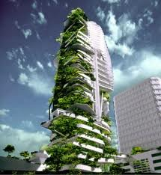
Part V: Data Warehouse, BI Big Data Sets Architecture
To fill a shape with an image.
Use existing picture box, DO NOT delete and create new picture box.
Right click on the shape.
At the bottom of the submenu select
“Format Shape”
Select “Fill” at the top of the “Format Shape” dialog box.
Select “Picture or Texture fill” from the options.
And select “File” under the “Insert from” option.
Navigate to the file you want to use and
select “Insert”
On the “Format” tab, in the Size group, click on “Crop to Fill” in the Crop tool and drag the image bounding box to the desired size
DELETE THIS INSTRUCTION NOTE WHEN NOT IN USE

Slide 94
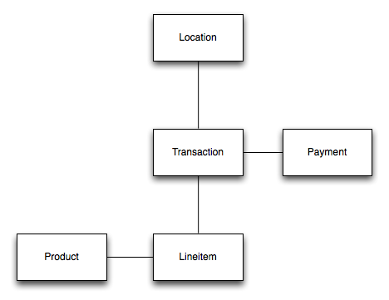
A Big Data Set
Data Volumes

Slide 95
A Big Data Set
Data Volumes
TABLE | SIZE OF SOURCE DATA | NUMBER OF RECORDS
Transactions | 52 GByte | 461M
Payments | 54 GByte | 461M
Line Items | 936 Gbyte | 6945M
Total | 1042 GByte | 7867M

Slide 96
A Big Data Set
Data Volumes
TABLE | SIZE OF TABLE | COMPRESSION RATIO
Transactions | 5 GByte | 7.00 : 1
Payments | 5 GByte | 7.60 : 1
Line Items | 54 Gbyte | 12.85 : 1
Total | 64 GByte | 11.98 : 1

Slide 97
Today’s DW Architectural Challenges
Loading Techniques
Direct path loading
Use of external tables
Compression on source and loaded data
Partition exchange operations
Incremental statistics

Slide 98
Verify Datal#1
Performance Data
Scans on data show:
Scans from disk only
Scans populating flash cache
Scan from combined flash and disk

Slide 99
Incremental Data #1
Performance Data
Daily load running on a single node specified by a service: 250,000,000+ rows loaded in 89 seconds

Slide 100
Today’s DW Architectural Challenges
Set vs. Row by Row Programming
When dealing with large data sets, learning to work/program the data as set rather than a single row becomes essential
Consider in your ETL process would you prefer to:
  Load 250,000,000 rows and then validate 250,000,000 rows
  Load 1 row, validate 1 row and re-execute that code 250,000,000 times
Set based techniques allow bulk processing algorithms and parallel techniques to be fully exploited.
This becomes critical when the data expansion becomes massive

Slide 101
The Maths of Big Data
Index Driven Query retrieving 1,000,000 rows
  Assume the Index is cache and the data is not.
    1,000,000 random IOPS @ 5ms per I/O
    This required 5000 Seconds to Execute
    This is why queries may take over an hour
  How much data could you scan in 5000 Seconds with a fully sized I/O system able to scan 28 Gig/Sec ?
Clearly For Oracle Data Warehouses the game is changing
  New Design Techniques
  Time to Re-Train the DBAs

Slide 102
Mythology – why isn’t it using my index
So, joe (or josephine) sql coder needs to run the following query:
select t1.object_name, t2.object_name
from t t1, t t2
where t1.object_id = t2.object_id
and t1.owner = 'WMSYS’
Rows Row Source Operation
------- ---------------------------------------------------
528384 HASH JOIN
8256 TABLE ACCESS FULL T
1833856 TABLE ACCESS FULL T
suppose they ran it or explain planned it -- and saw that plan. "Stupid stupid CBO" they say -- "I have indexes, why won't it use them. We all know that indexes mean fast=true! Ok, let me use the faithful RBO and see what happens"

Slide 103
Mythology – why isn’t it using my index
select /*+ RULE */ t1.object_name, t2.object_name
from t t1, t t2
where t1.object_id = t2.object_id
and t1.owner = 'WMSYS’
Execution Plan
----------------------------------------------------------
0 SELECT STATEMENT Optimizer=HINT: RULE
1 0 TABLE ACCESS (BY INDEX ROWID) OF 'T'
2 1 NESTED LOOPS
3 2 TABLE ACCESS (FULL) OF 'T'
4 2 INDEX (RANGE SCAN) OF 'T_IDX' (NON-UNIQUE)
See, now that’s what I’m talking about – indexes are good…
Or are they?

Slide 104
Mythology – why isn’t it using my index
call count cpu elapsed disk query current rows
------- ------ -------- ---------- ---------- ---------- ---------- ----------
Parse 1 0.00 0.00 0 0 0 0
Execute 1 0.00 0.00 0 0 0 0
Fetch 35227 5.63 9.32 23380 59350 0 528384
------- ------ -------- ---------- ---------- ---------- ---------- ----------
total 35229 5.63 9.33 23380 59350 0 528384
Misses in library cache during parse: 1
Optimizer goal: CHOOSE
Parsing user id: 80
Rows Row Source Operation
------- ---------------------------------------------------
528384 HASH JOIN
8256 TABLE ACCESS FULL T
1833856 TABLE ACCESS FULL T

Slide 105
Mythology – why isn’t it using my index
call count cpu elapsed disk query current rows
------- ------ -------- ---------- ---------- ---------- ---------- ----------
Parse 1 0.00 0.00 0 0 0 0
Execute 1 0.00 0.00 0 0 0 0
Fetch 35227 912.07 3440.70 1154555 121367981 0 528384
------- ------ -------- ---------- ---------- ---------- ---------- ----------
total 35229 912.07 3440.70 1154555 121367981 0 528384
Misses in library cache during parse: 0
Optimizer goal: RULE
Parsing user id: 80
Execution Plan
----------------------------------------------------------
0 SELECT STATEMENT Optimizer=HINT: RULE
1 0 TABLE ACCESS (BY INDEX ROWID) OF 'T'
2 1 NESTED LOOPS
3 2 TABLE ACCESS (FULL) OF 'T'
4 2 INDEX (RANGE SCAN) OF 'T_IDX' (NON-UNIQUE)

Slide 106
Mythology – why isn’t it using my index
1 SELECT phy.value,
2 cur.value,
3 con.value,
4 1-((phy.value)/((cur.value)+(con.value))) "Cache hit ratio"
5 FROM v$sysstat cur, v$sysstat con, v$sysstat phy
6 WHERE cur.name='db block gets'
7 AND con.name='consistent gets'
8* AND phy.name='physical reads'
VALUE VALUE VALUE Cache hit ratio
-------- ---------- ---------- ---------------
1277377 58486 121661490 .989505609
98.9% cache hit, not bad eh?

Slide 107
Validate Data#1
Performance Data
A series of set based queries validate all rows in staging table in 26 Secs

Slide 108
Modifying Big Data
DML Challenges
When modifying a large amount of data, the techniques adopted for OLTP become inefficient.
  Redo and undo generation becomes massive
  Use of the buffer cache itself becomes a bottleneck
  Compression impacts performance and the data may not be optimally compressed afterwards
  It is hard to optimize for bulk I/O with single block updates
Do not use UPDATE, DELETE, MERGE and INSERT!
Recreating the data to be preserved is a more appropriate strategy

Slide 109
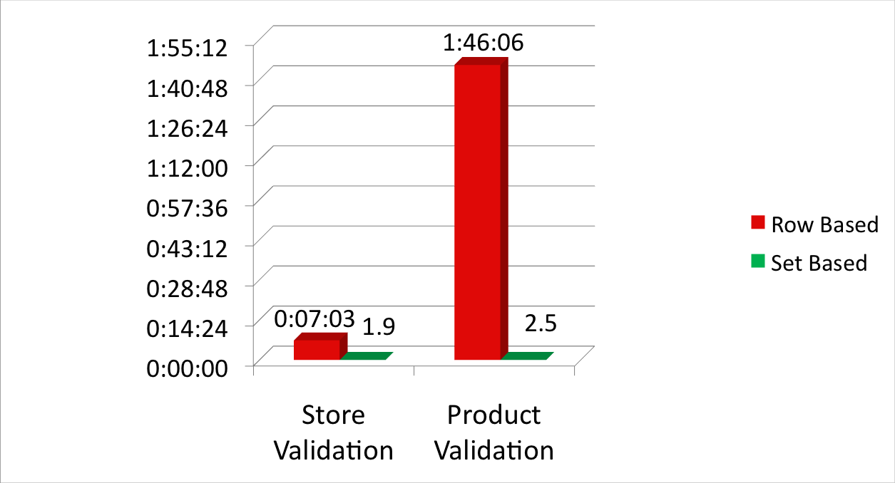
Big Data Techniques
Set based processing vs. row by row
Time
H:MI:SS
Notes:
As a proof point, we re-wrote the SQL base validation as a PL/SQL script. This was to mimic the kind of row-by-row processing that we often see in the so called “transformation tools”. So the store validation script, which runs in 1.9s takes over 7 minutes using row-by-row processing. We even built an index to “tune” the process. The product validation script in SQL takes 2.5s. Using row-by-row processing, it took over 1hour, 45 mins.

Slide 110
Validation and Transformation
For the two validation processes we can now make these claims
  Store Validation - Over 200 times faster
  Product Validation - Over 2500 times faster
Same Hardware!
  This is a case of using the wrong methodology
Notes:
It’s not uncommon for vendors to claim outrageous performance numbers compared with an existing system. However, these numbers are not because of better hardware or technology, but rather because of an application of the right technology to address the problem.

Slide 111
Transform Data#1
Performance Data
A series of INSERT INTO SELECT statements modify stage data by business rules in 29 seconds

Slide 112
Incremental Statistics#1
Performance Data
Gather incremental statistics: 20 seconds
Gather full table statistics: 190 seconds

Slide 113
Today’s DW Architectural Challenges
Daily Load Summary
Loading Operation for 250,000,000 Daily Rows | Elapsed Time (Seconds)
Daily Load | 89
Validate | 26
Transform | 29
Exchange | 1
Incremental Statistics | 20
Total Elapsed Time | 165 seconds ( 2 mins, 45 secs )

Slide 114
Today’s DW Architectural Challenges
Controlling the Workload
In order to control the workload in a parallel query environment, it is important to specify a policy for execution of queries.
The key items to learn and understand are:
  Specification/calculation of Degree of Parallelism (DOP)
  Query queuing semantics

Slide 115
Multiuser Query Workload#1
Performance Data
12 queries executed using default PARALLEL_ADAPTIVE_MULTI_USER

Slide 116
Multiuser Query Workload#1
Performance Data
12 queries execute with reduced DOP. Note uniform response time and full system utilization

Slide 117
Multiuser Query Workload#1
Performance Data
Queued workload fully utilizes system and remains stable by executing only 4 Queries. Over all system throughput is increased

Slide 118
Today’s Theme:
Learning to Critique Your Existing Architecture
Today’s reality
  There are very few new systems
    There are many applications that were written a long time ago
    There is a huge amount of motivation to run the old code as this is perceived as the lower cost and risk averse route
  Workloads, data set sizes and availability requirements continue to increase
    At some point, you can no longer use Moore’s law as a mechanism to maintain performance
  You may conclude you have reached the limitation of the application architecture. Failing to re-architect is now the high risk option

Slide 119
Today’s Theme:
Learning to Critique Your Existing Architecture
Technical challenges
  Correctly assessing the flaws in the architecture
  Proposing the correct solutions
Human/Political/Financial challenges
  When critiquing the current architecture, who do you threaten ?
    Your boss, your boss’s boss, your peers ?
    The vendor and consultancy community ?
    Will there ever be the resources to finance structural changes ?
    Will the changes pay for themselves? Or are they needed for survival ?

Slide 120
Today’s Theme:
Learning to Critique Your Existing Architecture
Identification of software or architectural limitations
  Performance requirements and data set size projections are order of magnitude increases
    10,000 to 100,000 transactions/seconds
    Terabytes to petabytes
    Response time improvement from hours to minutes/seconds
  Symptoms of an inadequate architecture
    Missed batch windows
    Poor response time and availability
    HW fully but inefficiently utilized, or an application unable to exploit HW

Slide 121
Ad Hoc Query SQL
with qbuy as
( select rt.TRX_NBR
from DWR_ORG_BSNS_UNIT obu, DWB_RTL_TRX rt, DWB_RTL_SLS_RETRN_LINE_ITEM rsrli, DWR_SKU_ITEM sku
where obu.ORG_BSNS_UNIT_KEY = rt.BSNS_UNIT_KEY
and rt.TRX_NBR = rsrli.TRX_NBR
and rt.DAY_KEY = rsrli.DAY_KEY
and rsrli.SKU_ITEM_KEY = sku.SKU_ITEM_KEY
and rt.DAY_KEY between 20090501 and 20090507
and obu.STATE in 'CA’
and sku.SKU_ITEM_DESC = 'Bananas'),
qall as
( select rt.TRX_NBR
from DWR_ORG_BSNS_UNIT obu, DWB_RTL_TRX rt
where obu.ORG_BSNS_UNIT_KEY = rt.BSNS_UNIT_KEY
and rt.DAY_KEY between 20090501 and 20090507
and obu.STATE in 'CA')
select sku.SKU_ITEM_DESC,q.SCANS
from
( select SKU_ITEM_KEY,count(*) as SCANS,rank() over (order by count(*) desc) as POP
from qall,qbuy, DWB_RTL_SLS_RETRN_LINE_ITEM rsrli
where qall.TRX_NBR = qbuy.TRX_NBR(+)
and qbuy.TRX_NBR IS NULL
and rsrli.TRX_NBR = qall.TRX_NBR
and rsrli.DAY_KEY between 20090501 and 20090507
group by SKU_ITEM_KEY) q, DWR_SKU_ITEM sku
where q.SKU_ITEM_KEY = sku.SKU_ITEM_KEY
order by q.POP asc;
4 Table join to select all transactions buying Bananas in California in the first week of May
2 Table join to select all transactions in California in the first week of May
Join the results sets in an outer join to find the exclusions, then rank,group and sort the results

Slide 122
Today’s DW Architectural Challenges
Controlling the Workload Summary
Resource Management Method | Average Response Time | Min | Max | Standard Deviation
Default PARALLEL_ADAPTIVE_MULTI_USER | 78.58 | 9.00 | 141.00 | 54.25
Reduced DOP | 24.33 | 22.00 | 26.00 | 1.37
Queued | 15.75 | 9.00 | 26.00 | 6.03

Slide 123
Critiquing your Architecture Summary
Key Indicators of a Problematic Architecture
OLTP
  Dynamic and uncontrolled database connections
  No governance to prevent race or runaway conditions
DW
  Use of serial processing
  Row by row techniques
  DML on large data sets
  No query queuing facilities to prevent overload

Slide 124

Evolution of Performance on Oracle Exadata Systems
Parallel Set based processing
CPU Upgrade from latest generation Intel Processors
I/O Balanced, Minimized, Optimized by Capacity Planning, Compression, Caching and Offload
Exploitation of parallel query techniques
DML re-written as CTAS or IAS
1000x
500x
5x
100x
50x
10x

