Slide 1
Supplied by Revera in partnership with Eagle Technologies
SPARC as a Service
VMs Under Your Command
Presented By:
Stephen Ponsford: Revera Limited
Stephen Metcalfe: Eagle Technologies Limited

Slide 2
Introductions
Introductions
Revera’s service provider credentials
Service overview
Technical briefing
Q&A session
How to find out more?

Slide 3
Introductions
Stephen Ponsford;
Revera, Service Design Lead SPARCaaS
Stephen Metcalfe;
Eagle Technologies, Solutions Architect

Slide 4
High Integrity Computing Infrastructure
Topics
Current and Future Data Centres
Multi Sourcing Strategy
Commitment to Innovation

Slide 5
High Integrity Computing Infrastructure
5 Data Centres Nationwide; Auckland, Christchurch, Hamilton, Tawa and Trentham Wellington,
2 Data Centres for Cross Government; Tier 3 in Trentham Wellington and Tier 2+ in Albany, Auckland
Expansion plans to build new Tier 3 Data Centre in Auckland

Slide 6
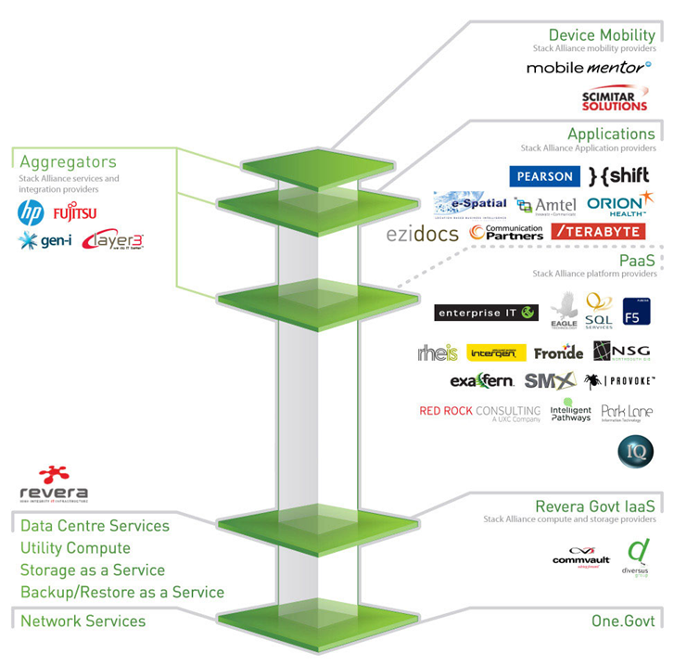
High Integrity Computing Infrastructure
Multi Sourcing – “Sticking to our Knitting”
Leveraging Revera’s Stack Alliance
Specialist suppliers doing specialist tasks
www.stackalliance.co.nz/partners

Slide 7
High Integrity Computing Infrastructure
Service Design Group established to focus innovation efforts
Dedicated position of Innovation programme manager
Up to version 5 of the service catalogue in 18 mths.
All Revera staff have the opportunity to submit ideas to service design group
Clients are our biggest driver of innovation

Slide 8
Service Overview
Industry leading partnership with Eagle Technologies
T4 Architecture in a multi-tenanted government or commercial configuration
Highly available management cluster at dual sites
Two offerings focussing on flexibility and performance
Additional client level management options
Complemented by additional Revera IaaS services including Storage and Backup

Slide 9
Service Goals
Provide clients with SPARC computing infrastructure offering the latest architecture
Client choice on how to support above hypervisor functions, VMs, LDOMs and Zones
Ability for clients to scale up and down on SPARC compute requirements
Architect a secure multi tenanted environment with SLAs for platform uptime

Slide 10
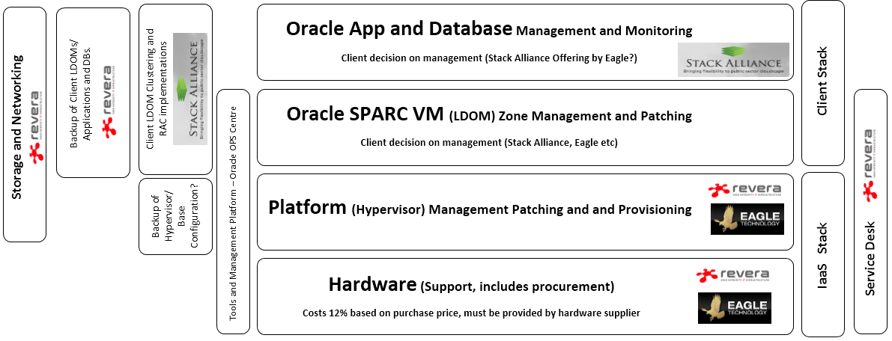
Service Diagram

Slide 11
Service Availability
Government SPARC as a Service
Available now in our Trentham Tier 3 Data Centre from the DIA Cross Government Catalogue
Commercial SPARC as a Service
To be offered based on demand, in current talks with 2 large commercial customers about their requirements

Slide 12
SPARCaaS Technical Dive
Stephen Metcalfe Eagle Technologies

Slide 13
Functional Overview
Provisioning of Oracle VM for SPARC (LDOM)
Solaris 10, 11 and branded zones for Solaris 8 and 9
Secure isolation on dedicated CPU and memory
Choice of shared virtual I/O or dedicated
Resilience to single points of failure and rapid recovery
Secure access to LDOM console
Backup and recovery services

Slide 14
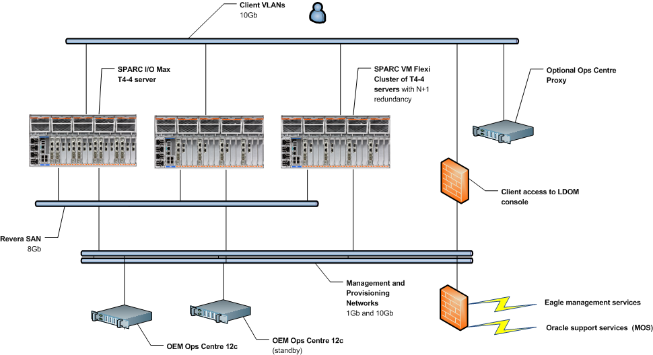
High Level Design

Slide 15
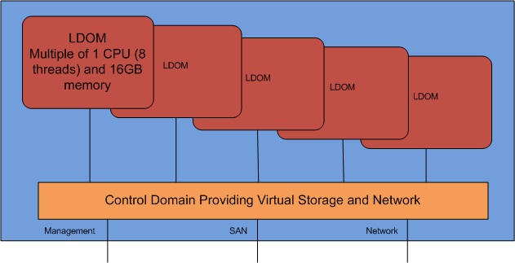
Service Option 1: SPARC VM Flexi
Virtual I/O architecture - Scalable sizing with workload migration

Slide 16
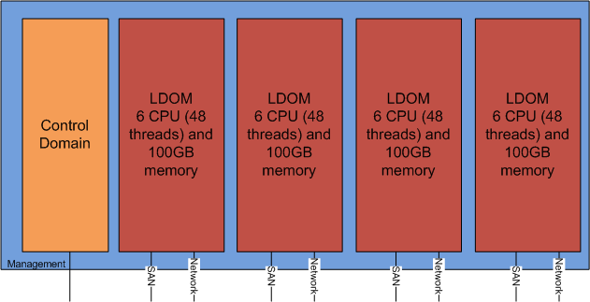
Service Option 2: SPARC IO Max
Direct I/O architecture - Fixed sizing - Maximum throughput

Slide 17
Security Overview
Follows Oracle Whitepaper “Secure Deployment of Oracle VM Server for SPARC”
Separate environments for Government and Commercial
Clients within environments protected by network security measures including VLANs and Firewalls
Management network separate from client networks and requires 2 factor authentication to access

Slide 18
Security Overview - Management
Isolated management network
Role based access via Oracle Enterprise Manager 12C
2 factor access required

Slide 19
Security Overview – Reduced Attack Surface
VLAN and Firewall separation between client LDOMs
Hypervisor based in firmware reducing attack surface

Slide 20
Q&A Session
?

Slide 21
How to find out more
Enquire today at our NZOUG stand
Contact Revera;
0508 REVERA (0508 738372) enquiry@revera.co.nz
You can also enquire with your existing Eagle Technologies account manager

