Slide 1
Shared Services: A Strategic Initiative. March 14, 2009
Wayne Andrews
Vice President, Finance JAPAC
Notes:
A little about myself
I have been with Oracle just under 10 years.
I am not a techie, in fact I am an accountant by profession and in another life a Ship Designer.
I am a am an Oracle User, like yourselves, a beneficiary of the technology with a layman’s understanding of how it works.
Just a businessman.
I originally joined Oracle to set up an SSC for the JAPAC Division.
When I joined there were 17 countries, all running various forms of applications, customized to the unique taste and purpose of the local management.
Finance Directors were entirely focused on the critical building blocks of Finance, like paying invoices, closing accounts and stat compliance
Each country had a CIO and IT team managing the IT infrastructure.
Control was a matter of personalities and interpretation
Results were not comparable
Change was an infinite consensus loop.

Slide 2
SSC Asia Pacific – facts 2006
150 people
13 process teams, 11 languages
Open 7am (NZ) to 11pm (India)
Australia - Taiwan
New Zealand - Korea
Singapore - Indonesia
Vietnam - India
Philippines - Hong Kong
Malaysia - Thailand
China - Pakistan
Japan (not in original scope)
Notes:
As discussed, the SSC project support Oracle’s transformation to an e-business.
Break correlation between head count and revenue to deliver improved margins by
eliminating duplicated processes,
capitalising on scale economies
and standardising and improving business processes.
Improving service levels by establishing a knowledge centre that leverages the capacity of a larger scale SSC to attract a high calibre of process focused staff.
Enable the realignment of locally based finance personnel to be outwardly focused on the strategic development of the business and in direct support of the sales and service delivery in our customer facing LOB’s as commercial advisers.
Improve management capability by providing a platform that ensures consistent application of our policies and procedures to produce comparative management information. The SSC model also allows the organisation to change more rapidly and effectively by leveraging the centralisation of expertise based activities such as COA maintenance.
Of course in our unique situation the SSC environment provides a compelling presales tool to showcase Oracles ebusiness suite to our customers in an environment that a large number of multinationals are trying to replicate.

Slide 3
Cost Savings Were Significant
Total cost of 231 FTEs = USD 13m
SSC operating costs = USD 7.5m
Annualized saving of USD 5.5m
Payback of less than 3 years
Notes:
The estimated annual cost of employing 231 people in the previous decentralised environment is USD 13 million. The annual operating costs of the SSC when serving all countries is expected to be USD 7.5 million resulting in an annualised saving of USD 5.5 million. Taking into account the set up costs and the fact that savings were only being generated once the centre reached a certain size, the payback period is estimated to be a little less than three years.

Slide 4
Centralize . . . Data, Processes, Systems and Decisions
65+ financial apps instances
Fragmented data: tens of
thousands of Excel
spreadsheets
Decentralized decision making
Geography
Line of business
1 financial app instance
1 data warehouse
Centralized decision making
Global process owner
Divisional process owner
Global application owner
1998
TODAY
Notes:
So that is the JAPAC story a success in its own right.
This was a great cost saving initiative, but saving a few million dollars is not strategic.
To convince you that this is a strategic initiative I need to take you global, which is where this initiative has played out.
Start to consider what this has done for us.
We saved some money for sure
We learned the best way to perform business functions and we built it into our process and the apps
We have tight control over our business
Spending
Reporting consistency
Comparative performance and KPIs

Slide 5
Centralize, in 5 Shared Service Centers 197 Countries, 22 Languages
Customer Contracts
Credit & Collections
Exp Reporting
Procurement
Comp Admin
Controllers
Revenue Recognition
Controllers
Revenue Recognition
Procurement
Comp Admin
Exp Reporting
Controllers
Order Entry
AR / Cash Apps
Exp Reporting
Purchasing
Fixed Assets
Project Acct
Credit & Collections
Customer Data
AP
Comp Admin
Customer Contracts
Credit & Collections

Slide 6
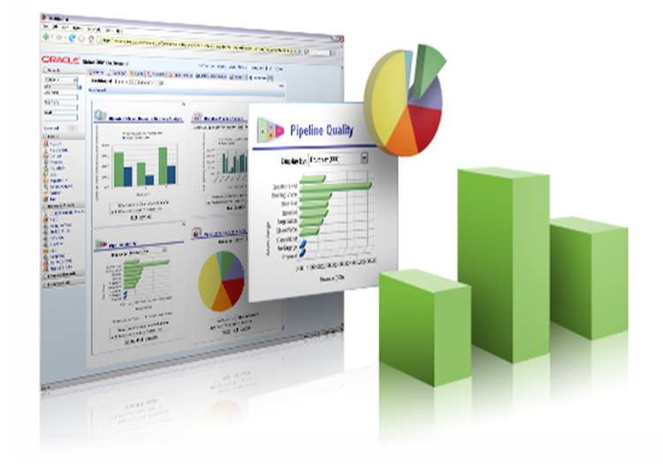
Automate: We Drink Our Own Champagne
Notes:
Oracle’s customer driven performance is the result of several key building blocks. With 80,000 employees and 320,000 customers it is vital that the appropriate organizational and technical framework is put in place to maximize the value of customer interactions with Oracle.
Clear and complete definitions and standards for customer data allow all Lines of Business to work together to meet customer needs. This enables the seamless transfer of knowledge and business transactions between people and teams within Oracle to ensure the highest quality customer engagement.
Establishing a master customer data repository not only reduces data management costs, but also improved customer satisfaction when all oracle departments have the same high quality customer information. Automating the distribution of customer data to secondary systems ensures that complete high quality data is available everywhere it is needed at the moment it is required. This also enables the collection of customer transactional data from secondary systems with minimal cost. (no need for MDM solutions to match customer records from secondary systems since the customer records are the same as the master)
A program to maintain and protect customer information is critical. Without this function the data quality will become so poor that no one can use the data. High Quality customer data is the lifeblood of the organization. But customer data does not need to be perfect before you can use it. A data quality program that offers a process to fix and correct data quality as the data is used will drive higher quality over time.
Automating all business processes that interact with customers provides a consistent high quality customer experience and allows the business to gain the needed insight to continually improve and grow business. Having these systems built with a strong customer centric data model makes it easy to derive the necessary business intelligence about the customer’s relationship with Oracle.
Oracle’s enterprise reporting strategy is enabling oracle to be a more intelligent Enterprise and results in both operational and management excellence. The Enterprise Reporting Solution is the “single instance” for business intelligence. All mission critical data assets are transformed into powerful business intelligence. This intelligence is provided securely to all employees as required by the job they perform. The customer dimension is one of the most important conformed dimensions around which many BI reports and dashboards are built.

Slide 7
Building Value From 60+ Acquisitions
APPLICATIONS
TECHNOLOGY
Enterprise Deals
Enterprise Deals
Middleware Management
Performance Management
Identity Management
Content Management & Collaboration
Database
Systems Management
Business Applications
Project-Intensive
Retail
Communications
Health Sciences
(Pending*)
Utilities
Banking
Insurance
Manufacturing
(Pending*)
Copyright @2009, Oracle and/or its affiliates. All rights reserved.
*Subject to closing conditions.

Slide 8
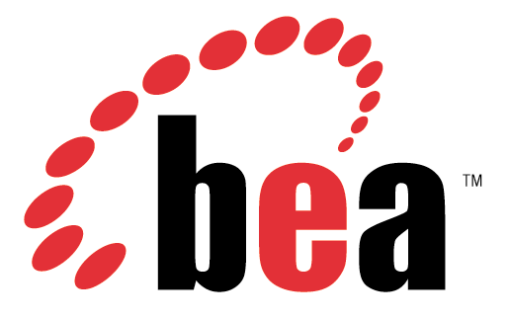
Our M&A Integration Process Drives Performance Improvements
Actual Margin
Non-GAAP Operating Margin
Figures based on Non-GAAP results. GAAP to Non-GAAP reconciliations are available at www.oracle.com/investor.
Figures for acquired companies are non-GAAP results for 12 month period preceding acquisition.

Slide 9
Summary
It is not sexy
Executive sponsorship
BUT it is a game changer
The real benefits are strategic
Figures based on Non-GAAP results. GAAP to Non-GAAP reconciliations are available at www.oracle.com/investor.
Notes:
It is hard and detailed graft
And it will not always be popular
But it is a game changer
Cost savings
Arbitrage if you want it
Control
Qualit comparable reporting
Enables rapid deployment of strategy

Slide 10
Notes:
Bring up on stage two customers to tell the audience about their experiences.
Manpower Associates is a $14.9B global company with 27,000 employees in the temporary staffing business. Manpower runs a combined PeopleSoft Enterprise and JD Edwards EnterpriseOne shop. These experts in human resources use Enterprise HCM for their own staffing and EnterpriseOne Payroll and Service Billing for handling the large volumes of US-based temporary staff. Manpower is very happy with Oracle’s support since purchasing PeopleSoft and is looking forward to a long relationship with Oracle.
Spokesperson will be Jay Schaudies, Vice President, Global eCommerce.
Welch Foods is the food processing and marketing arm of National Grape Cooperative Association. Organized in 1945, National Grape is a grower-owned agricultural cooperative with 1,461 members. The company, headquartered in Concord, Massachusetts, operates six plants located in Michigan, New York, Pennsylvania and Washington. The company was running a mix of legacy, home grown, and manual systems that failed to provide senior management with accurate and timely cost and production information. Welch’s required a centralized manufacturing and financial information system to improve management decision making. The solution had to be hot-pluggable with existing technologies, for example, Welch’s Plumtree portal.
Welch Foods chose Oracle over SAP for this business-critical application. The key to the customer’s business problem was their ability to manage costs. The company’s costs are driven by fruit solid content in each of their products, and they use a specialized technique called BRIX for measuring and calculating the cost of materials. Welch’s compared SAP and Oracle SAP’s software was too rigid and, therefore, unable to include the BRIX calculation in their manufacturing solution. Only Oracle’s OPM could bind this custom cost method into the Quality Management Process.
Technology customer yet to be determined. Current possibilities include eBay and FTD Florists.

